Slide 1
Applying Newton's Laws
Prepared by
Dedra Demaree, Georgetown University

Slide 2
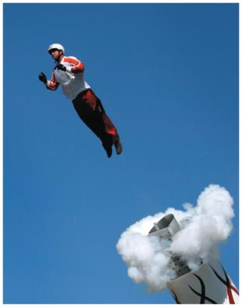
Applying Newton's Laws
How does knowing physics help human cannonballs safely perform their tricks?
Would an adult or a small child win a race down a water slide?
How does friction help us walk?

Slide 3
Be sure you know how to:
Use trigonometric functions (Appendix).
Use motion diagrams and mathematical equations to describe motion (Sections 1.2, 1.5, and 1.6).
Identify a system, construct a force diagram for it, and use the force diagram to apply Newton's second law of motion (Sections 2.1, 2.6, and 2.8).

Slide 4
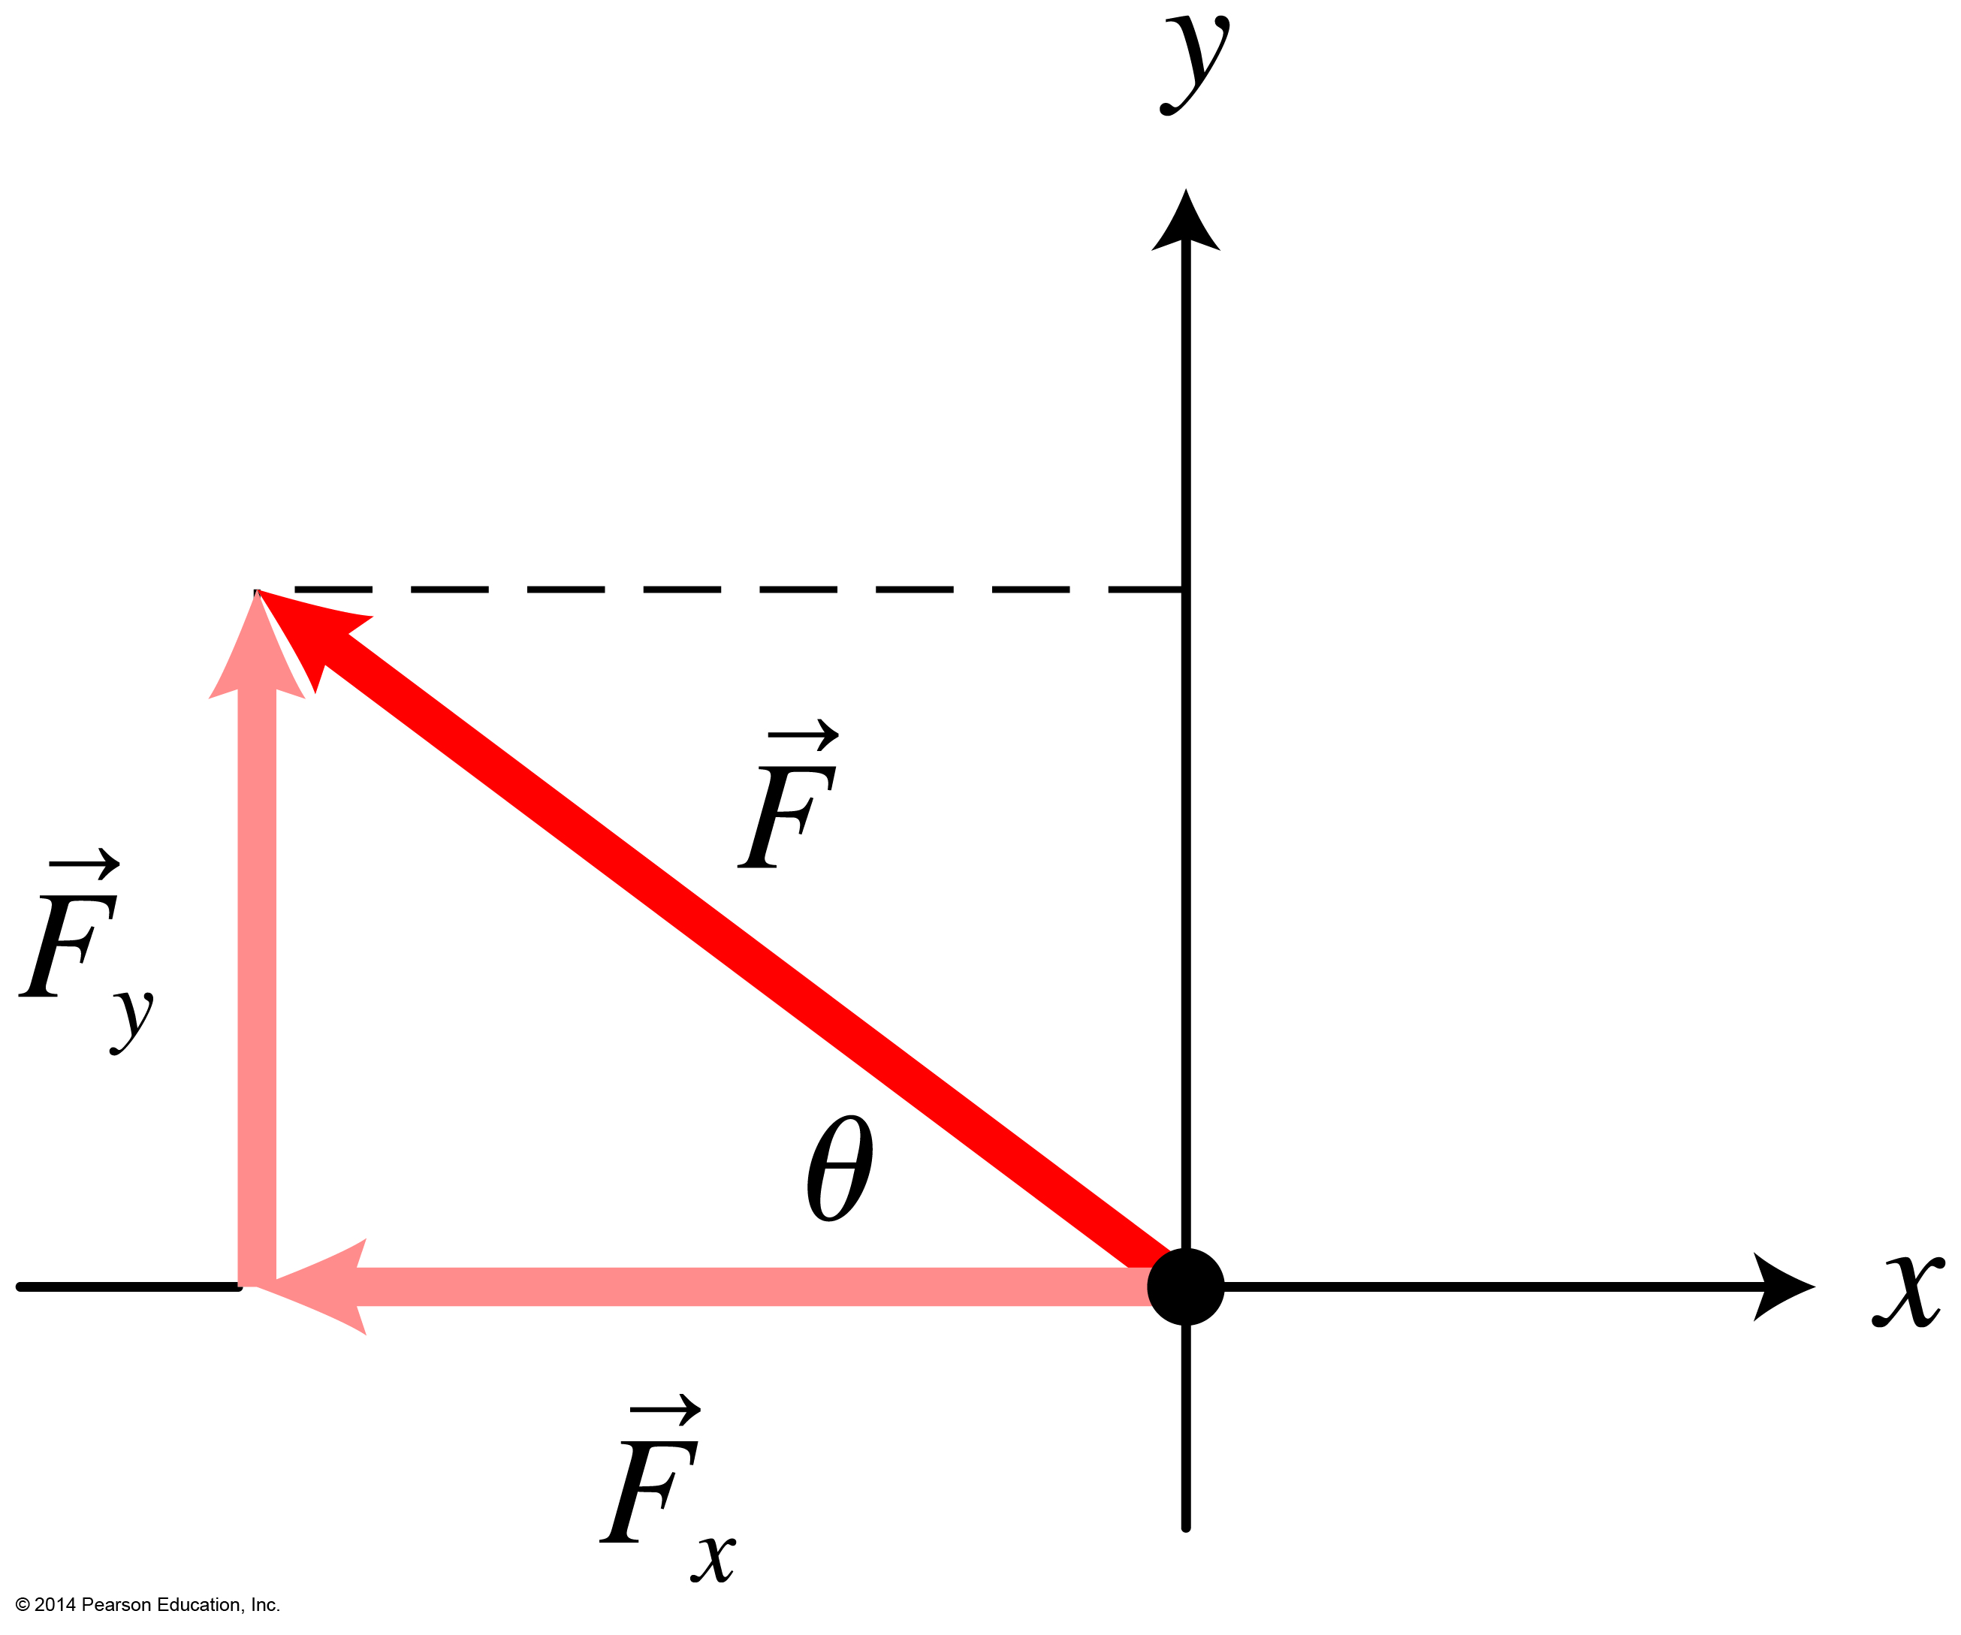
Using Newton's second law in more than one dimension
So far we have considered processes where we need to consider motion along only one axis.
Most everyday processes involve forces that are not all along the axis of motion.
Now we learn to apply Newton's laws to these more complex processes.
This requires breaking forces into their vector components to find the forces along each axis.

Slide 5
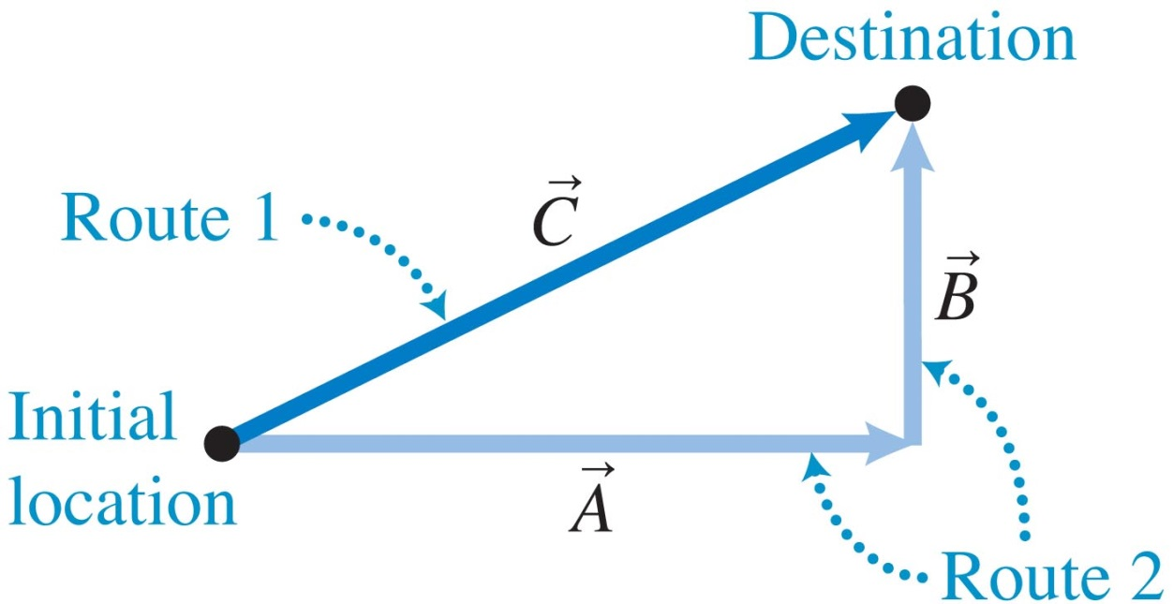
Breaking displacement into its vector components
Displacement starts from an object's initial position and ends at its final position.
Route 1 is a direct path represented by a displacement vector.
Its tail represents your initial location and its head represents your final destination.

Slide 6
Breaking displacement into its vector components (Cont'd)
Route 2 goes along two roads. You first travel along A, then along B.
You end at the same final destination with both routes.

Slide 7
Breaking displacement into its vector components
Route 1 has the same displacement as route 2, showing how to add vectors graphically.
+ = C
A and B are perpendicular to each other.
The key to breaking a vector into its components is to pick vectors perpendicular to each other that, when added, are equivalent to the original vector.

Slide 8
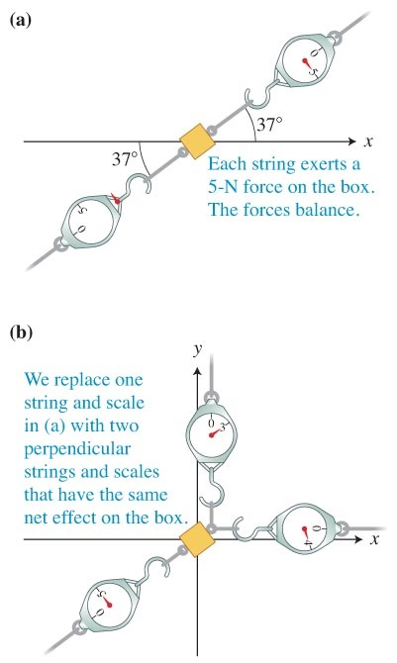
Example: Adding forces graphically
A small box on a very smooth surface is being pulled by spring scales.

Slide 9
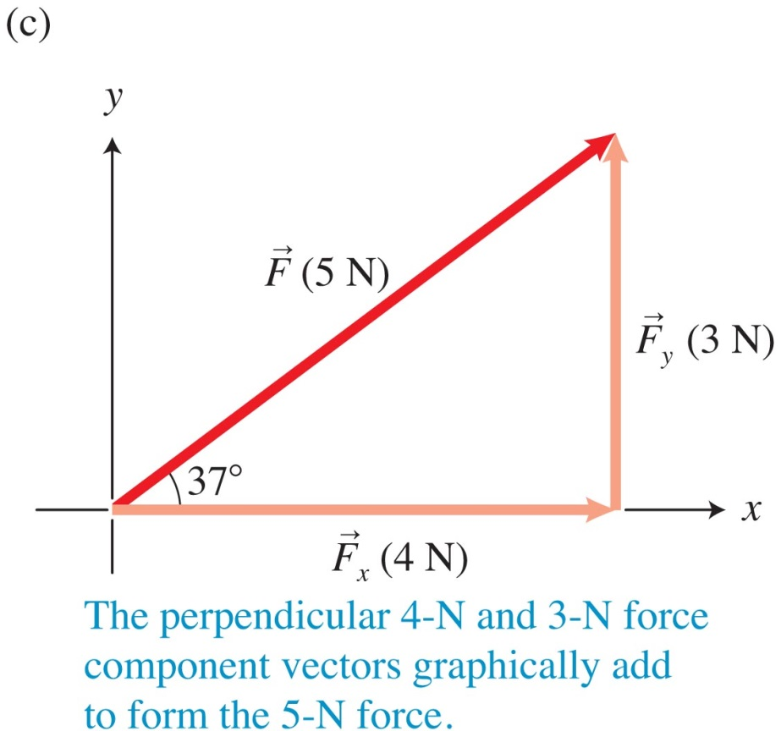
Example: Adding forces graphically
A 4-N force in the positive x-direction added to a 3-N force in the positive y-direction produces a 5-N force at 37° relative to the positive x-axis.
The vectors form a "3-4-5" right triangle:

Slide 10
Breaking force into scalar components
We can replace any force with two perpendicular forces F_{x} and F_{y} as long as the perpendicular forces graphically add to .
If F_{x} is along the x-axis, it is called the scalar component of and is represented by a positive or a negative number instead of a vector.

Slide 11
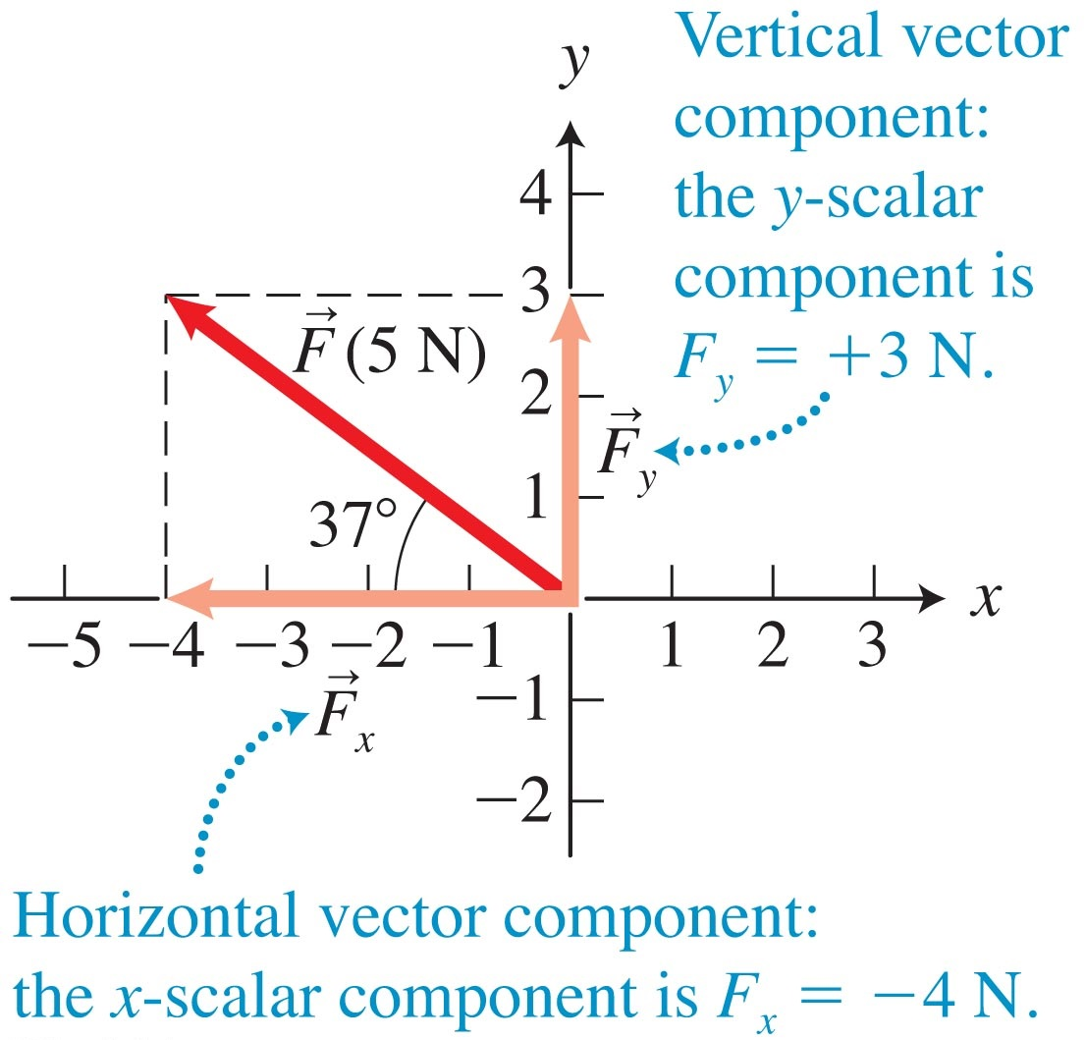
Breaking force into scalar components (Cont'd)
The same can be done with the y-scalar component, F_{y}, along the y-axis.

Slide 12
Finding the scalar components of a force from its magnitude and direction
If we know the magnitude of a force and the angle θ that the force makes above or below the positive or negative x-axis, we can determine its scalar components.

Slide 13
Finding the scalar components of a force from its magnitude and direction

Slide 14
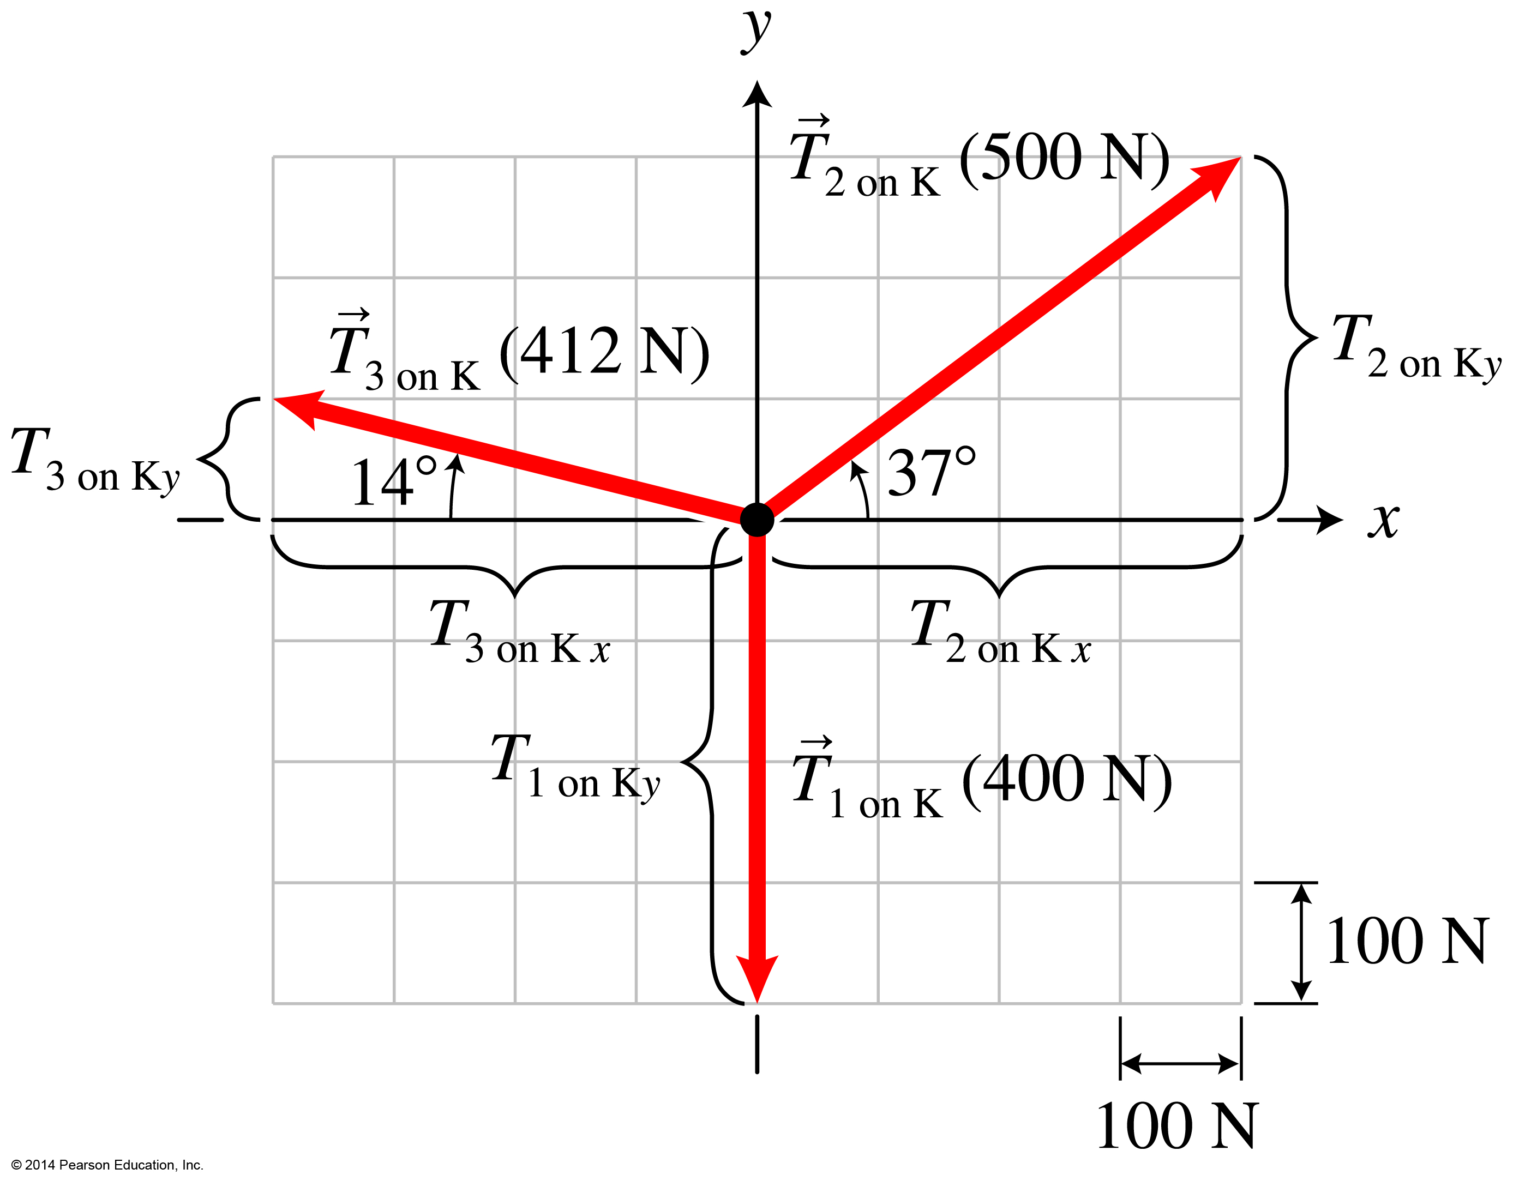
Newton's second law in component form
Apply Newton's second law to situations where forces are not along only one axis.
Find the scalar components of the forces.
The sum of the x-scalar force components equals the mass times the acceleration along the x-axis.

Slide 15
Newton's second law in component form (Cont'd)
The sum of the y-scalar force components equals the mass times the acceleration along the y-axis.
We usually choose the axes so that the object accelerates along only one axis and has zero acceleration along the other axis.

Slide 16
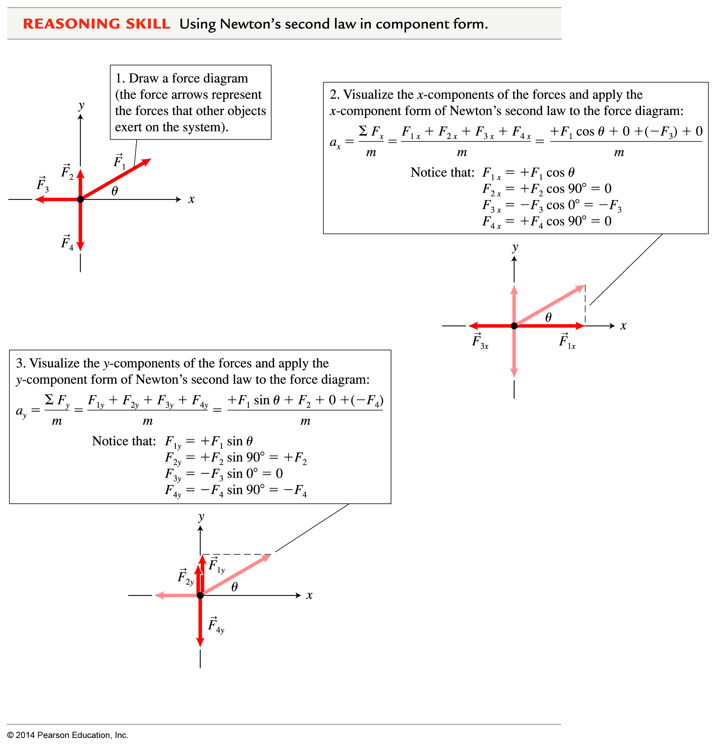
Reasoning Skill: Using Newton's second law in component form

Slide 17
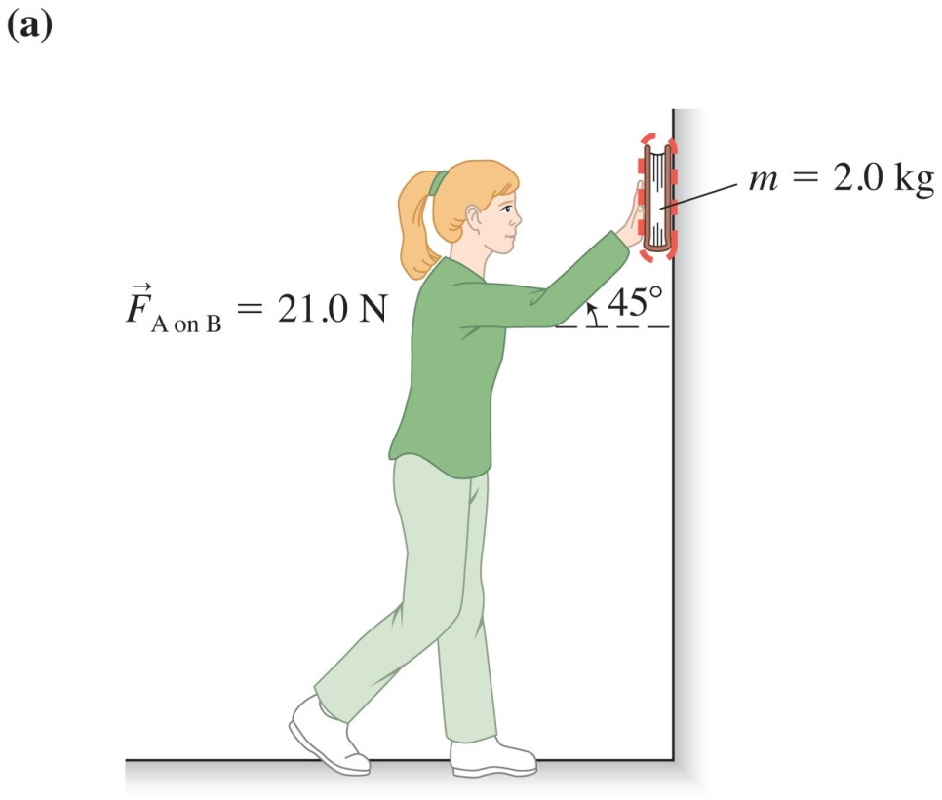
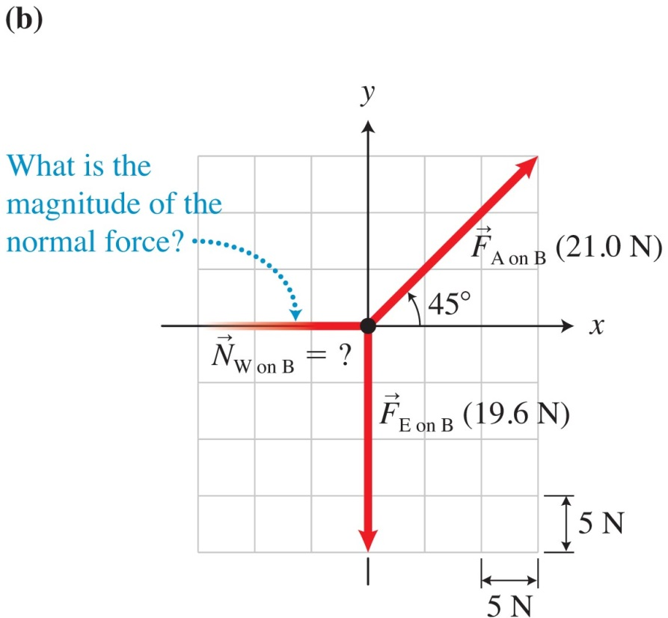
Example: Determining forces and acceleration
Alice pushes on a 2.0-kg book, exerting a 21.0-N force 45º above the horizontal as the book slides down a slippery vertical wall.
Sketch and translate
Simplify and diagram

Slide 18
Example: Determining forces and acceleration
Alice pushes on a 2.0-kg book, exerting a 21.0-N force 45° above the horizontal as the book slides down a slippery vertical wall.
Represent mathematically
Notes:
I'm leaving the rest of this for the instructor to do as an example

Slide 19
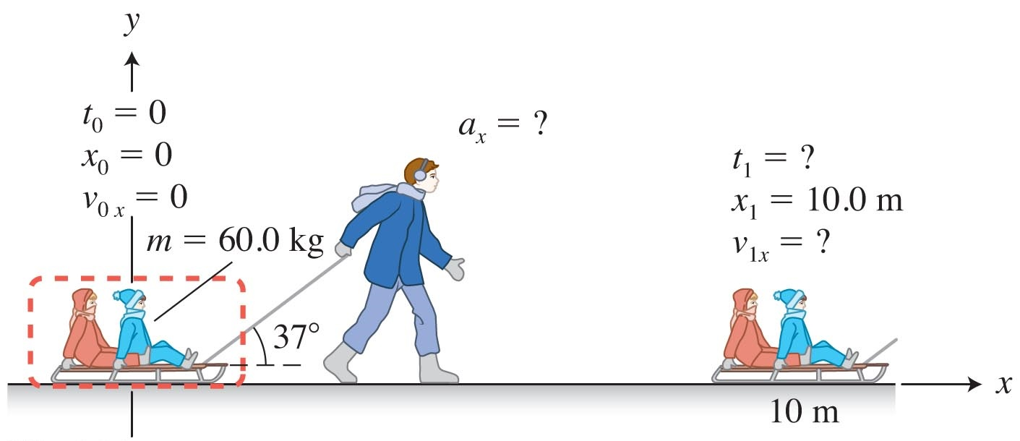
Problem-solving strategies for analyzing dynamic processes: Sketch and translate
Make a sketch of the process.
Choose a system.
Choose coordinate axes with one axis in the direction of acceleration and the other axis perpendicular to that direction.
Indicate in the sketch everything you know about the process relative to these axes. Identify the unknown quantity of interest.

Slide 20
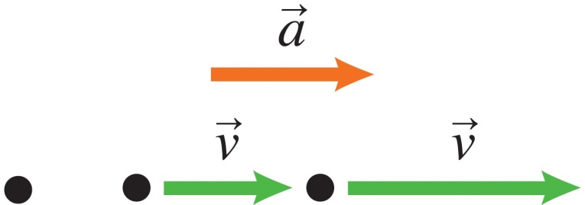
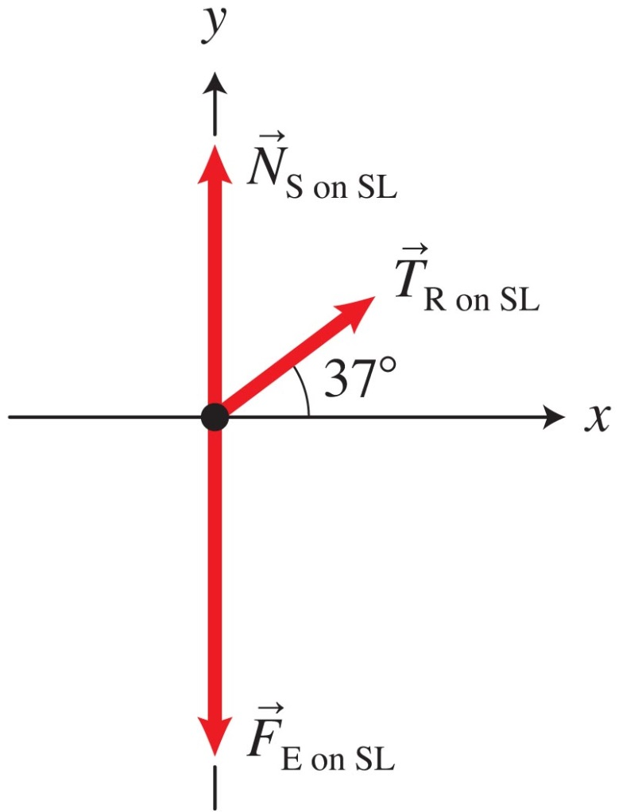
Problem-solving strategies for analyzing dynamics processes: Simplify and diagram
Simplify the process. For example, can you model the system as a point-like object? Can you ignore friction?
Represent the process diagrammatically with a motion diagram and/or a force diagram.
Check for consistency of the diagrams. For example, is the sum of the forces in the direction of the acceleration?

Slide 21
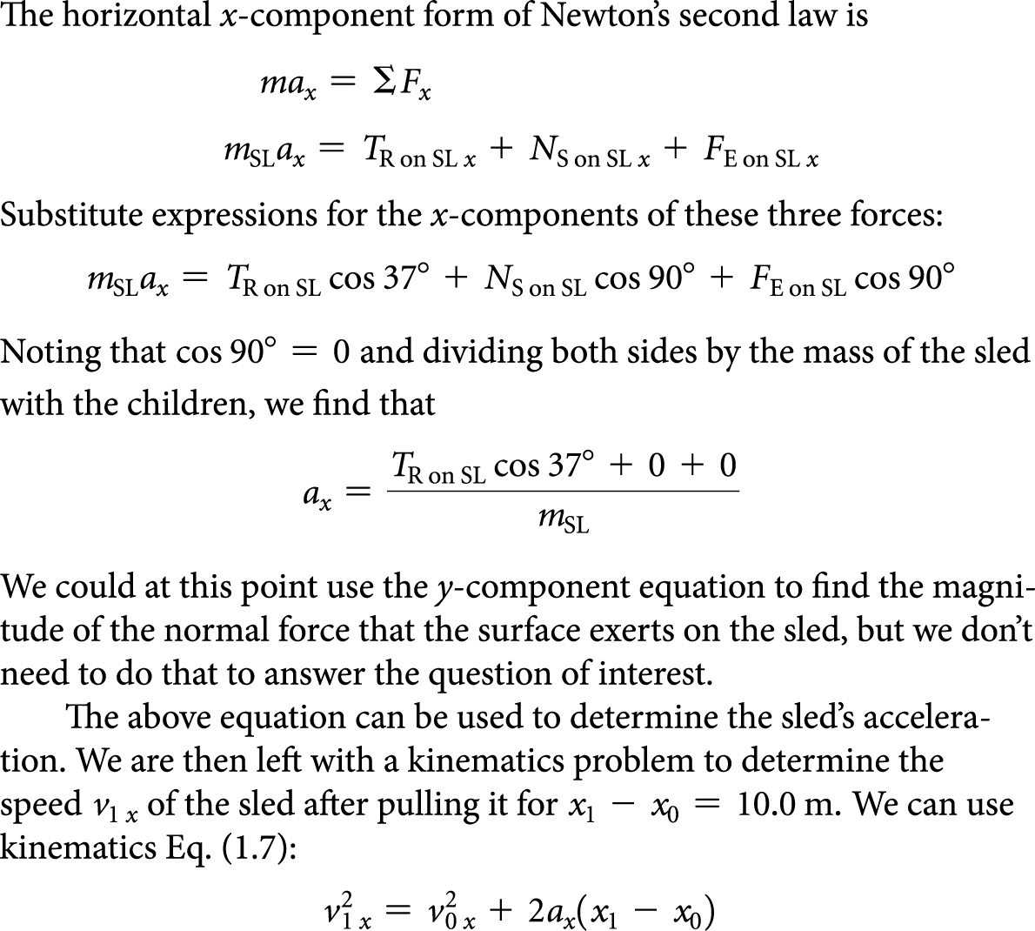
Problem-solving strategies for analyzing dynamics processes: Represent mathematically
Convert the qualitative representations into quantitative mathematical descriptions of the process using Newton's second law and kinematics equations.

Slide 22
Problem-solving strategies for analyzing dynamics processes: Solve and evaluate
Substitute the given values into the mathematical expressions and solve for the unknowns.
Decide whether the assumptions that you made were reasonable.
Evaluate your work to see if it is reasonable (for example, check units, limiting cases, and whether the answer has a reasonable magnitude).

Slide 23
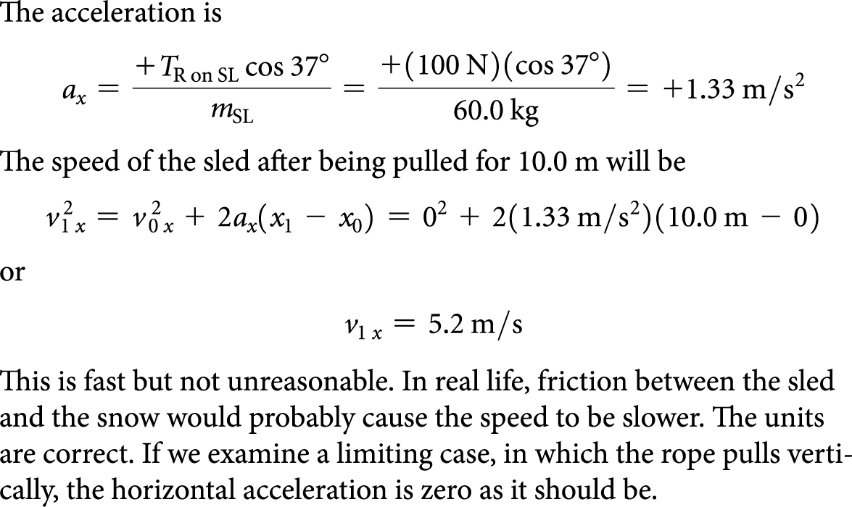
Problem-solving strategies for analyzing dynamics processes: Solve and evaluate (Cont'd)
Make sure the answer is consistent with other representations.

Slide 24
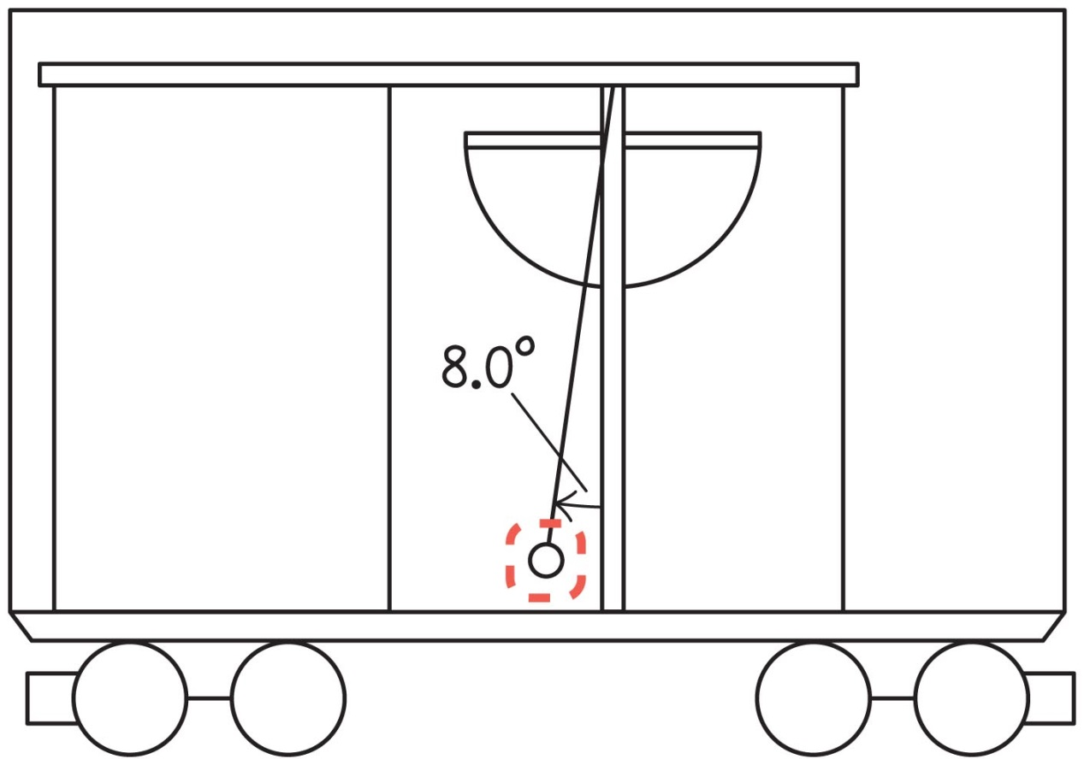
Example 3.3: Acceleration of a train
You carry a pendulum and a protractor with you onto a train. As the train starts moving, the pendulum string swings back to an angle of 8.0° with respect to the vertical.
Determine the acceleration of the train at that moment.
Notes:
I'm leaving this one for the instructor to solve in class

Slide 25
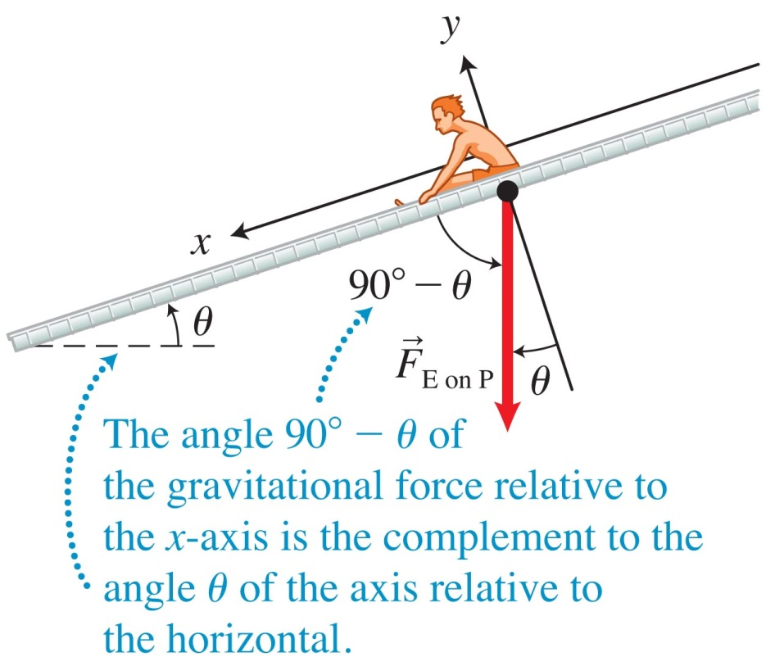
Processes involving inclines
To solve problems on an incline, we choose the x-axis to be parallel to the incline and the y-axis to be perpendicular to the incline.
This choice makes the acceleration along the y-axis zero, simplifying the mathematical solution because the acceleration is nonzero only along the x-axis.
With this choice, the angle of gravitational force exerted by Earth on the system relative to the x-axis plus the angle of the incline relative to the horizontal is 90°.

Slide 26
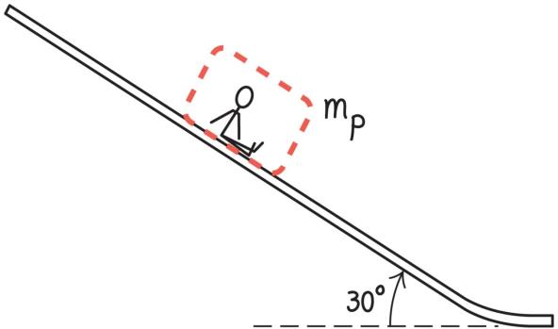
Example 3.4 on an incline: Who wins a water slide race?
A child of mass m and an adult of mass 4m simultaneously start to slide from the top of a water slide that has a downward slope of 30° relative to the horizontal.
Which person reaches the bottom first?
Notes:
I'm leaving this one for the instructor to solve in class

Slide 27
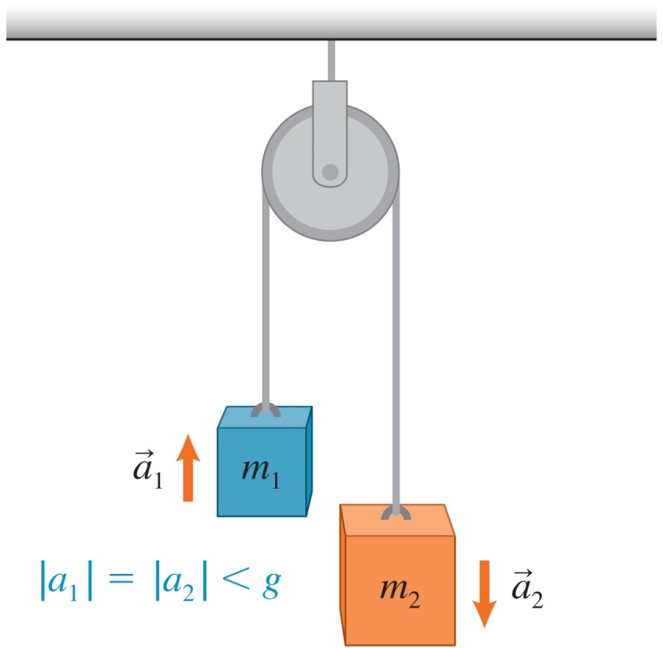
Objects linked together move with the same-magnitude acceleration
For objects linked together by a rope to move together, we need a rope that does not stretch.
All ropes stretch at least a little, but we make an assumption that the stretch is small enough to ignore.

Slide 28
Objects linked together move with the same-magnitude acceleration (Cont'd)
We assume the string is very light. If a pulley is present, we assume its mass is very small and it rotates with ignorable friction.
These assumptions allow us to state that the pulley changes the direction of motion but not the magnitude of the force exerted by the string.

