Slide 1
Rotational Motion
Prepared by
Dedra Demaree, Georgetown University

Slide 2
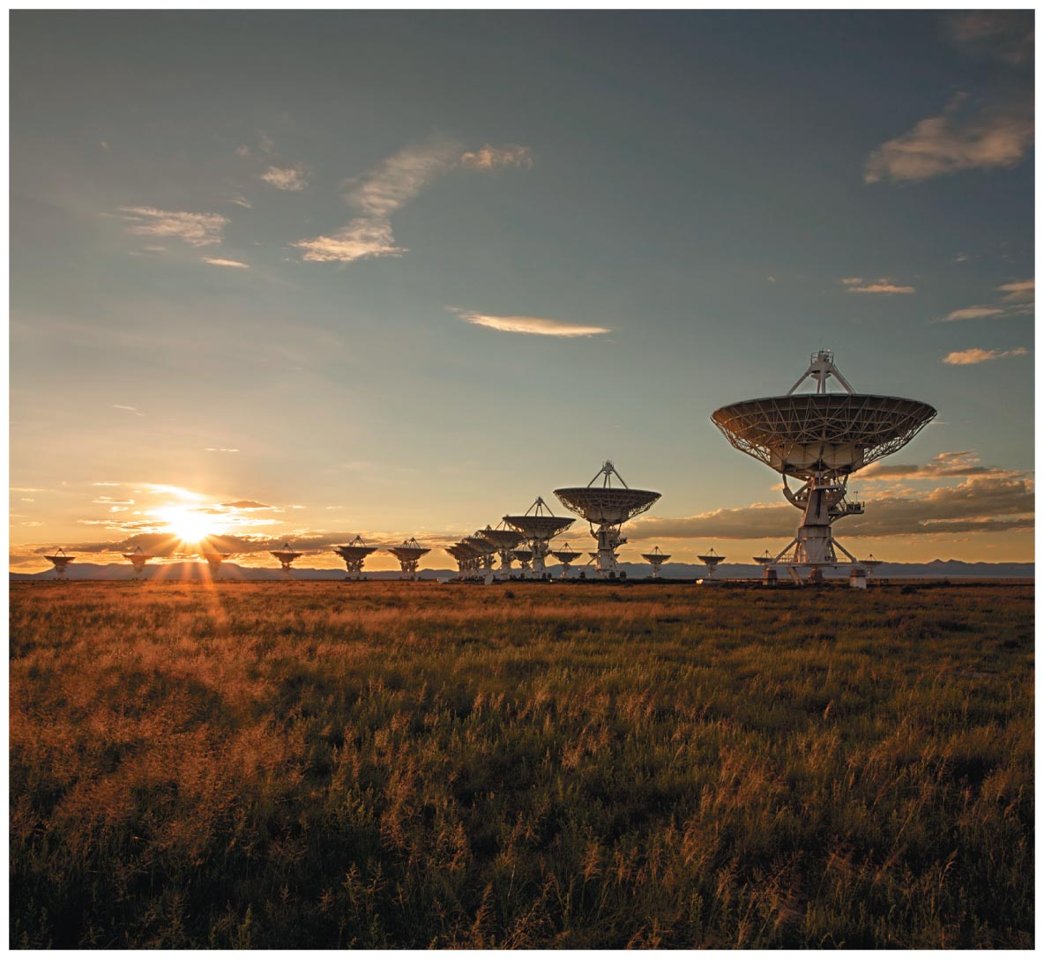
Rotational Motion
How can a star rotate 1000 times faster than a merry-go-round?
Why is it more difficult to balance on a stopped bike than on a moving bike?
How is the Moon slowing Earth's rate of rotation?

Slide 3
Be sure you know how to:
Draw a force diagram for a system (Section 2.1).
Determine the torque produced by a force (Section 7.2).
Apply conditions of static equilibrium for a rigid body (Section 7.3).

Slide 4
What's new in this chapter
In the last chapter, we learned about the torque that a force can exert on a rigid body.
We analyzed only rigid bodies that were in static equilibrium.
In this chapter, we learn how to describe, explain, and predict motion for objects that rotate.
For example, the hip joint and a car tire

Slide 5
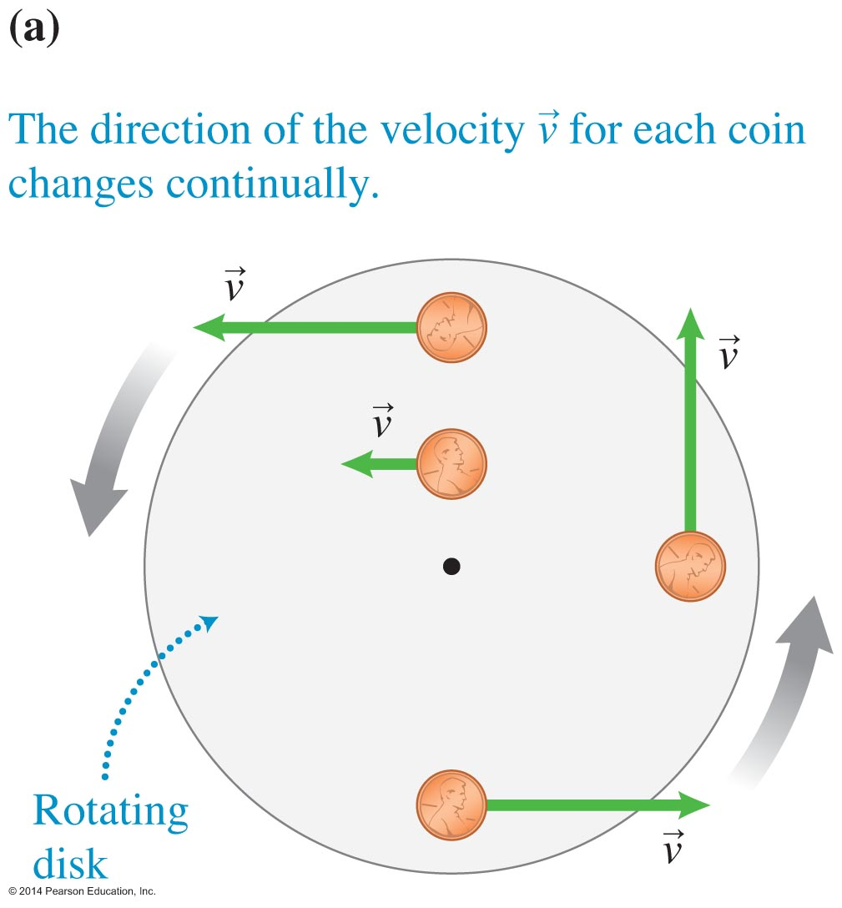
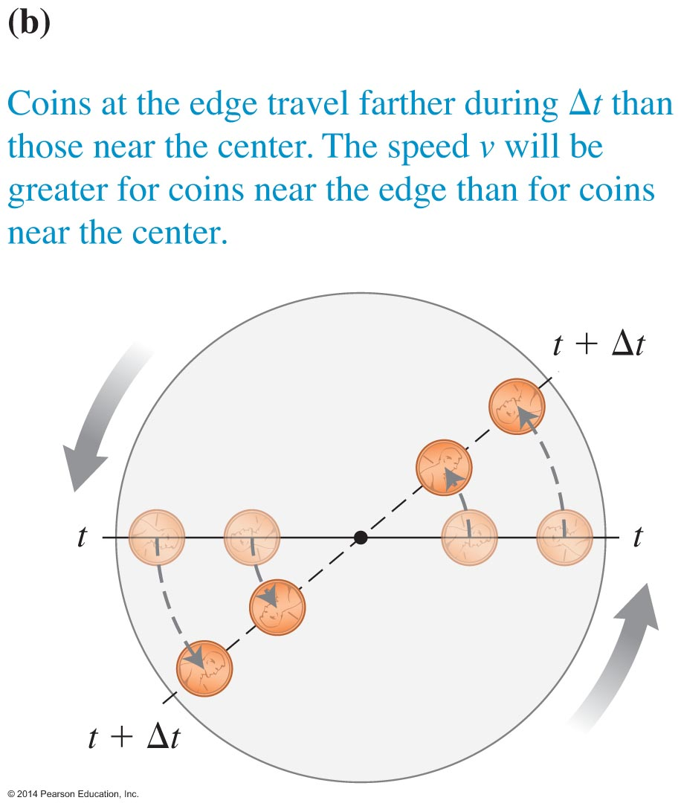
Rotational kinematics

Slide 6
Rotational kinematics
Imagine that you place small coins at different locations on the disk:
The direction of the velocity of each coin changes continually.
A coin that sits closer to the edge moves faster and covers a longer distance than a coin placed closer to the center.
Different parts of the disk move in different directions and at different speeds!

Slide 7
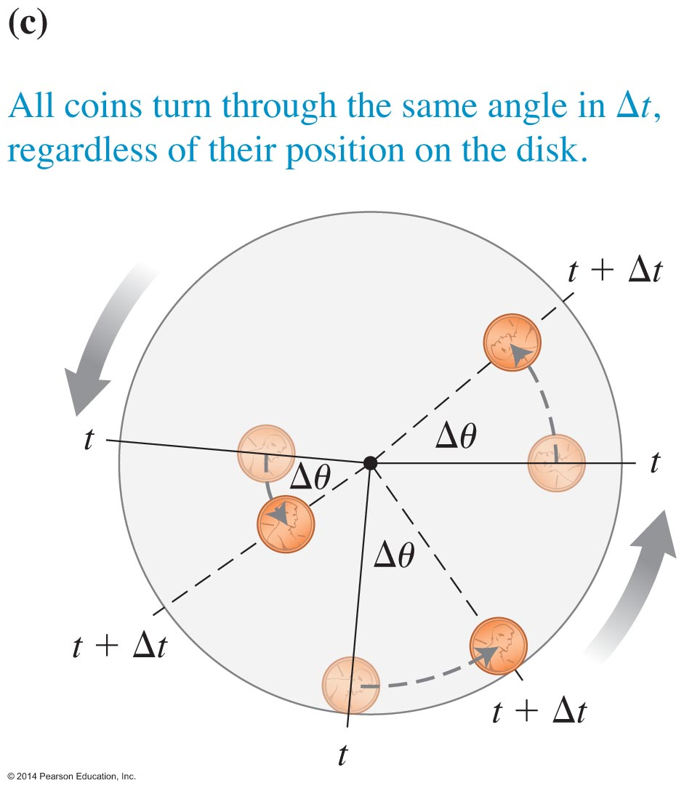
Rotational kinematics
There are similarities between the motions of different points on a rotating rigid body.
During a particular time interval, all coins at the different points on the rotating disk turn through the same angle.
Perhaps we should describe the rotational position of a rigid body using an angle.

Slide 8
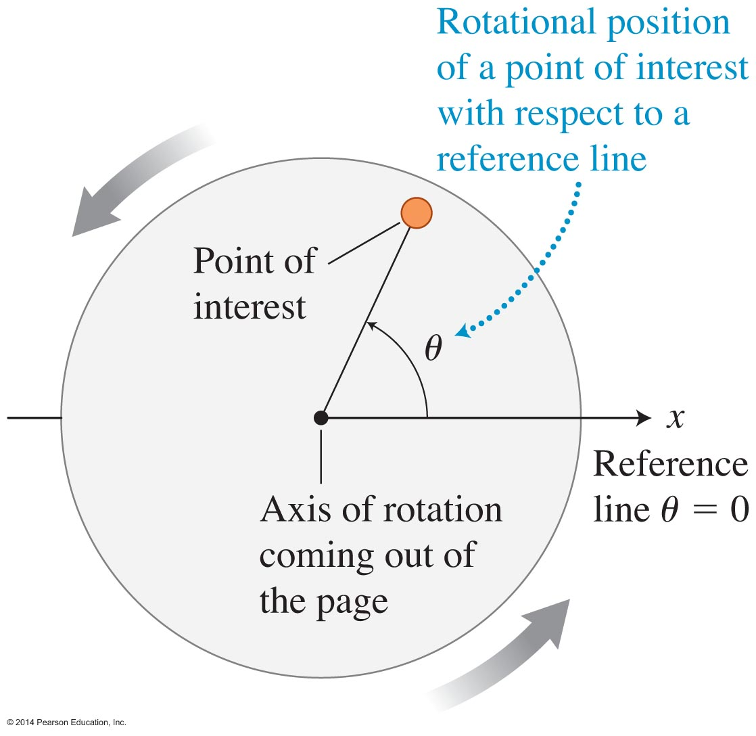
Rotational (angular) position θ

Slide 9
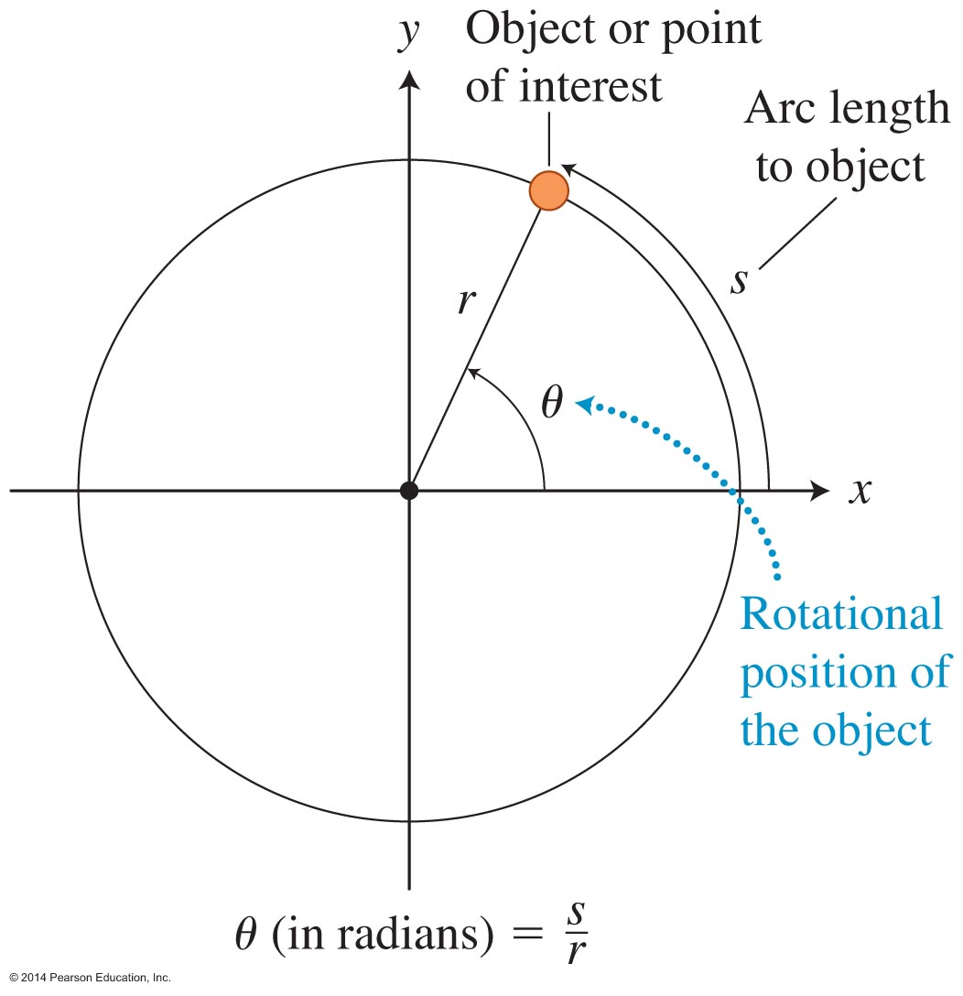
Units of rotational position
The unit for rotational position is the radian (rad). It is defined in terms of:
The arc length s
The radius r of the circle
The angle in units of radians is the ratio of s and r:
The radian unit has no dimensions; it is the ratio of two lengths. The unit rad is just a reminder that we are using radians for angles.

Slide 10
Tip

Slide 11
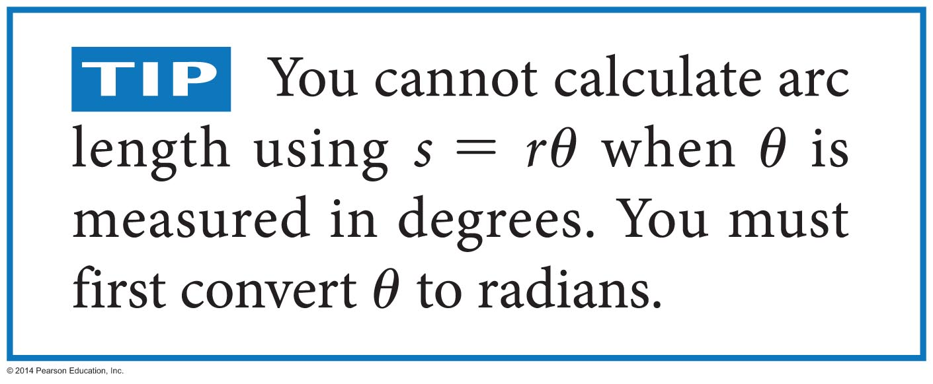
Tip

Slide 12
Rotational (angular) velocity ω
Translational velocity is the rate of change of linear position.
We define the rotational (angular) velocity v of a rigid body as the rate of change of each point's rotational position.
All points on the rigid body rotate through the same angle in the same time, so each point has the same rotational velocity.

Slide 13
Rotational (angular) velocity ω

Slide 14
Tips

Slide 15
Rotational (angular) acceleration α
Translational acceleration describes an object's change in velocity for linear motion.
We could apply the same idea to the center of mass of a rigid body that is moving as a whole from one position to another.
The rate of change of the rigid body's rotational velocity is its rotational acceleration.
When the rotation rate of a rigid body increases or decreases, it has a nonzero rotational acceleration.

Slide 16
Rotational (angular) acceleration α

Slide 17
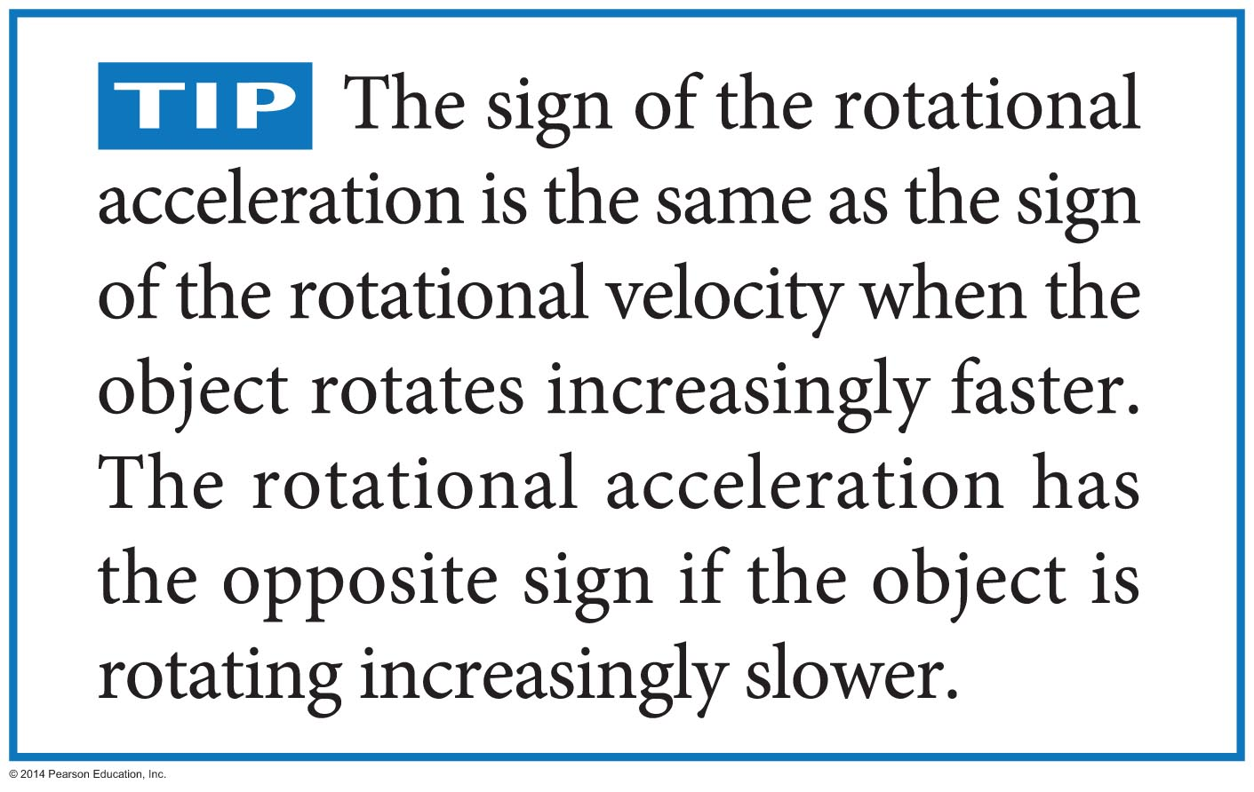
Tip

Slide 18
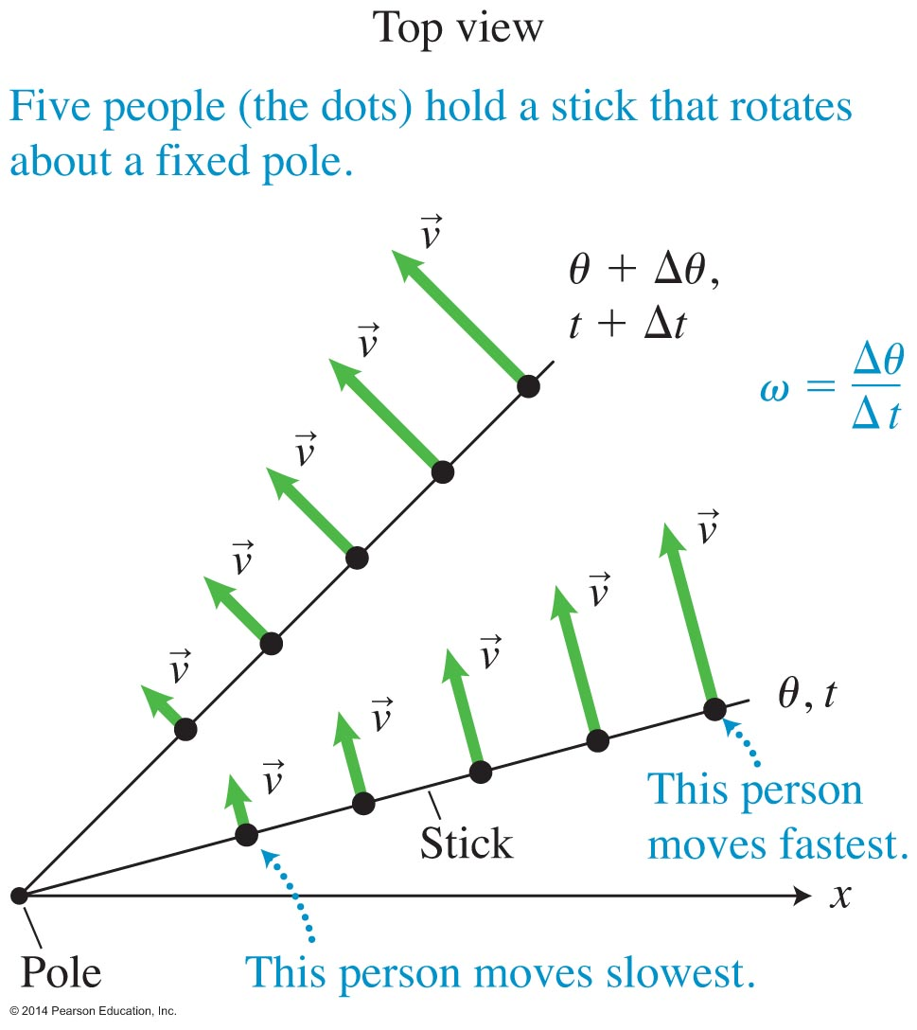
Relating translational and rotational quantities and tip

Slide 19
Quantitative Exercise 8.2
Determine the tangential speed of a stable gaseous cloud around a black hole.
The cloud has a stable circular orbit at its innermost 30-km radius. This cloud moves in a circle about the black hole about 970 times per second.

Slide 20
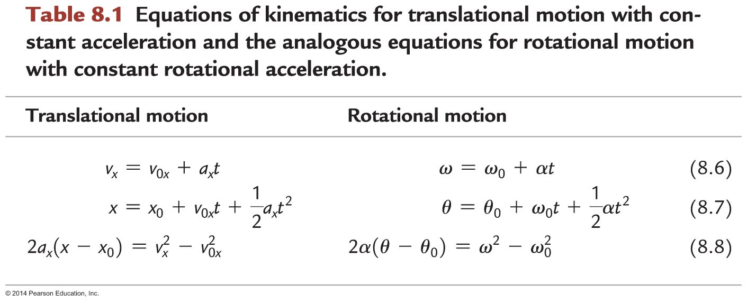
Rotational motion at constant acceleration
θ₀ is an object's rotational position at t₀ = 0.
ω₀ is an object's rotational velocity at t₀ = 0.
θ and ω are the rotational position and the rotational velocity at some later time t.
α is the object's constant rotational acceleration during the time interval from time 0 to time t.

Slide 21
Rotational motion at constant acceleration
Rotational position θ is positive if the object is rotating counterclockwise and negative if it is rotating clockwise.
Rotational velocity ω is positive if the object is rotating counterclockwise and negative if it is rotating clockwise.
The sign of the rotational acceleration α depends on how the rotational velocity is changing:
α has the same sign as ω if the magnitude of ω is increasing.
α has the opposite sign of ω if the magnitude of ω is decreasing.

Slide 22
Torque and rotational acceleration

Slide 23
Torque and rotational acceleration

Slide 24
Torque and rotational acceleration

Slide 25
Torque and rotational acceleration

Slide 26
Torque and rotational acceleration
The experiments indicate a zero torque has no effect on rotational motion but a nonzero torque does cause a change.
If the torque is in the same direction as the direction of rotation of the rigid body, the object's rotational speed increases.
If the torque is in the opposite direction, the object's speed decreases.

Slide 27
Torque and rotational acceleration
Our goal is to determine which physical quantities cause rotational acceleration of an extended object. There are two possibilities:
The sum of the forces (net force) exerted on the object or
The net torque caused by the forces
Testing experiments help us determine which (if either) of these quantities might affect rotational acceleration.

Slide 28
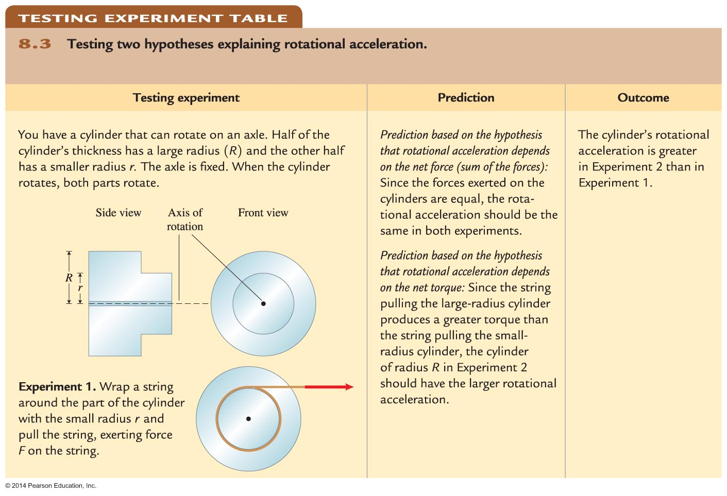
Torque and rotational acceleration

Slide 29
Torque and rotational acceleration

Slide 30
Torque and rotational acceleration
This is similar to what we learned when studying translational motion. A nonzero net force needs to be exerted on an object to cause its velocity to change. The greater the net force, the greater the translational acceleration of the object.

Slide 31
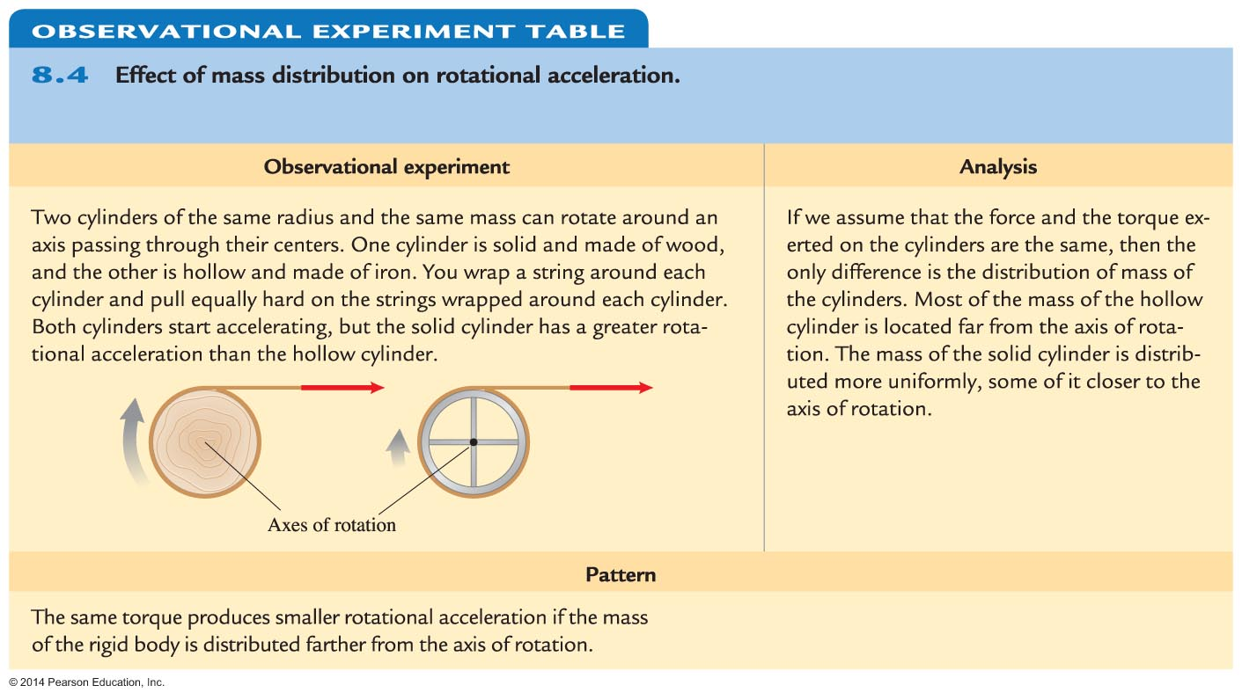
Rotational inertia

Slide 32
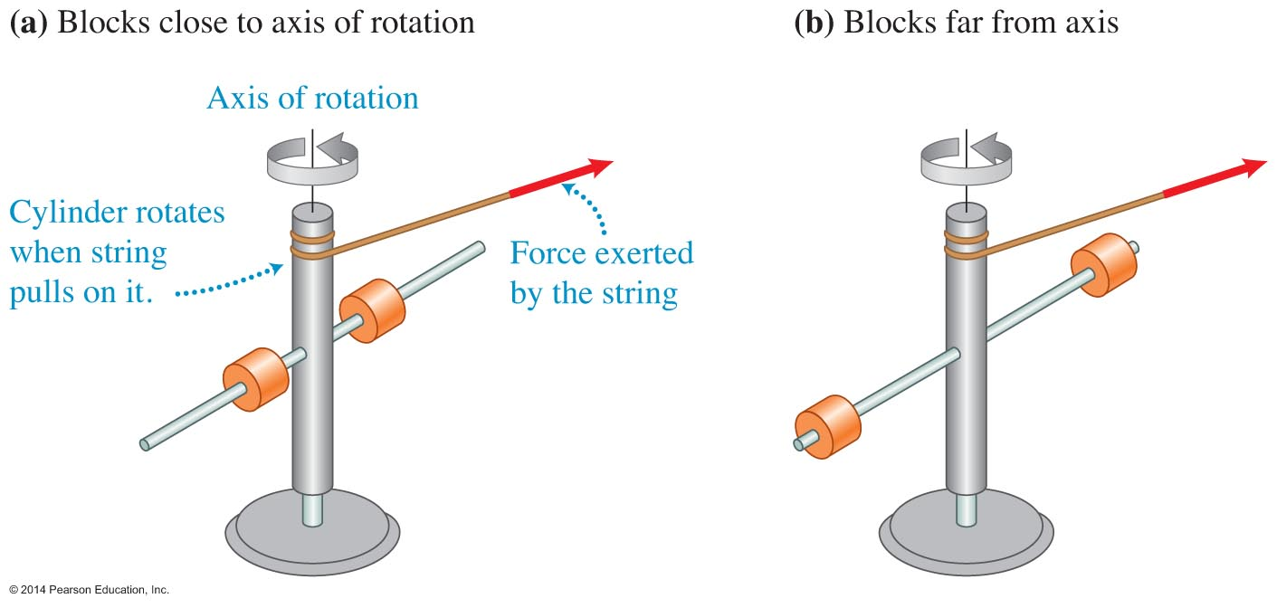
Rotational inertia
Pull each string, and compare the rotational acceleration for the arrangement shown on the left and the right:
Our pattern predicts that the rotational acceleration will be greater for the arrangement on the left because the mass is nearer to the axis of rotation.
When we try the experiment, we find this to be true, consistent with our pattern.

Slide 33
Rotational inertia
Rotational inertia is the physical quantity characterizing the location of the mass relative to the axis of rotation of the object.
The closer the mass of the object is to the axis of rotation, the easier it is to change its rotational motion and the smaller its rotational inertia.
The magnitude depends on both the total mass of the object and the distribution of that mass about its axis of rotation.

Slide 34
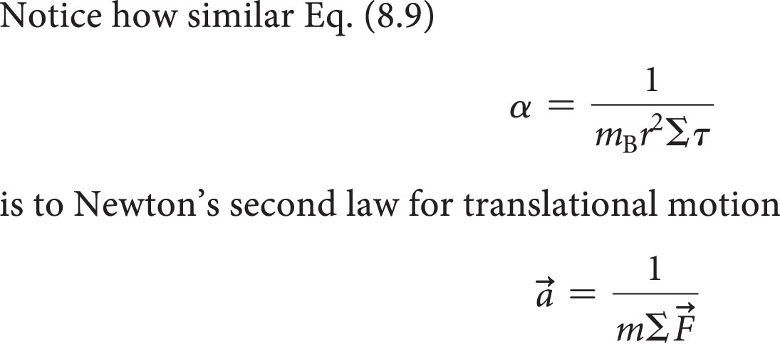
Analogy between translational motion and rotational motion

Slide 35
Example 8.3
A 60-kg rollerblader holds a 4.0-m-long rope that is loosely tied around a metal pole. You push the rollerblader, exerting a 40-N force on her, which causes her to move increasingly more rapidly in a counterclockwise circle around the pole. The surface she skates on is smooth, and the wheels of her rollerblades are well oiled. Determine the tangential and rotational acceleration of the rollerblader.

Slide 36
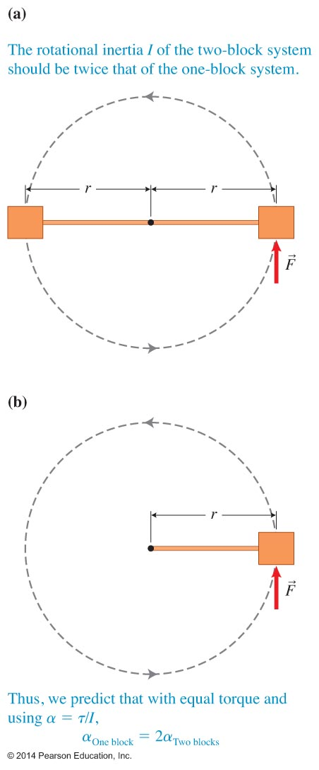
Newton's second law for rotational motion applied to rigid bodies
The rotational inertia of a rigid body about some axis of rotation is the sum of the rotational inertias of the individual point-like objects that make up the rigid body.
The rotational inertia of this two-block rigid body is twice the rotational inertia of the single block.

Slide 37
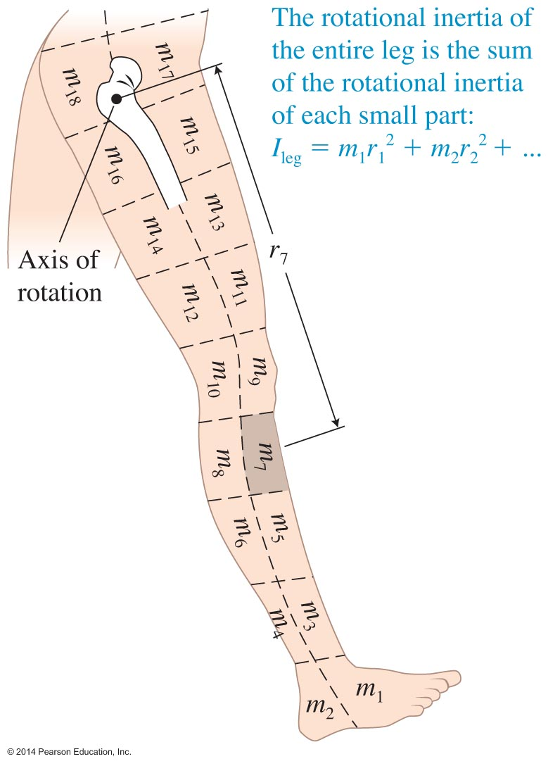
Calculating rotational inertia
The rotational inertia of the whole leg is:
There are other ways to perform the summation process. Often it is done using integral calculus, and sometimes it is determined experimentally.

Slide 38
Expressions for the rotational inertia of standard-shape objects

Slide 39
Expressions for the rotational inertia of standard-shape objects

Slide 40
Rotational form of Newton's second law

Slide 41
Tip

Slide 42
Example 8.5
In an Atwood machine, a block of mass m₁ and a less massive block of mass m₂ are connected by a string that passes over a pulley of mass M and radius R.
What are the translational accelerations a₁ and a₂ of the two blocks and the rotational acceleration α of the pulley?

Slide 43
Example 8.6
A woman tosses a 0.80-kg soft-drink bottle vertically upward to a friend on a balcony above. At the beginning of the toss, her forearm rotates upward from the horizontal so that her hand exerts a 20-N upward force on the bottle. Determine the force that her biceps exerts on her forearm during this initial instant of the throw. The mass of her forearm is 0.65 kg and its rotational inertia about the elbow joint is 0.044 kg•m². The attachment point of the biceps muscle is 5.0 cm from the elbow joint, the hand is 35 cm away from the elbow, and the center of mass of the forearm/hand is 16 cm from the elbow.

Slide 44
Rotational momentum

Slide 45
Rotational momentum

Slide 46
Rotational momentum
For each experiment, the rotational inertia of the spinning person decreased (the mass moved closer to the axis of rotation). Simultaneously, the rotational speed of the person increased.
We propose tentatively that when the rotational inertia I of an extended body in an isolated system decreases, its rotational speed ω increases, and vice versa.
We can test this idea with a testing experiment.

Slide 47
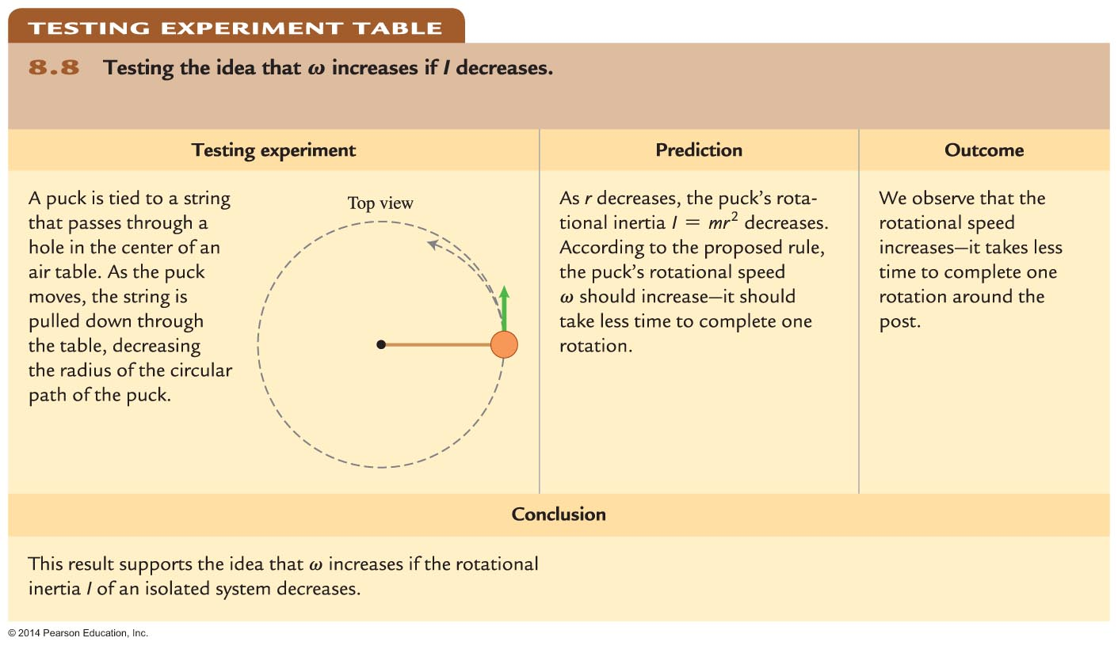
Rotational momentum

Slide 48
Rotational momentum is constant for an isolated system
If a system with one rotating body is isolated, then the external torque exerted on the object is zero.
In such a case, the rotational momentum of the object does not change: 0 = L_{f} – L_{i} L_{f} = L_{i}

Slide 49
Example 8.7
Attach a 100-g puck to a string, and let the puck glide in a counterclockwise circle on a horizontal, frictionless air table. The other end of the string passes through a hole at the center of the table. You pull down on the string so that the puck moves along a circular path of radius 0.40 m. It completes one revolution in 4.0 s. If you pull harder on the string so that the radius of the circle slowly decreases to 0.20 m, what is the new period of revolution?

Slide 50
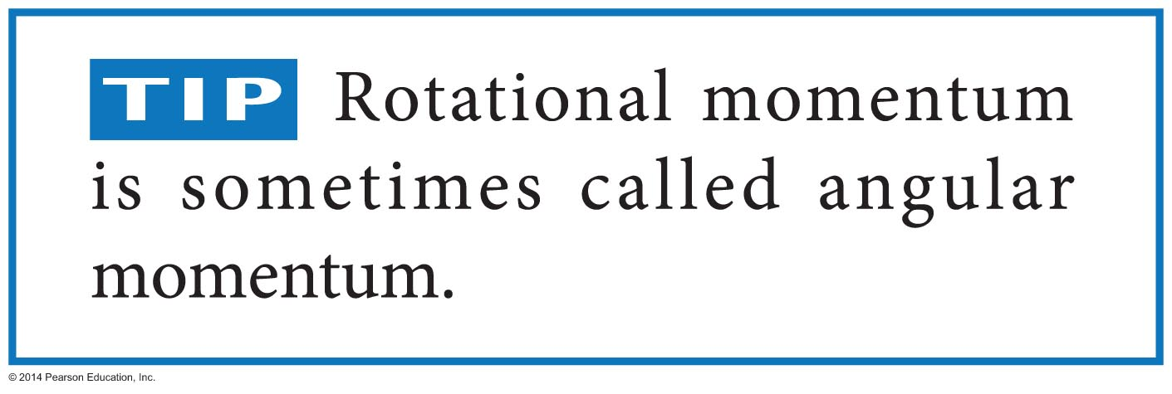
Rotational momentum of an isolated system is constant

Slide 51
Example 8.8
Imagine that our Sun ran out of nuclear fuel and collapsed. The Sun's current period of rotation is 25 days.
What would the Sun's radius have to be for its period of rotation to be the same as during the pulsar described earlier?

Slide 52
Right-hand rule for determining the direction of rotational velocity and rotational momentum
Curl the four fingers of your right hand in the direction of rotation of the turning object. Your thumb points in the direction of both the object's rotational velocity and its rotational momentum.
Curl the fingers of your right hand in the direction of the object rotation caused by that torque. Your thumb shows the direction of this torque.

Slide 53
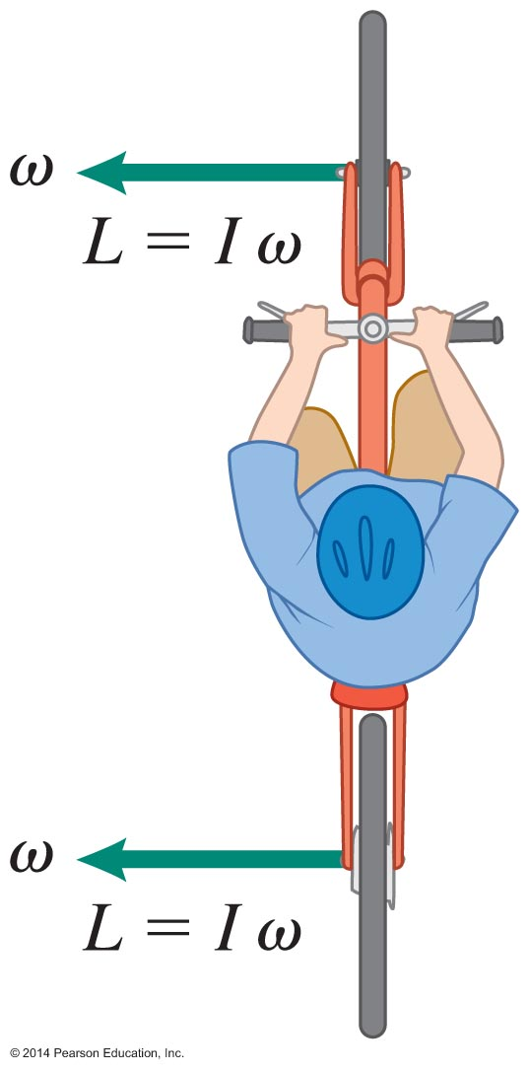
Stability of rotating objects
If the rider's balance shifts a bit, the bike + rider system will tilt and the gravitational force exerted on it will produce a torque.
The rotational momentum of the system is large, so torque does not change its direction by much.
The faster the person is riding the bike, the greater the rotational momentum of the system and the more easily the person can keep the system balanced.

Slide 54
Rotational kinetic energy
We are familiar with the kinetic energy of a single particle moving along a straight line or in a circle.
It would be useful to calculate the kinetic energy of a rotating body. Doing so would allow us to use the work-energy approach to solve problems involving rotation.
We will test an analogous expression for rotational kinetic energy:

Slide 55
Rotational kinetic energy

Slide 56
Rotational kinetic energy

Slide 57
Rotational kinetic energy

Slide 58
Flywheels for storing and providing energy
In a car with a flywheel, instead of rubbing a brake pad against the wheel and slowing it down, the braking system converts the car's translational kinetic energy into the rotational kinetic energy of the flywheel.
As the car's translational speed decreases, the flywheel's rotational speed increases. This rotational kinetic energy could then be used later to help the car start moving again.

Slide 59
Example 8.9
A 1600-kg car traveling at a speed of 20 m/s approaches a stop sign. If it could transfer all of its translational kinetic energy to a 0.20-m-radius, 20-kg flywheel while stopping, what rotational speed would the flywheel acquire?

Slide 60
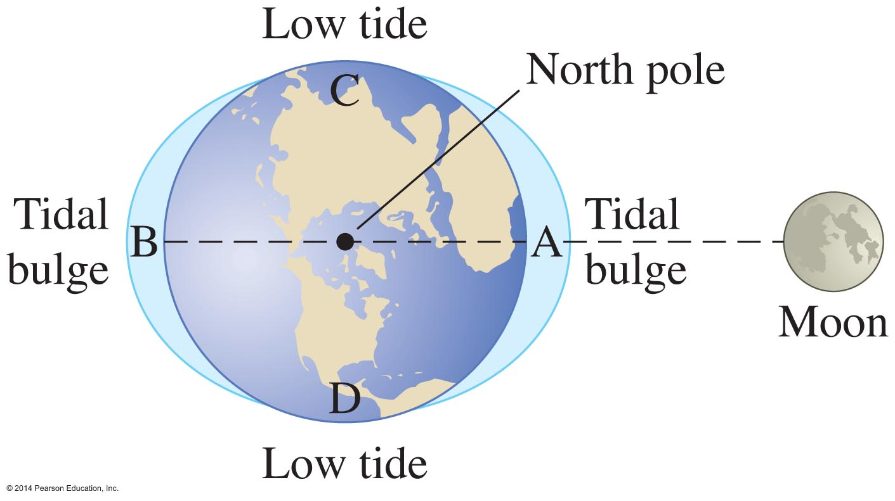
Rotational motion: Putting it all together—Tides and Earth's day
Point A is closer to the Moon than point B, so the gravitational force exerted by the Moon on point A is greater than that exerted on point B.
Due to the difference in forces, Earth elongates along the line connecting its center to the Moon's center.
This makes water rise to a high tide at point A and (surprisingly) at point B. The water "sags" a little at points C and D, forming low tides at those locations.

Slide 61
Example 8.10
Estimate the effective tidal friction force exerted by ocean water on Earth that causes a 0.0016-s increase in Earth's rotation time every 100 years.

Slide 62
Rotational motion: Putting it all together—Example 8.11: Cricket bowling
Estimate the average force that the bowler's hand exerts on the cricket ball (mass 0.156 kg) during the pitch. The bowler's body is moving forward at about 4 m/s and the ball leaves his hand at 40 m/s relative to the bowler's torso and at 44 m/s relative to the ground.

Slide 63
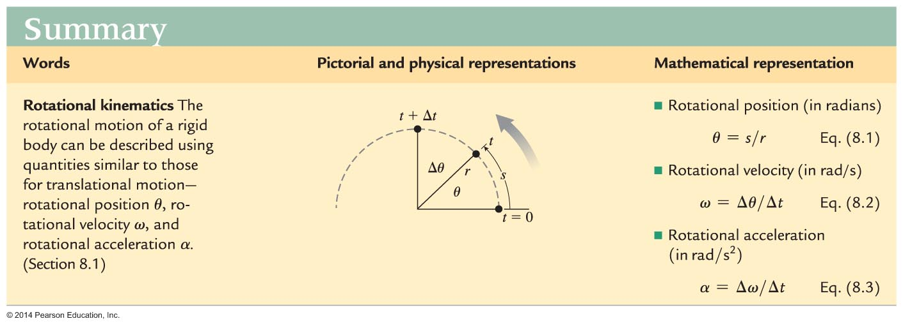
Summary

Slide 64
Summary

Slide 65
Summary

