Slide 1
Newtonian Mechanics
Prepared by
Dedra Demaree,
Georgetown University

Slide 2
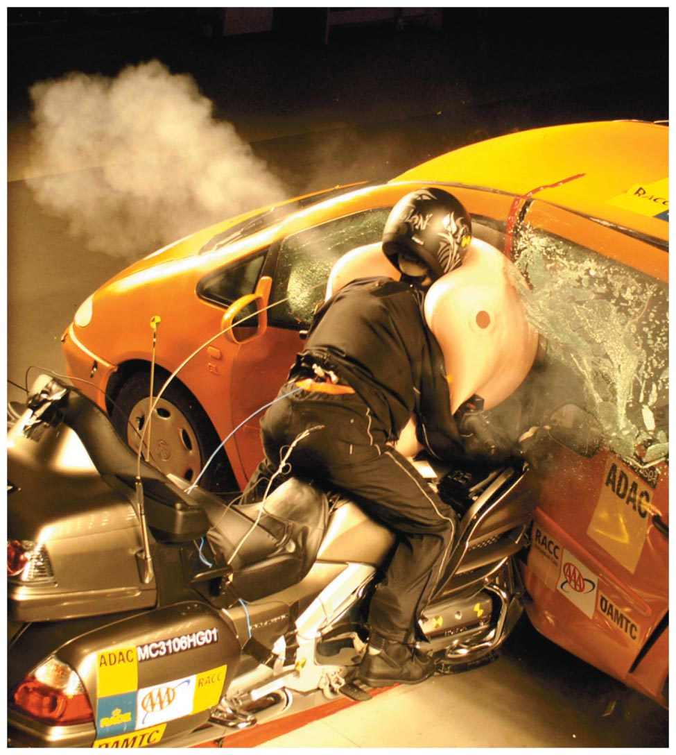
Newtonian Mechanics
Why do seat belts and air bags save lives?
If you stand on a bathroom scale in a moving elevator, does its reading change?
Can a parachutist survive a fall if the parachute does not open?

Slide 3
Be sure you know how to:
Draw a motion diagram for a moving object (Section 1.2)
Determine the direction of acceleration using a motion diagram (Section 1.6)
Add vectors graphically and by components for one-dimensional motion (Section 1.2 and Appendix B)
Last chapter: learned to describe motion
This chapter: learn why an object has a particular acceleration

Slide 4
Describing and representing interactions
Objects can interact directly, when they touch each other—for example, in a push or a pull.
Objects can interact at a distance—for example, when a magnet attracts or repels another magnet without touching it.

Slide 5
Choosing a system to describe interactions
We choose one particular object for analysis; this object is called the system.
All objects not part of the system can interact with it (touch it, pull it, and push it) and are in the system's environment.
Interactions between the system object and objects in the environment are called external interactions.
External interactions can affect the motion of the system.

Slide 6
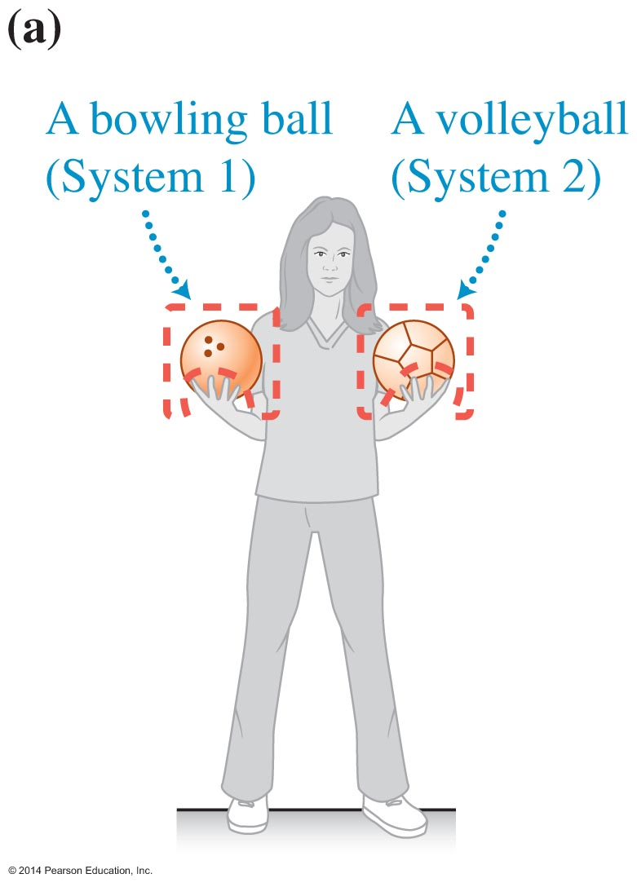
Choosing a system to describe interactions (Cont'd)

Slide 7
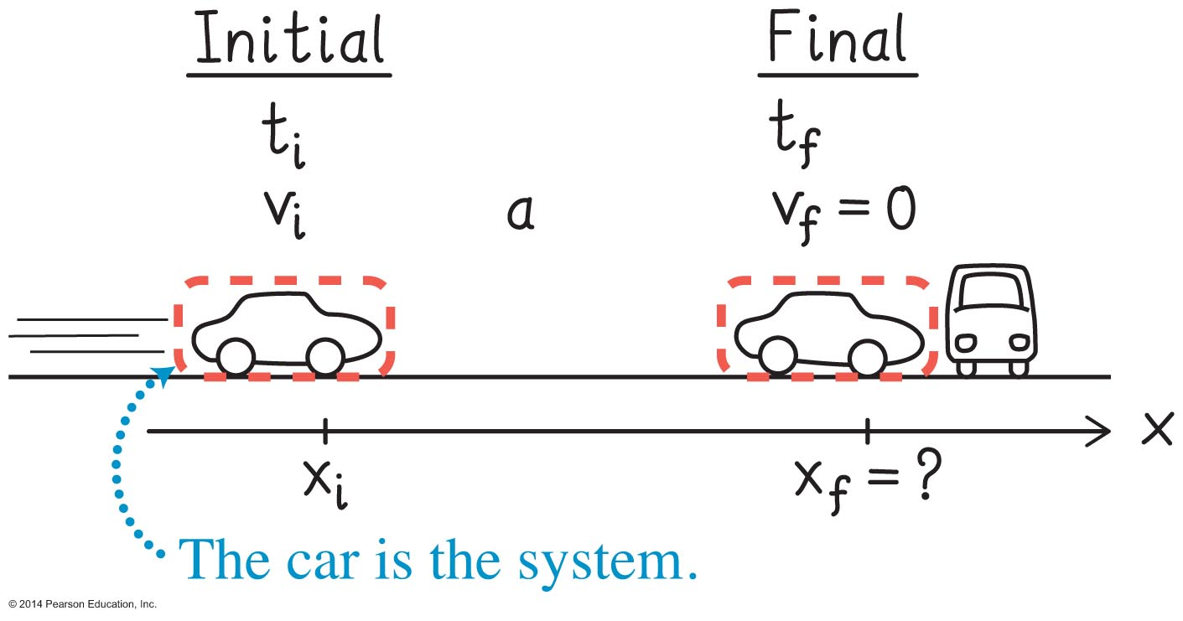
Using a system when sketching a process
Make a light boundary (a closed dashed line) around the system object to emphasize the system choice.
Any parts of an object that are inside the system can have internal interactions.
We will model an object such as a car as point-like and ignore internal interactions.

Slide 8
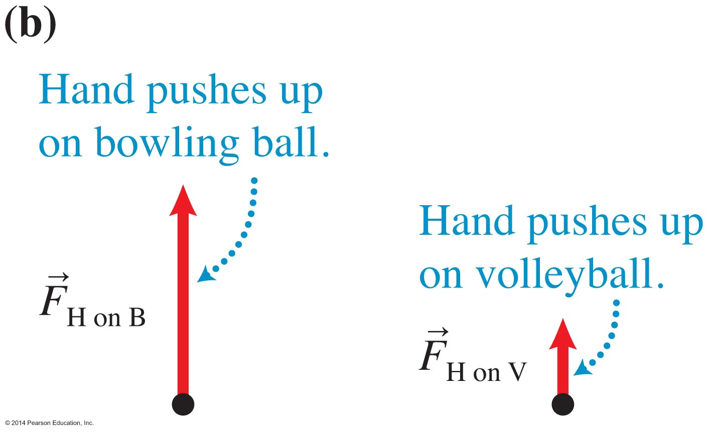
Representing interactions
Make a light boundary (a closed dashed line) around the system object to emphasize the system choice.
Draw an arrow to represent interactions between the system and the environment, such as the arrow in the figure showing the hands pushing upward on each ball.

Slide 9
Force
Force is a vector quantity that characterizes how hard (magnitude) and in which direction an external object pushes or pulls on the system object.
The symbol for force has subscripts identifying the external object that exerts the force and the system object on which the force is exerted.
The SI unit for force is the newton (N).

Slide 10
Testing a hypothesis
Accept the hypothesis as true.
Design an experiment whose outcome can be predicted using this hypothesis.
Compare the outcome of the experiment and the prediction.
Make a preliminary judgment about the hypothesis.
  If the outcome matches the prediction, the hypothesis has not been disproved.
  If the outcome and the prediction do not match, reconsider the hypothesis and possibly reject it.

Slide 11
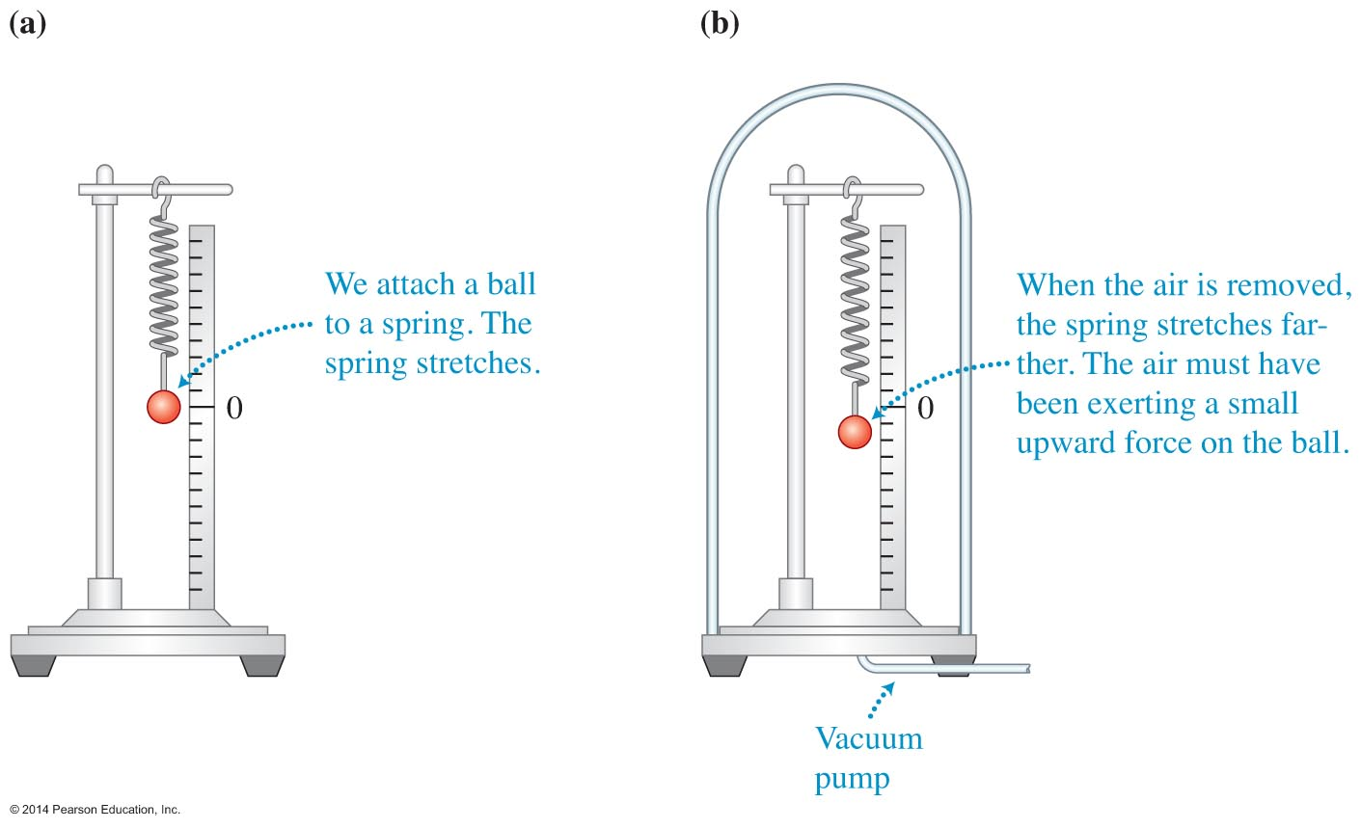
Testing a hypothesis: Does air push down on a ball?
Hypothesis: air pushes down on the ball.
Design the experiment shown in the figure.

Slide 12
Testing a hypothesis: Does air push down on a ball? (Cont'd)
Predict that if the air inside the jar pushes down on the ball, then when we pump the air out, the spring should stretch less.
When we do the experiment, the outcome does not match the prediction: the spring actually stretches slightly more.
Evidently the air does not push the ball down.

Slide 13
Force diagrams
Used with the point-like model
  The system object is represented by a dot.
Arrows used to represent the forces
  Length of the arrow relates to the strength of the force.
  Direction the arrow points relates to the direction in which the force is exerted on the system object.
Includes forces exerted on the system object
Shows the forces at a single instant

Slide 14
Drawing force diagrams
Sketch the situation.
Circle the system.
Identify external interactions.
Place a dot at the side of the sketch representing the system object.
Draw force arrows to represent the external interactions.
Label the forces with a subscript containing two elements.

Slide 15
Constructing force diagrams
Example: a rock sinking into sand

Slide 16
Normal forces
Perpendicular touching forces are called normal forces.
Normal forces are labeled using the letter N.
Normal forces are contact forces (due to touching objects such as book "A" on book "B").
Normal forces are not always vertical as in the previous example.

Slide 17
Adding forces graphically
Draw the vectors head to tail.
Draw the vector that goes from the tail of the first vector to the head of the second vector.
  This is the sum vector, also called the resultant vector.
  In this case this vector is the net force (it is not a new force, but rather the combined effect of all the forces being exerted on the object).

Slide 18
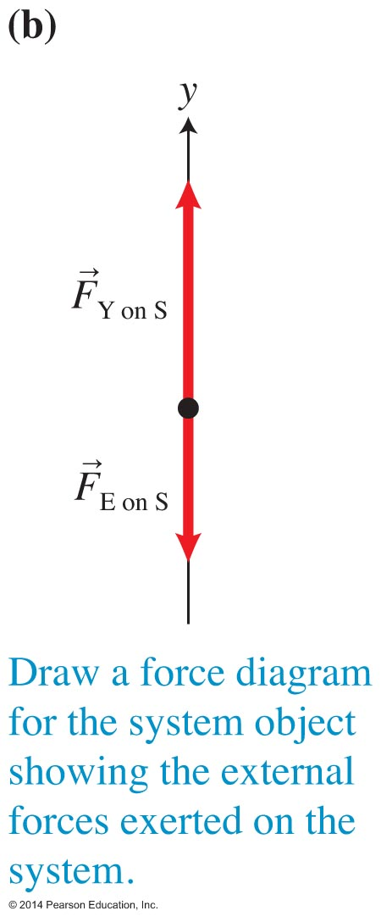
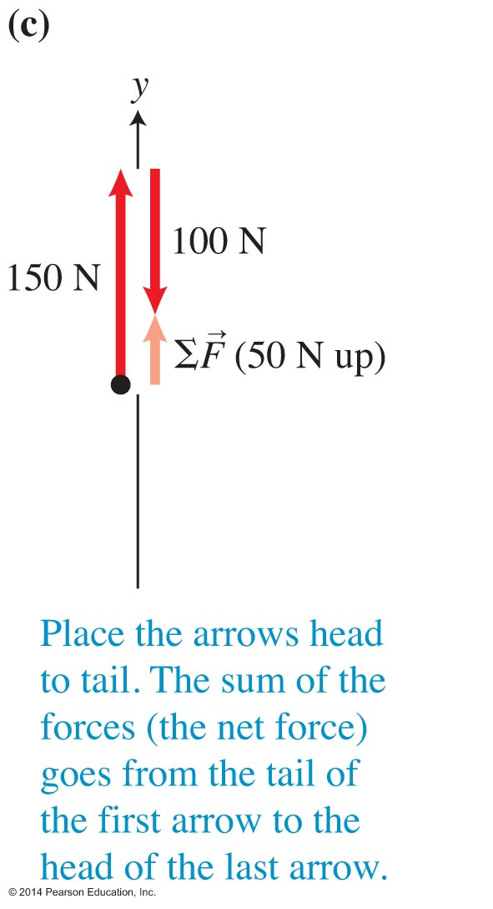
Adding forces graphically (Cont'd)

Slide 19
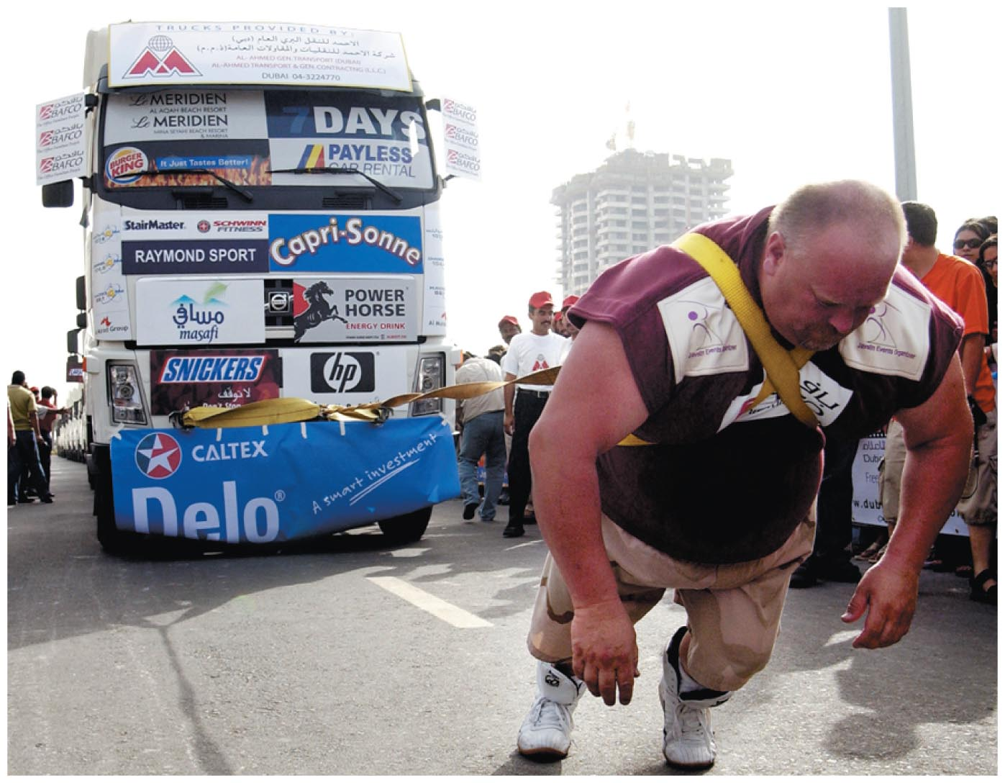
Example: Lifting a suitcase
The upward force you exert on the suitcase is larger than the downward force Earth exerts on the suitcase.
The net effect is a 50-N force pointed straight up.

Slide 20
Adding more than two forces graphically
If several external objects in the environment exert forces on the system object, we still use vector addition to find the sum of the forces exerted on the object.

Slide 21
Measuring force magnitudes
Force is a vector quantity with both magnitude and direction.
One method to measure an unknown force is to calibrate a spring in terms of some standard force.
This calibrated spring can then be used to measure other forces.
A spring scale is the simplest instrument to measure forces.

Slide 22
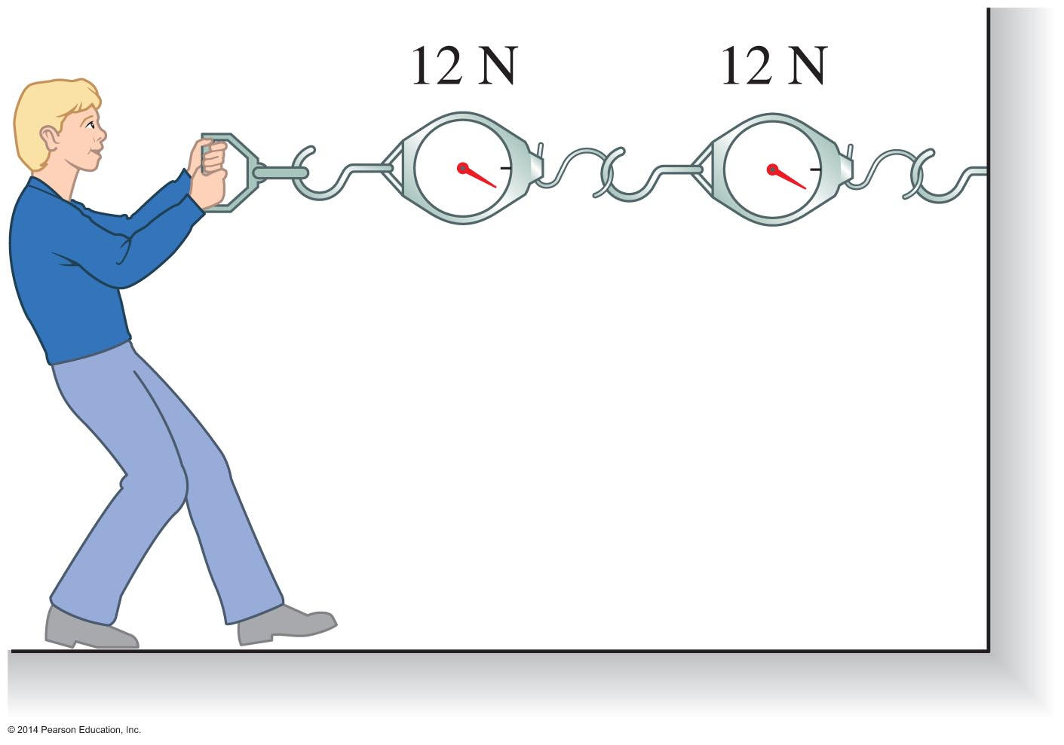
Measuring force magnitudes (Cont'd)

Slide 23
Physics language: Force
Force is a physical quantity characterizing an interaction between two objects.
  Always identify the two interacting objects.
  Force includes both the magnitude and the direction of the interaction.
The word "force" in physics is more precisely defined than how we use it in everyday life.
The definition of "force" in physics has also been refined through history.

Slide 24
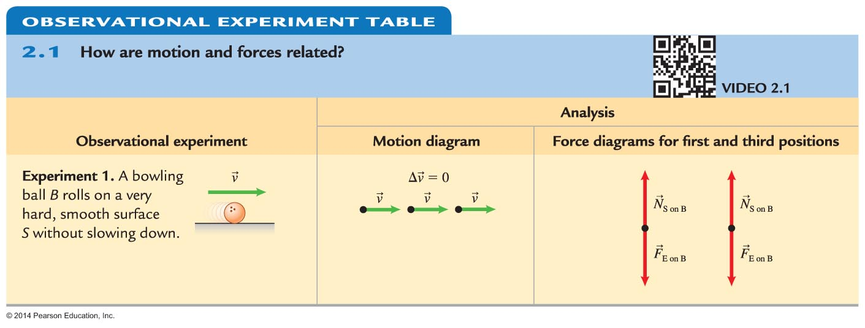
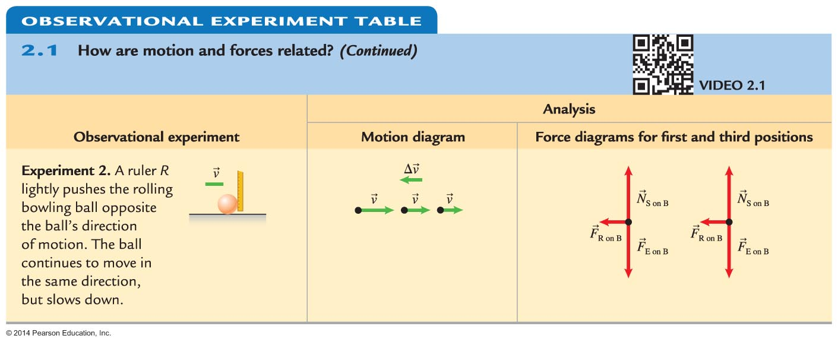
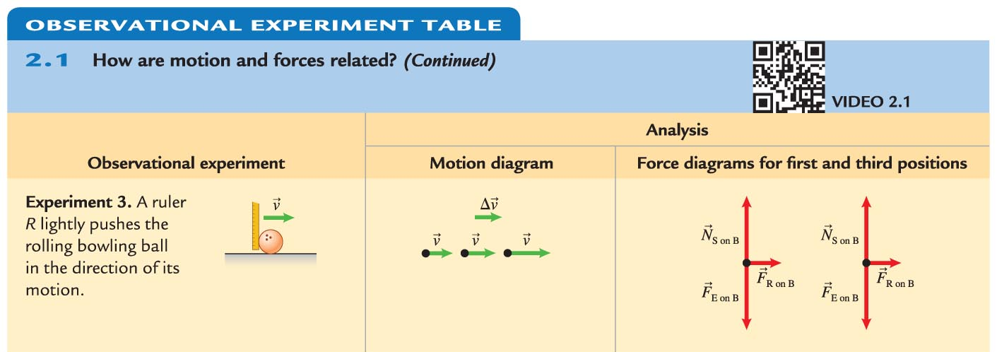
Patterns observed in the experiments

Slide 25
Observational experiments for a bowling ball rolling on a very hard, smooth surface
In all experiments, the vertical forces add to zero and cancel.
  We consider only forces exerted in the horizontal direction.
In the first experiment, the sum of the forces exerted on the ball is zero.
  The ball's velocity remains constant.
When the ruler pushes the ball, the velocity change arrow points in the same direction as the sum of the forces.

Slide 26
Testing possible relationships between force and motion
Two patterns are commonly proposed:
  The sum of the forces exerted is in the same direction as the velocity of the system object.
  The sum of the forces exerted is in the same direction as the change in velocity of the system object.
We must do testing experiments to determine which pattern is consistent with the relationship between force and motion.

Slide 27
Testing possible relationships between force and motion
Two possible relationships:
  The sum of forces is in the same direction as the velocity.
  The sum of forces is in the same direction as the change in velocity.
Use each relationship to predict the outcome of testing experiments.
Perform the experiments and compare the outcomes with the predictions.
From this comparison, decide whether we can reject one or both of the relationships.

Slide 28
Relating forces and motion

Slide 29
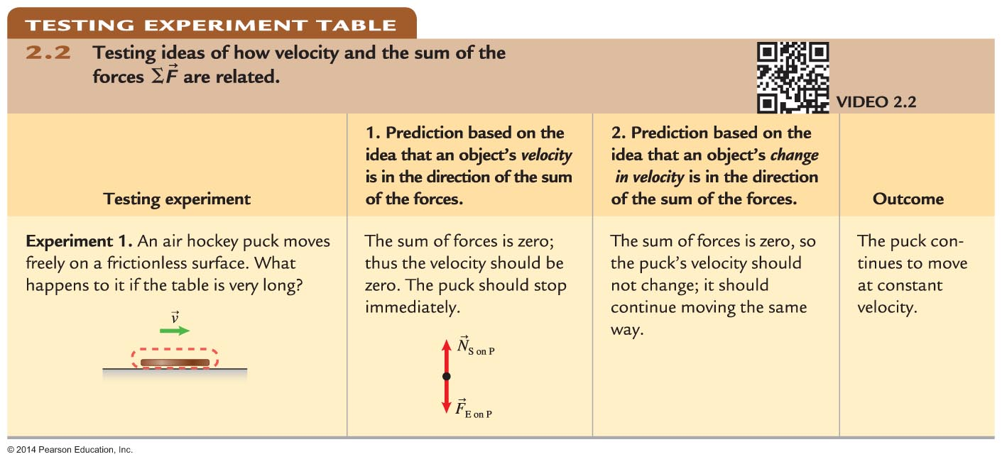
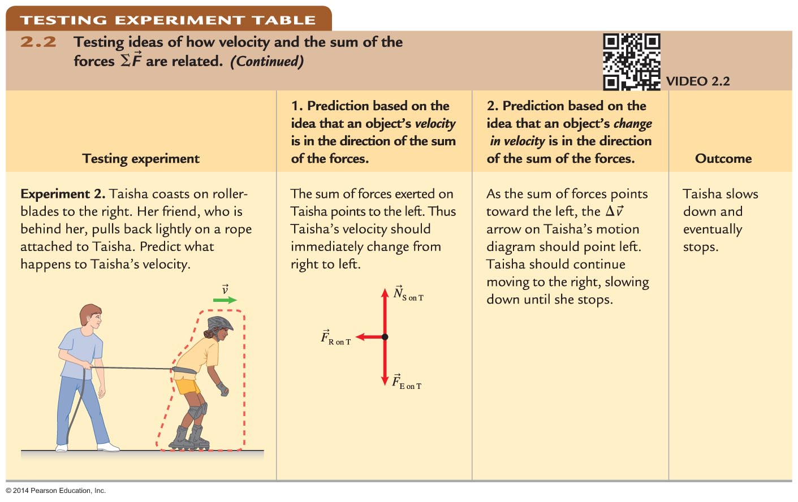
Testing the relationship between the sum of forces and the motion of the system object

Slide 30
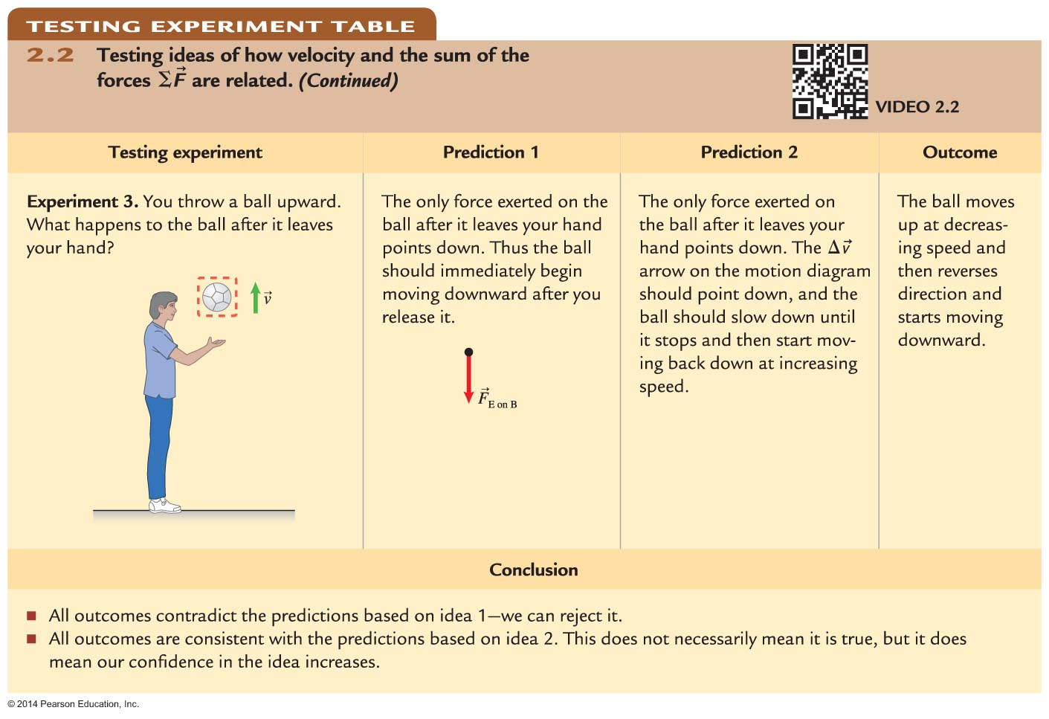
Testing the relationship between the sum of forces and the motion of the system object

Slide 31
Reasoning without mathematical equations
Motion and force diagrams and the rule relating motion and force can be used to reason qualitatively about physical processes:
  To determine the relative magnitudes of forces if you have information about motion
  To estimate velocity changes if you have information about forces
Make sure the unknown representation is consistent with the known representation.

Slide 32
Inertial reference frame
An inertial reference frame is one in which an observer:
  Sees that the velocity of the system object does not change if no other objects exert forces on it or
  Sees no change in the velocity if the sum of all forces exerted on the system object is zero
In noninertial reference frames, the velocity of the system object can change even though the sum of forces exerted on it is zero.

Slide 33
Inertial reference frame
A passenger in a car or train that is speeding up or slowing down with respect to Earth is an observer in a noninertial reference frame.
  When you are in a car that stops abruptly, your body jerks forward, yet nothing is pushing you forward.
Observers in noninertial reference frames cannot explain the changes in velocity of objects by considering the forces exerted on them by other objects.

Slide 34
Newton's first law of motion
For an observer in an inertial reference frame, the object continues moving at constant velocity (including remaining at rest):
  When no other objects exert forces on an system object or
  When the forces exerted on the object add to zero
Inertia is the phenomenon in which an object continues to move at constant velocity when the sum of the forces exerted on it by other objects is zero.

Slide 35
Observational experiment
Based on experiments 1 and 2, we observe the following patterns:

Slide 36
Newton's second law of motion
Observation experiments help us construct the following relationship between the sum of forces on a system object and the system object's motion:
The symbol α means "is proportional to." For example, if the sum of the forces doubles, then the acceleration doubles.

Slide 37
Mass
Mass is a measure of the amount of matter.
Mass is represented by the symbol m.
To measure mass quantitatively, you first define a standard unit of mass.
The SI standard unit of mass is the kilogram (kg).
The kilogram standard is a cylinder made of a platinum-iridium alloy stored in a museum of measurements near Paris.

Slide 38
Mass
Mass characterizes the amount of matter in an object.
When the same unbalanced force is exerted on two objects, the object with greater mass has a smaller acceleration.
Mass is a scalar quantity, and masses add as scalars.

Slide 39
Newton's second law of motion
Observation experiments help us construct the following relationship for the proportionality between the acceleration of a system object and the system object's mass:

Slide 40
Newton's second law of motion
Combining the results of our observational experiment findings, we have:
Force is a ubiquitous quantity so it has a unit defined for it called a newton (N).
A force of 1 newton (1 N) causes an object with a mass of 1 kg to accelerate at 1 m/s².

Slide 41
Newton's second law of motion
"Vector sum of the forces" means we cannot add the forces as numbers; the directions of the vectors affect the magnitude of the vector sum.

Slide 42
Making sense of Newton's second law
The equation we deduced for Newton's second law is:
  If the mass is infinitely large, the acceleration is zero.
  If the mass is zero, the acceleration is infinitely large.
Both of these extreme cases make sense.

Slide 43
Cause-effect relationships
The equation we deduced for Newton's second law is:
The right side of the equation (the sum of the forces being exerted on the system) is the cause of the effect (the system's acceleration) on the left side.

Slide 44
Operational definition versus cause-effect
The equal sign in Newton's second law does not imply the same thing as the equal sign used for the definition of acceleration.
  is a cause-effect relationship: why the acceleration occurs.
  is an operational definition:
  how to determine a quantity by defining it in terms of another quantity (but does not tell the reason for the acceleration!).

Slide 45
Force components used for forces along one axis
Our equation for Newton's second law can be written in vector component form. For example, in the x-direction we have:
  Identify the positive direction of the axis.
  Find the components of all the forces being exerted on the system.
  Forces that point in the positive direction have a positive component; forces that point in the negative direction have a negative component.

Slide 46
Gravitational force law
Objects falling in a vacuum (for instance, a tube with the air removed) show that all objects fall straight down with the same acceleration.
  This acceleration has a magnitude of
  9.8 m/s².
Earth (E) exerts the only force on the falling object (O) (in a vacuum).
  F_{E on Oy} = m_{O}a_{Oy} = m_{O}(9.8 m/s²)
  We define g such that:

Slide 47
Gravitational force

Slide 48
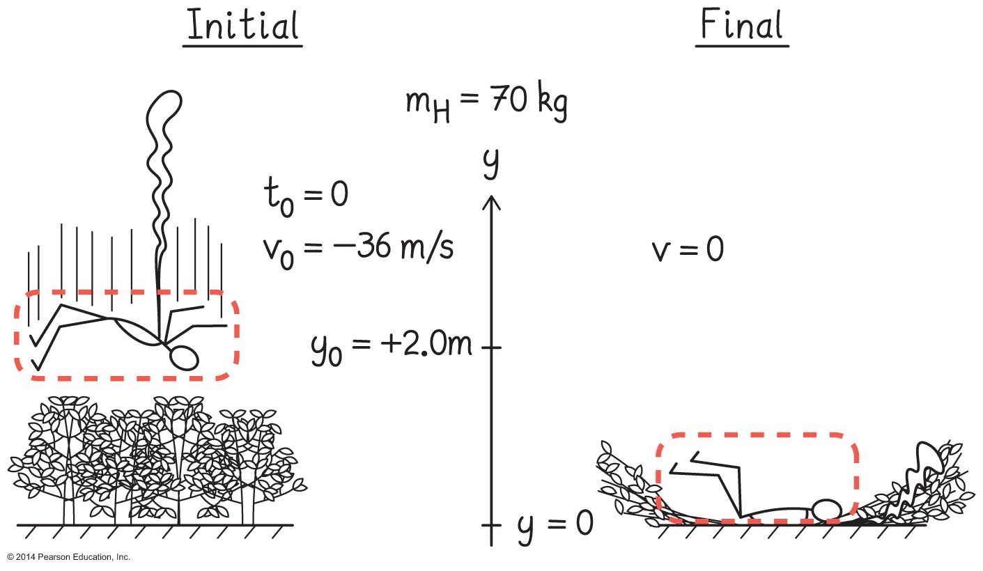
Skills for applying Newton's second law for one-dimensional processes
Sketch and translate.
  Sketch the process, choose the system object and coordinate system, and label the sketch with everything you know about the situation.

Slide 49
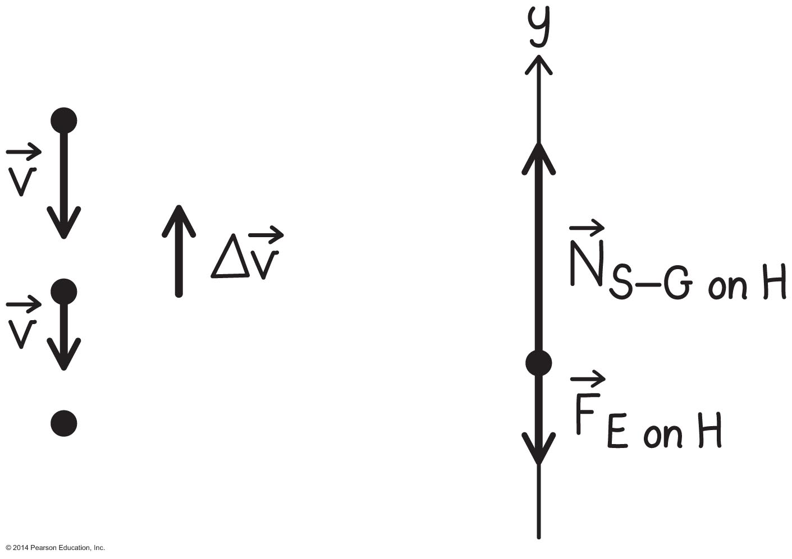
Skills for applying Newton's second law for one-dimensional processes (Cont'd)
Simplify and diagram.
  Make appropriate simplifying assumptions and represent the process with a motion diagram and/or a force diagram.

Slide 50
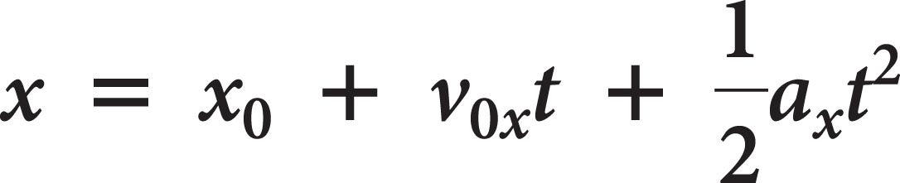
Skills for applying Newton's second law for one-dimensional processes (Cont'd)
Represent mathematically.
  Convert the representations into quantitative mathematical descriptions using kinematics and Newton's second law.
Solve and evaluate.
  Substitute the known values and solve, and then evaluate your work to see if it is reasonable. Check whether all representations are consistent.

Slide 51
Weight
The weight of the object on a planet is the force that the planet exerts on the object.
In everyday language, the normal force that a scale exerts on you (which balances the downward force you exert on it) is your weight.
We will not use the term "weight of an object" because it implies that weight is a property of the object rather than an interaction between two objects.

Slide 52
Forces come in pairs
Suppose you wear rollerblades and push abruptly on a wheeled cart loaded with a heavy box.
If you and the cart are on a hard smooth floor, the cart starts moving away (it accelerates), and you also start to move and accelerate in the opposite direction.
You exerted a force on the cart and the cart exerted a force on you.
Because the accelerations were in opposite directions, the forces must point in opposite directions.

Slide 53
Testing experiment: Newton's third law of motion
Attach one spring scale to a hook on the wall and pull on its other end with a second spring scale.
  If the hypothesis is correct, then the scale you pull should have the same reading as the scale fixed to the wall.
  You find that the scales have the same readings.
  If you reverse the scales and repeat the experiment, you find they always have the same readings.

Slide 54

Newton's third law of motion
When two objects interact, object 1 exerts a force on object 2. Object 2 in turn exerts an equal-magnitude, oppositely directed force on object 1.
These forces are exerted on different objects and cannot be added to find the sum of the forces exerted on one object.

Slide 55
Tips for Newton's third law of motion
The forces in Newton's third law are exerted on two different objects.
  This means that the two forces will never appear on the same force diagram.
  Also, they should not be added together to find the sum of the forces.
You have to choose the system object and consider only the forces exerted on it!

Slide 56
Putting it all together: Air bags
An air bag is like a balloon made of heavy-walled material that is packed in a small box.
It is designed to deploy when a car has an acceleration of 10 g or more (~98 m/s²).
The bag:
  Spreads out the force that stops the person over a larger area of the body
  Increases the stopping distance, consequently reducing the average force to stop the driver

Slide 57
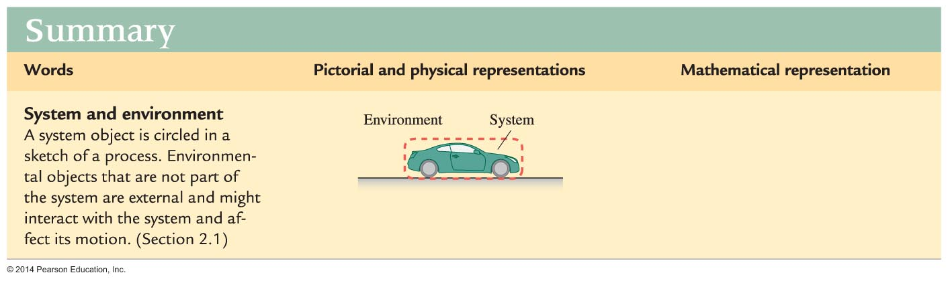
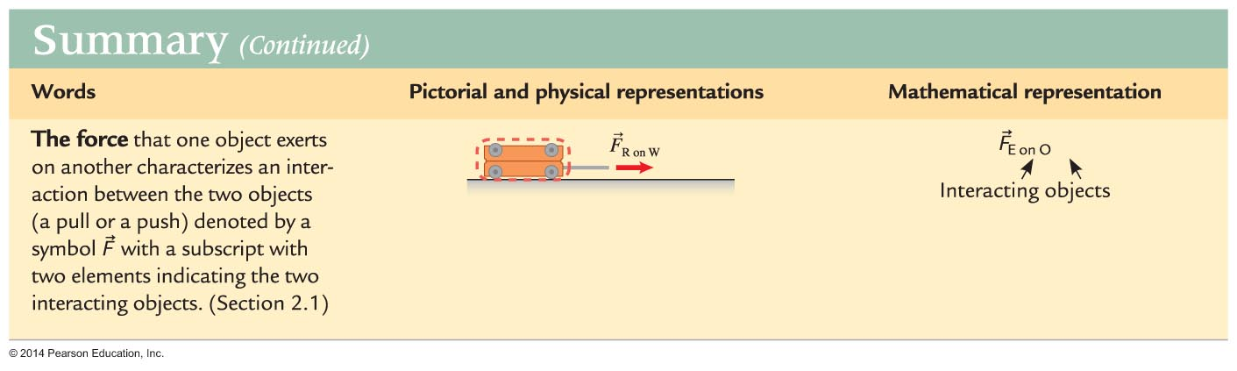
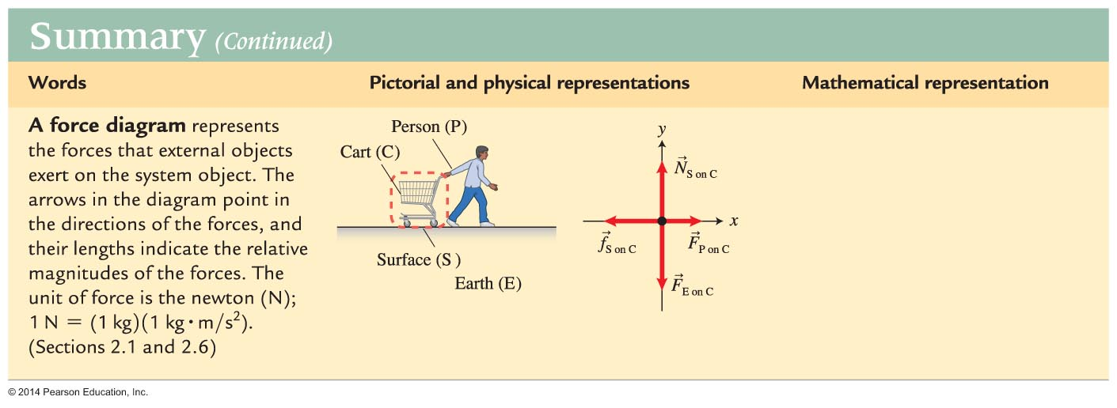
Summary

Slide 58
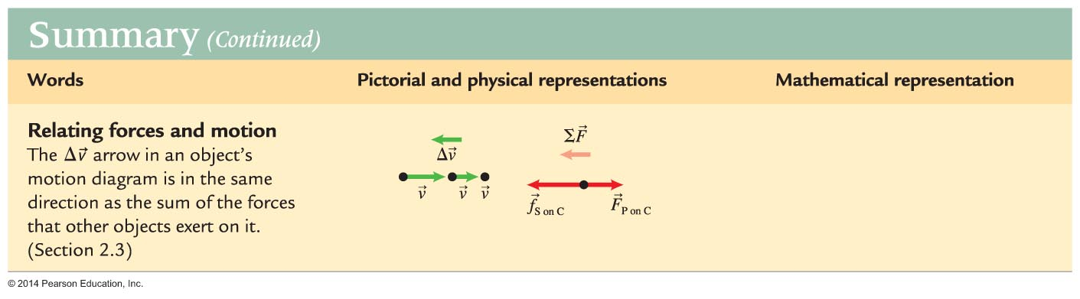
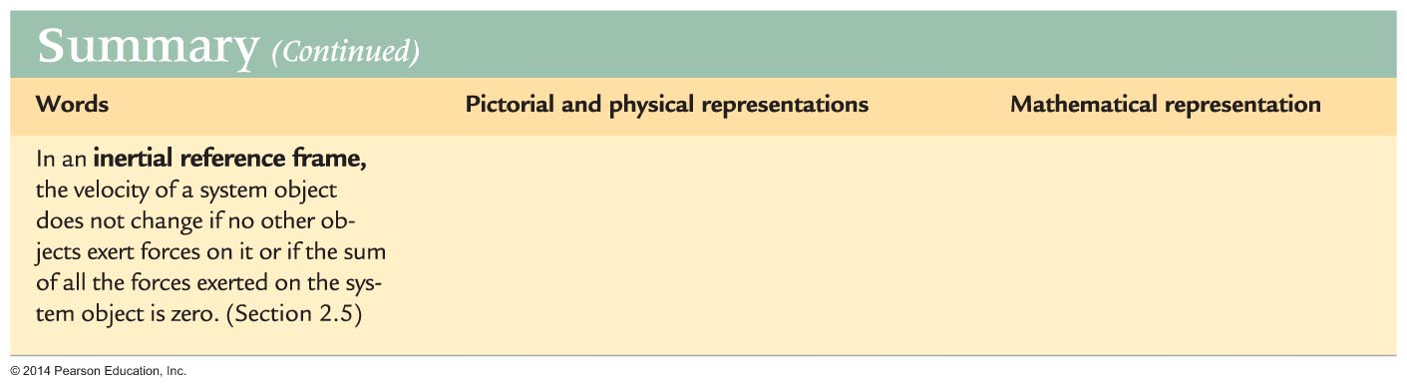
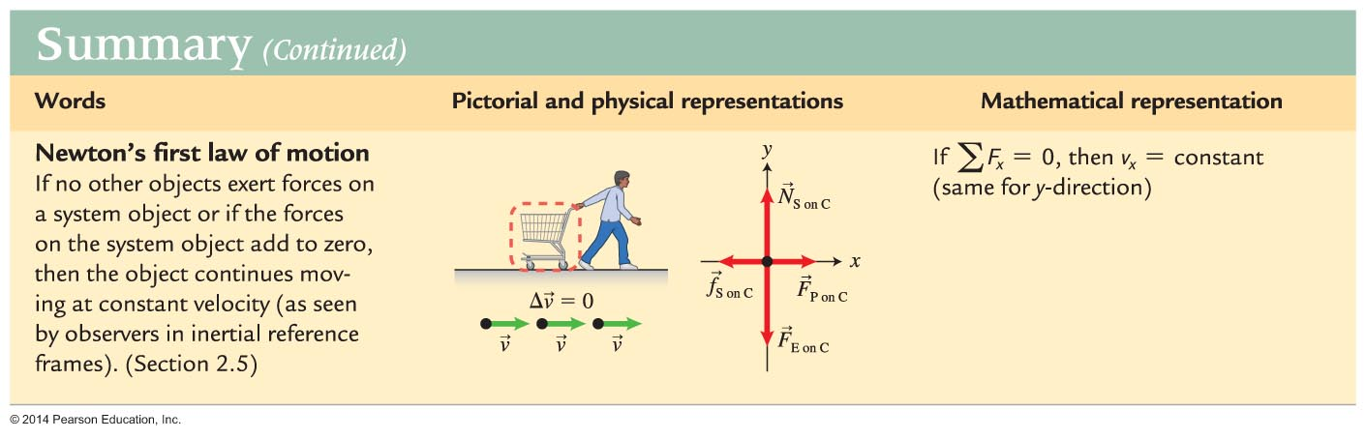
Summary

Slide 59
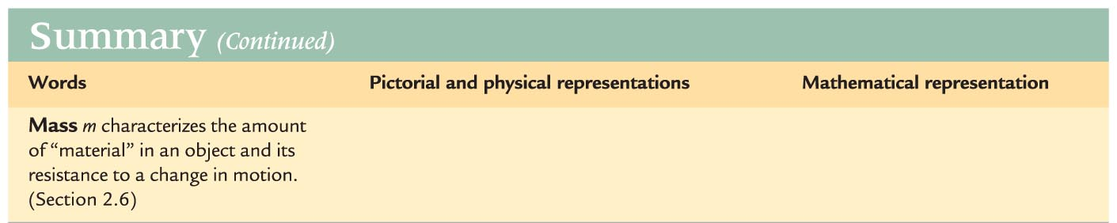
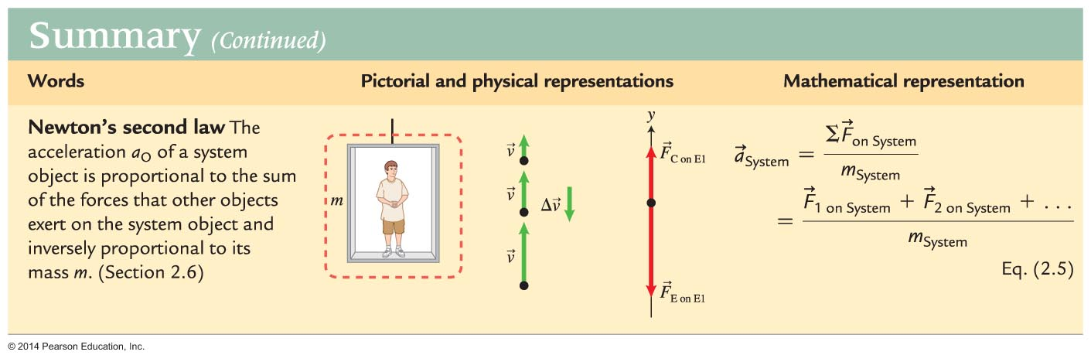
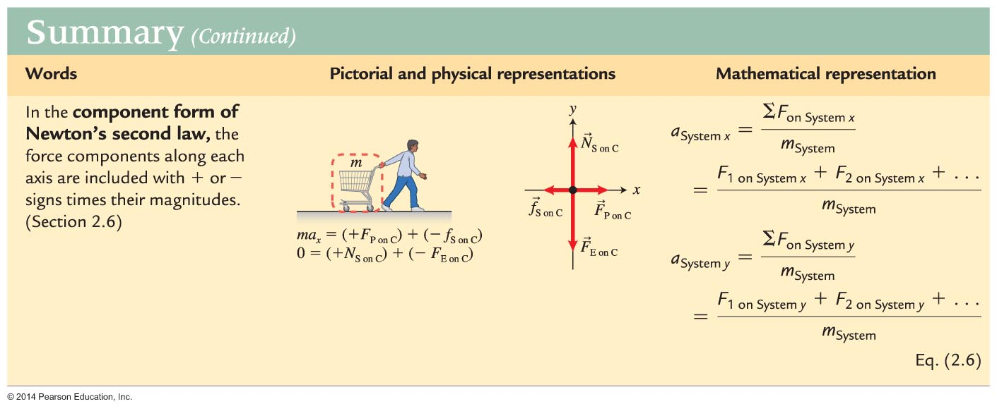
Summary

Slide 60
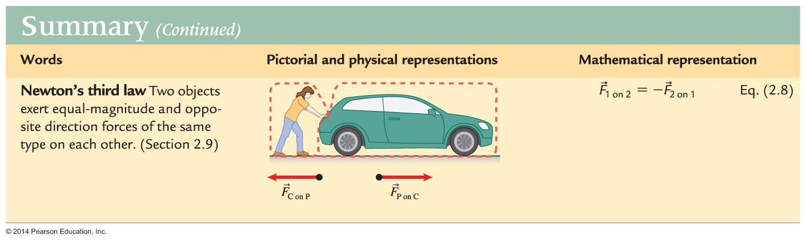
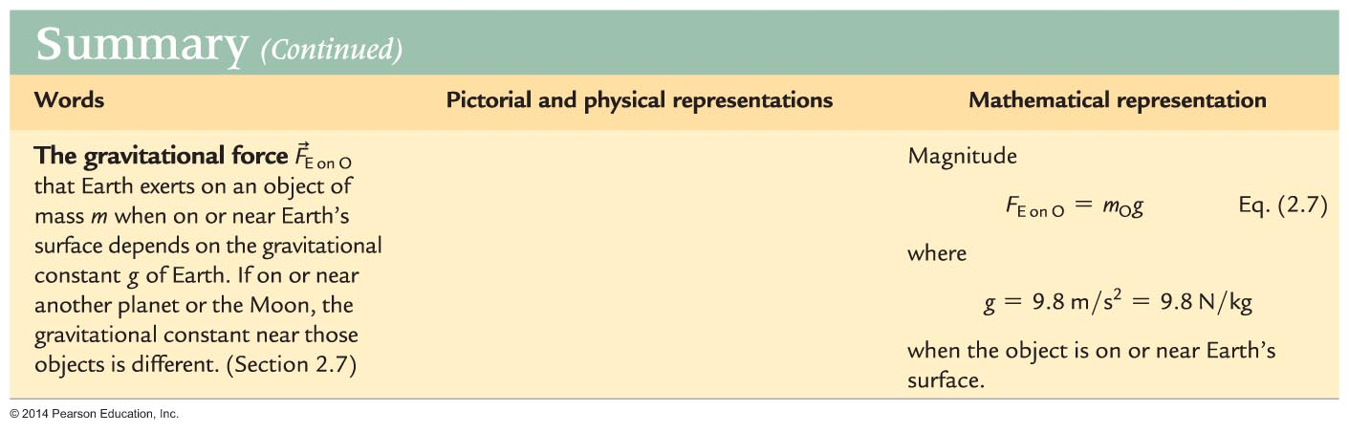
Summary

