Slide 1
Objectives
The Causes of Weather
Compare and contrast weather and climate.
Analyze how imbalances in the heating of Earth’s surface create weather.
Describe how and where air masses form.
Vocabulary
meteorology
weather
climate
air mass
air mass modification

Slide 2
Weather

Slide 3
The Causes of Weather
The Causes of Weather
Meteorology is the study of atmospheric phenomena.
Cloud droplets and forms of precipitation that contain water in any phase are known as hydrometeors.
Smoke, haze, dust, and other condensation nuclei are called lithometeors.
Thunder and lightning are examples of electrometeors, which are visible or audible manifestations of atmospheric electricity.

Slide 4
Weather and Climate
The Causes of Weather
Weather is the current state of the atmosphere, including short-term variations that affect our lives.
Climate describes the average weather over a long period of time and is usually averaged over the course of 30 years or more.
Meteorology, weather, and climate are related.

Slide 5
A Question of Balance
The Causes of Weather
In meteorology, a crucial question is how solar radiation is distributed around the planet.
The Sun feels hotter in the tropics because its rays strike Earth more directly, than it does in the polar regions where its rays strike Earth at a low angle.
Because the Sun’s rays are more spread out when they strike Earth at a low angle, the same amount of energy is spread over a larger area.

Slide 6
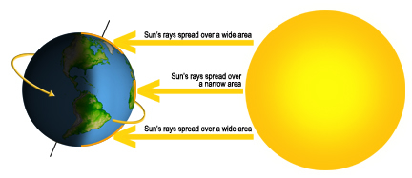
A Question of Balance
The Causes of Weather

Slide 7
A Question of Balance
The Causes of Weather
Balancing the Budget
The tropics and other places maintain fairly constant average temperatures because heat energy is redistributed around the world.
The continual motion of air and water reallocates heat energy among Earth’s surface, oceans, and atmosphere and brings it into balance.
Virtually everything that we consider to be weather is part of a constant redistribution of Earth’s heat energy.

Slide 8
Air Masses
The Causes of Weather
An air mass is a large body of air that takes on the characteristics of the area over which it forms.
Meteorologists call the region over which an air mass forms the source region.
Air masses that form over land are generally drier than those that form over water.

Slide 9
Air Masses
The Causes of Weather
Classifying Air Masses
Air masses are classified according to their source regions.
The main types of air masses are:
warm and dry - continental tropical (cT)
warm and humid - maritime tropical (mT)
cold and dry - continental polar (cP)
cold and humid - maritime polar (mP)
arctic (A)

Slide 10
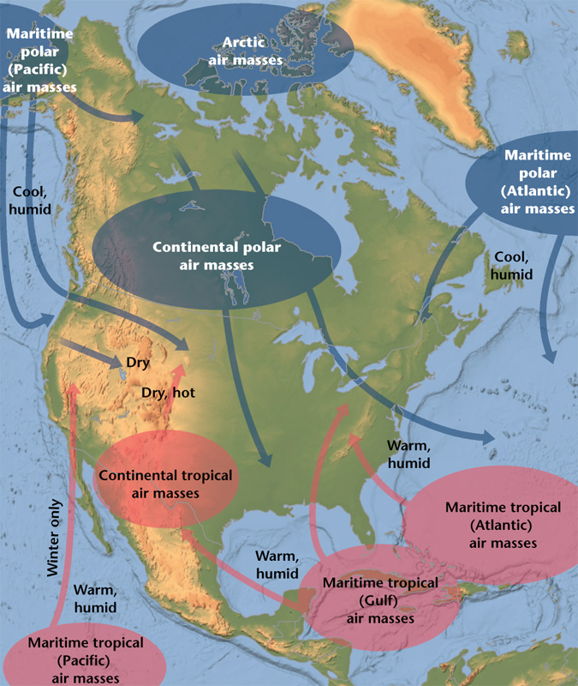
Air Masses
The Causes of Weather
Classifying Air Masses
Each of the major air masses that affects weather in the United States has a similar temperature and moisture content as the area over which it formed.

Slide 11
Air Masses
The Causes of Weather
Source Regions
All five main types of air masses can be found in North America because of the continent’s proximity to the source regions associated with each air mass.
Maritime polar air forms over the cold waters of the North Atlantic and North Pacific.
Continental polar air forms over the interior of Canada and Alaska.
The origins of maritime tropical air are tropical and subtropical oceans, such as the Caribbean Sea and the Gulf of Mexico.

Slide 12
Air Masses
The Causes of Weather
Source Regions
All five main types of air masses can be found in North America because of the continent’s proximity to the source regions associated with each air mass.
The desert Southwest and Mexico are the source regions of continental tropical air.
Arctic air develops over latitudes above 60°N in the ice- and snow-covered regions of Siberia and the Arctic Basin.
The stability of air is an important factor in its ability to produce clouds and precipitation.

Slide 13
Air Masses
The Causes of Weather
Air Mass Modification
Eventually, air masses move, transferring heat from one area to another and thus establishing the heat balance.
As an air mass moves, it starts to acquire some of the characteristics of the new surface beneath it.
Air mass modification is the exchange of heat or moisture with the surface over which an air mass travels.
Eventually, an air mass becomes modified to such a degree that its characteristics are almost the same as the new surface over which it is traveling.

Slide 14
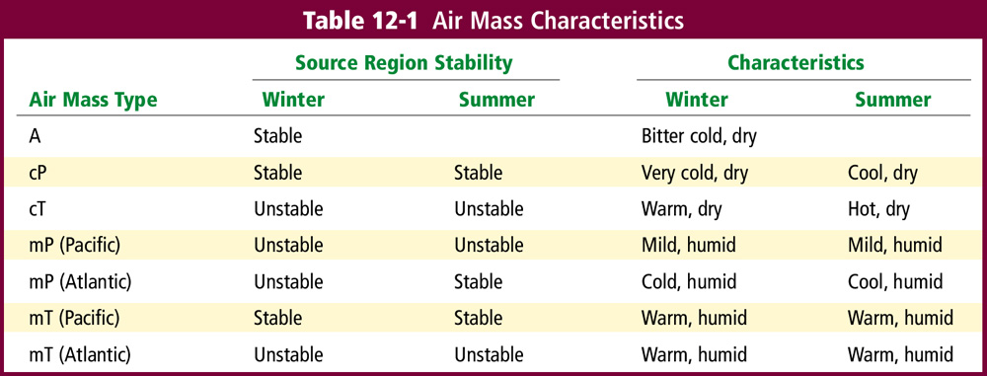
Air Masses
The Causes of Weather
Air Mass Modification

Slide 15
End of Section 1

Slide 16
Objectives
Weather Systems
Describe how the rotation of Earth affects the movement of air.
Compare and contrast wind systems.
Identify the various types of fronts.
Vocabulary
Coriolis effect
trade winds
prevailing westerlies
polar easterlies
jet stream
front

Slide 17
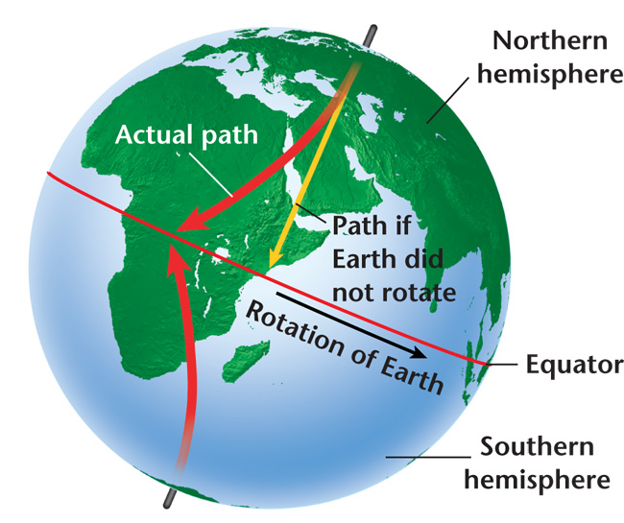
Weather Systems
Weather Systems
The Coriolis effect, which is a result of Earth’s rotation, causes moving particles such as air to be deflected to the right in the northern hemisphere and to the left in the southern hemisphere.
The Coriolis effect combines with the heat imbalance found on Earth to create distinct global wind systems that transport colder air to warmer areas and warmer air to colder areas.

Slide 18
Global Wind Systems
Weather Systems
There are three basic zones, or wind systems, in each hemisphere.
The trade winds, the first major wind zone, flows at 30° north and south latitude, where air sinks, warms, and returns to the equator in a westerly direction.
Around 30° latitude, known as the horse latitudes, the sinking air associated with the trade winds creates a belt of high pressure that in turn causes generally weak surface winds.

Slide 19
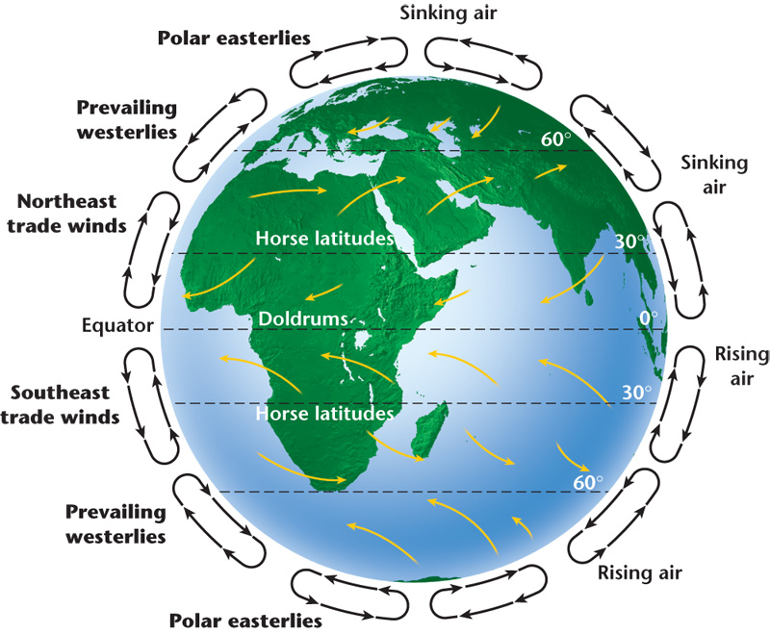
Global Wind Systems
Weather Systems

Slide 20
Global Wind Systems
Weather Systems
When air converges it is forced upward and creates an area of low pressure in a process called convergence.
Near the equator, convergence occurs over a large area called the intertropical convergence zone (ITCZ), also called the doldrums.
The ITCZ migrates south and north of the equator as the seasons change.
The ITCZ is characterized by a band of cloudiness and occasional showers.

Slide 21
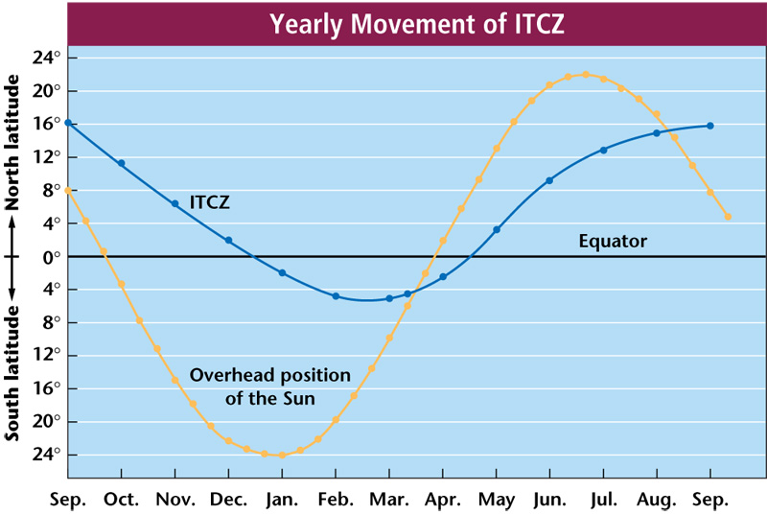
Global Wind Systems
Weather Systems

Slide 22
Global Wind Systems
Weather Systems
Other Wind Zones
The prevailing westerlies, the second major wind zone, flows between 30° and 60° north and south latitude in a circulation pattern opposite that of the trade winds.
The prevailing westerlies are responsible for much of the movement of weather across the United States and Canada.
The polar easterlies, the third major wind zone, lies between 60° latitude and the poles.
In both hemispheres, the polar easterlies are characterized by cold air.

Slide 23
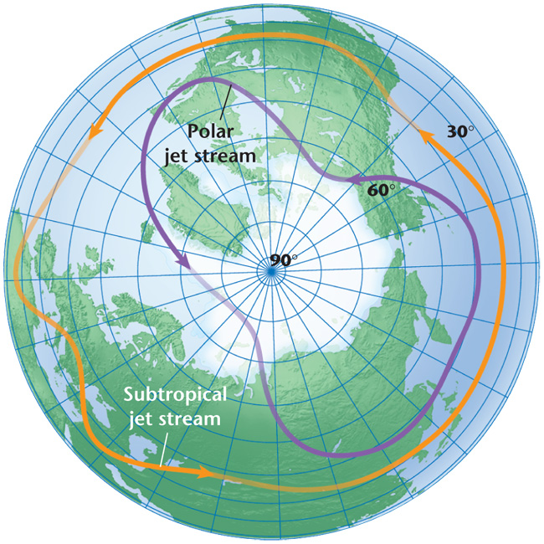
Jet Streams
Weather Systems
Jet streams are narrow bands of high-altitude, westerly winds that flow at speeds up to 185 km/h at elevations of 10.7 km to 12.2 km.
The polar jet stream separates the polar easterlies from the prevailing westerlies.
The subtropical jet stream is located where the trade winds meet the prevailing westerlies.

Slide 24
Jet Streams
Weather Systems
Large-Scale Weather Systems
The position of the jet stream varies, and it can split into different branches and later reform into a single stream.
The jet stream represents the strongest core of westerly winds.
Weather systems generally follow the path of the jet stream.
The jet stream affects the intensity of weather systems by moving air of different temperatures from one region to another.

Slide 25
Fronts
Weather Systems
In the middle latitudes, air masses with different characteristics sometimes collide, forming a front.
A front is the narrow region separating two air masses of different densities that are caused by differences in temperature, pressure, and humidity.
The interaction between the colliding air masses can bring dramatic changes in weather.
There are four main types of fronts: cold fronts, warm fronts, stationary fronts, and occluded fronts.

Slide 26
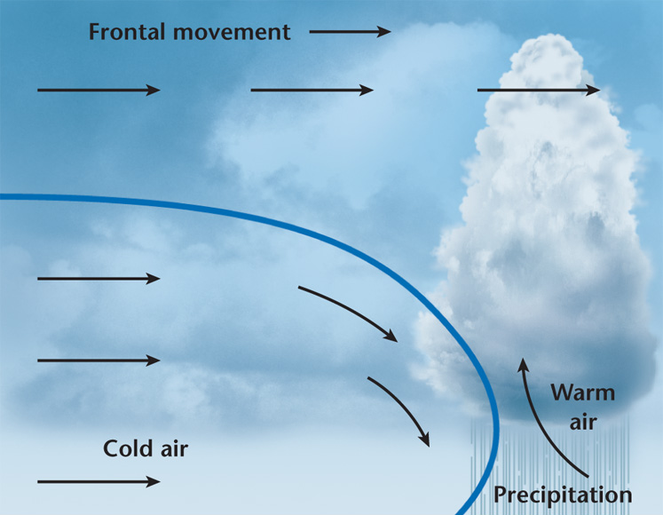
Fronts
Weather Systems
Cold Fronts
In a cold front, cold, dense air displaces warm air and forces the warm air up along a steep front.
Clouds, showers, and sometimes thunderstorms are associated with cold fronts.
A cold front is represented on a weather map as a solid blue line with blue triangles that point in the direction of the front’s motion.

Slide 27
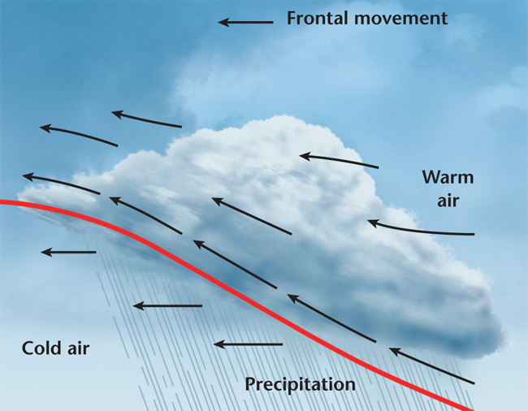
Fronts
Weather Systems
Warm Fronts
In a warm front, advancing warm air displaces cold air.
The warm air develops a gradual frontal slope rather than a steep boundary.
A warm front is characterized by extensive cloudiness and precipitation.
On a weather chart, a warm front appears as a solid red line with regularly spaced, solid red semicircles pointing in the direction of the front’s motion.

Slide 28
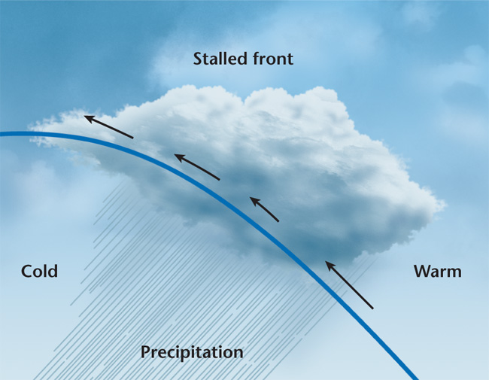
Fronts
Weather Systems
Stationary Fronts
A stationary front is the result of two air masses meeting and neither advancing into the other’s territory, stalling the boundary between them.
Stationary fronts seldom have extensive cloud and heavy precipitation patterns.
A stationary front is represented on a weather map by a combination of short segments of cold- and warm-front symbols.

Slide 29
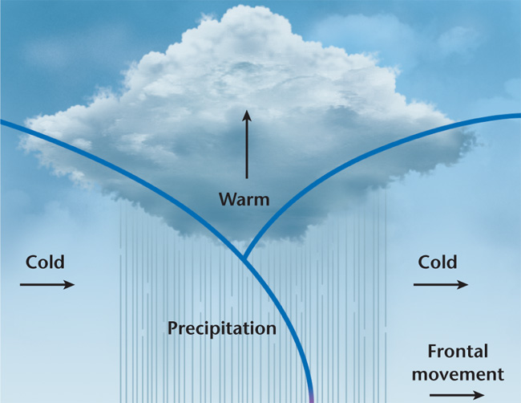
Fronts
Weather Systems
Occluded Fronts
An occluded front is the result of a cold air mass overtaking a warm front, wedging the warm air upward.
Precipitation is common on both sides of an occluded front.
An occluded front is represented on a weather map by a line with alternating purple triangles and semicircles that point toward the direction of motion.

Slide 30
Pressure Systems
Weather Systems
At Earth’s surface, rising air is associated with low pressure and sinking air is associated with high pressure.
Rising or sinking air, combined with the Coriolis effect, results in the formation of rotating low- and high-pressure systems in the atmosphere.
Air in these systems moves in a general circular motion around either a high- or low-pressure center.

Slide 31
Pressure Systems
Weather Systems
High-Pressure Systems
In a high-pressure system, air sinks, so that when it reaches Earth’s surface it spreads away from the center.
The Coriolis effect causes the overall circulation around a high-pressure center to move in a clockwise rotation in the northern hemisphere. (Clear weather.)
High-pressure systems rotate in a counterclockwise direction in the southern hemisphere.

Slide 32
Pressure Systems
Weather Systems
Low-Pressure Systems
In a low-pressure systems, air rises, causing an inward net flow toward the center and then upward.
In contrast to air in a high- pressure system, air in a low- pressure system in the northern hemisphere rotates in a counterclockwise direction. (Rainy Weather)
This movement is reversed in the southern hemisphere.

Slide 33
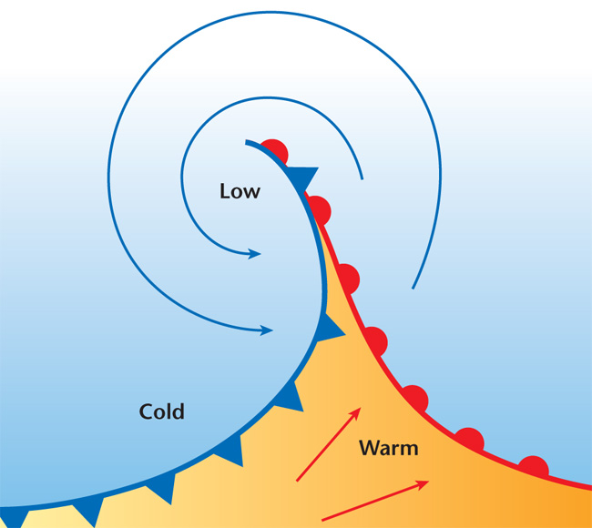
Pressure Systems
Weather Systems
Low-Pressure Systems
A wave cyclone, one of the main producers of inclement weather in the middle latitudes, usually begins along a stationary front.
Part of the front moves south as a cold front and another part of the front moves north as a warm front.
This sets up a counterclockwise or cyclonic circulation that can form into a fully developed low-pressure system.

Slide 34
End of Section 2

Slide 35
Objectives
Gathering Weather Data
Recognize the importance of accurate weather data.
Describe the technology used to collect weather data.
Analyze the strengths and weaknesses of weather observation systems.
Vocabulary
thermometer
barometer
anemometer
hygrometer
ceilometer
radiosonde
Doppler effect

Slide 36
Gathering Weather Data
Gathering Weather Data
Meteorologists measure the atmospheric variables of temperature, air pressure, wind, and relative humidity to make accurate weather forecasts.
Two of the most important factors in weather forecasting are the accuracy and the density of the data, or the amount of data available.

Slide 37
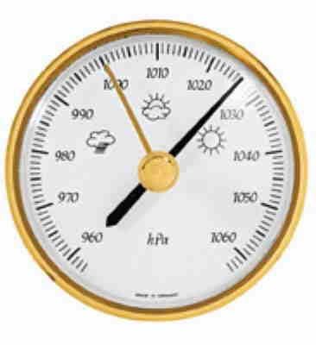
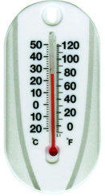
Surface Data
Gathering Weather Data
A thermometer is a device used to measure temperature.
A barometer is a device used to measure air pressure.

Slide 38
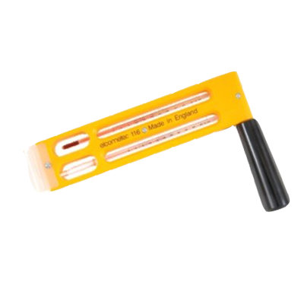
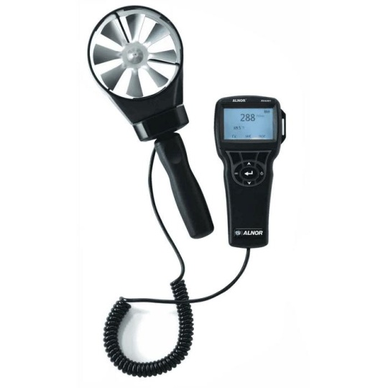
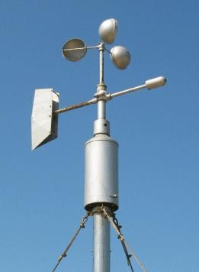
Surface Data
Gathering Weather Data
Other Surface Instruments
An anemometer is used to measure wind speed.
A hygrometer measures relative humidity.
One type of hygrometer uses the temperature differences between wet- and dry-bulb thermometers in conjunction with a relative humidity chart to determine relative humidity.

Slide 39
Surface Data
Gathering Weather Data
Automated Surface Observing System
The National Weather Service in the United States has established a surface observation network across the country made up of some 1700 official sites.
The network gathers data in a consistent manner at regular intervals—usually a minimum of once an hour—mainly through the Automated Surface Observing System (ASOS).
To supplement standard surface instruments, ASOS also uses a rain gauge and a ceilometer.
A ceilometer measures the height of cloud layers and estimates the amount of sky covered by clouds.

Slide 40
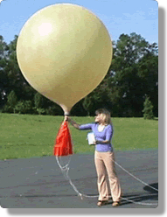
Upper-Level Data
Gathering Weather Data
To make accurate forecasts, meteorologists must gather atmospheric data at heights of up to 30 000 m.
A radiosonde, a balloon-borne package of sensors, is presently the instrument of choice for gathering upper-level data.
The sensors on a radiosonde measure temperature, air pressure, and humidity.
The radiosonde is also tracked to determine wind speed and direction at various altitudes.

Slide 41
Weather Radar
Gathering Weather Data
A weather radar system is used to pinpoint where rain is falling.
A radar system transmits electromagnetic waves that bounce, or scatter, off of large raindrops.
Receiving antennae receive the scattered waves, or echoes, which are then amplified.
A computer then processes the signals and displays them on a screen, allowing meteorologists to identify the location of the rain relative to the receiving antennae.

Slide 42
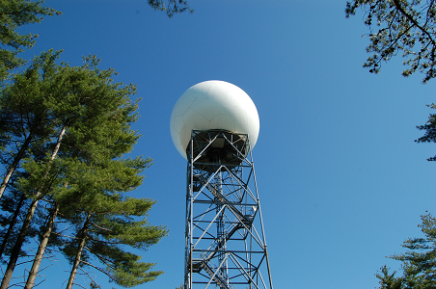

Slide 43
Weather Radar
Gathering Weather Data
Doppler Radar
The Doppler effect is the change in wave frequency that occurs in energy, such as sound or light, as that energy moves toward or away from an observer.
Meteorologists use Doppler radar, which is based on the Doppler effect, to plot the speed at which raindrops move toward or away from a radar station.
Because the motion of the moving raindrops is caused by wind, Doppler radar provides a good estimation of the wind speeds associated with precipitation areas, including those that are experiencing severe weather such as thunderstorms and tornados.

Slide 44
Weather Radar
Gathering Weather Data
Doppler Radar
As the train approaches, the sound waves ahead of it are compressed. These shorter waves have a high frequency, so the horn sounds high. Behind the train, the sound waves are stretched out. These longer waves have a lower frequency, so the horn sounds lower.

Slide 45
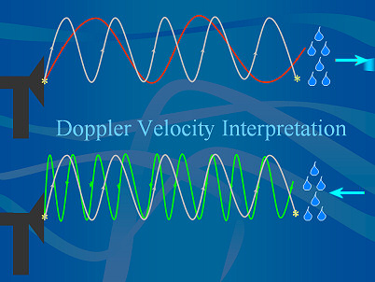
http://www.weather.gov/images/mkx/images/radar/dopplershift.jpg

Slide 46
Weather Satellites
Gathering Weather Data
In addition to communications, one of the main uses of satellites in orbit around Earth is to observe weather.
Cameras mounted aboard a weather satellite take photos of Earth at regular intervals.
Unlike weather radar, which tracks precipitation but not clouds, satellites track clouds but not necessarily precipitation.
By combining data from the two types of technology, meteorologists can determine where both clouds and precipitation are occurring.

Slide 47
Weather Satellites
Gathering Weather Data
Infrared Imagery
Weather satellites use both visible light and invisible radiation to observe the atmosphere.
Infrared imagery detects differences in thermal energy, which are used to map either cloud cover or surface temperatures.
Infrared images allow meteorologists to determine the temperature of a cloud, and thus, infer what type it is and estimate its height.
Because the strength of a thunderstorm is related to its height, infrared imagery can be used to establish a storm’s potential to produce severe weather.

Slide 48
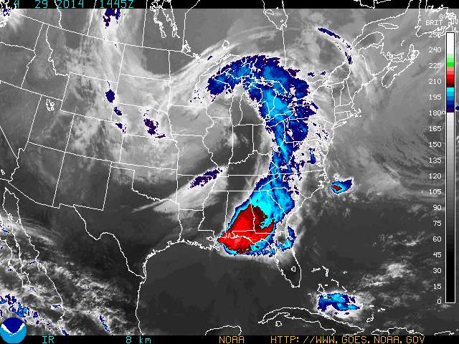

Slide 49
End of Section 3

Slide 50
Objectives
Weather Analysis
Analyze a basic surface weather chart.
Distinguish between analog and digital forecasting.
Describe problems with long-term forecasts.
Vocabulary
station model
isopleth
digital forecast
analog forecast

Slide 51
Surface Analysis
Weather Analysis
To plot data nationwide or globally, meteorologists use isopleths.
Isopleths are lines that connect points of equal values, such as pressure or temperature.
Lines of equal pressure are called isobars.
Lines of equal temperature are called isotherms.

Slide 52
Surface Analysis
Weather Analysis
You can make inferences about weather by studying isobars or isotherms on a map.
You can tell how fast wind is blowing in an area by noting how closely isobars are spaced.
Isobars that are close together indicate a large pressure difference over a small area and thus, strong winds.
Isobars that are spread far apart indicate a small difference in pressure which equates to light winds.

Slide 53
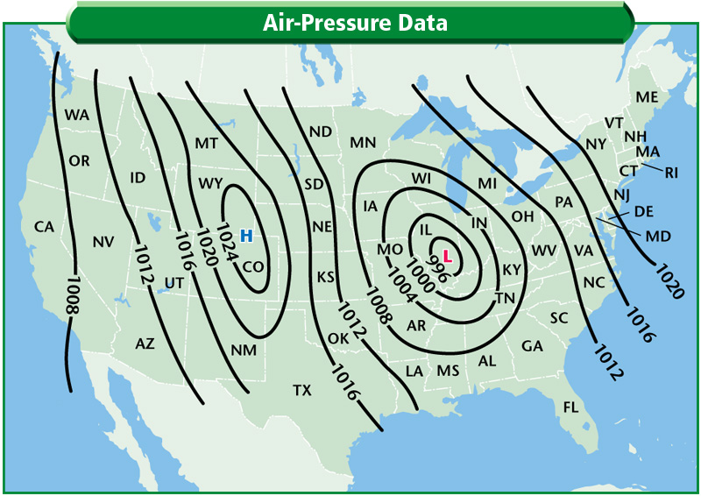
Weather Analysis
Isobars also indicate the locations of high- and low-pressure systems.
Isobars that are close together indicate high winds.

Slide 54
Short-Term Forecasts
Weather Analysis
Weather systems change directions, speed, and intensity with time in response to changes in the upper atmosphere.
A reliable forecast must analyze data from different levels in the atmosphere.

Slide 55
Short-Term Forecasts
Weather Analysis
Digital Forecasts
The atmosphere behaves much like a fluid and shares many of the same principles.
These principles can be expressed in mathematical equations to determine how atmospheric variables change with time.
A digital forecast is a forecast that relies on numerical data.
Digital forecasting is the main method used by modern meteorologists and it is highly dependent on the density of the data available.

Slide 56
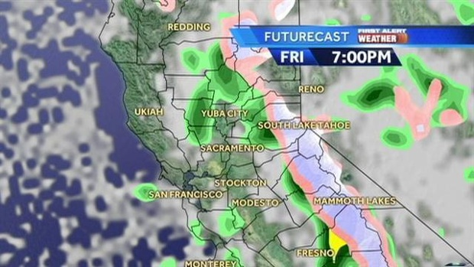

Slide 57
Short-Term Forecasts
Weather Analysis
Analog Forecasts
An analog forecast involves comparing current weather patterns to patterns that took place in the past on the assumption that weather systems will behave in a similar fashion.
Analog forecasting is so called because meteorologists look for a pattern from the past that is analogous, or similar to, a current pattern.
Analog forecasting is useful for conducting monthly or seasonal forecasts, which are based mainly on the past behavior of cyclic weather patterns.

Slide 58
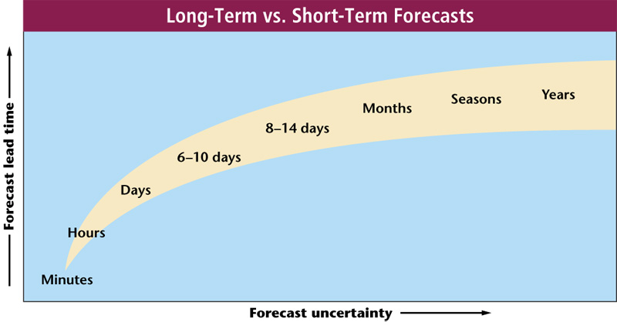
Long-Term Forecasts
Weather Analysis
Because of the number of variables involved, forecasts become less reliable when they attempt to predict long-term changes in the weather.

Slide 59
Long-Term Forecasts
Weather Analysis
The most accurate and detailed forecasts are short-term in nature.
For hourly forecasts, extrapolation is a reliable forecasting method.
Forecasts in the one- to three-day range are dependent on the behavior of larger surface and upper-level features, such as low-pressure systems.
At this range, the forecast can somewhat accurately predict the overall weather but it will not be able to pinpoint an exact temperature or sky condition at a specific time.

Slide 60
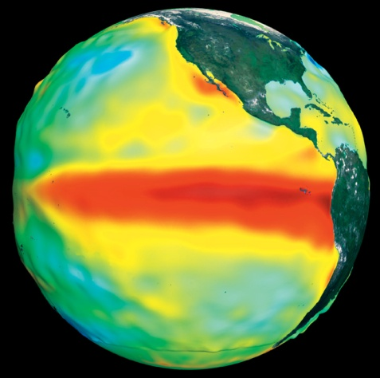
Long-Term Forecasts
Weather Analysis
Accuracy Declines with Time
At the four- to seven-day range, forecasts must attempt to predict changes in surface weather systems based on circulation patterns throughout the troposphere and lower stratosphere.
At the one- to two-week range, forecasts are based on changes in large-scale circulation patterns.
Long-term forecasts involving months and seasons are based largely on patterns or cycles involving changes in the atmosphere, ocean currents, and solar activity.

Slide 61
End of Section 4

Slide 62
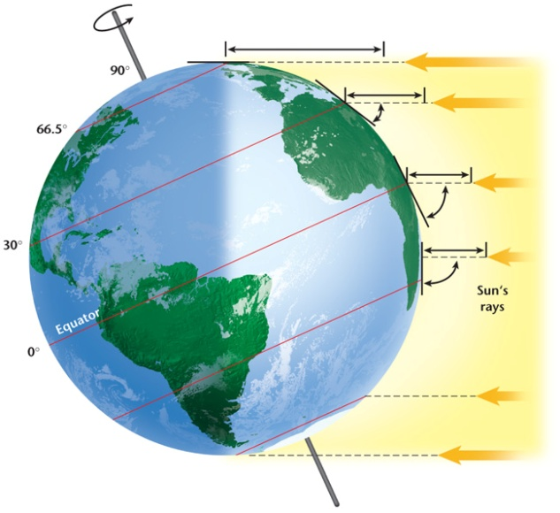
Chapter 12 Images
Image Bank

Slide 63
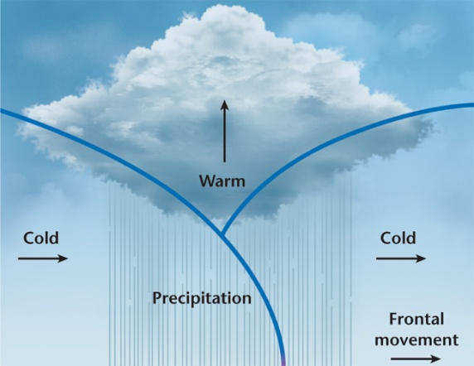
Chapter 12 Images
Image Bank

Slide 64
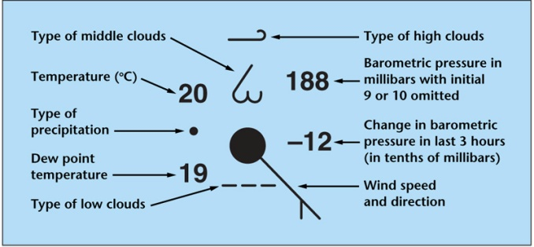
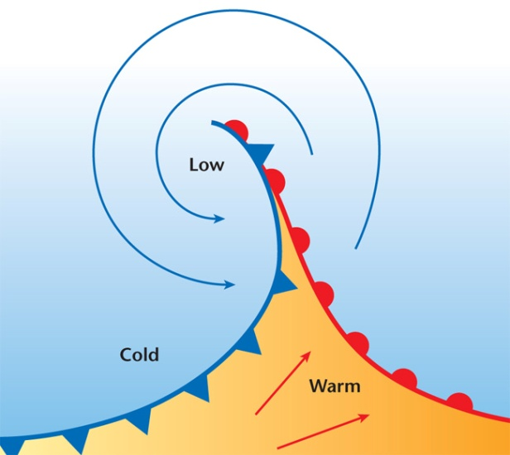
Chapter 12 Images
Image Bank

