Slide 1
Circular Motion
Prepared by
Dedra Demaree, Georgetown University

Slide 2
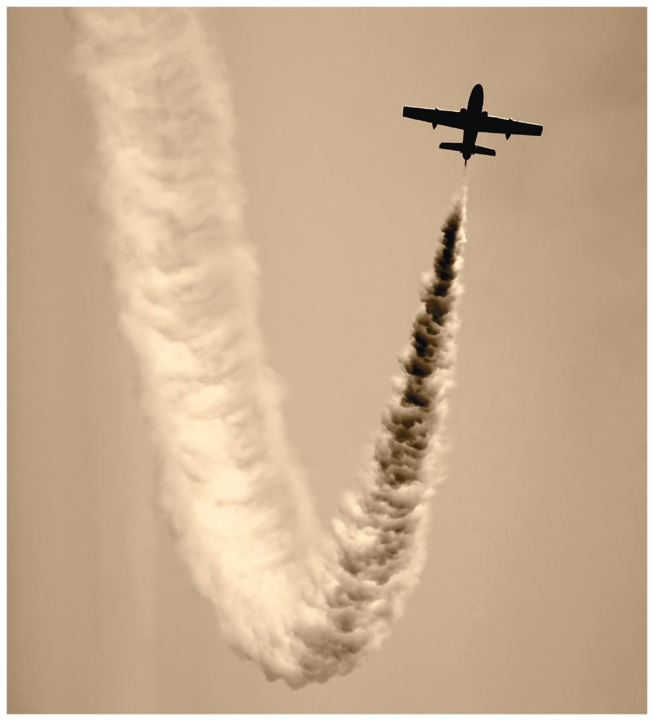
Circular Motion
Why do pilots sometimes black out while pulling out at the bottom of a power dive?
Are astronauts really "weightless" while in orbit?
Why do you tend to slide across the car seat when the car makes a sharp turn?

Slide 3
Be sure you know how to:
Find the direction of acceleration using a motion diagram (Section 1.6).
Draw a force diagram (Section 2.1).
Use a force diagram to help apply Newton's second law in component form (Sections 3.1 and 3.2).

Slide 4
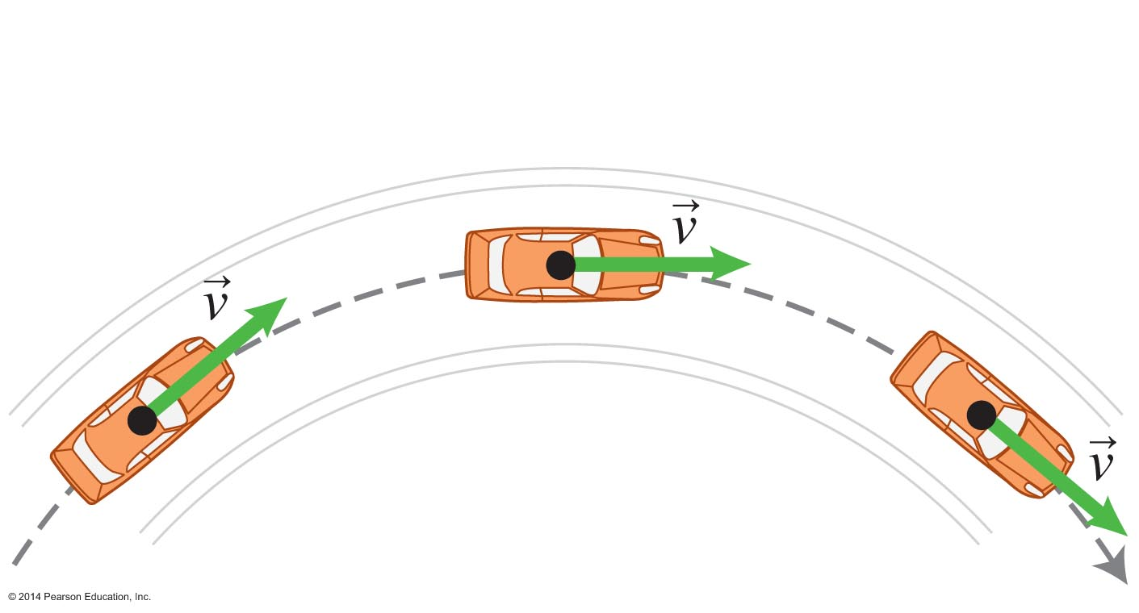
Forces in more complex situations
First we addressed constant forces that act along only one axis (Chapter 2).
Then we addressed constant forces along two dimensions (Chapter 3).
Most forces are not constant; they can change in both magnitude and direction.
Now we deal with the simplest case of continually changing forces: circular motion.

Slide 5
The qualitative velocity change method for circular motion
Instantaneous velocity is tangent to the displacement for any instant.
In circular motion, the system object travels in a circle and the velocity is tangent to the circle at every instant.
Even if an object is moving at constant speed around a circle, its velocity changes direction.
A change in velocity means there is acceleration!

Slide 6
Using the velocity change method to estimate the direction of acceleration
This method is used to estimate the direction of acceleration of any object during a short time interval Δt = t_{f} – t_{i}.

Slide 7
Tips for using the velocity change method
Make sure that you choose initial and final points at the same distance before and after the point at which you are estimating the acceleration direction.
Draw long velocity arrows so that when you put them tail to tail, you can clearly see the direction of the velocity change arrow.
Make sure that the velocity change arrow points from the head of the initial velocity to the head of the final velocity.

Slide 8
Conceptual Exercise 4.1: Direction of a racecar's acceleration
Determine the direction of the racecar's acceleration at points A, B, and C in the figure as the racecar travels at constant speed on the circular path.
Notes:
This is left for the instructor to solve for students

Slide 9
Testing Experiment 1: The sum of the forces exerted on an object moving at constant speed along a circular path points toward the center of that circle in the same direction as the object's acceleration

Slide 10
Testing Experiment 2: The sum of the forces exerted on an object moving at constant speed along a circular path points toward the center of that circle in the same direction as the object's acceleration

Slide 11
Newton's second law and circular motion
The results of our experiments are consistent with our hypothesis.
The sum of the forces exerted on an object moving at constant speed along a circular path points toward the center of that circle in the same direction as the object's acceleration.
Tip: when the object moves at constant speed along the circular path, the net force has no tangential component.

Slide 12
Testing Experiment 1: The sum of the forces exerted on an object moving at constant speed along a circular path points toward the center of that circle in the same direction as the object's acceleration
What is the predicted outcome of this experiment based on the hypothesis?
Which outcome is observed, and does it match the prediction?

Slide 13
Determining the factors that might affect acceleration
Imagine our experience in a car following the circular curve of a highway.
The faster the car moves along a highway curve, the greater the risk that the car will skid off the road.
The tighter the turn radius (r), the greater the risk that the car will skid.
We guess the acceleration depends on v and r.

Slide 14
Dependence of acceleration on speed

Slide 15
Dependence of acceleration on speed

Slide 16
Dependence of acceleration on speed

Slide 17
Dependence of acceleration on speed
Use the velocity kinematics relationship between change in velocity and acceleration to devise a mathematical relationship between radial acceleration and velocity by considering:
An object moving in a circle with radius r and speed v
An object moving in the same circle with radius r but twice as fast (speed 2v)
An object moving in the same circle with radius r but three times as fast (speed 3v)

Slide 18
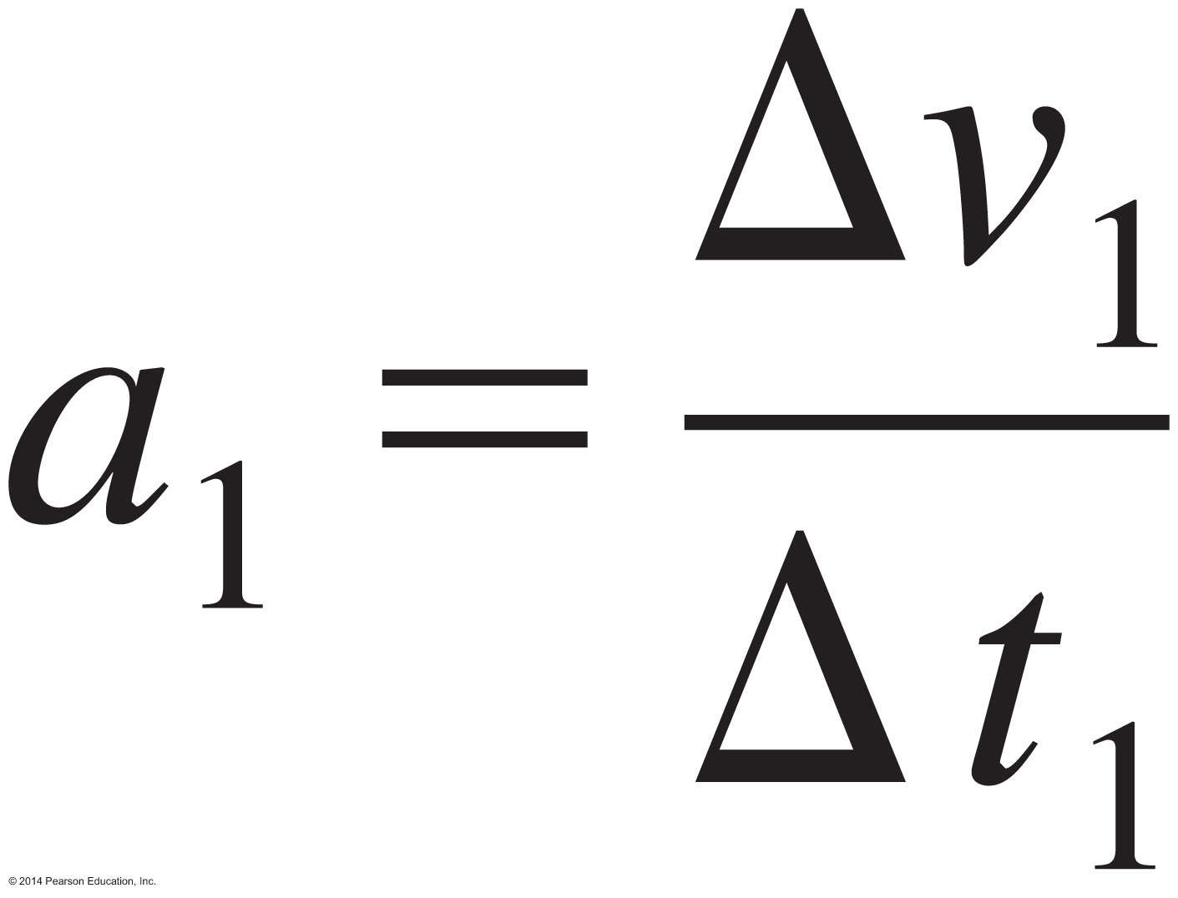
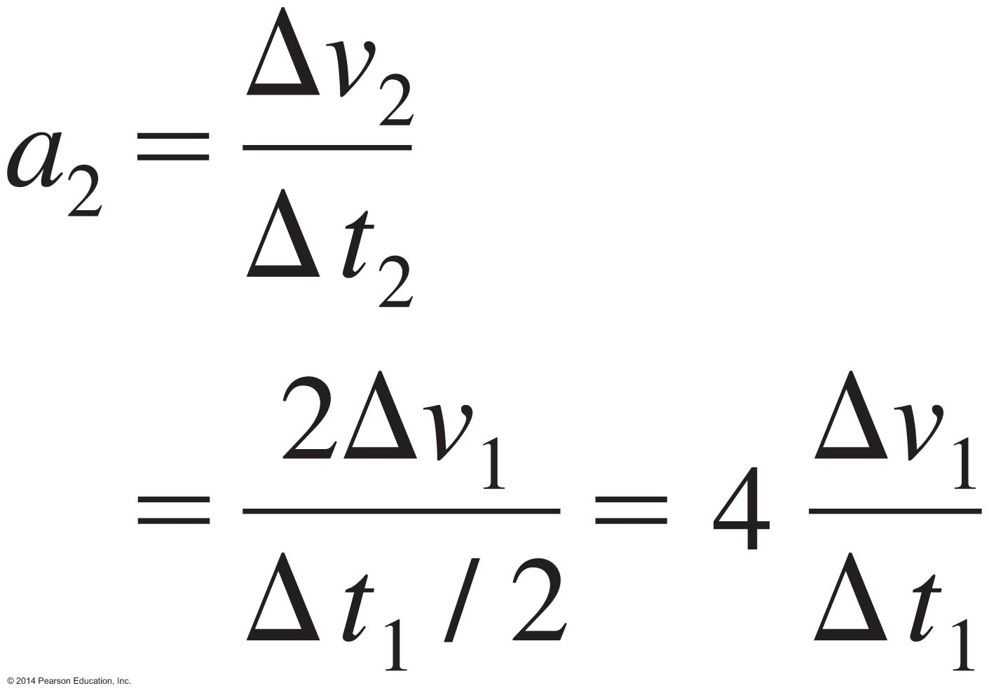
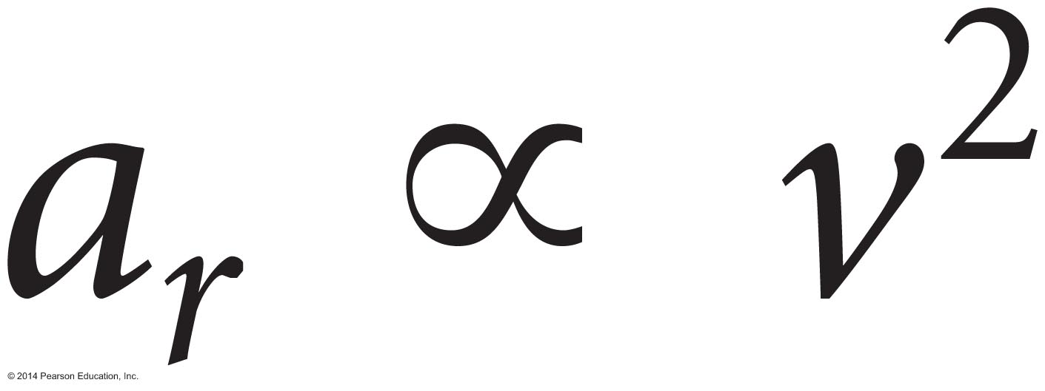
Dependence of acceleration on speed
An object moving in a circle with radius r and speed v that has acceleration:
An object moving in the same circle with radius r but twice as fast (speed 2v):
An object moving in the same circle with radius r but three times as fast (speed 3v):
We find the following pattern:

Slide 19
Dependence of acceleration on radius

Slide 20
Dependence of acceleration on radius

Slide 21
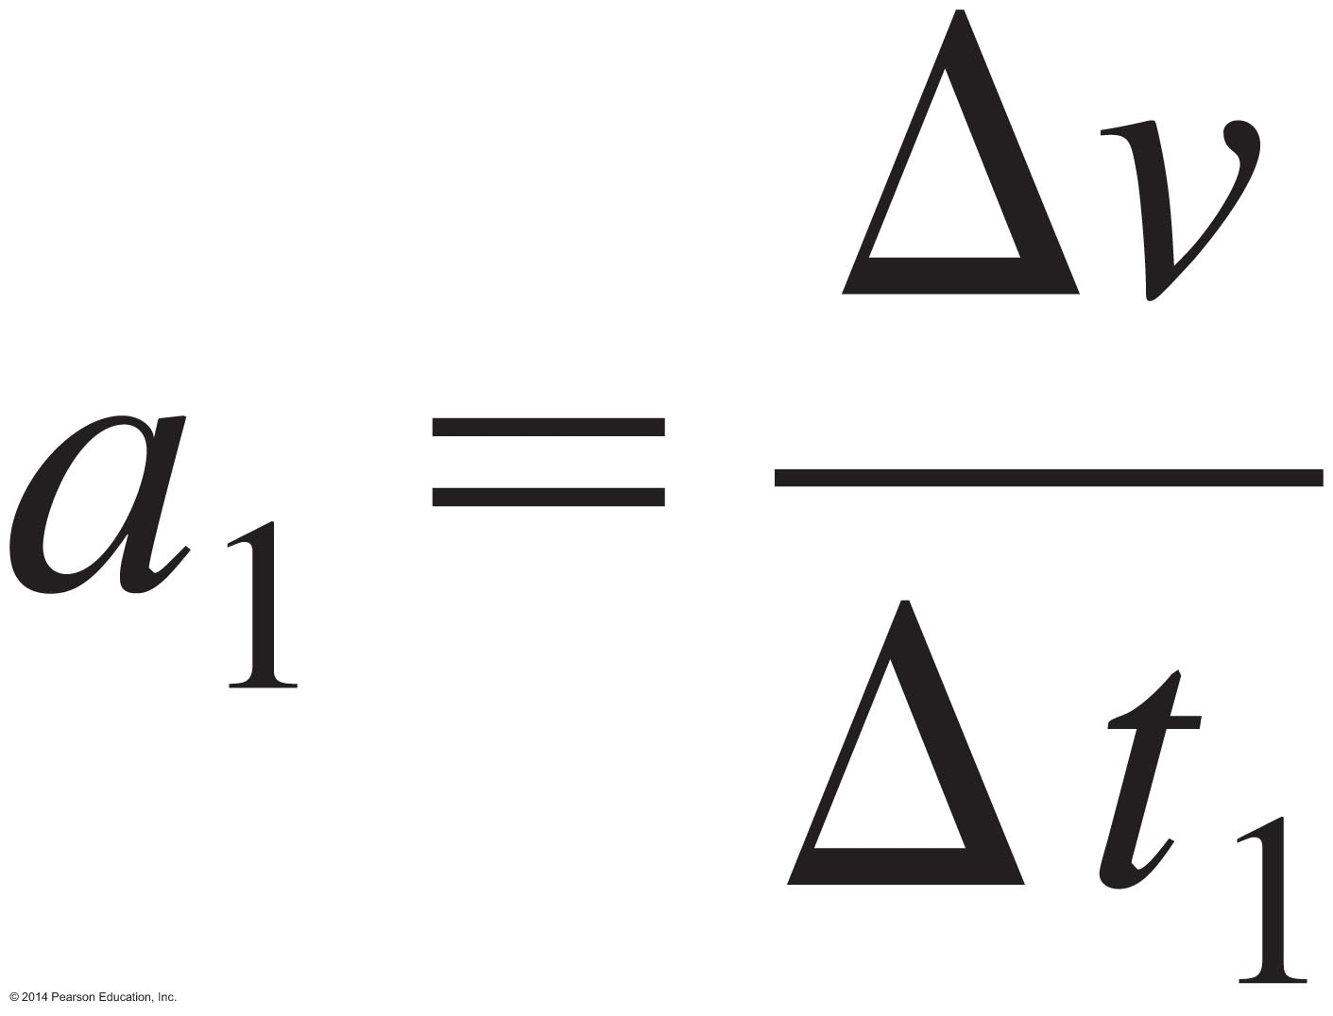
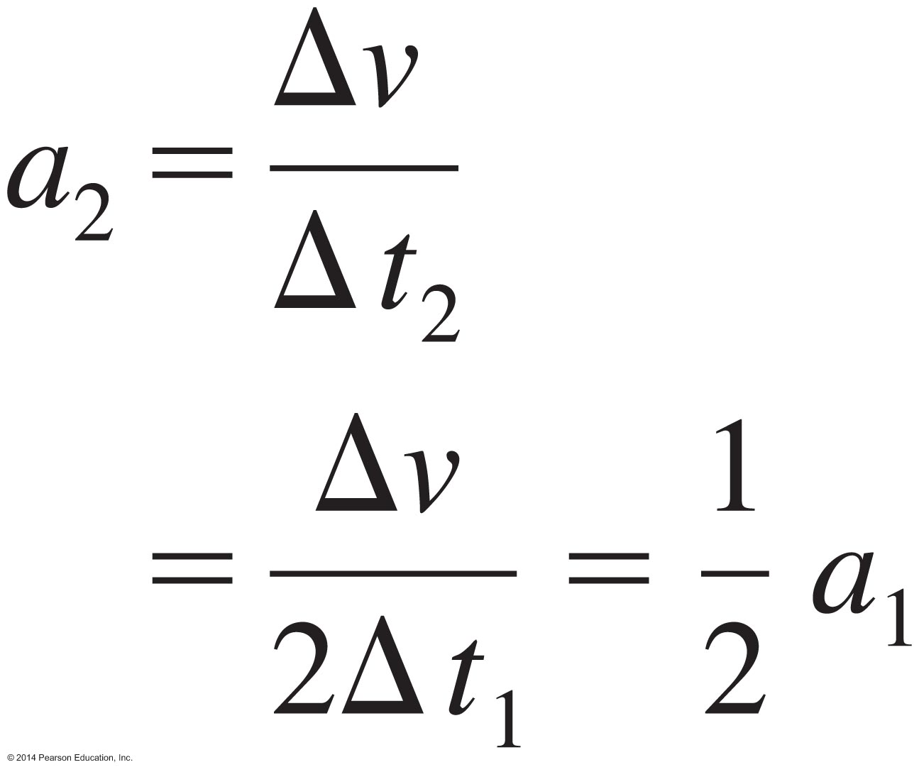
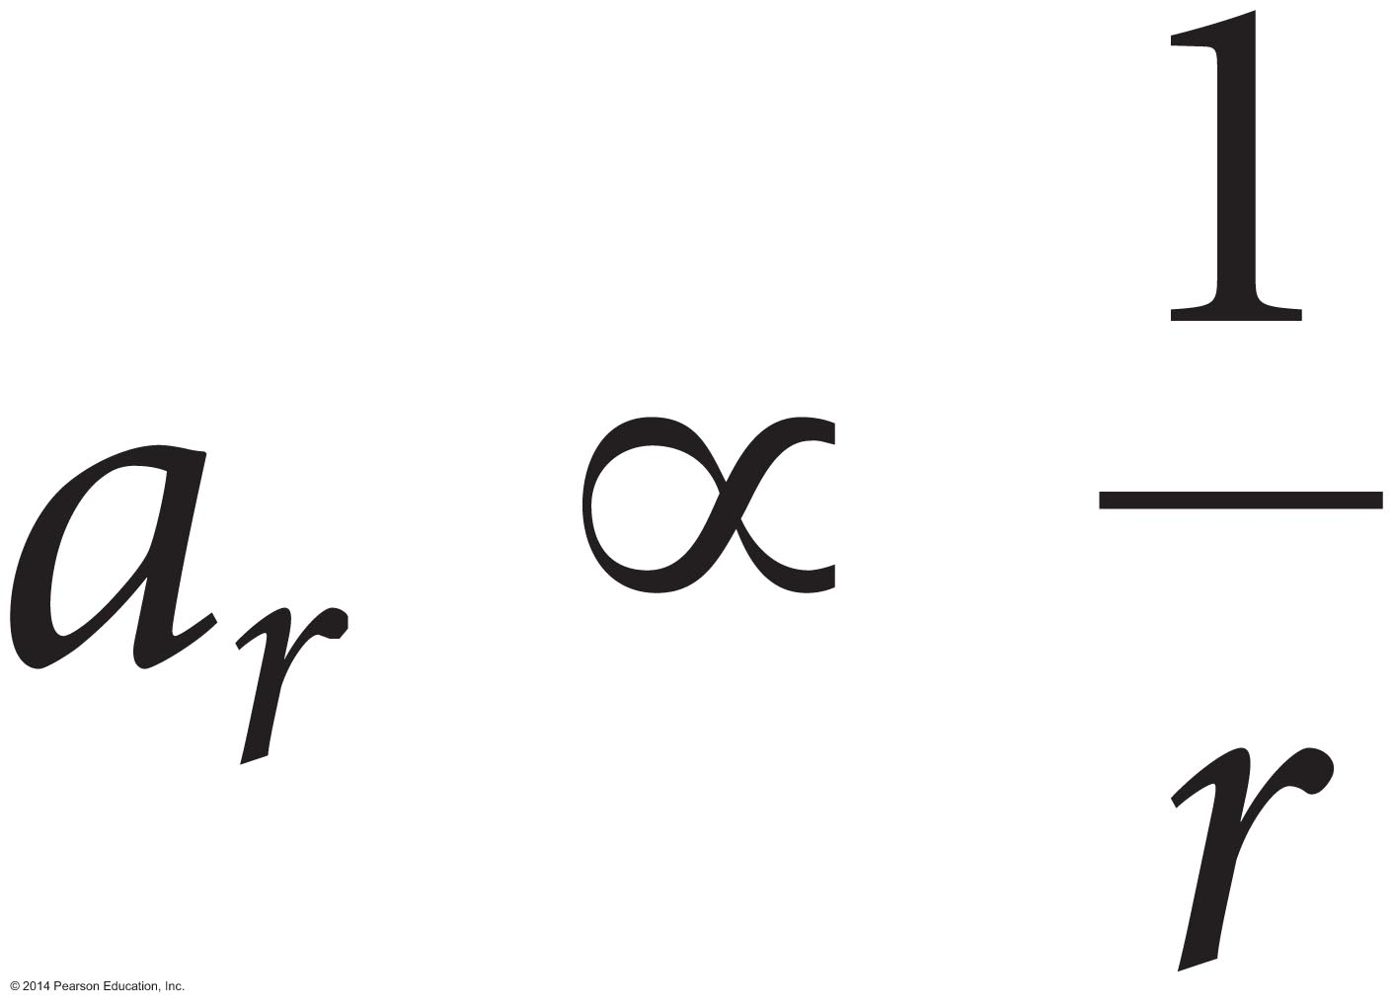
Dependence of acceleration on radius
An object moving in a circle with radius r and speed v that has acceleration:
An object moving in a circle with radius 2r but at the same speed v:
We find the following pattern:

Slide 22
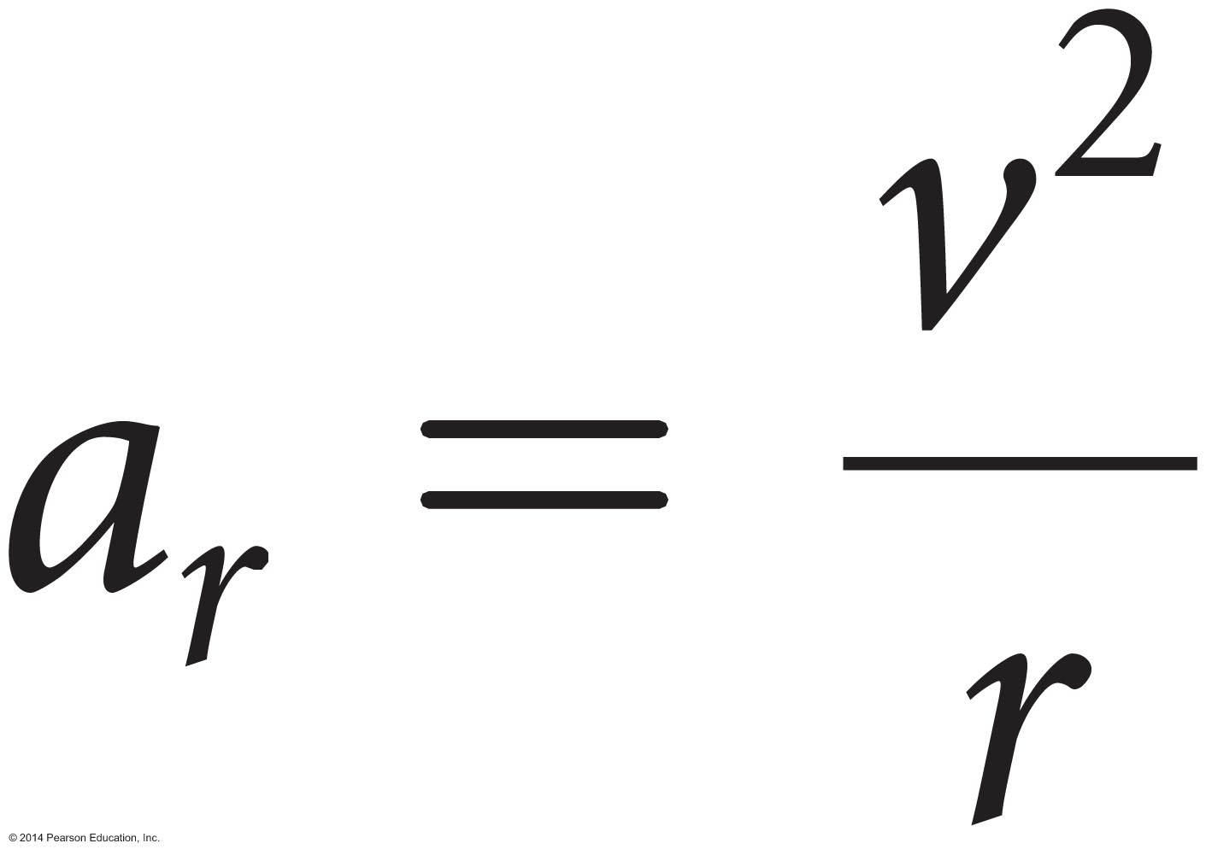
Radial acceleration: An object at constant speed v on a circular path of radius r
Based on our testing experiments, we found:
The constant of proportionality is 1, so we can define the radial acceleration as:
The acceleration points toward the center.
The SI units are m/s².
In the limiting case of a straight line, the radius goes to infinity and the acceleration goes to zero. This equation makes sense.

Slide 23
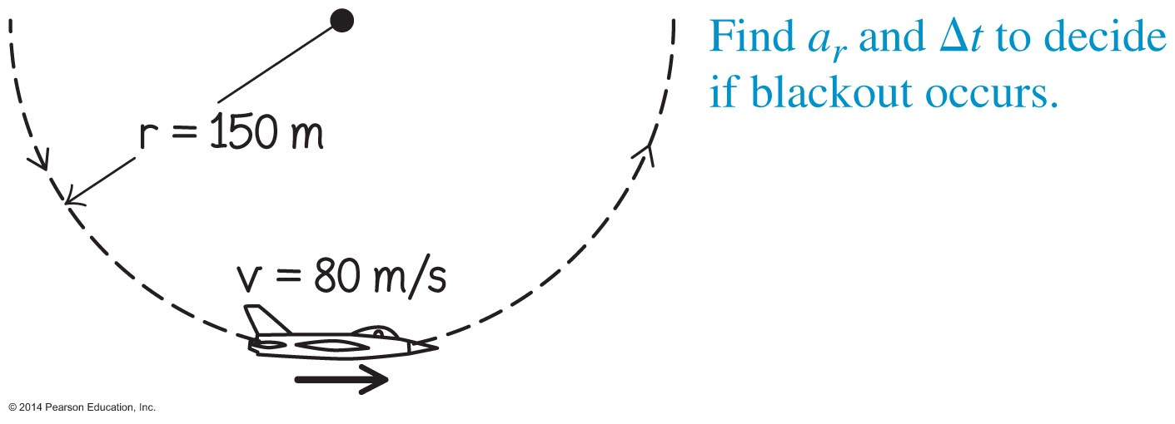
Example 4.2: Blackout
When a fighter pilot pulls out from the bottom of a power dive, his body moves at high speed along a segment of an upward-bending, approximately circular path. While his body moves up, his blood tends to move straight ahead (tangent to the circle) and begins to fill the easily expandable veins in his legs. This can deprive his brain of blood and cause a blackout if the radial acceleration is 4 g or more and lasts several seconds.
During a dive, an airplane moves at a modest speed of v = 80 m/s through a circular arc of radius r = 150 m. Is the pilot likely to black out?
Notes:
I'm leaving this for the instructor to solve

Slide 24
Example 4.2: Blackout
When a fighter pilot pulls out from the bottom of a power dive, his body moves at high speed along a segment of an upward-bending approximately circular path. While his body moves up, his blood begins to fill the easily expandable veins in his legs. This can deprive his brain of blood and cause a blackout if the radial acceleration is 4 g or more and lasts several seconds.
Simplify and diagram
Sketch and translate
Represent mathematically

Slide 25
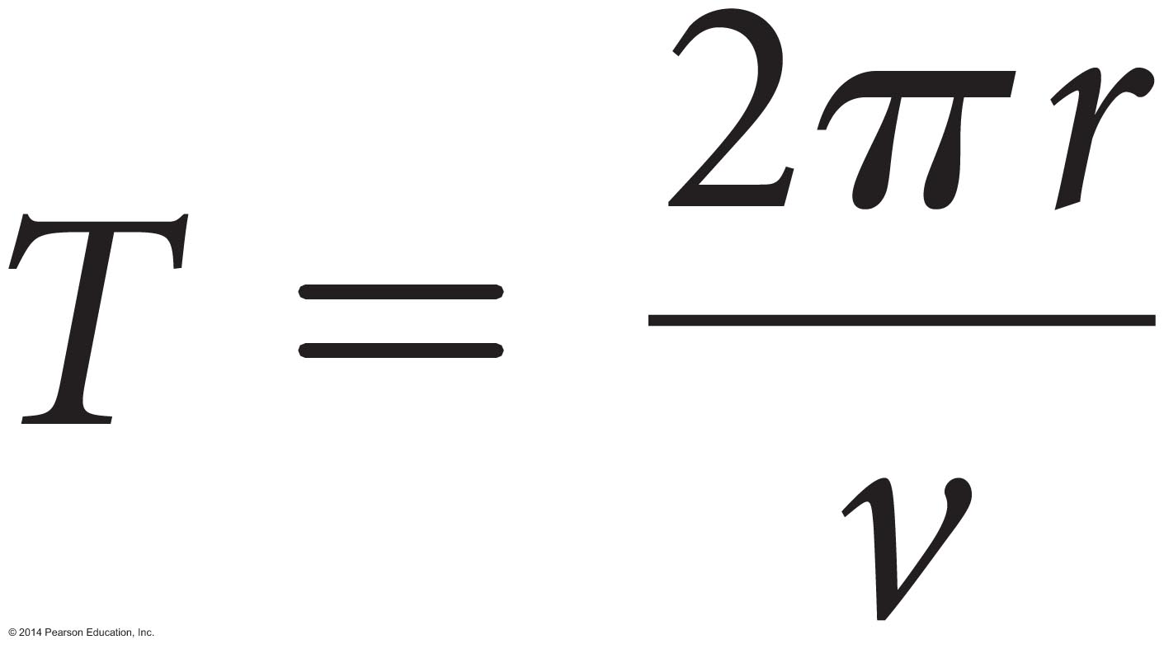
Period
Period is the time interval it takes an object to travel around an entire circular path one time.
Period has units of time, so the SI unit is s.
For constant-speed circular motion, we divide the distance traveled in one period (the circumference of the circular path, 2πr) by the time interval T (its period) to get:
Do not confuse the symbol T for period with the symbol T for the tension force.

Slide 26
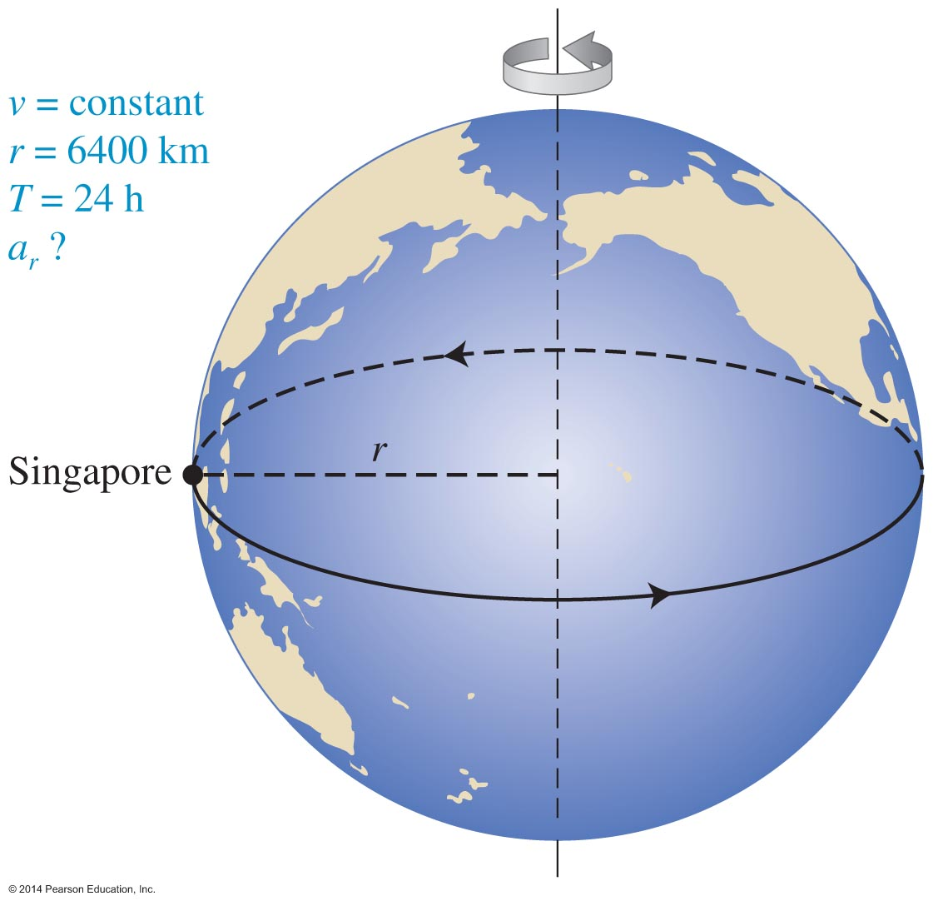
Quantitative Exercise 4.3: Singapore hotel
What is your radial acceleration when you sleep in a hotel in Singapore at Earth's equator?
Remember that Earth turns on its axis once every 24 hours, and everything on the planet's surface actually undergoes constant-speed circular motion with a period of 24 hours.
Notes:
I leave this for the instructor to solve

Slide 27
Quantitative Exercise 4.3: Singapore hotel
We want to determine your radial acceleration when you sleep in a hotel in Singapore at Earth's equator.
Earth turns on its axis once every 24 hours, and everything on its surface actually undergoes constant-speed circular motion with a period of 24 hours.
Represent this situation mathematically, THEN solve and evaluate.

Slide 28
Is Earth a noninertial reference frame?
Newton's laws are valid only for observers in inertial reference frames (nonaccelerating observers).
Observers on Earth's surface are accelerating due to Earth's rotation.
Does this mean that Newton's laws do not apply?
The acceleration due to Earth's rotation is much smaller than the accelerations we experience from other types of motion.
In most situations, we can assume that Earth is not rotating and, therefore, does count as an inertial reference frame.

Slide 29
Circular motion component form of Newton's second law

Slide 30
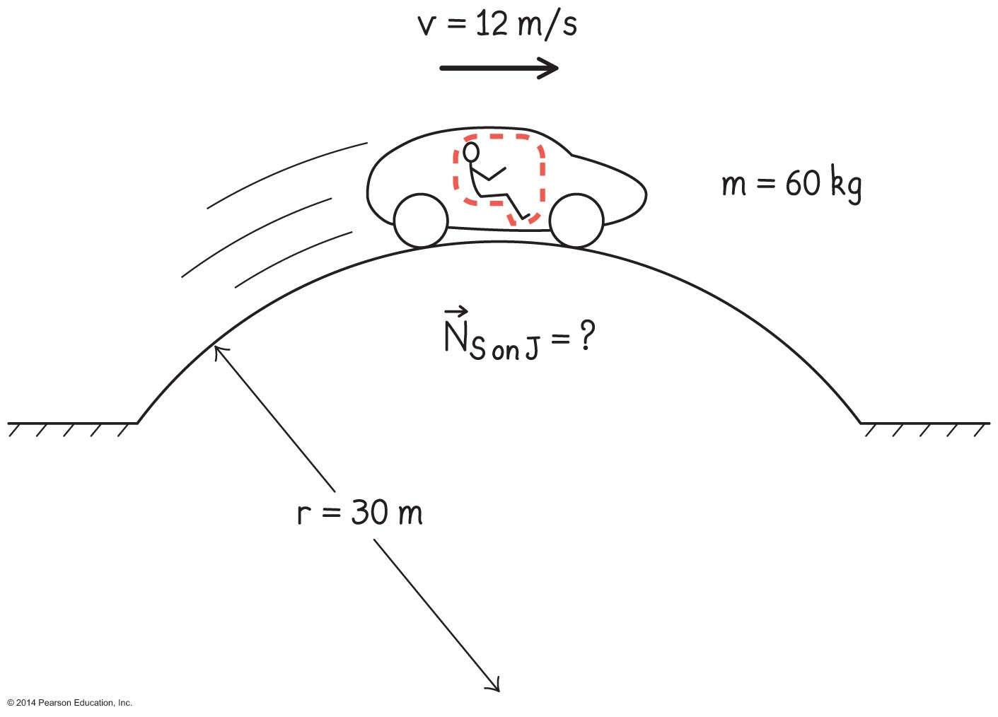
Problem-solving strategy: Processes involving constant-speed circular motion
Sketch and translate
Sketch the situation described in the problem statement. Label it with all relevant information.
Choose a system object and a specific position to analyze its motion.

Slide 31
Problem-solving strategy: Processes involving constant-speed circular motion
Simplify and diagram
Decide if the system can be modeled as a point-like object.
Determine if the constant-speed circular motion approach is appropriate.
Indicate with an arrow the direction of the object's acceleration as it passes the chosen position.
Draw a force diagram for the system object at the instant it passes that position.
On the force diagram, draw an axis in the radial direction toward the center of the circle.

Slide 32
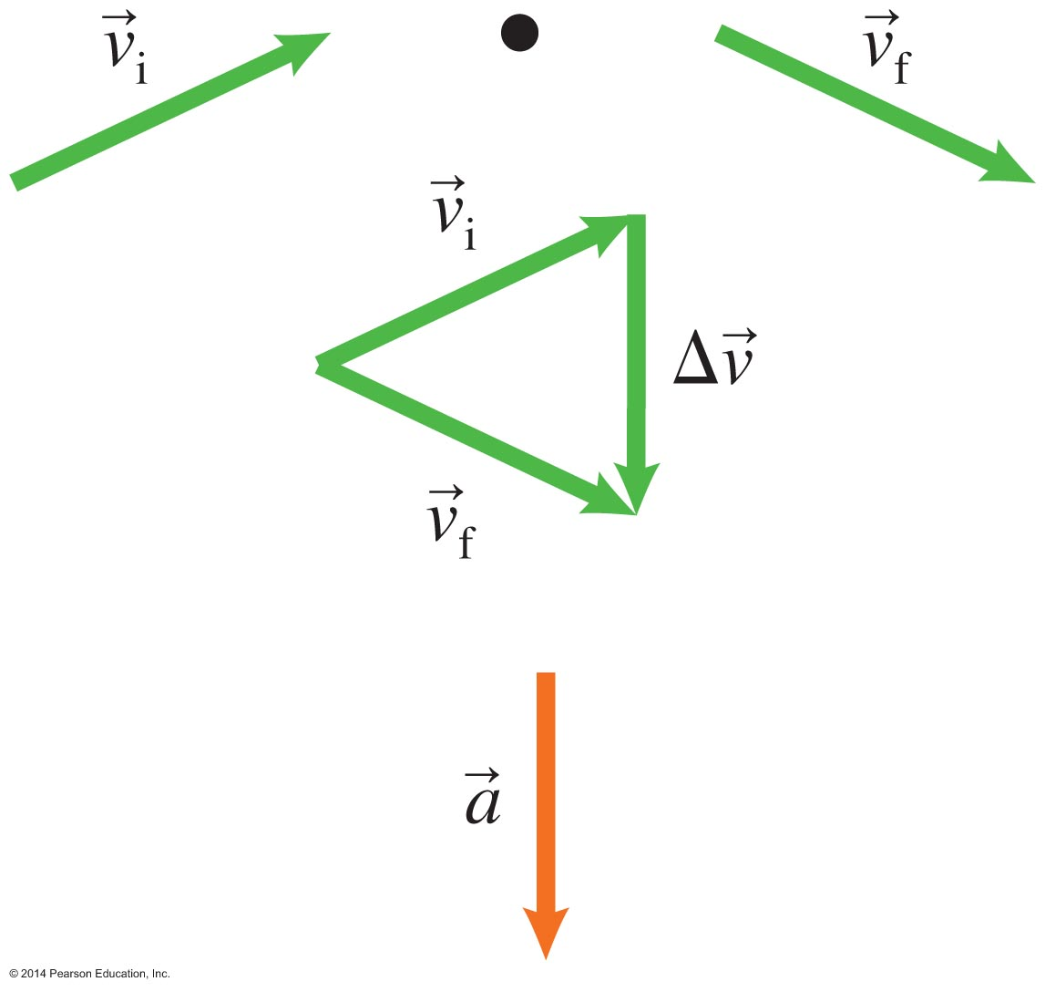
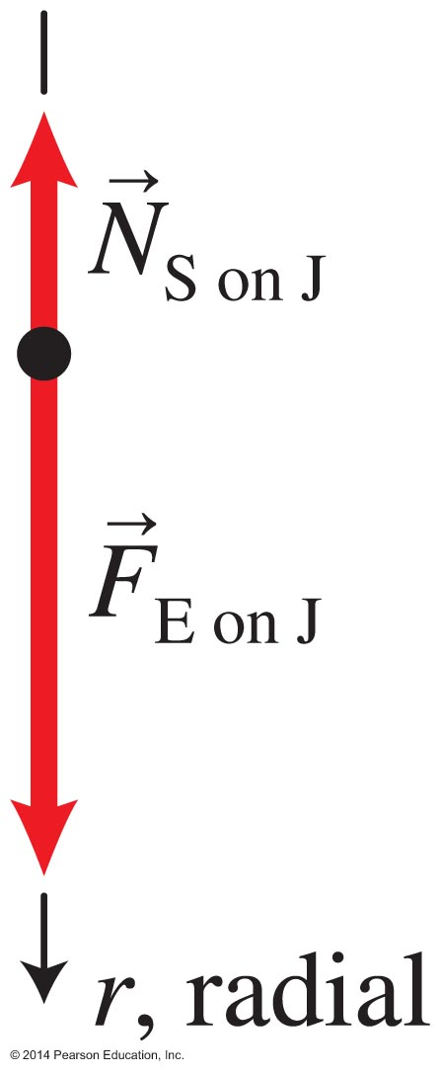
Problem-solving strategy: Processes involving constant-speed circular motion (Cont'd)

Slide 33
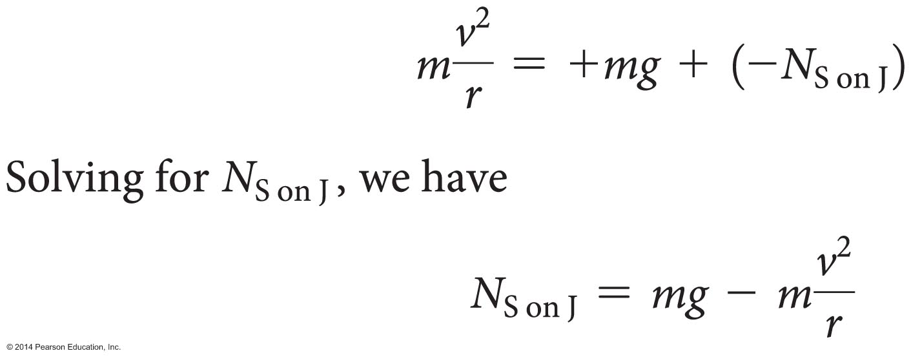
Problem-solving strategy: Processes involving constant-circular motion
Represent mathematically
Convert the force diagram into the radial r-component form of Newton's second law.
For objects moving in a horizontal circle (unlike this example), you may also need to apply a vertical y-component form of Newton's second law.

Slide 34
Problem-solving strategy: Processes involving constant-speed circular motion
Solve and evaluate
Solve the equations formulated in the previous two steps.
Evaluate the results to see if they are reasonable (e.g., the magnitude of the answer, its units, limiting cases).

Slide 35
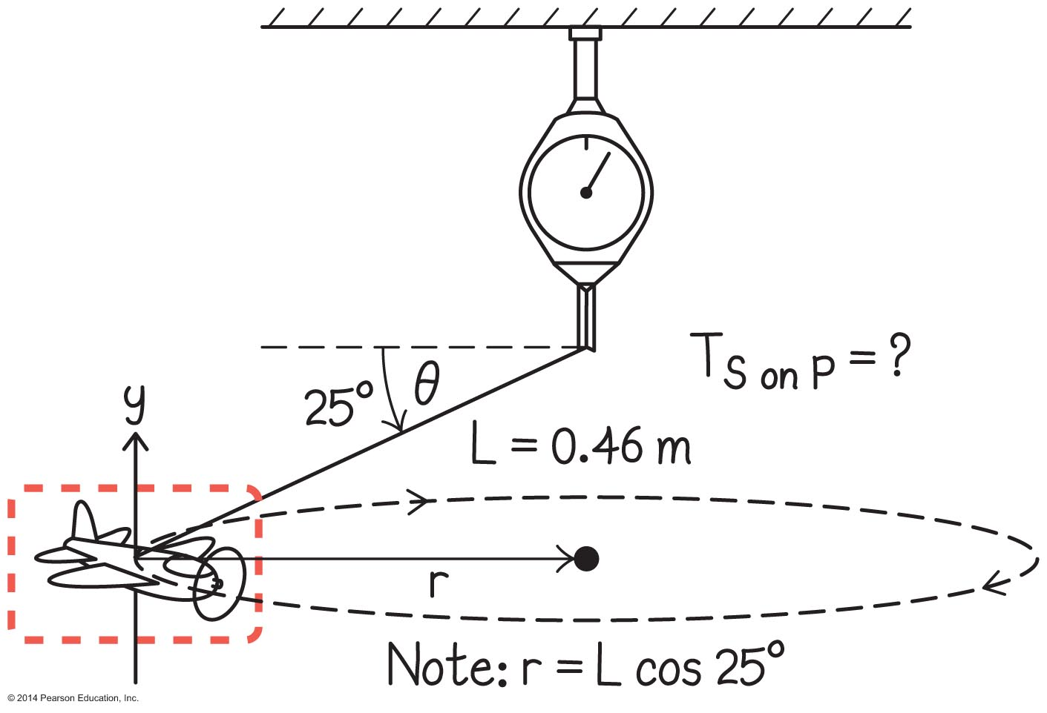
Example 4.5: Toy airplane
A toy airplane flies around in a horizontal circle at constant speed. The airplane is attached to the end of a 46-cm string, which makes a 25° angle relative to the horizontal while the airplane is flying. A scale at the top of the string measures the force that the string exerts on the airplane.
Predict the period of the airplane's motion (the time interval for it to complete one circle).
Notes:
This is left for the instructor to solve

Slide 36
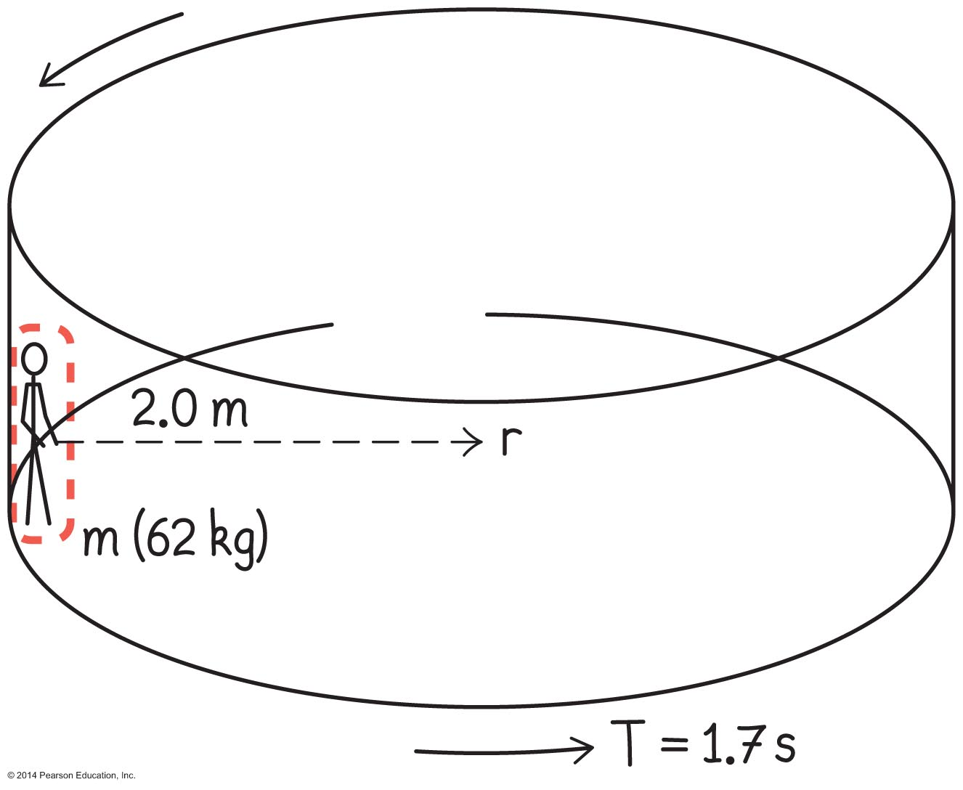
Example 4.6: Rotor ride
A 62-kg woman is a passenger in a rotor ride. A drum of radius 2.0 m rotates at a period of 1.7 s. When the drum reaches this turning rate, the floor drops away but the woman does not slide down the wall. Imagine that you were one of the engineers who designed this ride.
Which characteristics would ensure that the woman remained stuck to the wall?
Justify your answer quantitatively.

Slide 37
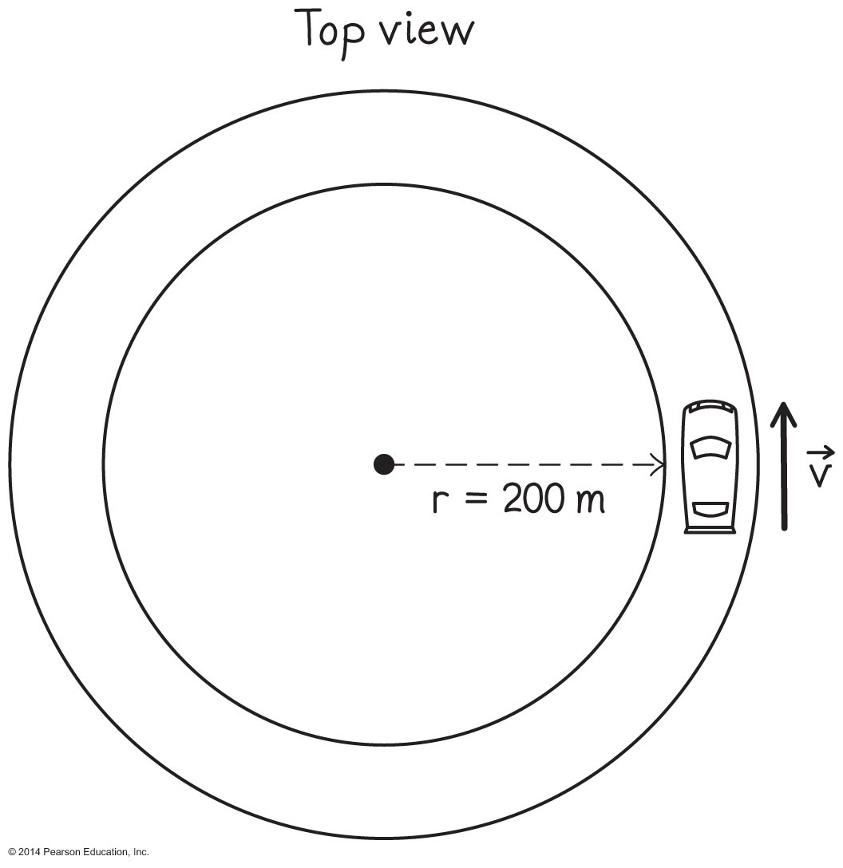
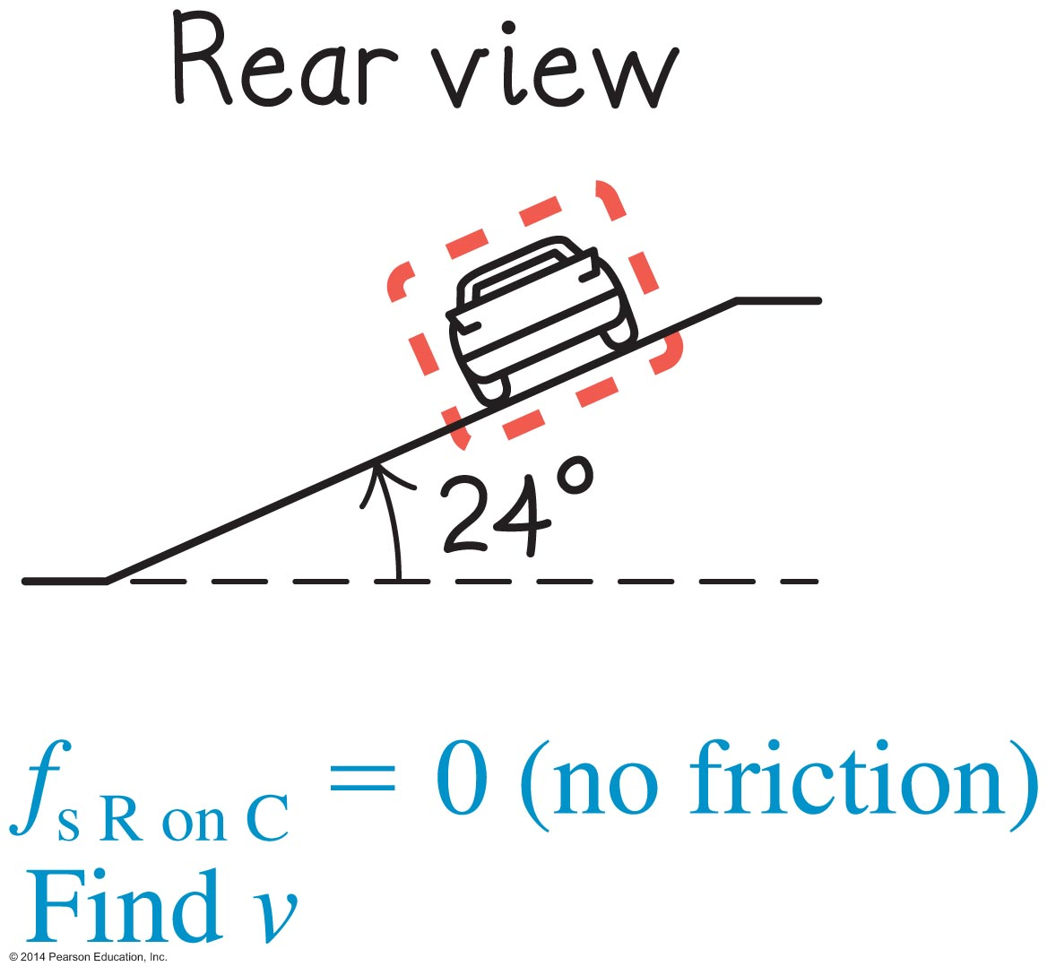
Example 4.7: Texas Motor Speedway
Texas Motor Speedway is a 2.4-km (1.5-mile)-long oval track. One of its turns is about 200 m in radius and is banked at 24° above the horizontal.
How fast would a car have to move so that no friction is needed to prevent it from sliding sideways off the raceway (into the infield or off the track)?

Slide 38
Tip for circular motion
There is no special force that causes the radial acceleration of an object moving at constant speed along a circular path.
This acceleration is caused by all of the forces exerted on the system object by other objects.
Add the radial components of these regular forces.
This sum is what causes the radial acceleration of the system object.

Slide 39
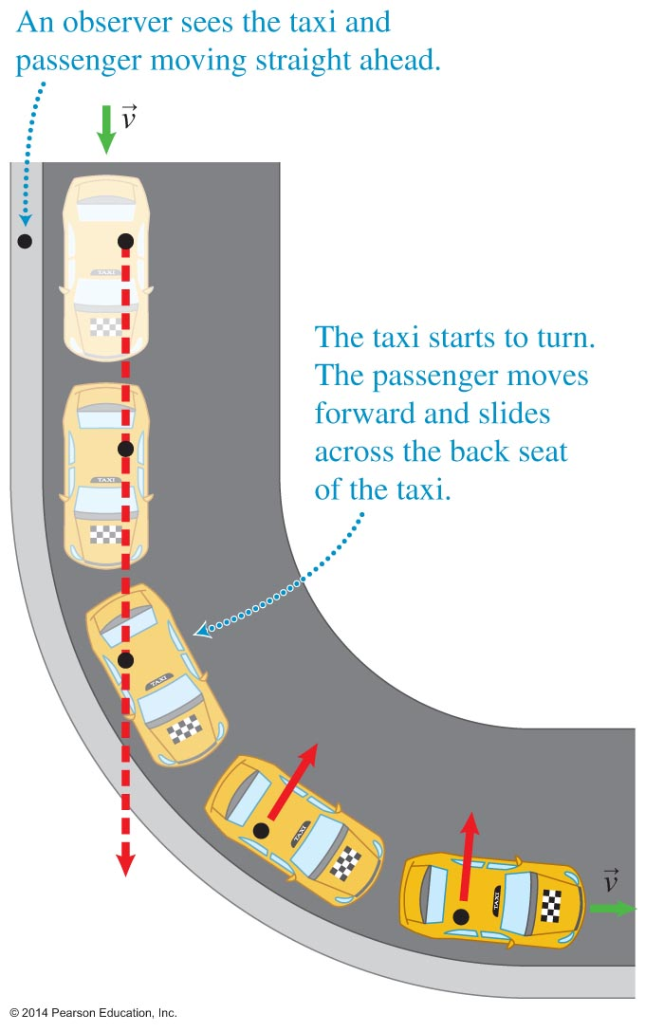
Conceptual difficulties with circular motion
When sitting in a car that makes a sharp turn, you feel thrown outward, inconsistent with the idea that the net force points toward the center of the circle (inward).

Slide 40
Conceptual difficulties with circular motion (Cont'd)
Because the car is accelerating as it rounds the curve, passengers in the car are not in an inertial reference frame.
A roadside observer would see the car turn left and you continue to travel straight because the net force exerted on you is zero.

Slide 41
Observations and explanations of planetary motion
Newton was among the first to hypothesize that the Moon moves in a circular orbit around Earth because Earth pulls on it, continuously changing the direction of the Moon's velocity.
He wondered if the force exerted by Earth on the Moon was the same type of force that Earth exerted on falling objects, such as an apple falling from a tree.

Slide 42
Observations and explanations of planetary motion
Newton compared the acceleration of the Moon if it could be modeled as a point particle near Earth's surface to the acceleration of the moon observed in its orbit:

Slide 43
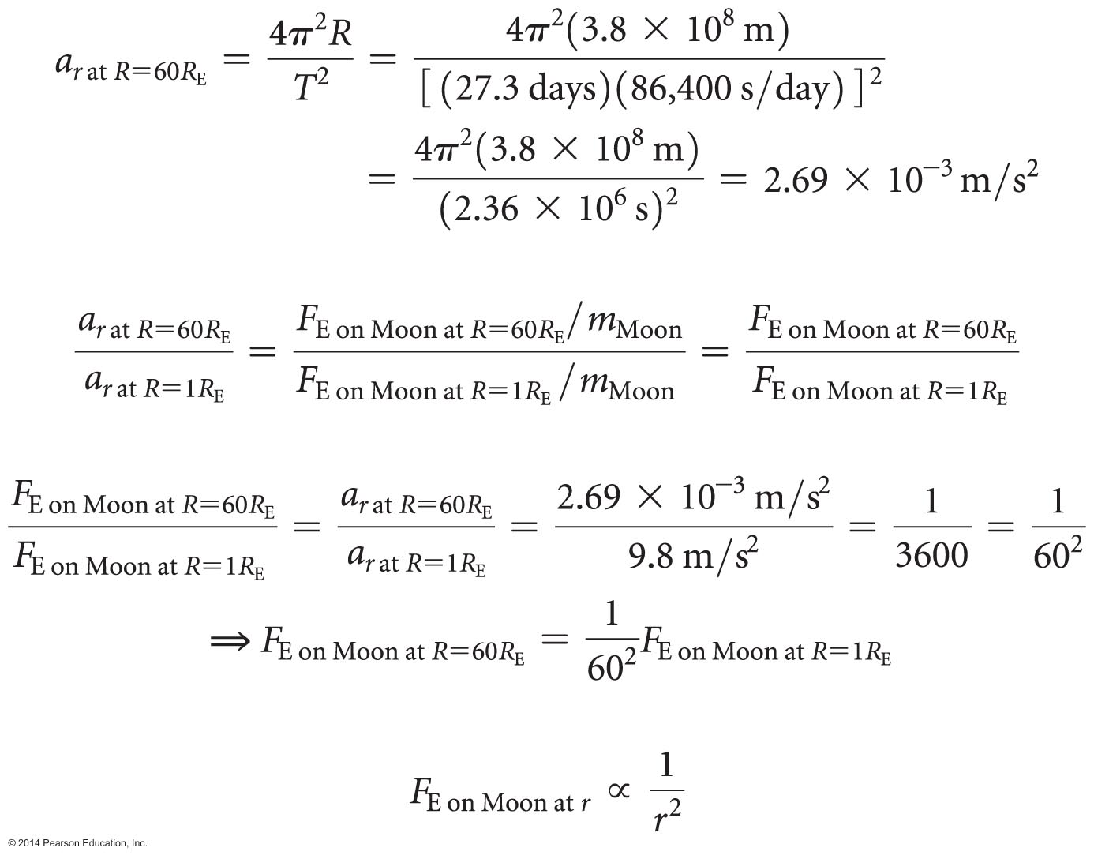
Observations and explanations of planetary motion (Cont'd)

Slide 44
Tip
You might wonder why if Earth pulls on the Moon, the Moon does not come closer to Earth in the same way that an apple falls from a tree.
The difference in these two cases is the speed of the objects. The apple is at rest with respect to Earth before it leaves the tree, and the Moon is moving tangentially.
If Earth stopped pulling on the Moon, it would fly away along a straight line.

Slide 45
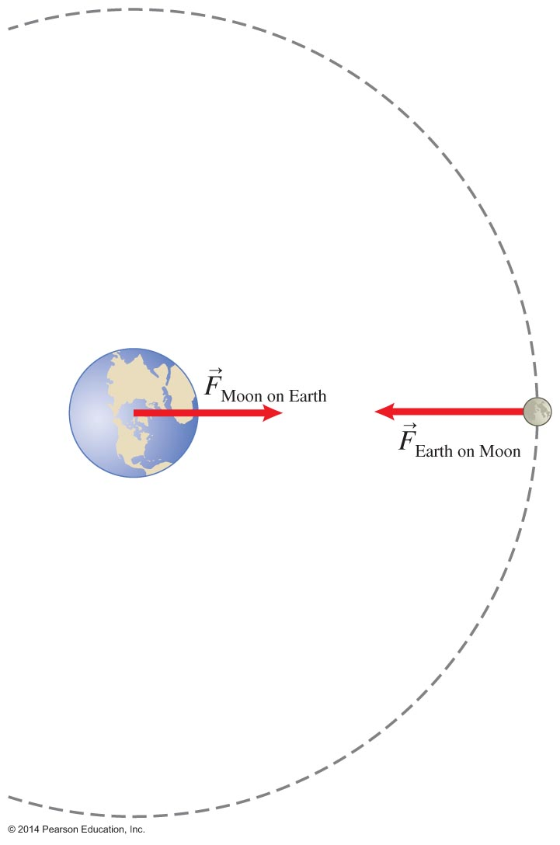
Dependence of gravitational force on mass
Newton deduced by recognizing that acceleration would equal g only if the gravitational force was directly proportional to the system object's mass.
Newton deduced by applying the third law of motion.

Slide 46
The law of universal gravitation
Newton deduced but did not know the proportionality constant; in fact, at that time the mass of the Moon and Earth were unknown.
Later scientists determined the proportionality:
G is the universal gravitational constant, indicating that this law works anywhere in the universe for any two masses.

Slide 47
The universal gravitational constant
G is very small.
For two objects of mass 1 kg that are separated by 1 m, the gravitational force they exert on each other equals 6.67 x 10^{–11} N.
The gravitational force between everyday objects is small enough to ignore in most calculations.

Slide 48
Newton's law of universal gravitation

Slide 49
Making sense of the gravitational force that everyday objects exert on Earth
It might seem counterintuitive that objects exert a gravitational force on Earth; Earth does not seem to react every time someone drops something.
Acceleration is force divided by mass, and the mass of Earth is very large, so Earth's acceleration is very small.
For example, the acceleration caused by the gravitational force a tennis ball exerts on Earth is 9.2 x 10^{–26} m/s².

Slide 50
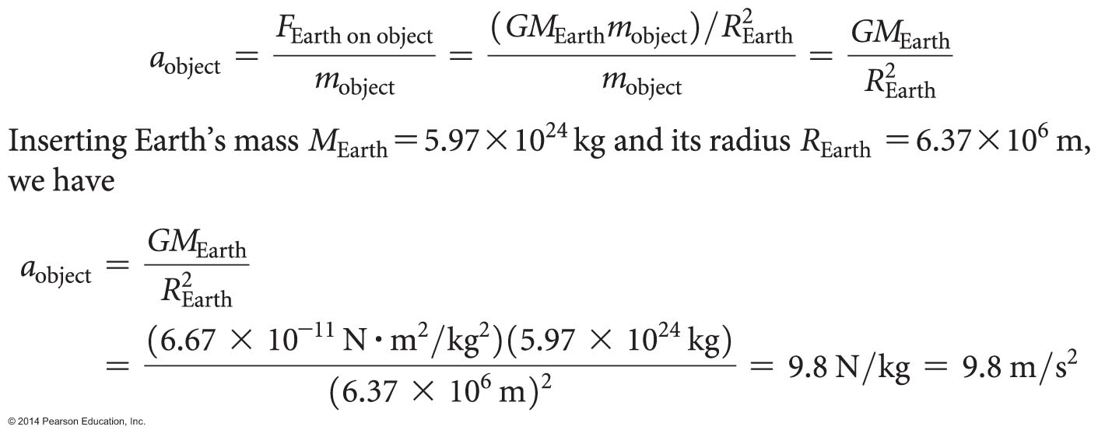
Free-fall acceleration
We can now understand why free-fall acceleration on Earth equals 9.8 m/s².
This agrees with what we measure, providing a consistency check that serves the purpose of a testing experiment.

Slide 51
Kepler's laws and the law of universal gravitation
About 50 years before Newton's work, Johannes Kepler (1571–1630) crafted his three laws of planetary motion.
Newton used the law of universal gravitation to explain Kepler's laws.
This work contributed to scientists' confidence in the law of universal gravitation.

Slide 52
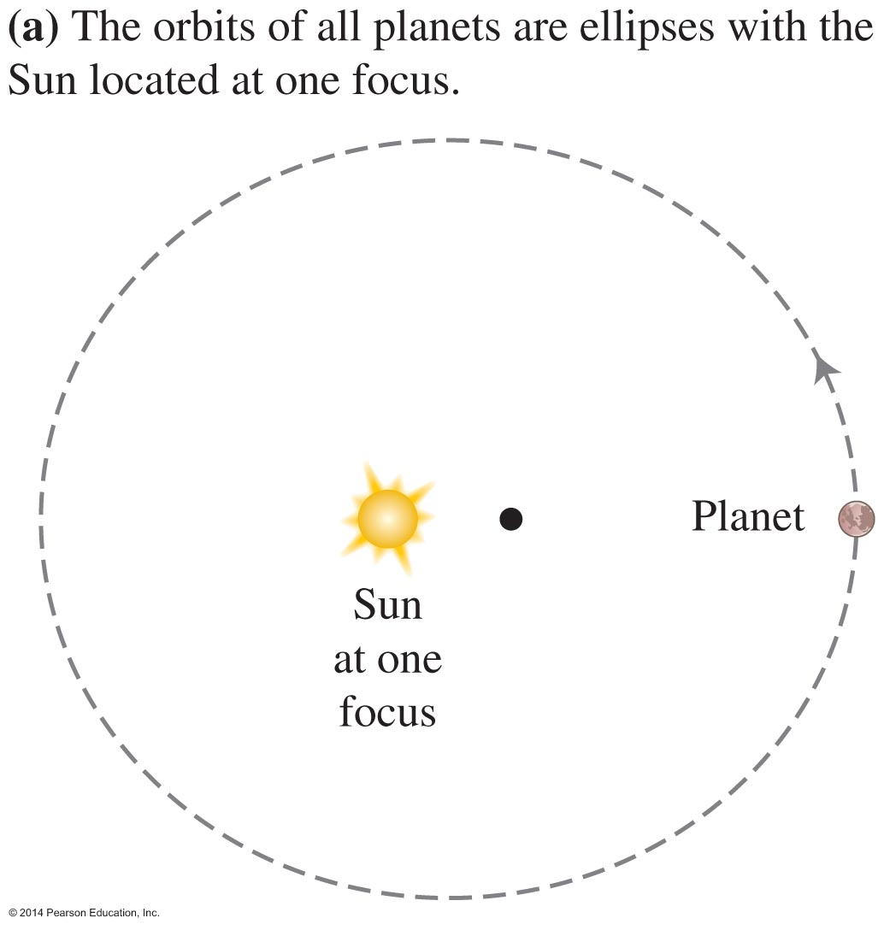
Kepler's first law of planetary motion
The orbits of all planets are ellipses, with the Sun located at one of the ellipse's foci.
The shape of the planetary orbits is close to circular for most planets. In those cases, the foci of the ellipse are very close to the center of the circular orbit that most closely approximates the ellipse.

Slide 53
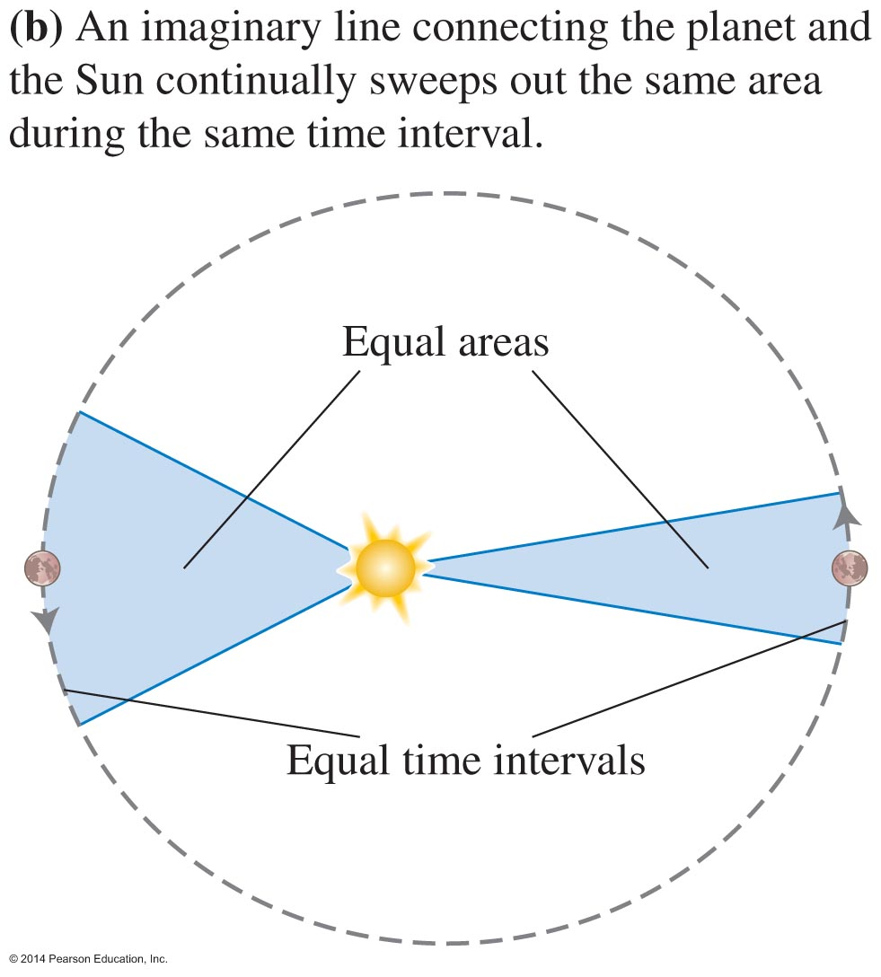
Kepler's second law of planetary motion
When a planet travels in an orbit, an imaginary line connecting the planet and the Sun continually sweeps out the same area during the same time interval, independent of the planet's distance from the Sun.

Slide 54
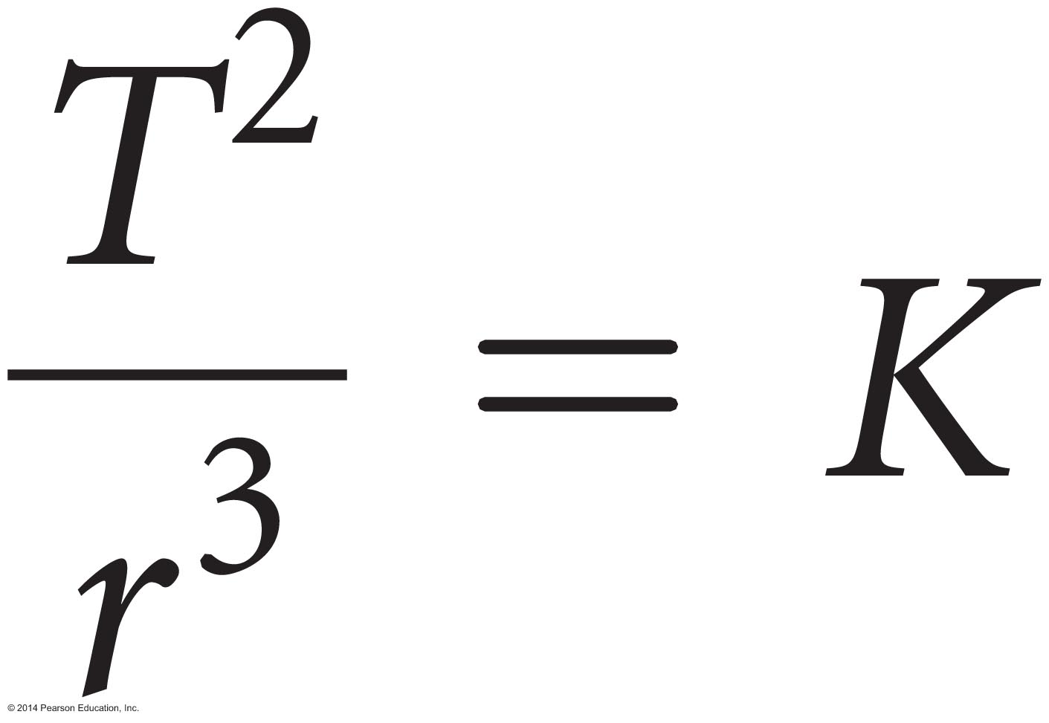
Kepler's third law of planetary motion
The square of the period T of the planet's motion (the time interval to complete one orbit) divided by the cube of the semi-major axis of the orbit (which is half the maximum diameter of the elliptical orbit and the radius r of a circle) equals the same constant for all the known planets:

Slide 55
Limitations of the law of universal gravitation
The law of universal gravitation in the form of applies only to objects:
With spherical symmetry (i.e., in the shape of a sphere and with density that varies only with distance from the object's center) and
Whose separation distance is much bigger than their size
We can model these objects as though all of their mass was located ???
Otherwise, we can use calculus to apply this law by dividing each object into a collection of very small point-like objects.

Slide 56
Limitations of the law of universal gravitation
Even with calculus, the law cannot account for the details of some motions.
When astronomers made careful observations of the orbit of Mercury, they noticed that its orbit exhibited some patterns that the law of universal gravitation could not explain.
It was not until the early 20th century, when Einstein constructed a more advanced theory of gravity, that scientists could predict all of the details of the motion of Mercury.

Slide 57
Satellites and astronauts: Putting it all together
Geostationary satellites stay at the same location in the sky. This is why a satellite dish always points in the same direction.
These satellites must be placed at a specific altitude that allows the satellite to travel once around Earth in exactly 24 hours while remaining above the equator.
An array of such satellites can provide communications to all parts of Earth.

Slide 58
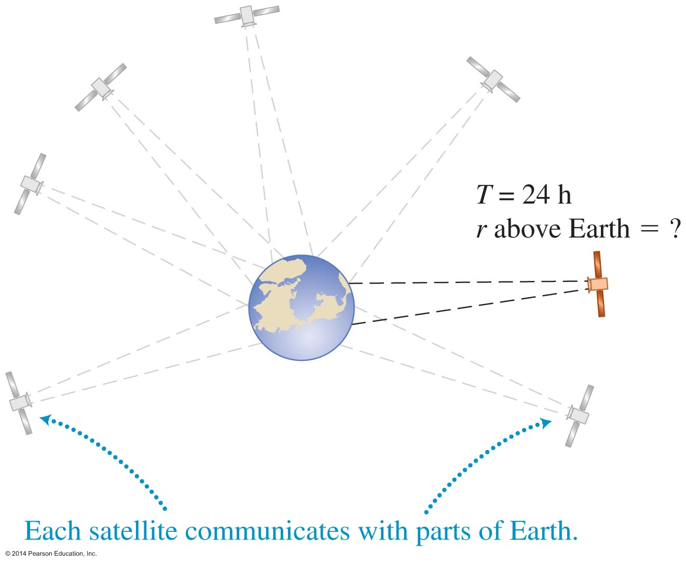
Example 4.8: Geostationary satellite
You are in charge of launching a geostationary satellite into orbit.
At which altitude above the equator must the satellite orbit be to provide continuous communication to a stationary dish antenna on Earth?
The mass of Earth is 5.98 x 10²⁴ kg.
Notes:
This is left for the instructor to solve as an example

Slide 59
Quantitative Exercise 4.9: Are astronauts weightless in the International Space Station?
The International Space Station orbits approximately 0.50 x 10⁶ m above Earth's surface, or 6.78 x 10⁶ m from Earth's center.
Compare the force that Earth exerts on an astronaut in the station to the force that Earth exerts on the same astronaut when he is on Earth's surface.
Notes:
This is left for the instructor to solve as an example

Slide 60
Astronauts are NOT weightless in the International Space Station
Earth exerts a gravitational force on them!
This force causes the astronaut and space station to fall toward Earth at the same rate while they fly forward, staying on the same circular path.
The astronaut is in free fall (as is the station).
If the astronaut stood on a scale in the space station, the scale would read zero even though the gravitational force is nonzero.
Weight is a way of referring to the gravitational force, not the reading of a scale.

Slide 61
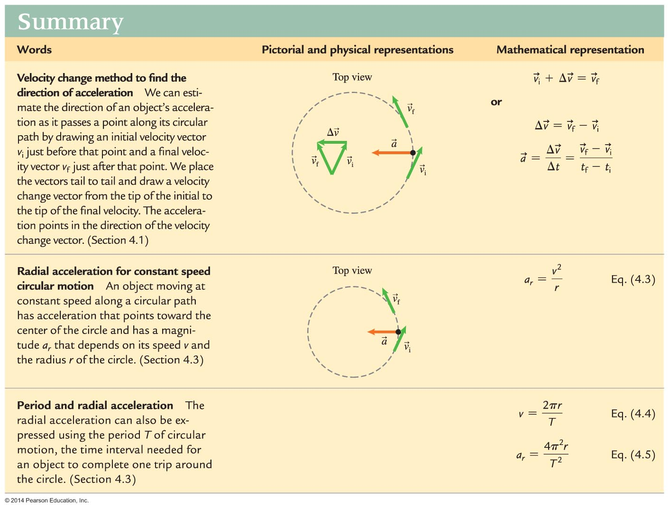
Summary

Slide 62
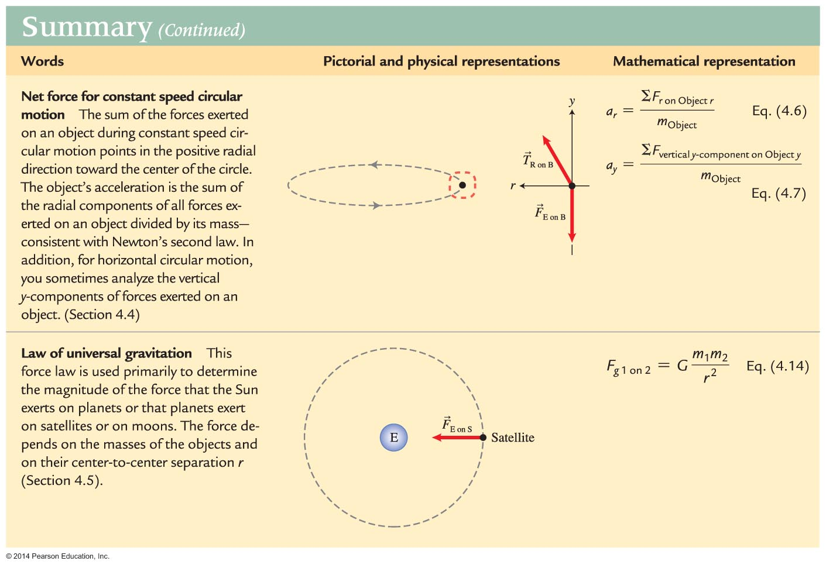
Summary

