Slide 1
Kinematics: Motion in One Dimension
Prepared by
Dedra Demaree,
Georgetown University

Slide 2
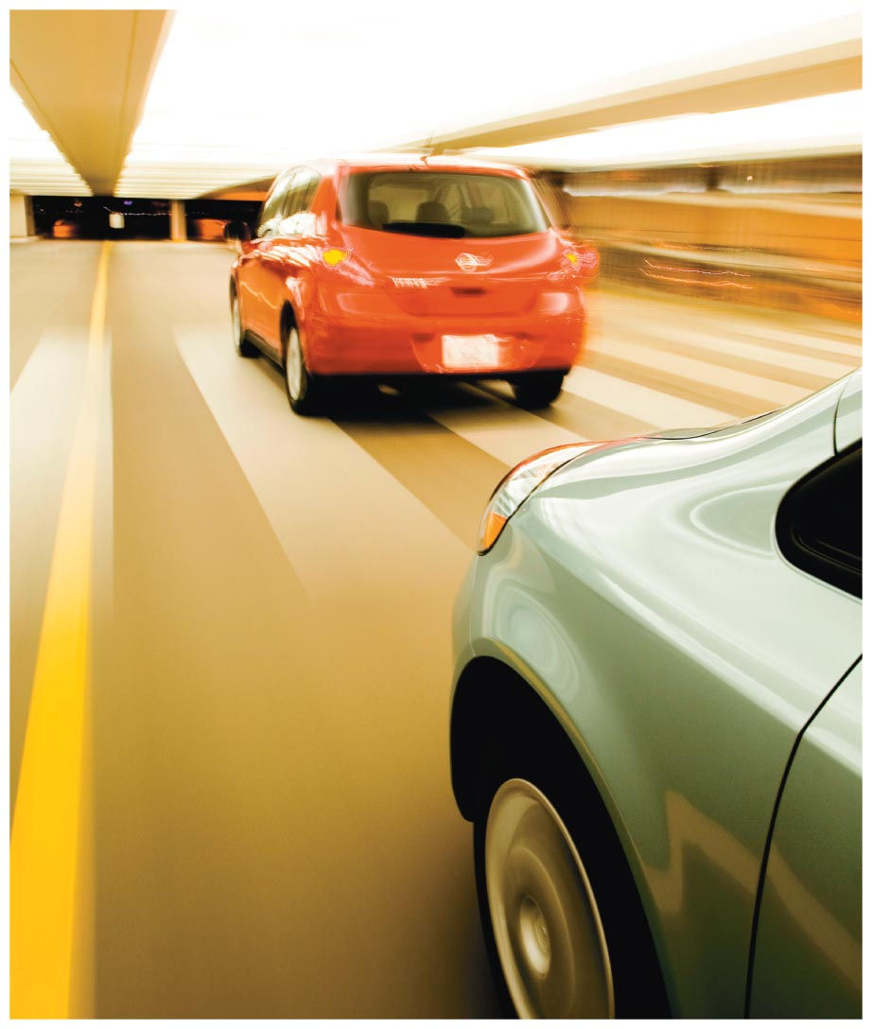
Kinematics: Motion in One Dimension
What is a safe following distance between you and the car in front of you?
Can you be moving and not moving at the same time?
Why do physicists say that an upward-thrown object is falling?

Slide 3
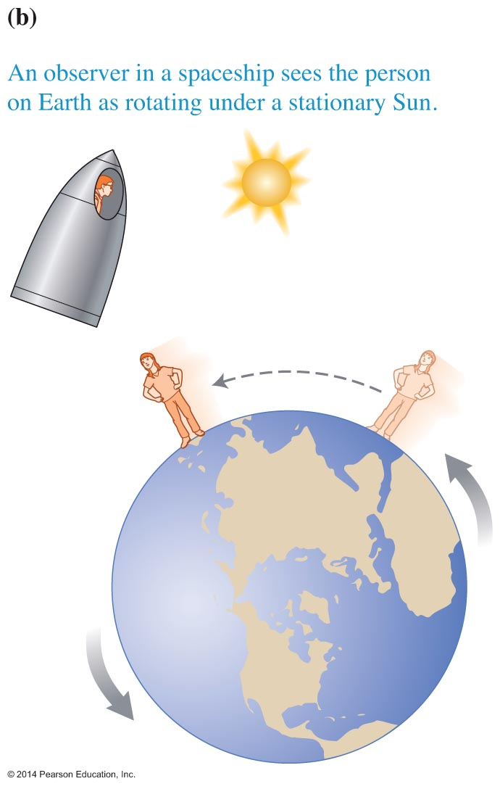
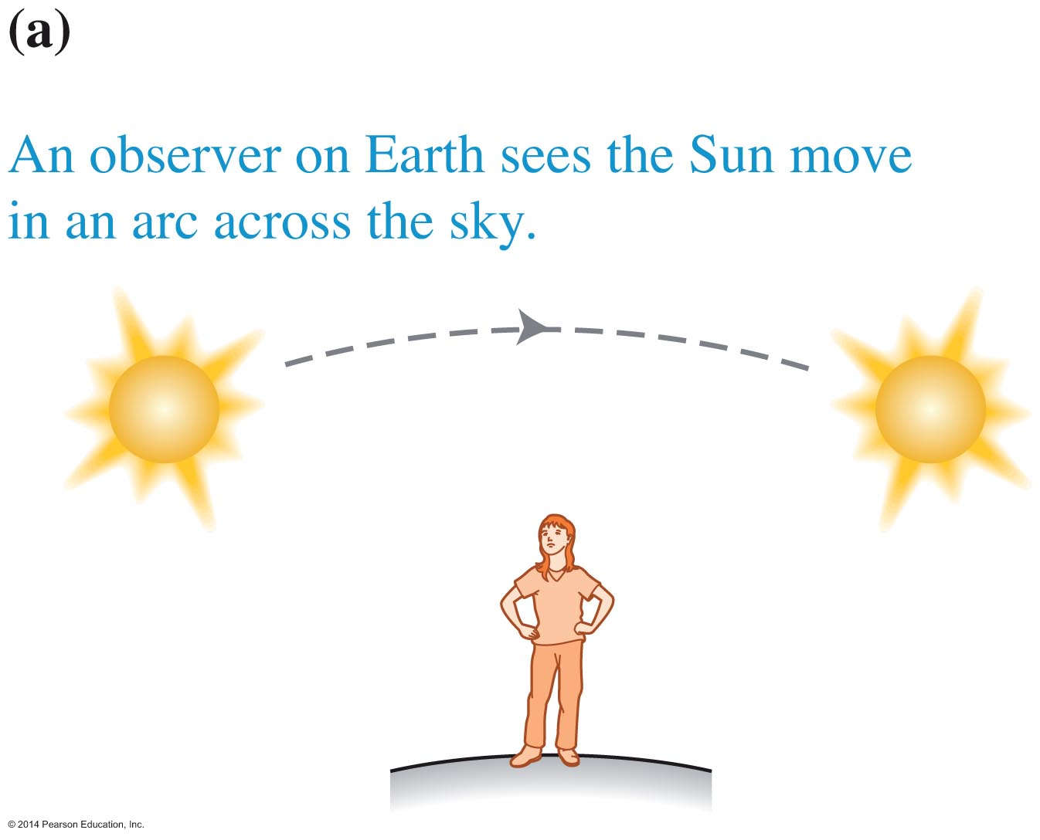
Who is observing matters!
Identify the object of interest AND the Observer
An observer in a spaceship describes the motion of the Sun differently than an observer standing on Earth.
The observer must be specified!

Slide 4
What is motion?
Motion is a change in an object's position relative to a given observer during a certain change in time.
Without identifying the observer, it is impossible to say whether the object of interest moved.
Physicists say motion is relative, meaning that the motion of any object of interest depends on the point of view of the observer.

Slide 5
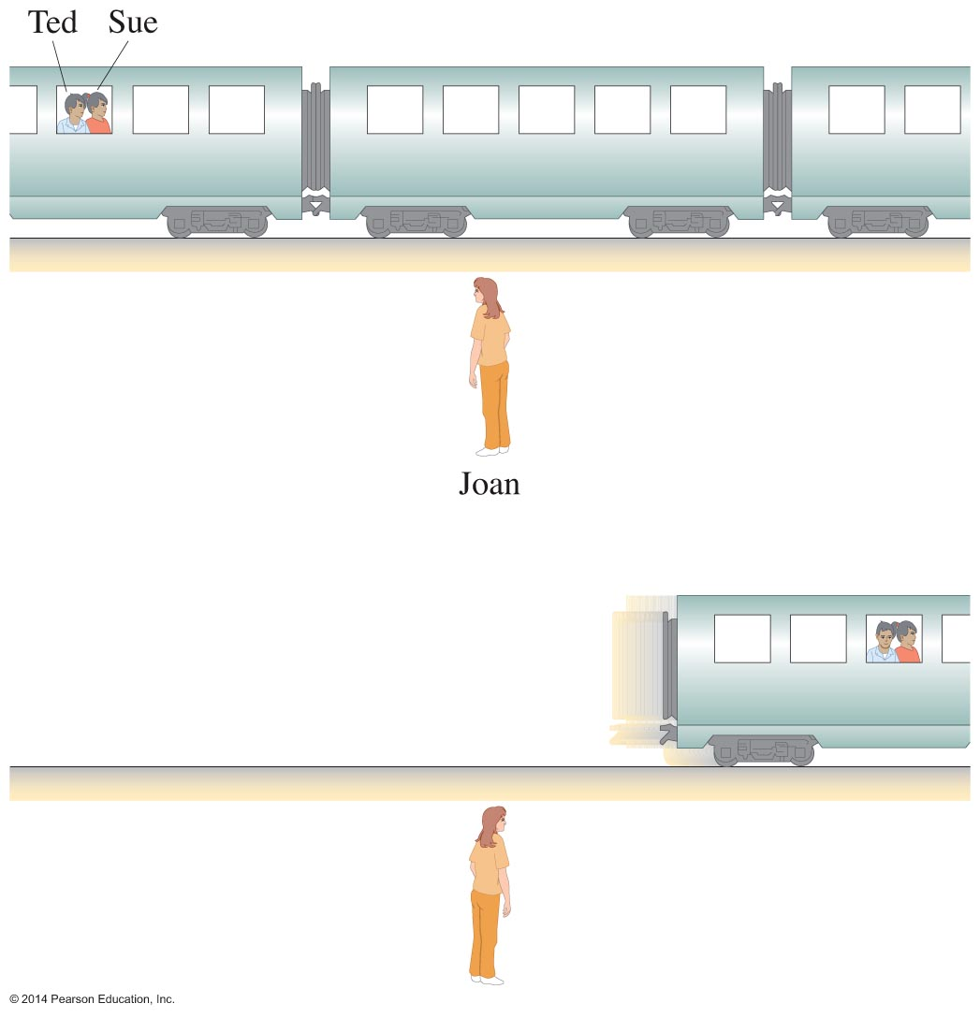
Observational experiment
Different observers can describe the same process differently, including whether motion is even occurring.

Slide 6
Reference frames require:
An object of reference (or a point on an object if the object is large)
A coordinate system with a scale for measuring distance
A clock to measure time

Slide 7
Linear motion
Linear motion is a model of motion that assumes that an object, considered as a point-like object, moves along a straight line.
A car moving along a straight highway can be modeled with linear motion; we simplify the car as a point, which is small compared to the length of the road.
A tire of the car cannot be modeled with linear motion.

Slide 8
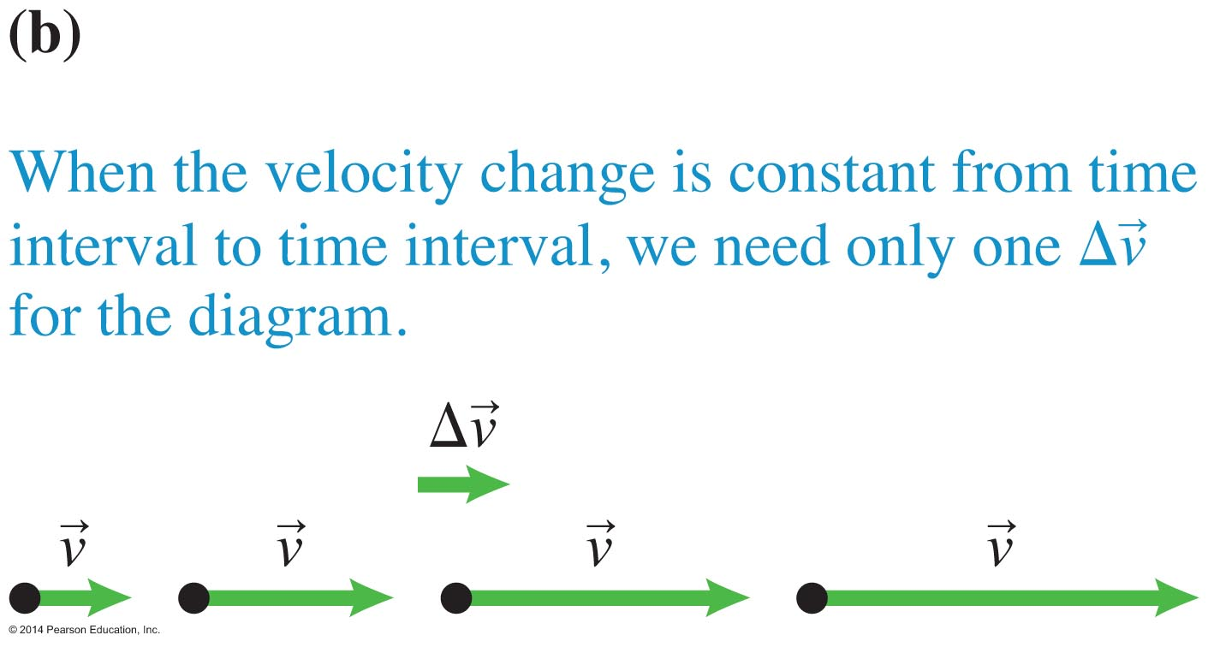
Motion diagrams contain:
Dots representing the location of the object for progressive, equal time intervals
Velocity vectors on each dot representing the velocity of the object at each time interval (the length of the velocity vector represents how fast the object is moving)
Velocity change arrows showing how the velocity vectors are changing
The specified location of the observer

Slide 9
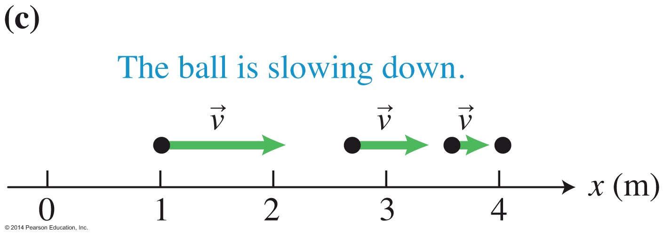
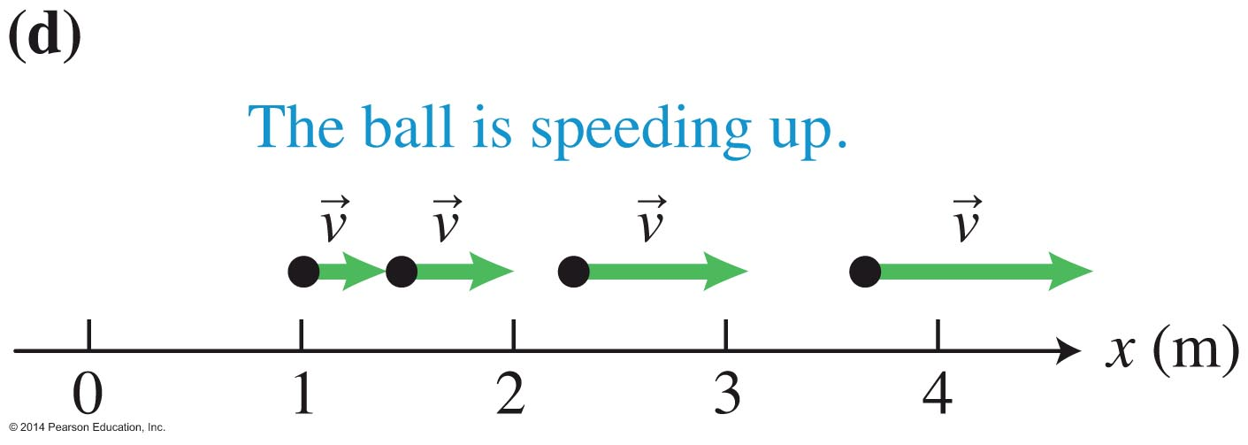
Patterns found from motion diagrams
The spacing of the dots allows us to visualize motion.
When the object travels without speeding up or slowing down, the dots are evenly spaced.
When the object slows down, the dots get closer together.
When the object moves faster and faster, the dots get farther apart.

Slide 10
Velocity change arrows
Delta means "change in."
Change always means final minus initial: what it is now compared to what it was before.
The arrow above v reminds us that velocity is a vector; it has both magnitude and direction.

Slide 11
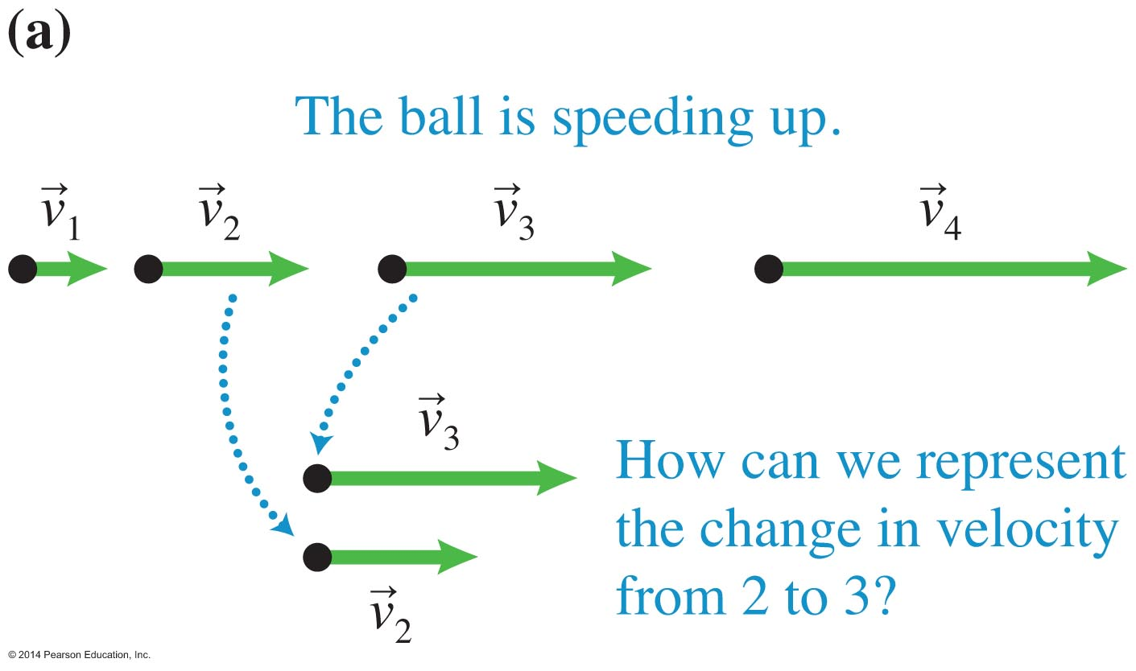
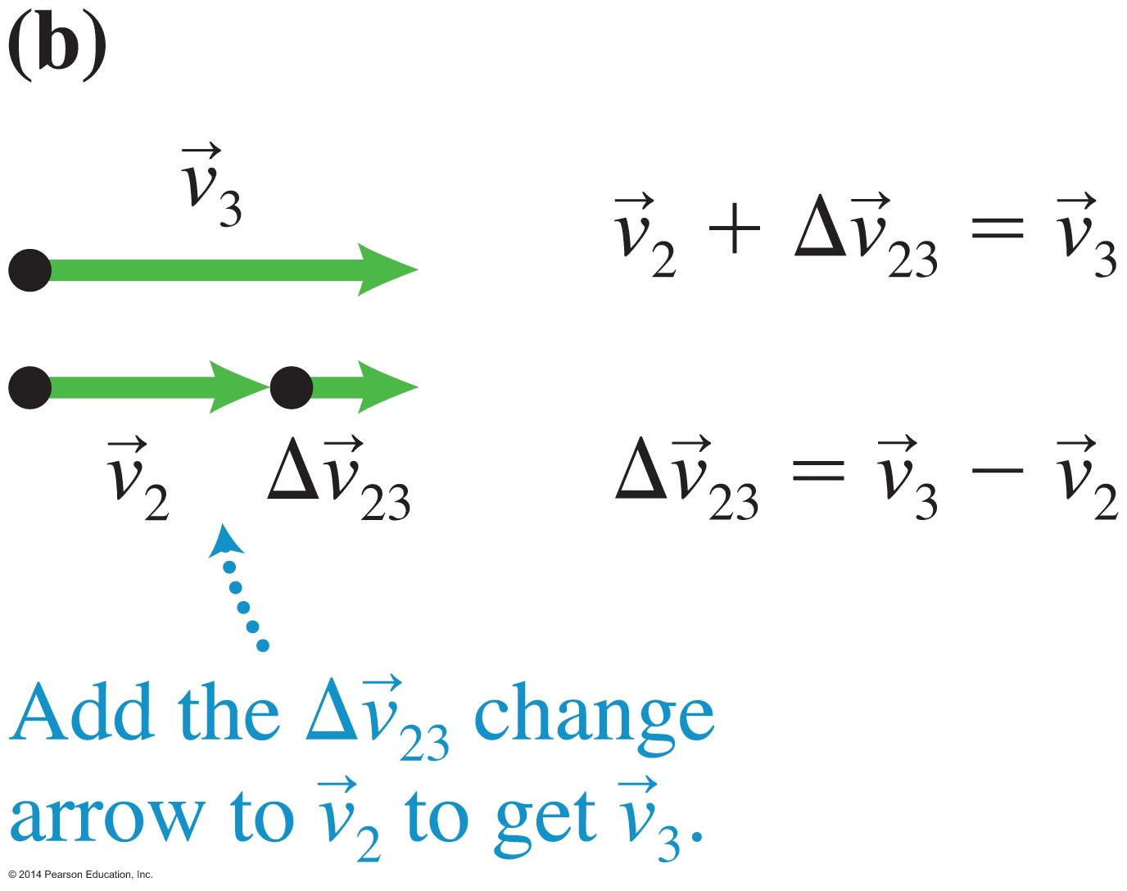
Finding velocity change arrows
Consider two adjacent velocity vectors, in this example at points 2 and 3.
Find which vector would need to be added to the velocity corresponding to point 2 to get the velocity corresponding to point 3.

Slide 12
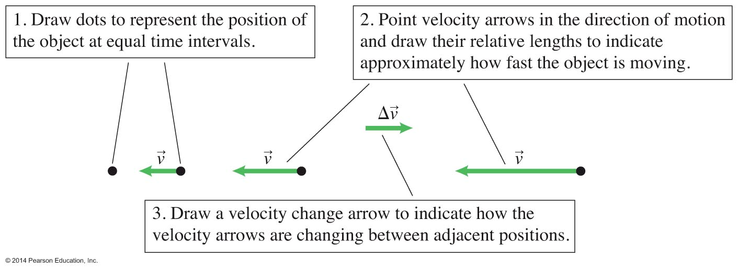
Constructing a motion diagram

Slide 13
Quantities for describing motion
Motion diagrams represent motion qualitatively.
To analyze situations, we need to describe motion quantitatively.
These quantities are needed to describe linear motion:
  Time and time interval
  Position, displacement, distance, and path length
  Scalar component of displacement for motion along one axis

Slide 14
Time and time interval
The time t is a clock reading.
The time interval (t₂ - t₁) or Δt is a difference in clock readings. (The symbol delta represents "change in" and is the final value minus the initial value.)
These are both scalar quantities.
The SI units for both quantities are seconds (s).

Slide 15
Position, displacement, distance, and path length
These quantities describe the location and motion of an object.
  Position is an object's location with respect to a particular coordinate system.
  Displacement is a vector that starts from an object's initial position and ends at its final position.
  Distance is the magnitude (length) of the displacement vector.
  Path length is how far the object moved as it traveled from its initial position to its final position.
Imagine laying a string along the path the object took. The length of the string is the path length.

Slide 16
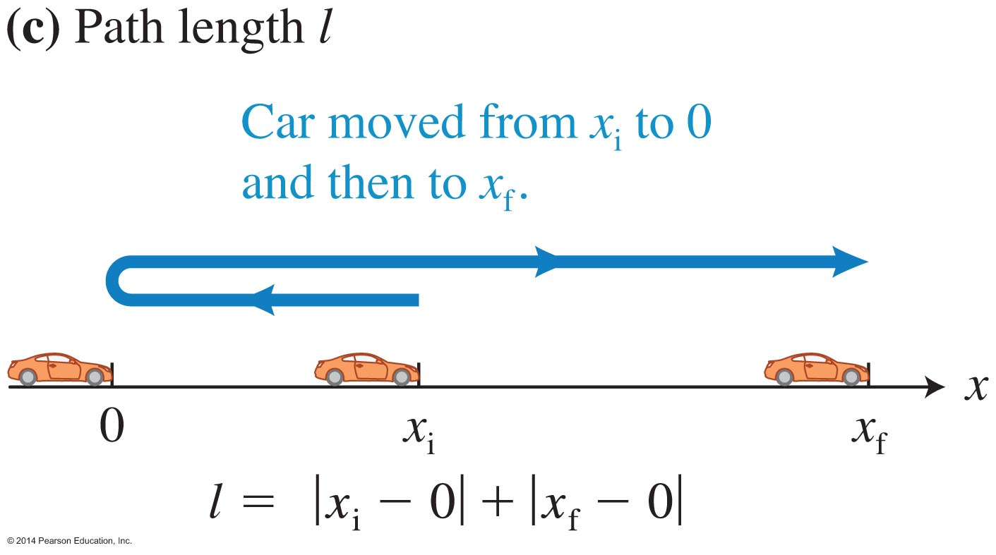
Example: A car backs up (moving in the negative direction) toward the origin of the coordinate system at x = 0. The car stops and then moves in the positive x-direction to its final position x_{f}.
The initial position and the origin of a coordinate system are not necessarily the same points.
The displacement for the whole trip is a vector that points from the starting position at x_{i} to the final position at x_{f}.
The distance for the trip is the magnitude of the displacement (always positive).
The path length is the distance from x_{i} to 0 plus the distance from 0 to x_{f}. Note that the path length does not equal the distance.

Slide 17
Motion along one axis
Specify a reference frame.
Point one coordinate axis parallel or antiparallel (opposite in direction) to the object's direction of motion.
The displacement vector points from the initial position x_{i} to the final position x_{f}.
The x scalar component of the displacement vector is determined through the operation x_{f} – x_{i}. It is abbreviated as d_{x}.
Distance is always positive; it equals the absolute value of the displacement.

Slide 18
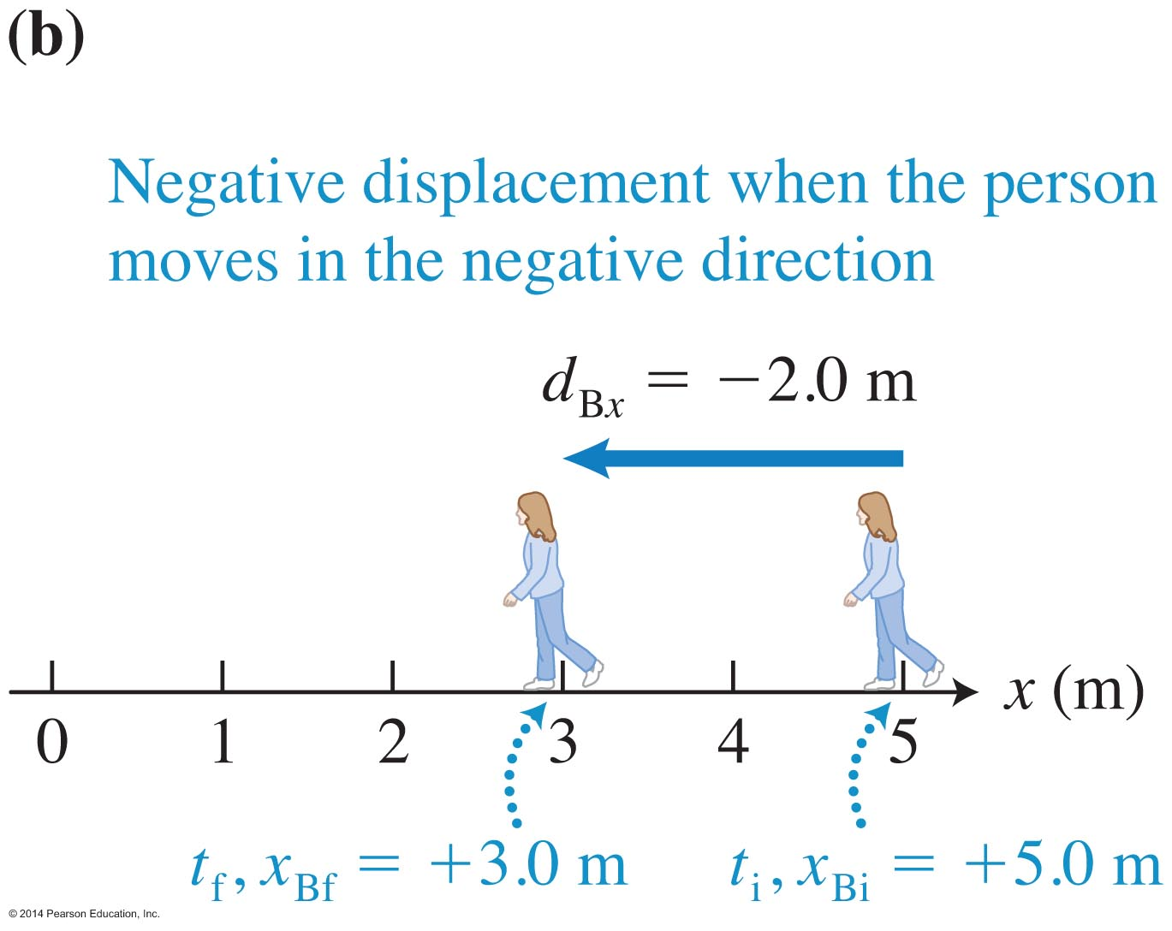
Example: Motion along one axis
The ground is the reference frame.
The coordinate axis points to the right (antiparallel to the direction of motion).
The displacement vector is shown in blue.
d_{x} = x_{f} - x_{i} = 3.0 m – 5.0 m = –2.0 m
The distance traveled is 2 m.

Slide 19
Significant digits
We should be able to measure the person's location at one instant of time to within about 0.1m but not to 0.01 m.
The locations can reasonably be given as +3.0 m, which implies an accuracy of ±0.1 m.

Slide 20
Representing motion with data tables and graphs
A data table can record position and time data collected when observing motion.
A graph of the data in the table can help identify patterns in the data.
This type of graph is called a kinematics position-versus-time graph.
Kinematics means "description of motion."

Slide 21
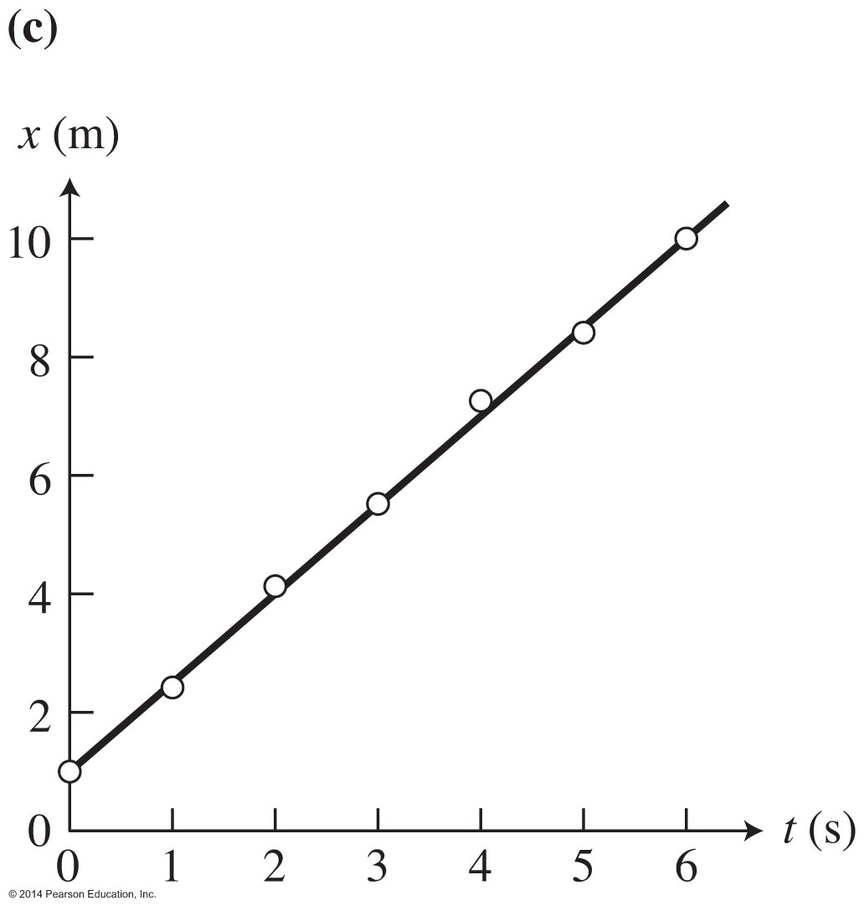
Kinematics graphs
Time t is usually the independent variable: the horizontal axis.
Position x is the dependent variable (position changes with time): the vertical axis (even if the motion is horizontal!).
A trendline is a best-fit curve that passes as close as possible to the data points.

Slide 22
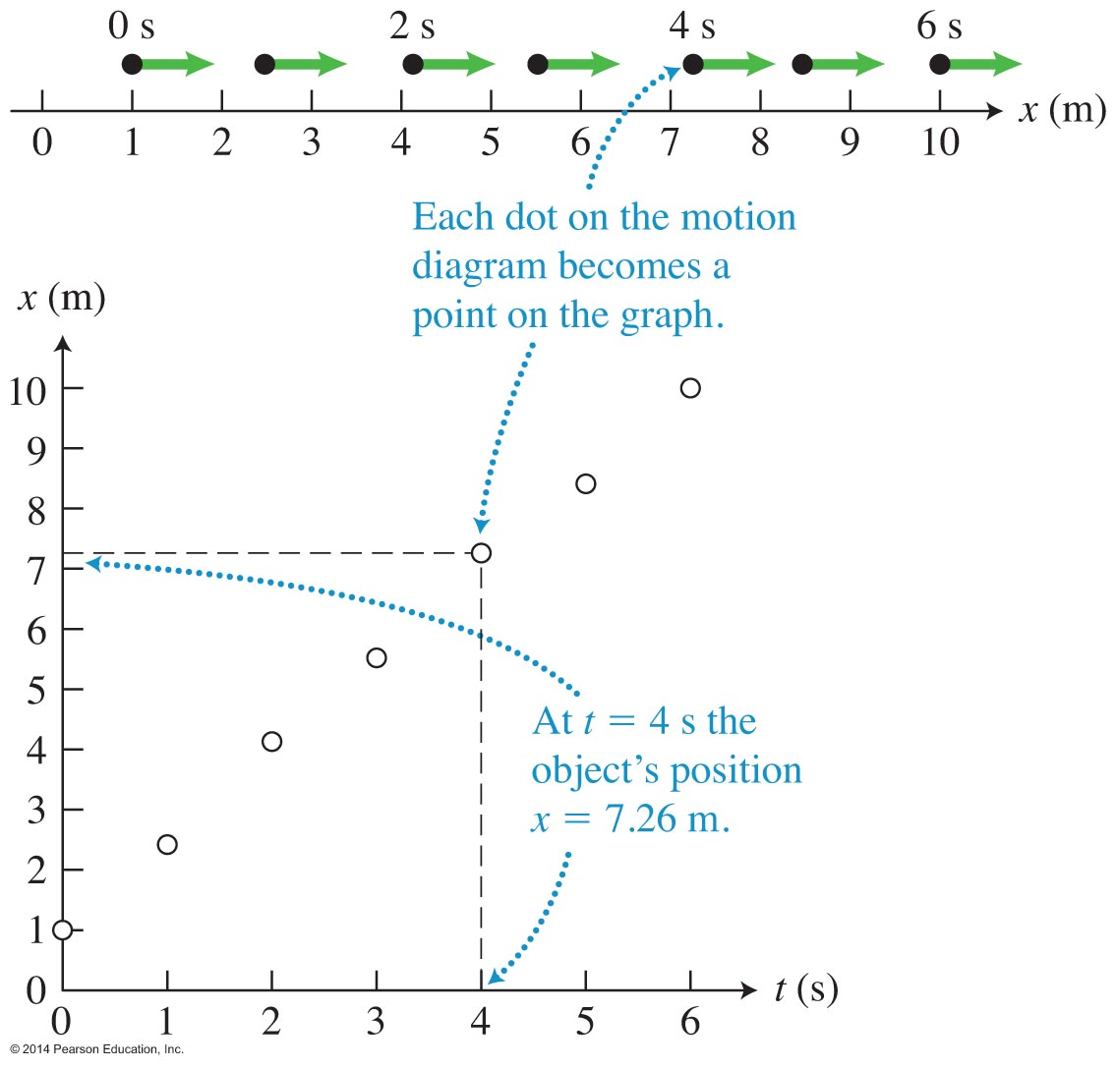
Correspondence between a motion diagram and position-versus-time graph
Kinematics graphs can contain more precise information than motion diagrams.
The position of each dot on the motion diagram corresponds to a point on the position axis.
The graph line combines information about the position of an object and the clock reading when this position occurred.

Slide 23
Mathematics of linear motion
A dependent variable, usually y, depends on the value of an independent variable, usually x.
y(x) = f(x) is an operation that one needs to do if x is an input and y is the output.
For a straight line, y(x) = kx + b, where k is the slope and b is the y intercept; the value of y when x = 0.
For motion along the x-axis, we write x(t) to depict that the motion is dependent on time;
x(t) = kt + b.

Slide 24
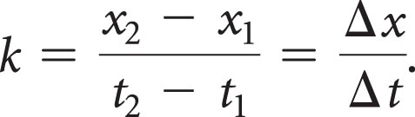
Connecting graphical representations of linear motion to a mathematical representation
A linear function is written: x(t) = kt + b
  k is the slope of the line; it is the change in the dependent variable divided by the change in the independent variable.
  The slope k can be found from
  k has units of m/s and indicates how the position changes with time.
  k can be positive or negative; it represents not only how fast, but also in which direction an object is moving.
  b is the location of the object at t = 0; it is x₀.

Slide 25
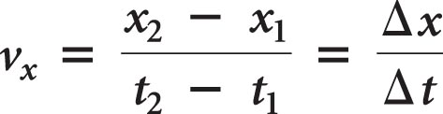
Velocity: Slope of the position-versus-time graph
If the slope is positive, the object is moving along the +x axis.
If the slope is negative, the object is moving along the –x axis.
The magnitude of the slope (which is always positive) is the speed of the object.
The speed and the direction together are called the velocity of the object.

Slide 26
Equation of motion for constant-velocity linear motion

Slide 27
Comparing the motion of two objects (constant-velocity linear motion)
Draw a sketch for the objects of interest.
Choose the reference frame, the coordinate system, and the origin to simplify any parameters in the problem.
Mathematically describe the positions and velocities of the objects at the beginning of the process.
The initial clock reading is zero at the origin (the time when we started analyzing the process).
Write the equations for each object using the same variable for time t, being careful to choose a specific subscript for each position variable x to denote the two objects separately (such as x₁ and x₂).

Slide 28
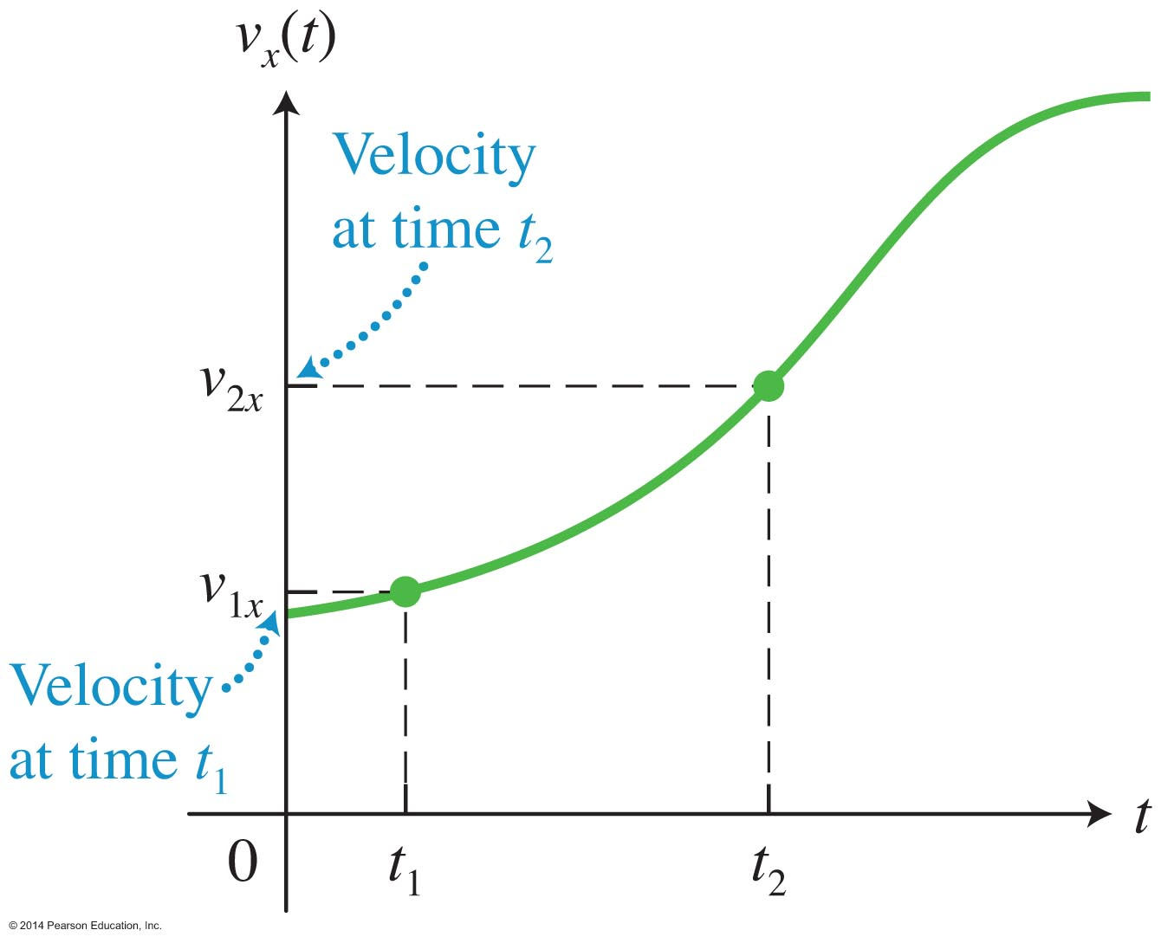
Graphing velocity
Place clock readings on the horizontal axis and the x-component of velocity on the vertical axis.
A horizontal line on the velocity-versus-time graph means that the object is moving at constant velocity (it does not change with time).
A horizontal line on a position-versus-time graph means that the object is at rest (the position is constant with time).

Slide 29
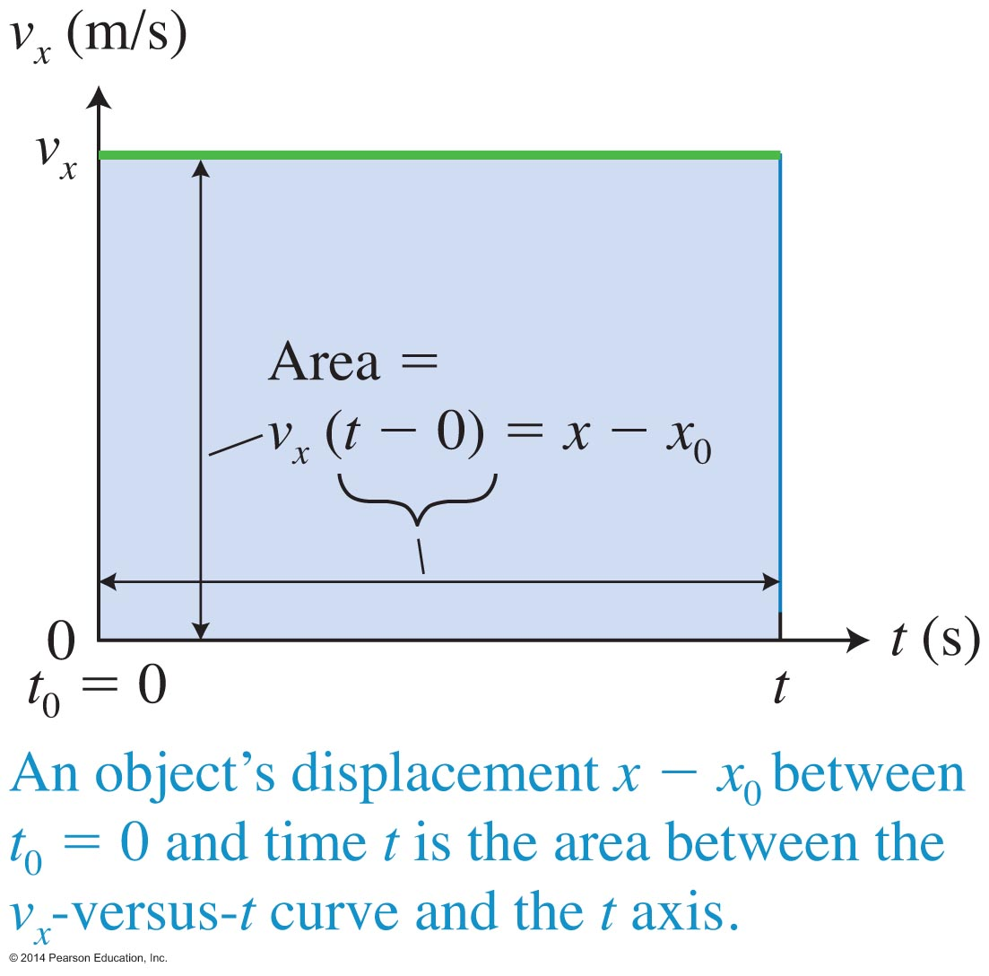
Finding displacement from a velocity graph
Displacement x – x₀ between t₀ = 0 and time t is the area between the v_{x}-versus-t curve and the t axis.
Area is width times height = v_{x}(t–t₀)
Since v_{x}= (x – x₀)/(t–t₀), (x – x₀) = v_{x}(t–t₀)

Slide 30
Finding displacement from a velocity graph

Slide 31
When velocity is not constant
On a velocity-versus-time graph, velocity will be a straight line only if it is constant.
Instantaneous velocity is the velocity of an object at a particular time.
Average velocity is the ratio of the change in position and the time interval during which this change occurred.
For motion at constant velocity, the instantaneous and average velocities are equal; for motion with changing velocity, they are not.

Slide 32
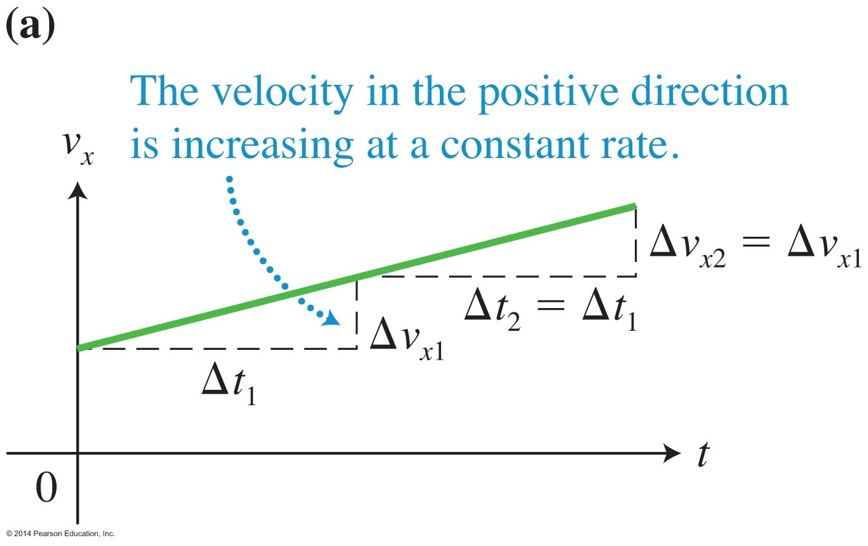
Acceleration characterizes the rate at which the velocity of an object is changing
The simplest type of linear motion with changing velocity occurs when the velocity of the object increases or decreases by the same amount during the same time interval (a constant rate of change).
In this simple case, the velocity-versus-time graph will be linear.

Slide 33
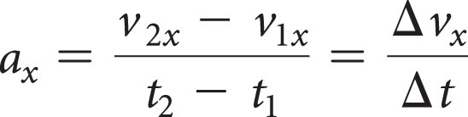
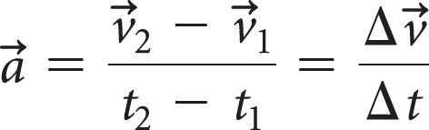
Finding acceleration from a velocity-versus-time graph
Acceleration is the slope of the velocity-versus-time graph:
A larger slope indicates the velocity is increasing at a faster rate.
Velocity is a vector quantity; therefore acceleration is also a vector quantity.
The average acceleration of an object during a time interval is

Slide 34
Acceleration

Slide 35
When is acceleration negative?
Acceleration can be positive or negative.
If an object moving in the positive direction is slowing down, its velocity-versus-time graph has a negative slope, corresponding to a decreasing speed and negative acceleration.
An object can have a negative acceleration and speed up!
  Consider an object moving in the negative direction with a negative component of velocity, but whose speed is increasing in magnitude.

Slide 36
Determining the velocity change from the acceleration
From the slope of the velocity-versus-time graphs, we see
a_{x} = (v_{x} − v_{0x})/(t−t₀), or a_{x} (t−t₀) = (v_{x} − v_{0x})
Set t₀ = 0 to simplify (the clock starts at 0) and move v_{0x} to the other side:
v_{x} = v_{0x} + a_{x}t

Slide 37
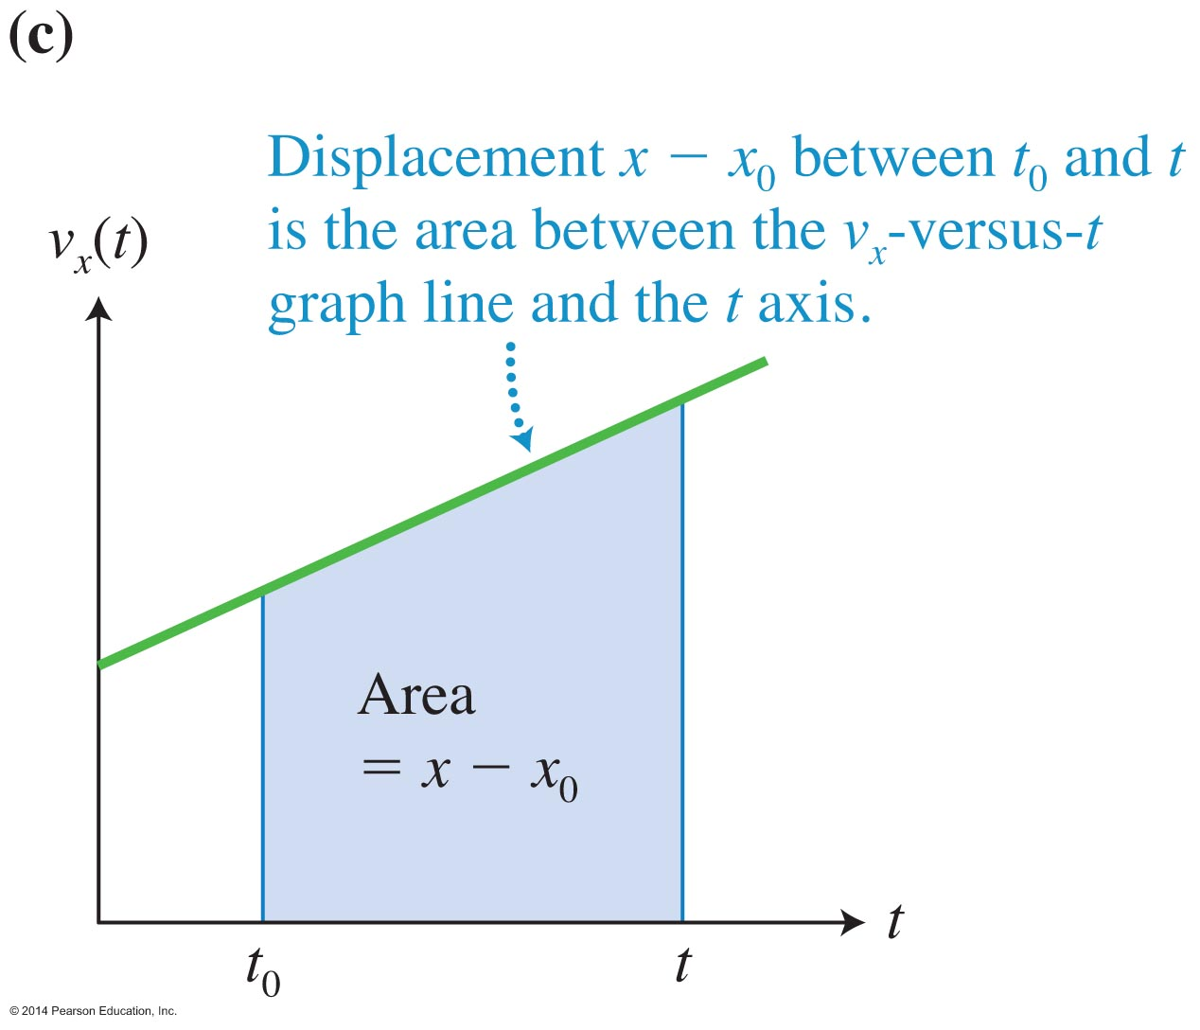
Displacement of an object moving at constant acceleration

Slide 38
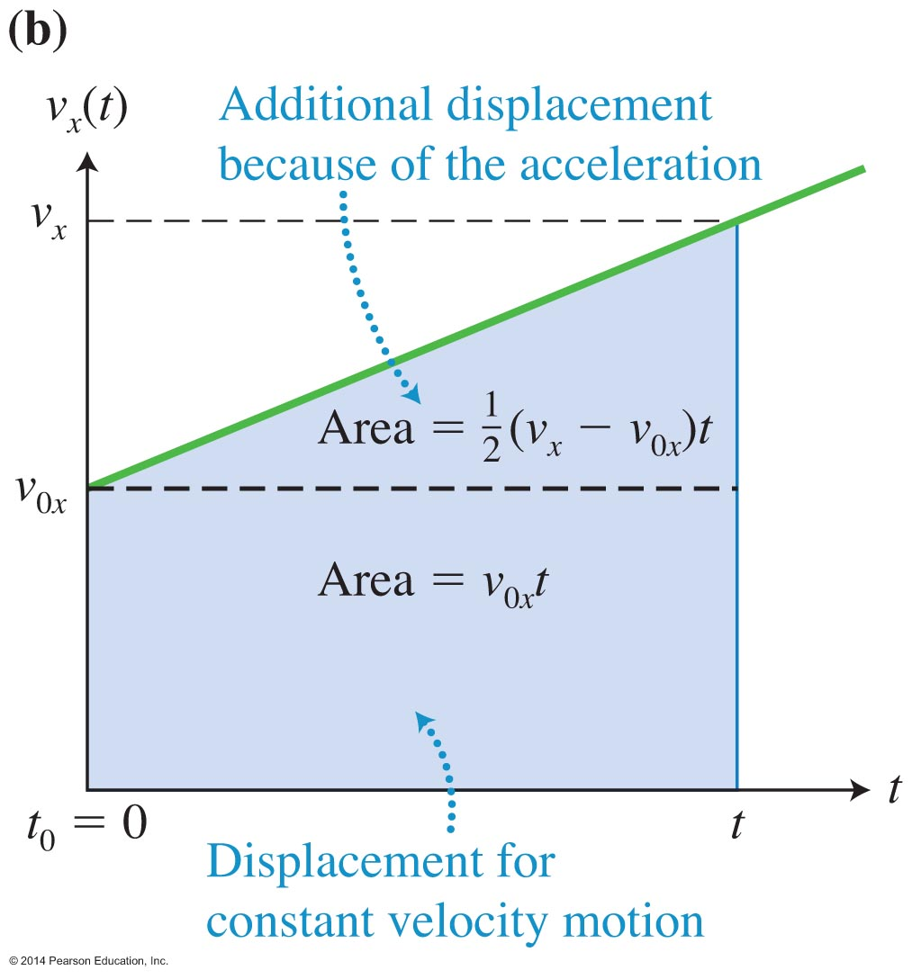
Position as a function of time
The equation for displacement can be found from the area between the velocity-versus-time graph line and the time axis.

Slide 39
Position of an object during linear motion with constant acceleration

Slide 40
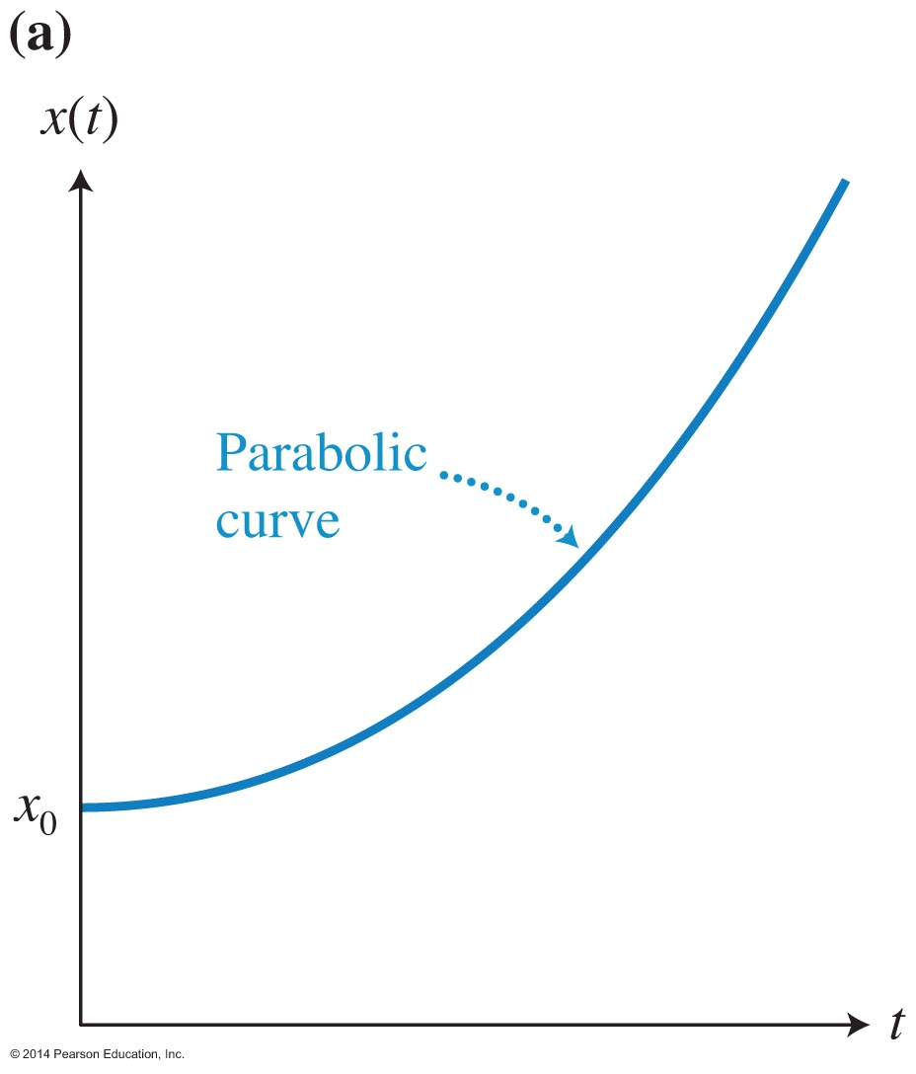
Graph of position versus time for constant acceleration motion
Position is quadratic in time (there is a t² term), so the graph is parabolic.
The slopes of the tangent lines (indicating the instantaneous velocity) are different for different times.

Slide 41
Three equations of motion

Slide 42
Skills for analyzing situations involving motion
Represent processes in multiple ways:
  The words in the problem statement
  A sketch
  One or more diagrams
  Possibly a graph
  A mathematical description
Different representations have to agree with each other; they need to be consistent.

Slide 43
Problem-solving strategy for kinematics: Step 1
Sketch and Translate:
  Sketch the situation described in the problem. Choose the object of interest.
  Include an object of reference and a coordinate system. Indicate the origin and the positive direction.
  Label the sketch with relevant information.

Slide 44
Problem-solving strategy for kinematics: Step 2
Simplify and Diagram:
  Decide how you will model the moving object (for example, as a point-like object).
  Can you model the motion as constant velocity or constant acceleration?
  Draw motion diagrams and kinematics graphs if needed.

Slide 45
Problem-solving strategy for kinematics: Step 3
Represent Mathematically:
  Use the sketch(es), motion diagram(s), and kinematics graph(s) to construct a mathematical representation (equations) of the process. Be sure to consider the sign of each quantity.

Slide 46
Problem-solving strategy for kinematics: Step 4
Solve and Evaluate:
  Solve the equations to find the answer to the question you are investigating.
  Evaluate the results to see if they are reasonable. Check the units and decide if the calculated quantities have reasonable values (sign, magnitude). Check limiting cases: examine whether the final equation leads to a reasonable result if one of the quantities is zero or infinity.

Slide 47
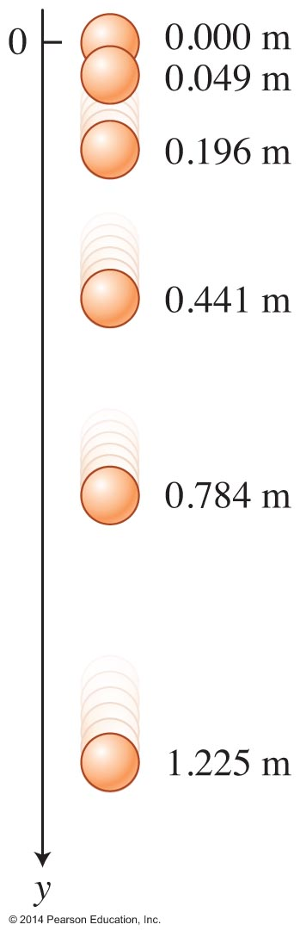
Free fall
The hypothetical motion of falling objects in the absence of air is a model of the real process and is called free fall.
Galileo hypothesized, based on experiments, that free fall occurs exactly the same way for all objects regardless of their mass and shape.
Galileo hypothesized that speed increases in the simplest
way—linearly with time of flight; the acceleration of free-falling objects is constant.

Slide 48
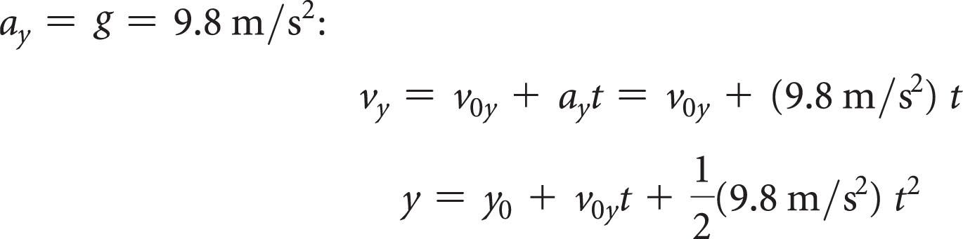
Mathematics of free fall
The acceleration of objects in free fall is given a special symbol g:
We replace x by y in our equations of motion for constant acceleration because free fall is placed along the vertical axis.
These equations use the choice that the positive y-axis is downward!

Slide 49
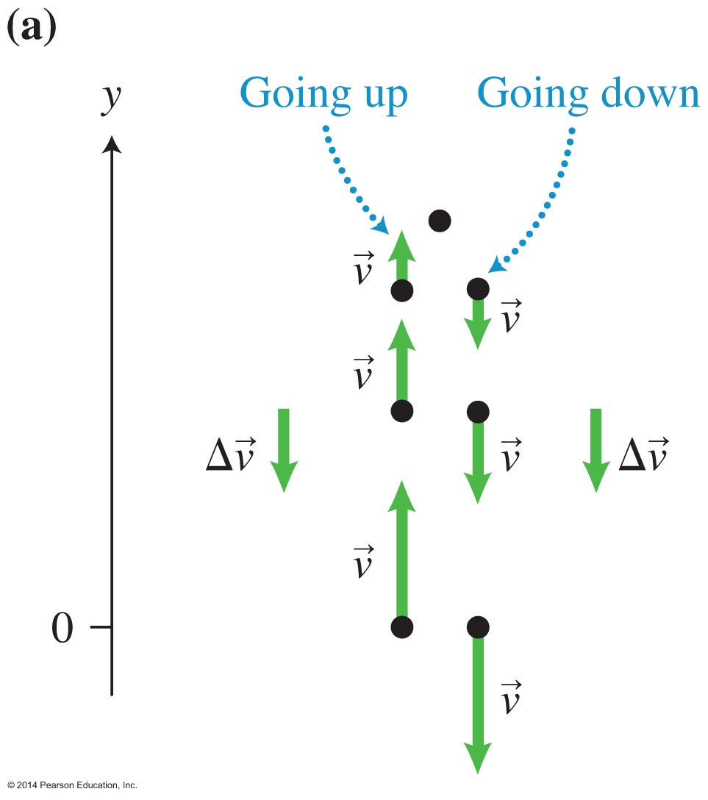
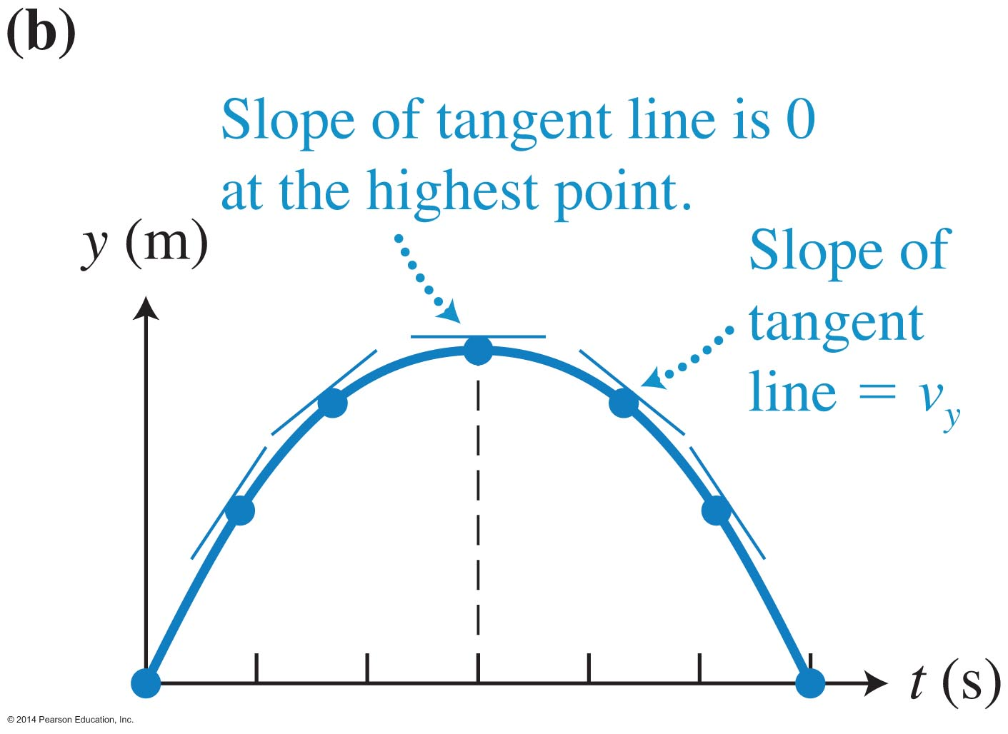
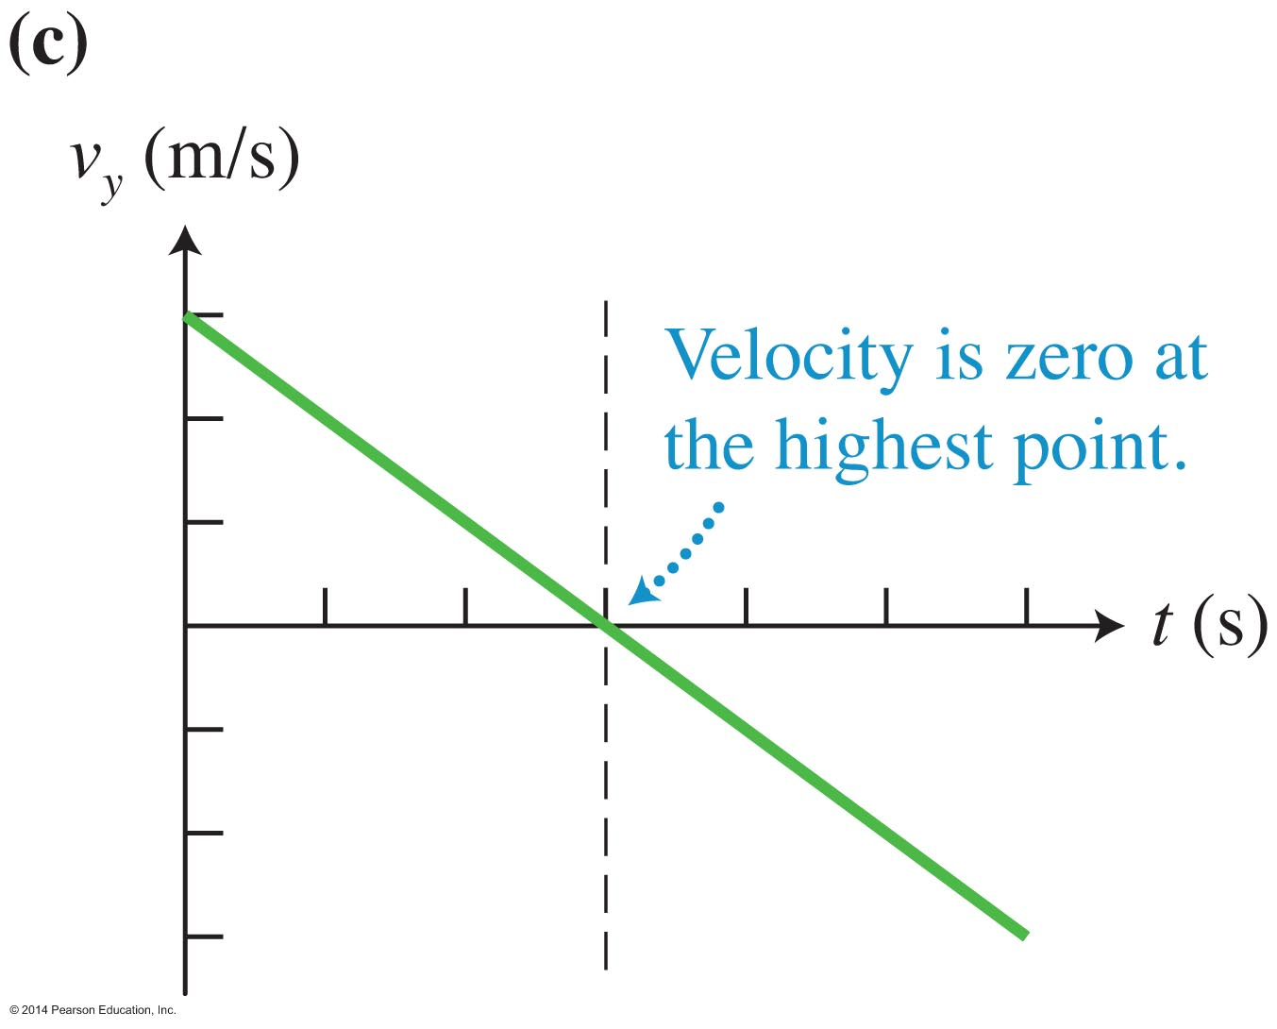
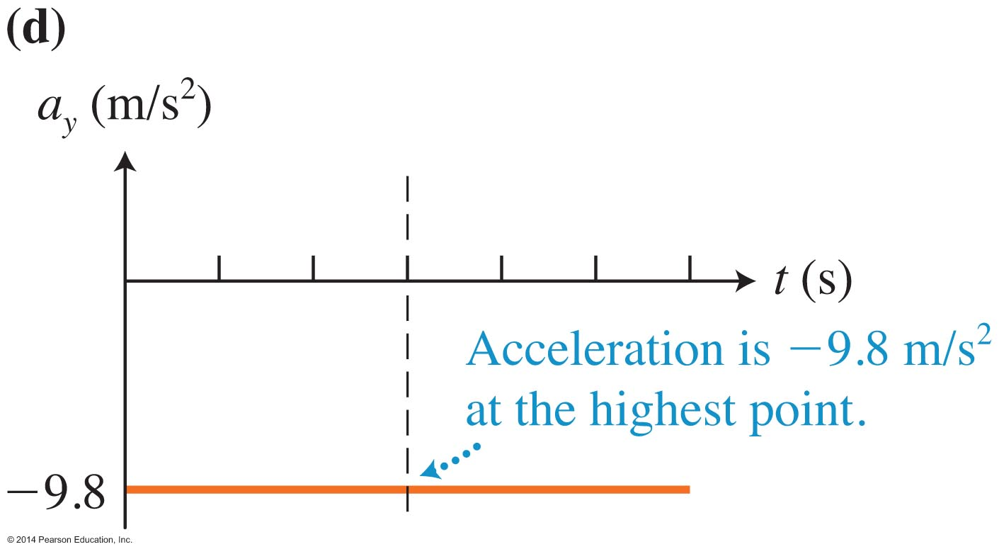
Motion diagrams and graphs for free fall

Slide 50
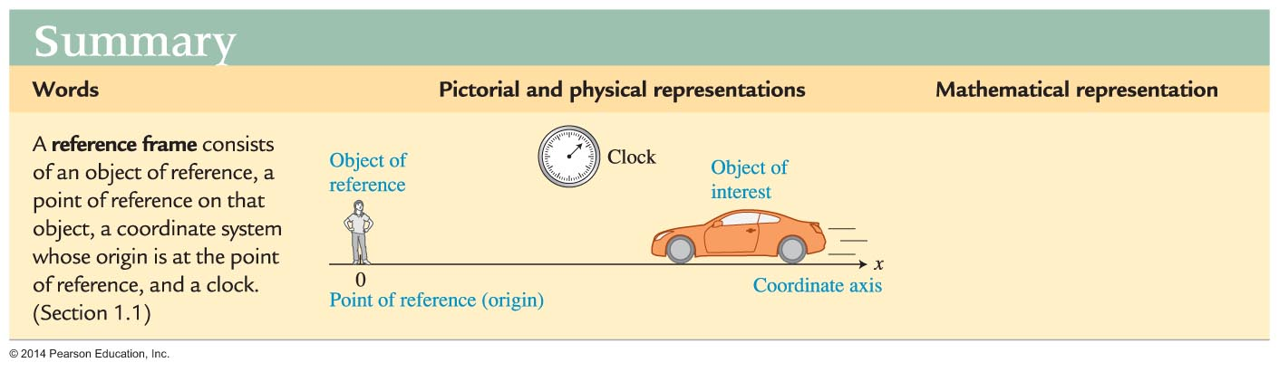
Summary

Slide 51
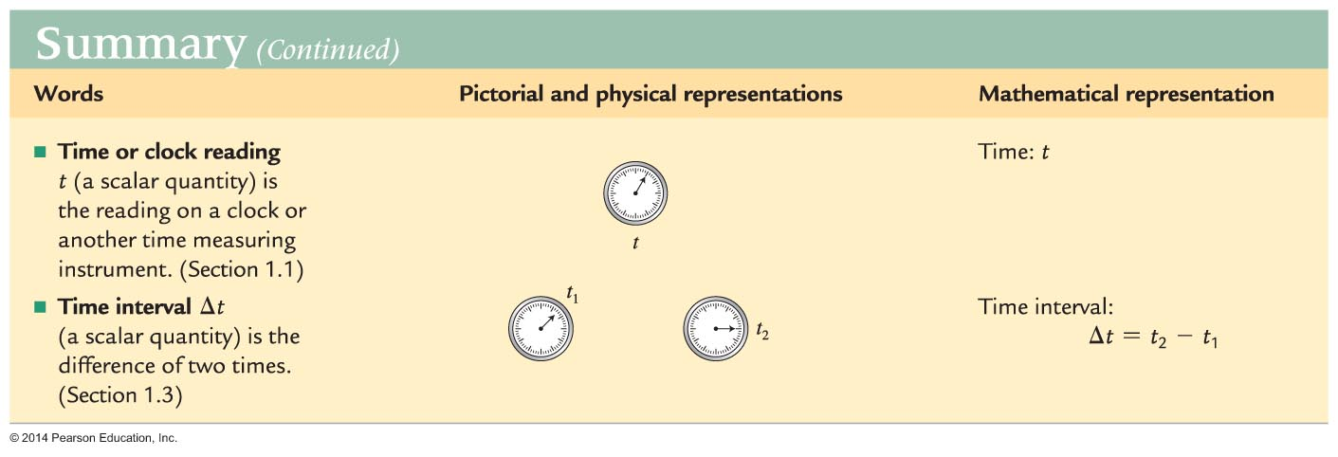
Summary

Slide 52
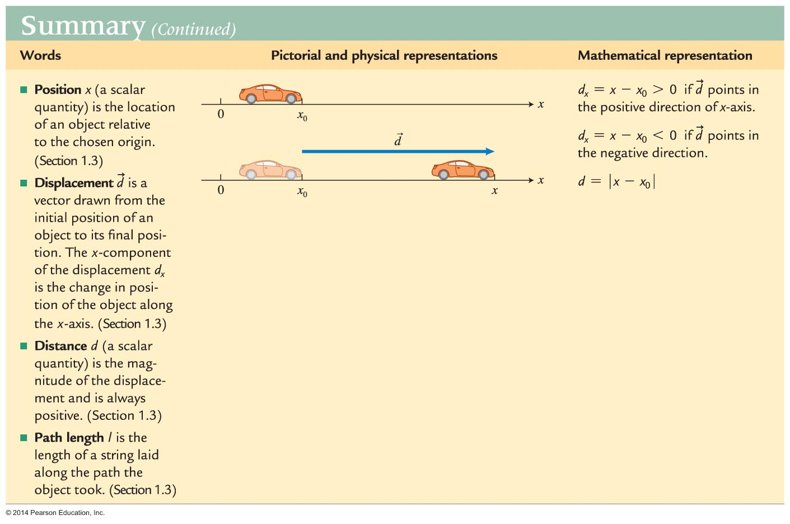
Summary

Slide 53
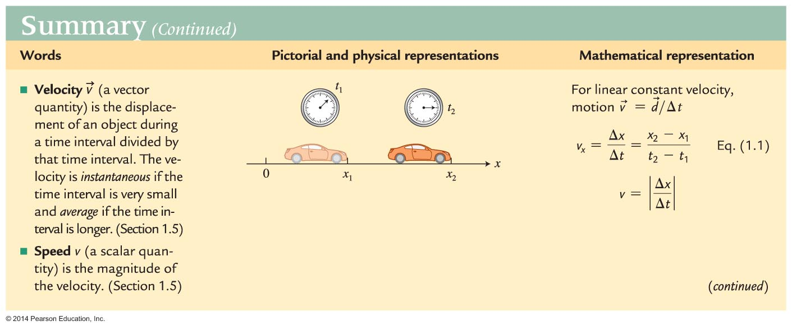
Summary

Slide 54
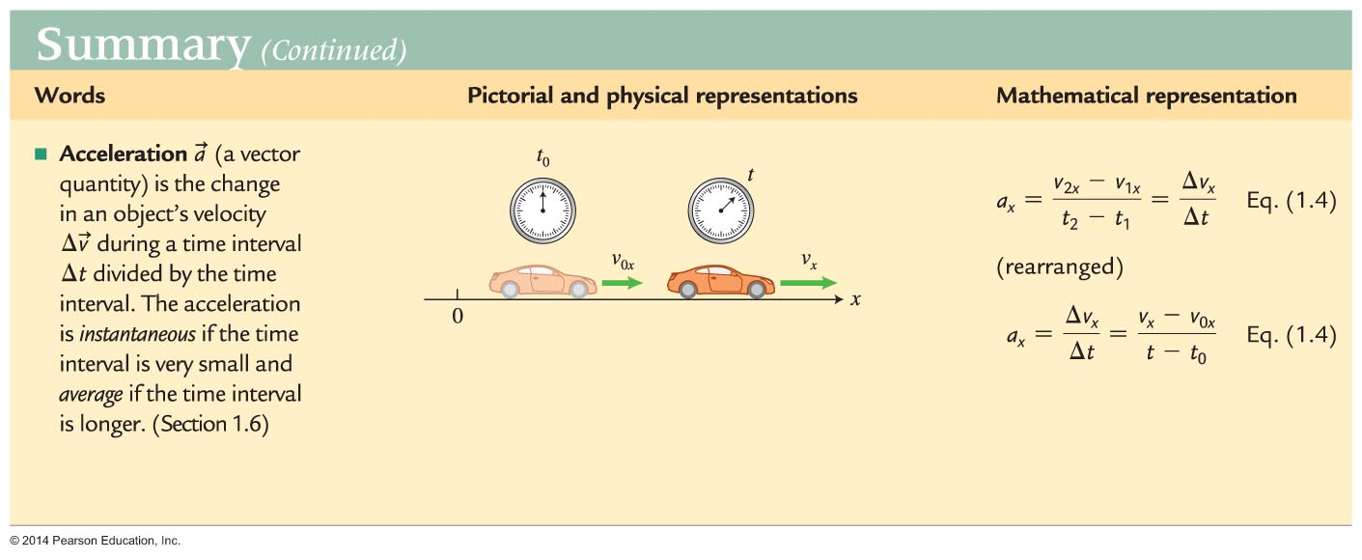
Summary

Slide 55
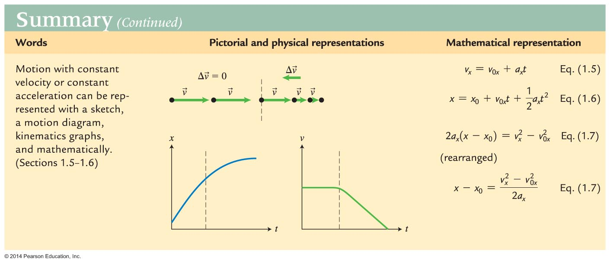
Summary

