Slide 1
Extended Bodies at Rest
Prepared by
Dedra Demaree, Georgetown University

Slide 2
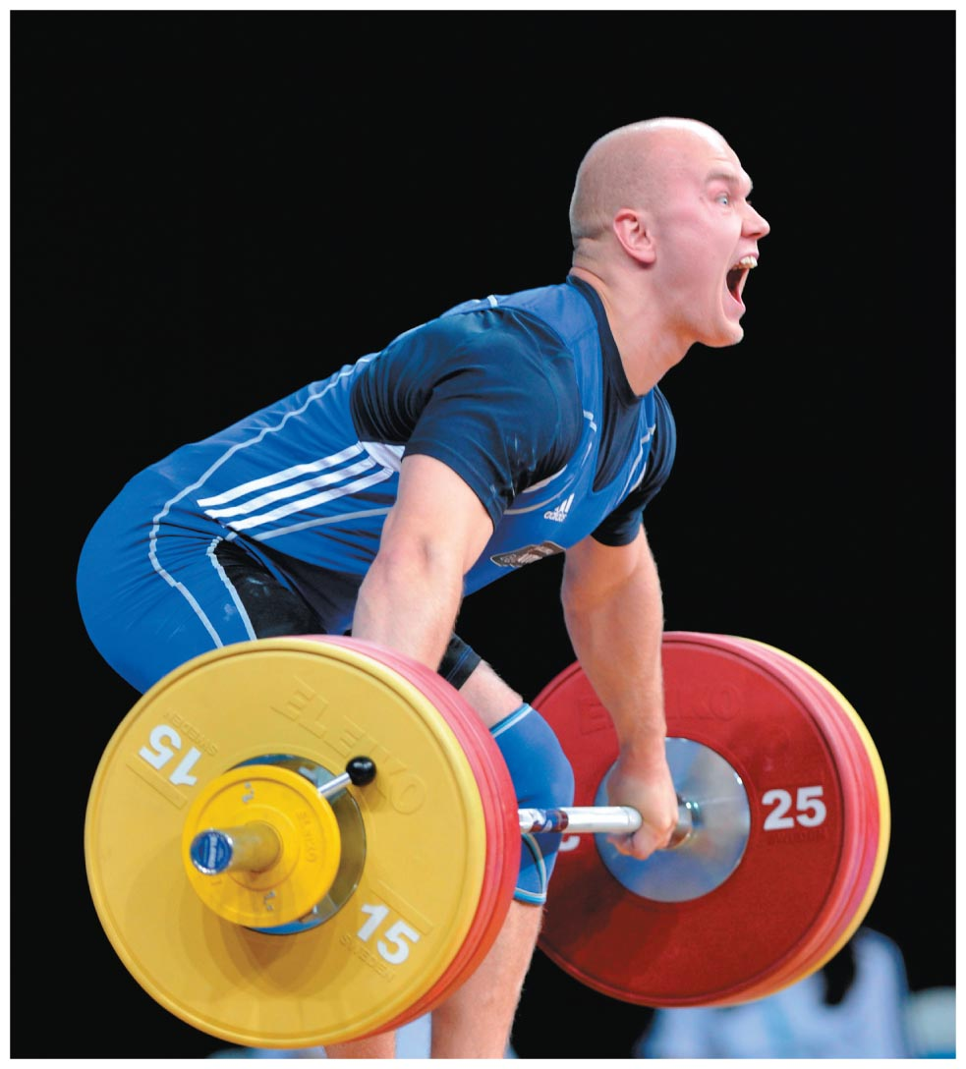
Extended Bodies at Rest
Why is it best to lift heavy objects with your knees bent and the object near your body?
Why are doorknobs located on the side of the door opposite the hinges?
Why must your biceps muscle exert about seven times more force on your forearm to lift a barbell than the force that Earth exerts on it?

Slide 3
Be sure you know how to:
Define the point-like model for an object (Section 1.2).
Draw a force diagram for a system (Section 2.1).
Use the component form of Newton's second law of motion (Section 3.5).

Slide 4
Where we are headed:
So far we have been modeling objects as point-like with no internal structure.
Objects are actually extraordinarily complex, with many internal parts that rotate and move relative to one another.
To study complex structures, we need to develop a new way of modeling objects and of analyzing their interactions.

Slide 5
Rigid bodies
A rigid body is a model for an extended object.
We assume that the object has a nonzero size but the distances between all parts of the object remain the same (the size and shape of the object do not change).

Slide 6
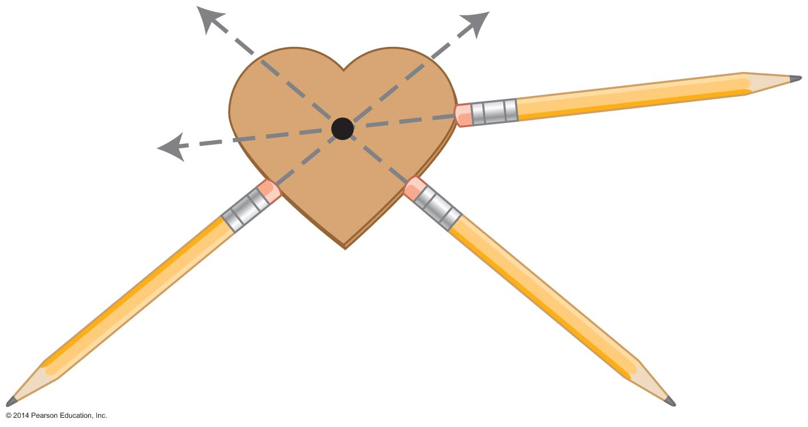
Center of mass
A rigid body possesses a special point such that if a force is exerted on that point, the object will not turn.
We call this point the object's center of mass.

Slide 7
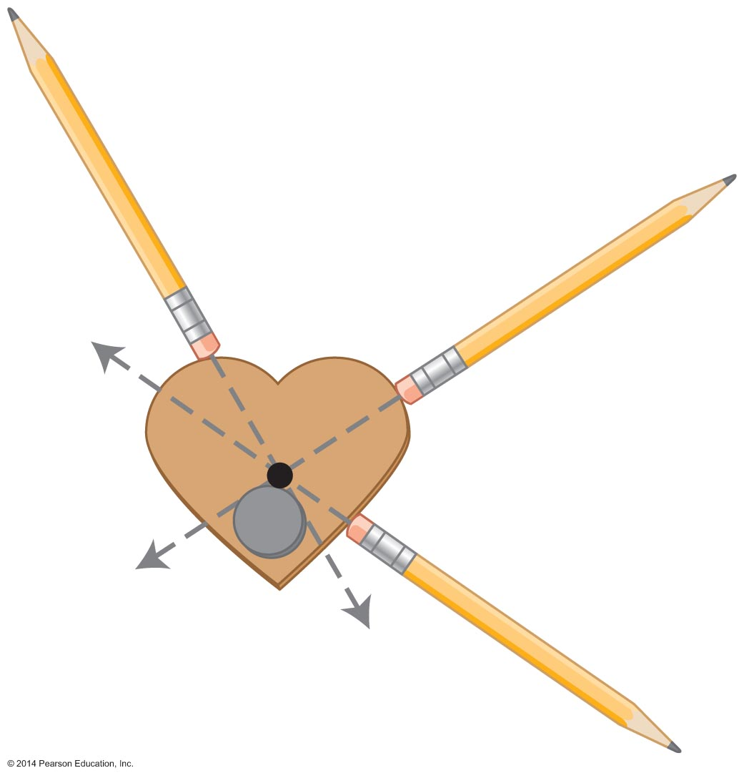
Center of mass: Qualitative definition
The center of mass of an object is a point where a force exerted on the object pointing directly toward or away from that point will not cause the object to turn. The location of this point depends on the mass distribution of the object.

Slide 8
Tip
Although the location of the center of mass depends on the mass distribution of the object, the mass of the object is not necessarily evenly distributed around the center of mass. We will learn more about the properties of the center of mass; we just want to caution you about taking the name of this point literally.

Slide 9
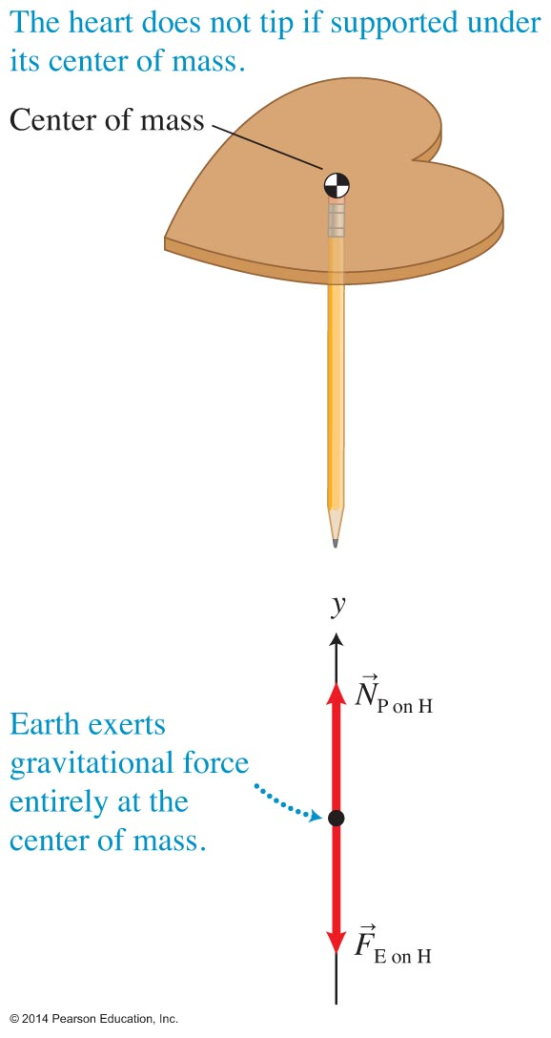
Where is the gravitational force exerted on a rigid body?
If the cardboard does not tip, all forces exerted on it pass through the center of mass.
We can assume that the gravitational force exerted on an object is exerted at the location of its center of mass.
That is why the object's center of mass is sometimes called the object's center of gravity.

Slide 10
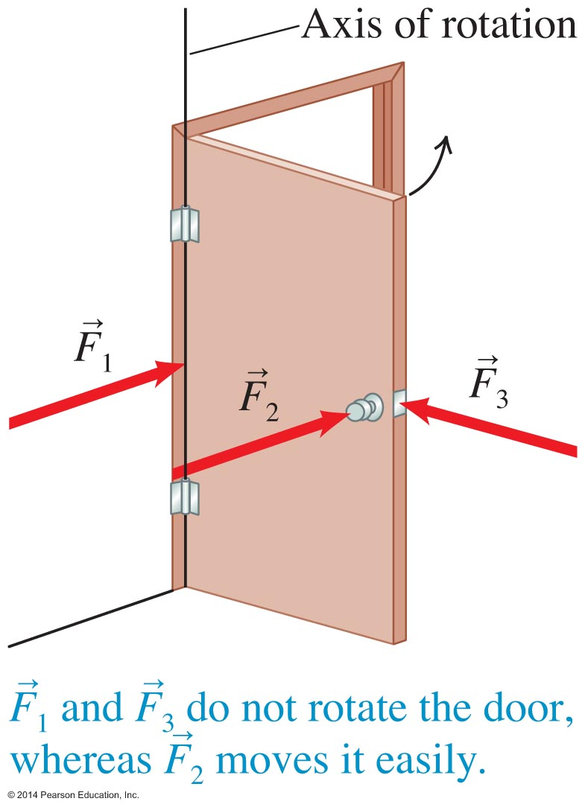
Axis of rotation
When objects turn around an axis, physicists say that they undergo rotational motion.
We call the imaginary line passing through the hinges the axis of rotation.

Slide 11
Causing rotation
Three factors affect the turning ability of a force:
The place where the force is exerted
The magnitude of the force
The direction in which the force is exerted

Slide 12
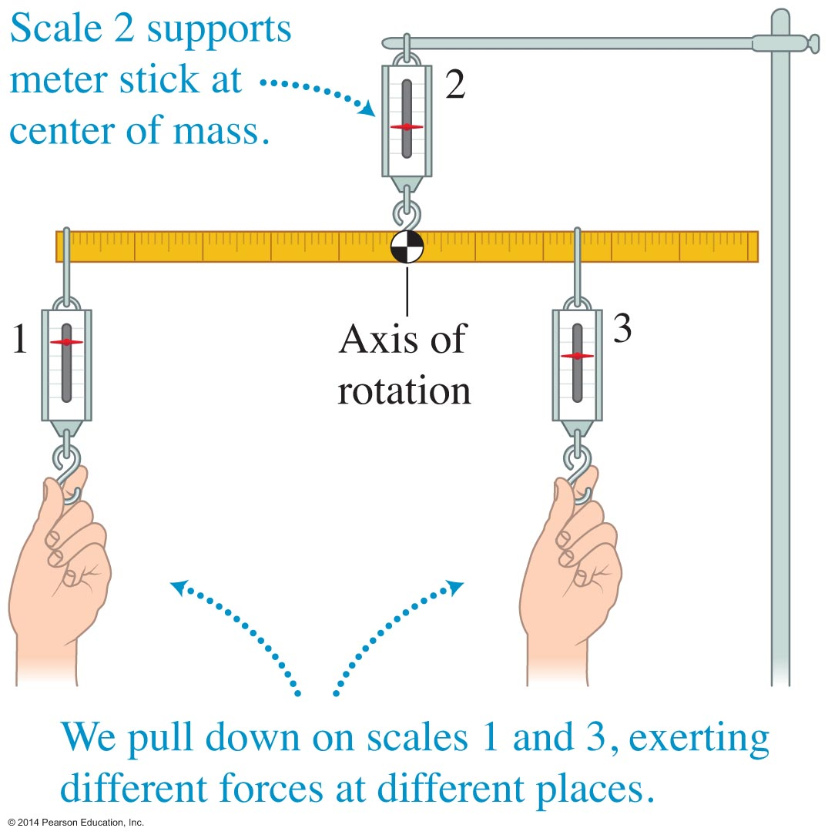
Quantitative expression for the turning ability of a force
If scale 1 is twice as far from the axis of rotation and pulls half as hard as scale 3, the stick remains in equilibrium.
If scale 1 is three times farther from the axis of rotation and exerts one-third of the force of scale 3, the stick remains in equilibrium

Slide 13
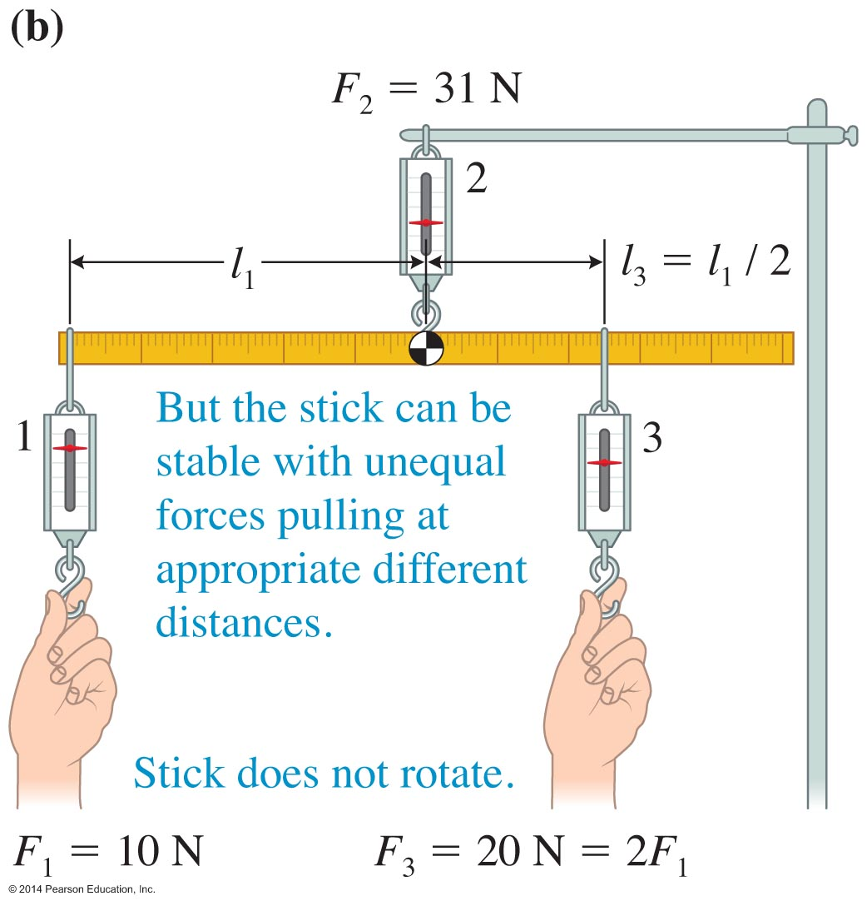
Static equilibrium
An object is in static equilibrium when it remains at rest (does not undergo either translational or rotational motion) with respect to a particular observer in an inertial reference frame.

Slide 14
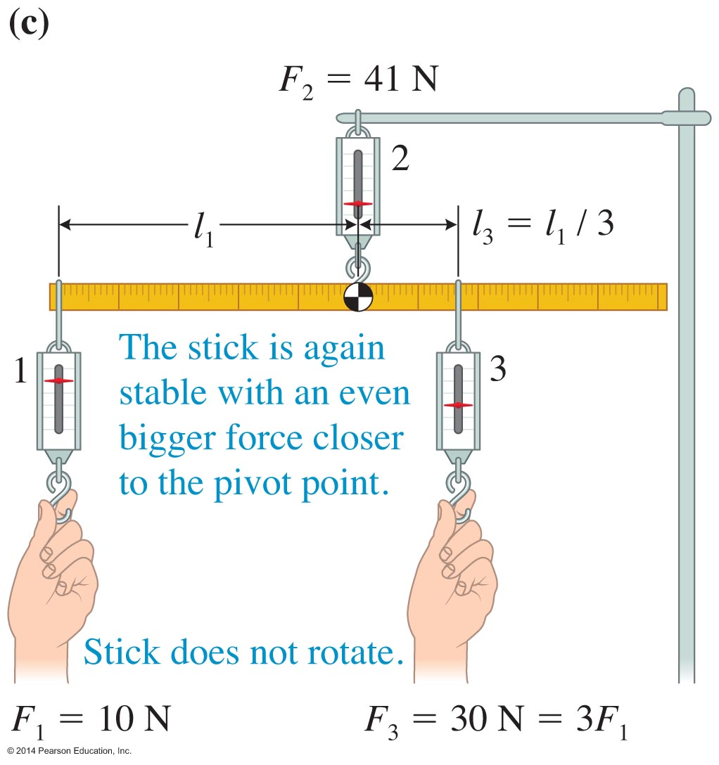
Static equilibrium
When the following condition is satisfied, an object will remain in static equilibrium:
F_{left} l_{left} = F_{right} l_{right}

Slide 15
So far, this is what we know about the new quantity that characterizes the turning ability of a force:
It is equal to the product of the magnitude of the force and the distance the force is exerted from the axis of rotation.
It is positive when the force tends to turn the object counterclockwise and negative when it turns the object clockwise.
When one force tends to rotate an object counterclockwise and another force rotates it clockwise, their effects can cancel.

Slide 16
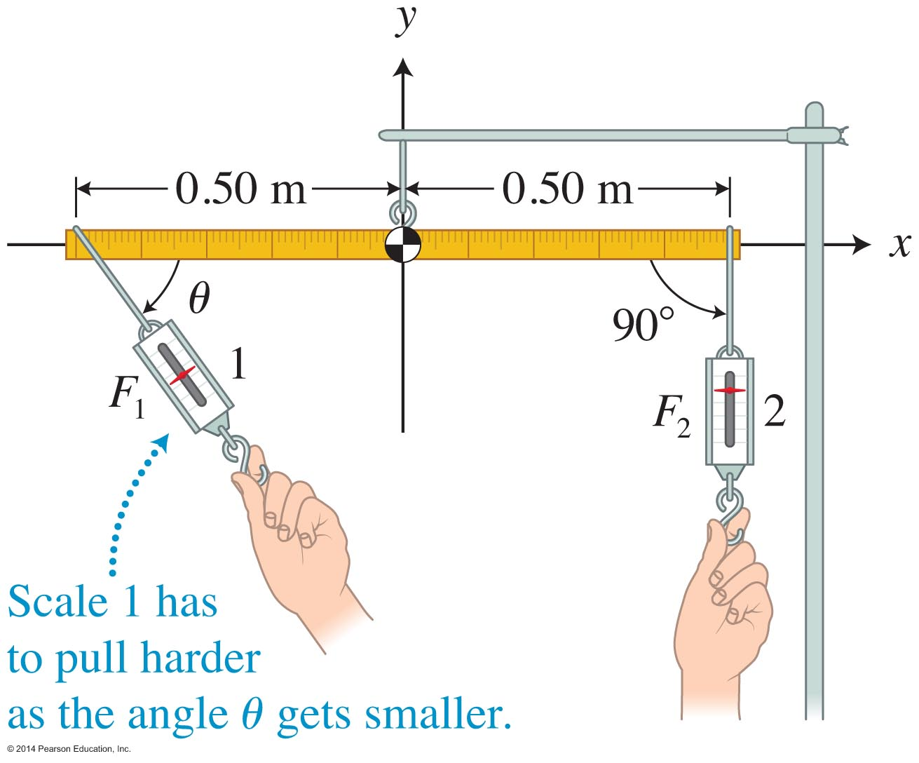
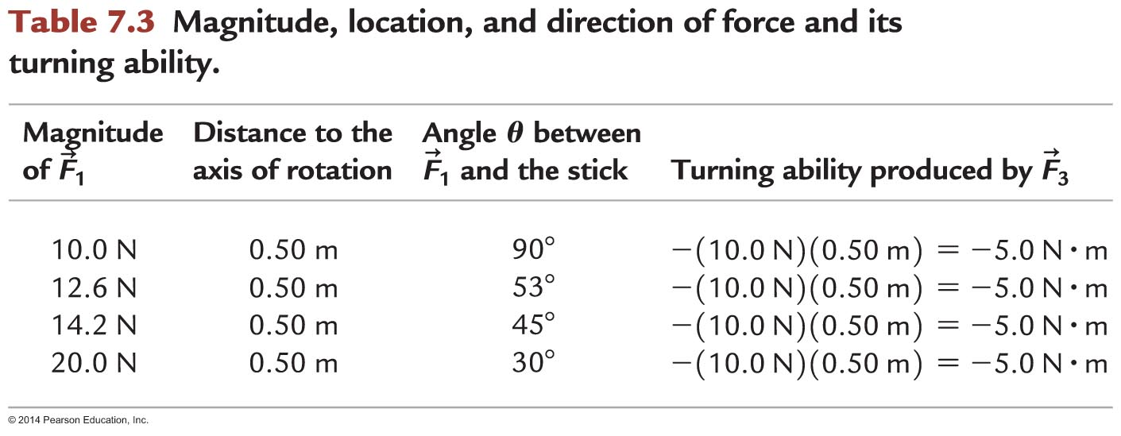
Dependence of the turning ability of a force on angle

Slide 17
Factors that affect the turning ability of a force
The direction (counterclockwise or clockwise) that the force can potentially rotate the object
The magnitude of the force F
The distance l of the point of application of the force from the axis of rotation
The angle that the force makes relative to a line from the axis of rotation to the point of application of the force

Slide 18
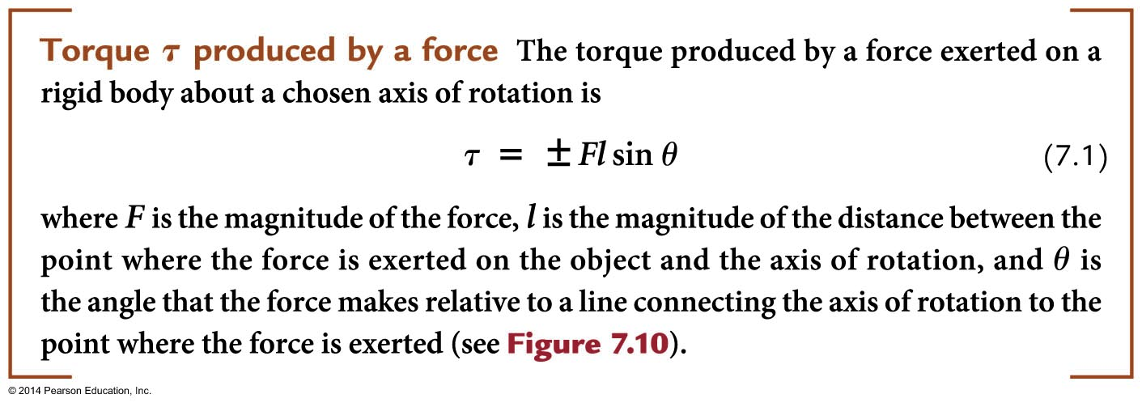
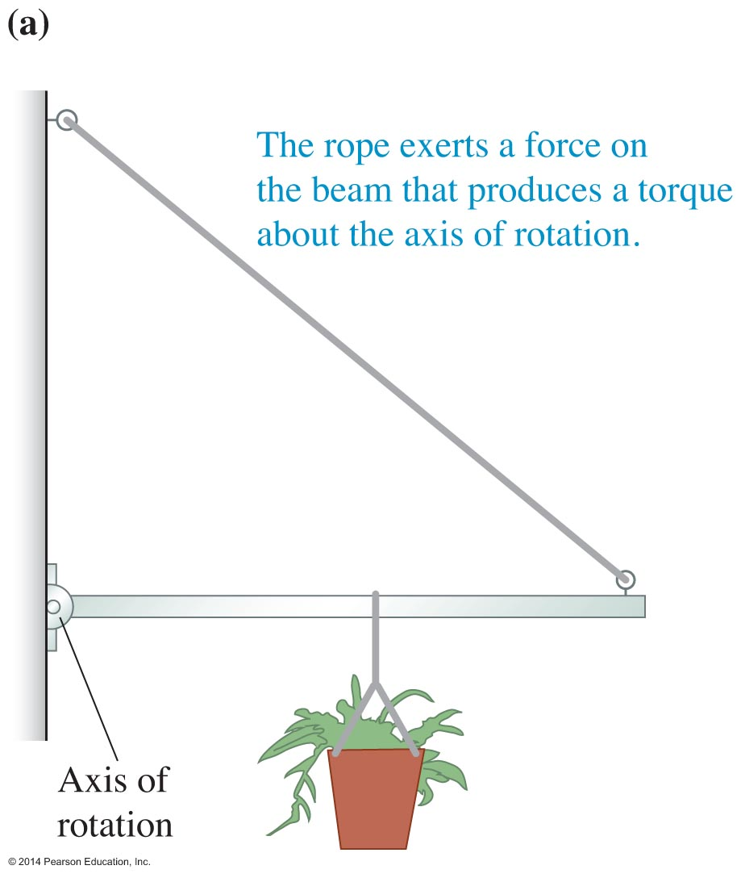
Torque τ produced by a force
The SI unit of force is the Newton-meter (N-m).

Slide 19
Tip

Slide 20
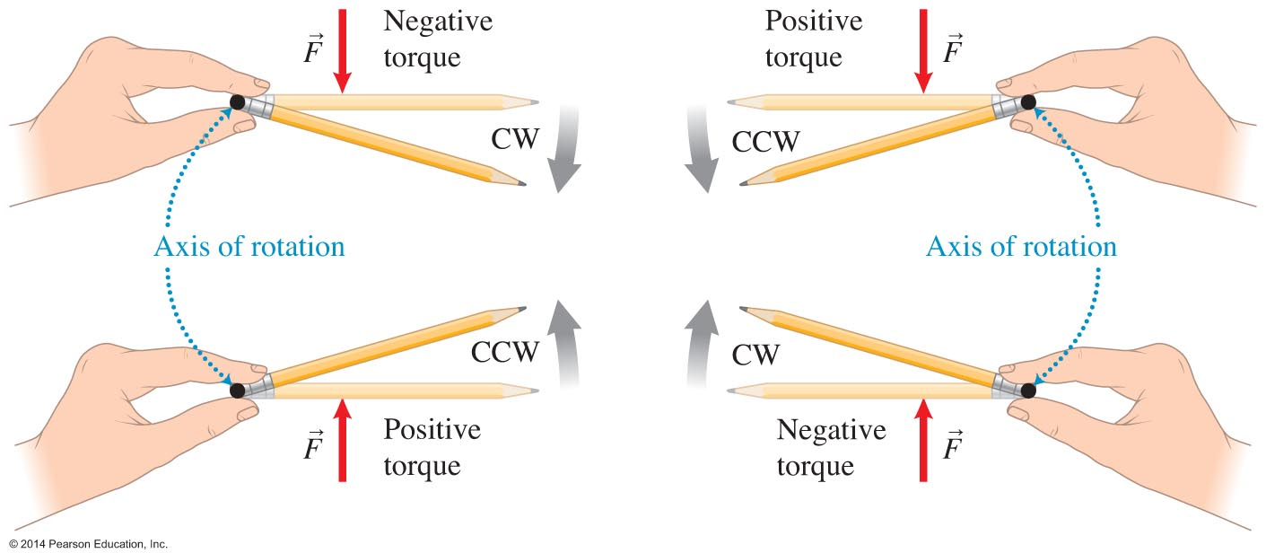
Tip
To decide the sign of the torque, pretend that a pencil is the rigid body. Hold it with two fingers at a place that represents the axis of rotation, and exert a force on the pencil representing the force whose torque sign you wish to determine. Does the force cause the pencil to turn counterclockwise (a positive torque) or clockwise (a negative torque) about the axis of rotation?

Slide 21
Conditions of equilibrium
An object remains at rest with respect to a particular observer in an inertial reference frame.
In this chapter, we consider only observers who are at rest with respect to Earth.

Slide 22
Observational Experiment 1

Slide 23
Observational Experiment 2

Slide 24
Condition 1: Translational (force) condition of static equilibrium
An object modeled as a rigid body is in translational static equilibrium with respect to a particular observer if it is at rest with respect to that observer and the components of the sum of the forces exerted on it in the perpendicular x- and y- directions are zero.

Slide 25
Condition 2: Rotational (torque) condition of equilibrium
A rigid body is in turning or rotational static equilibrium if it is at rest with respect to the observer and the sum of the torques (positive counterclockwise torques and negative clockwise torques) about any axis of rotation produced by the forces exerted on the object is zero.

Slide 26
Tip
All of the gravitational forces exerted by Earth on the different parts of a rigid body can be summarized as a single gravitational force being exerted on the center of mass of the rigid body.

Slide 27
Tip
If a rigid body is in static equilibrium, the sum of the torques about any axis of rotation is zero. In problem solving, it is often helpful to place the imaginary axis at the point on the rigid body where the force you know least about is exerted. That force drops out of the second condition of the equilibrium, and you can then use that equation to solve for some other unknown quantity.

Slide 28
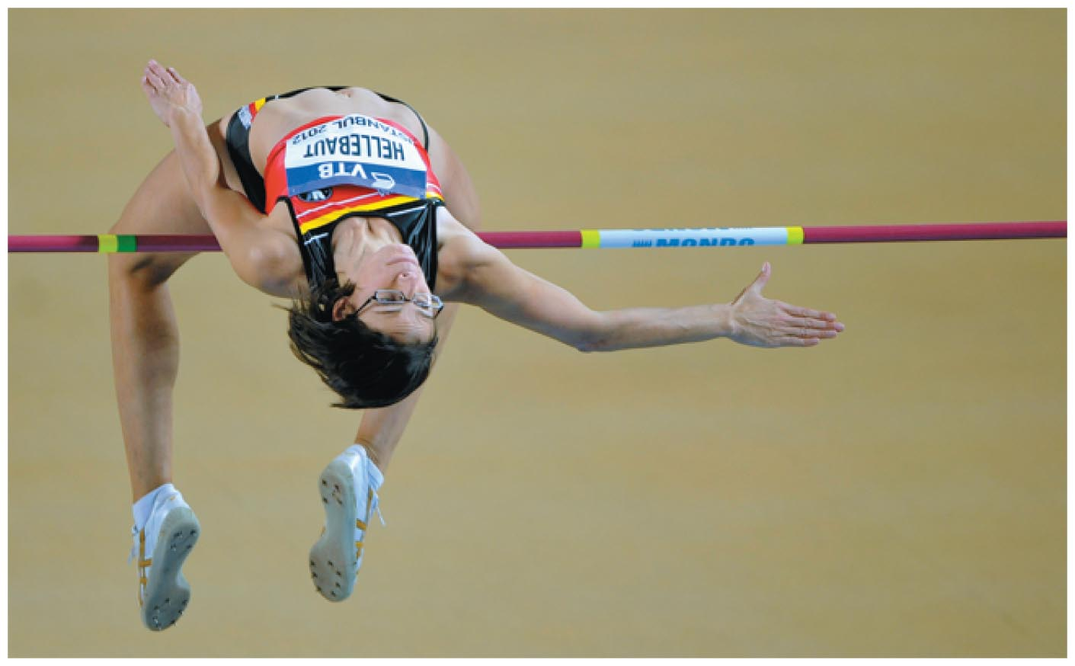
Center of mass
The high jumper does not have to jump as high because she is able to reorganize her body's shape so that her center of mass passes under the bar.
Without realizing it, we change the position of our center of mass with respect to other parts of the body quite often.

Slide 29
Center of mass: Quantitative definition
Using these equations for an object with a continuous mass distribution is difficult and involves calculus.

Slide 30
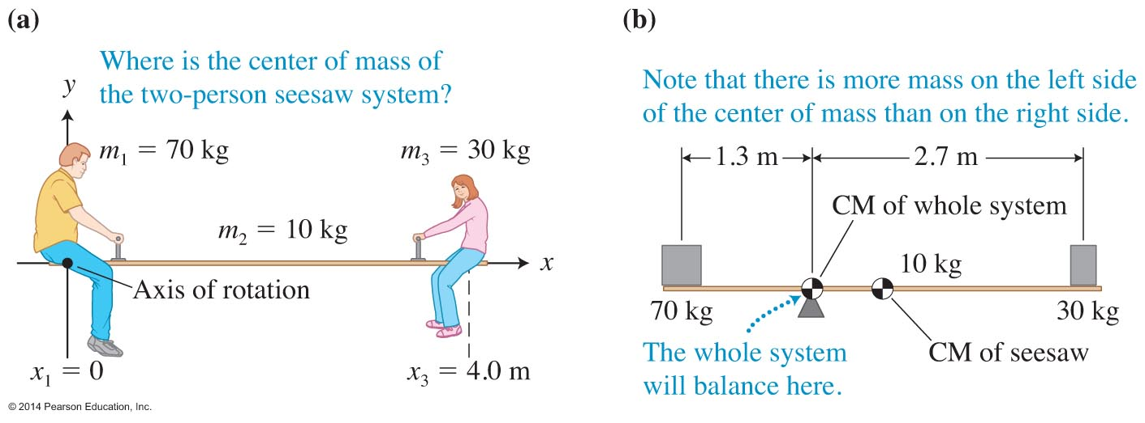
Mass distribution and center of mass
To find the center of mass, we need a coordinate system with an origin.

Slide 31
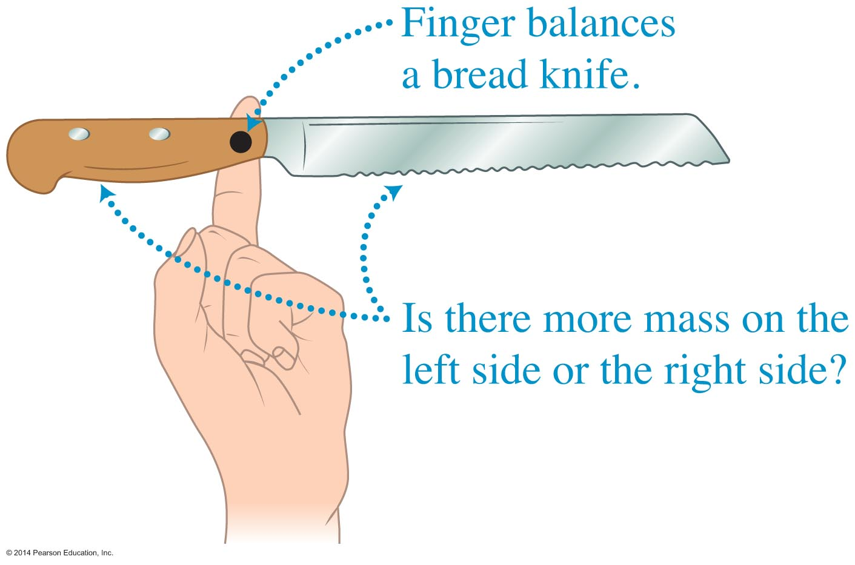
Mass distribution and center of mass
When an object with distributed mass is in static equilibrium, the torques produced by the forces exerted by Earth on the objects on each side of the center of mass have equal magnitudes.

Slide 32
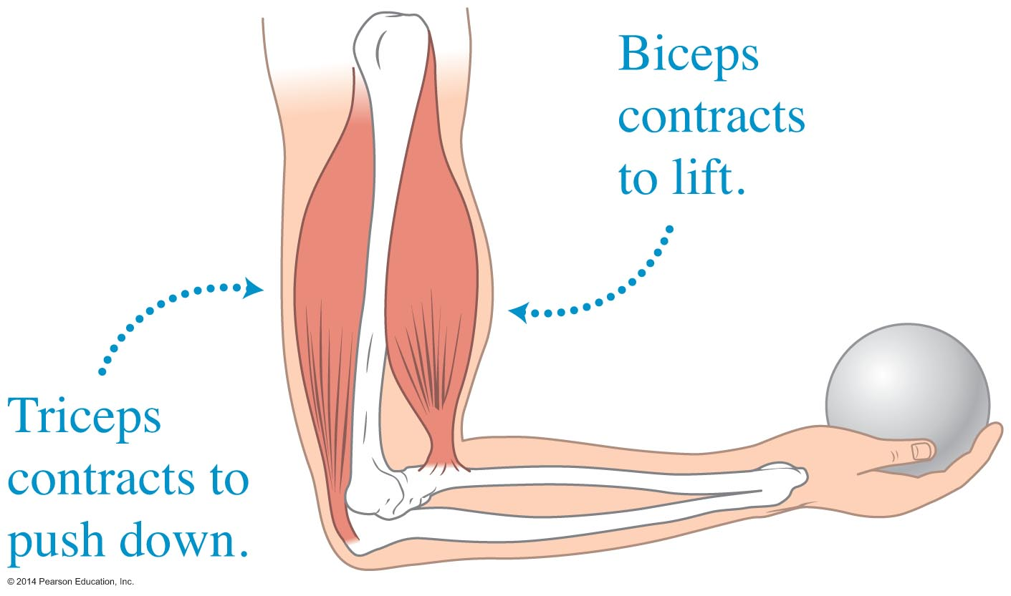
Skills for analyzing situations using equilibrium conditions
When you hold a ball in your hand, your bicep muscle tenses and pulls up on your forearm in front of the elbow joint.
When you push down with your hand on a desk, your triceps muscle tenses and pulls up on a protrusion of the forearm behind the elbow joint.
The equations of equilibrium allow you to estimate these muscle tension forces

Slide 33
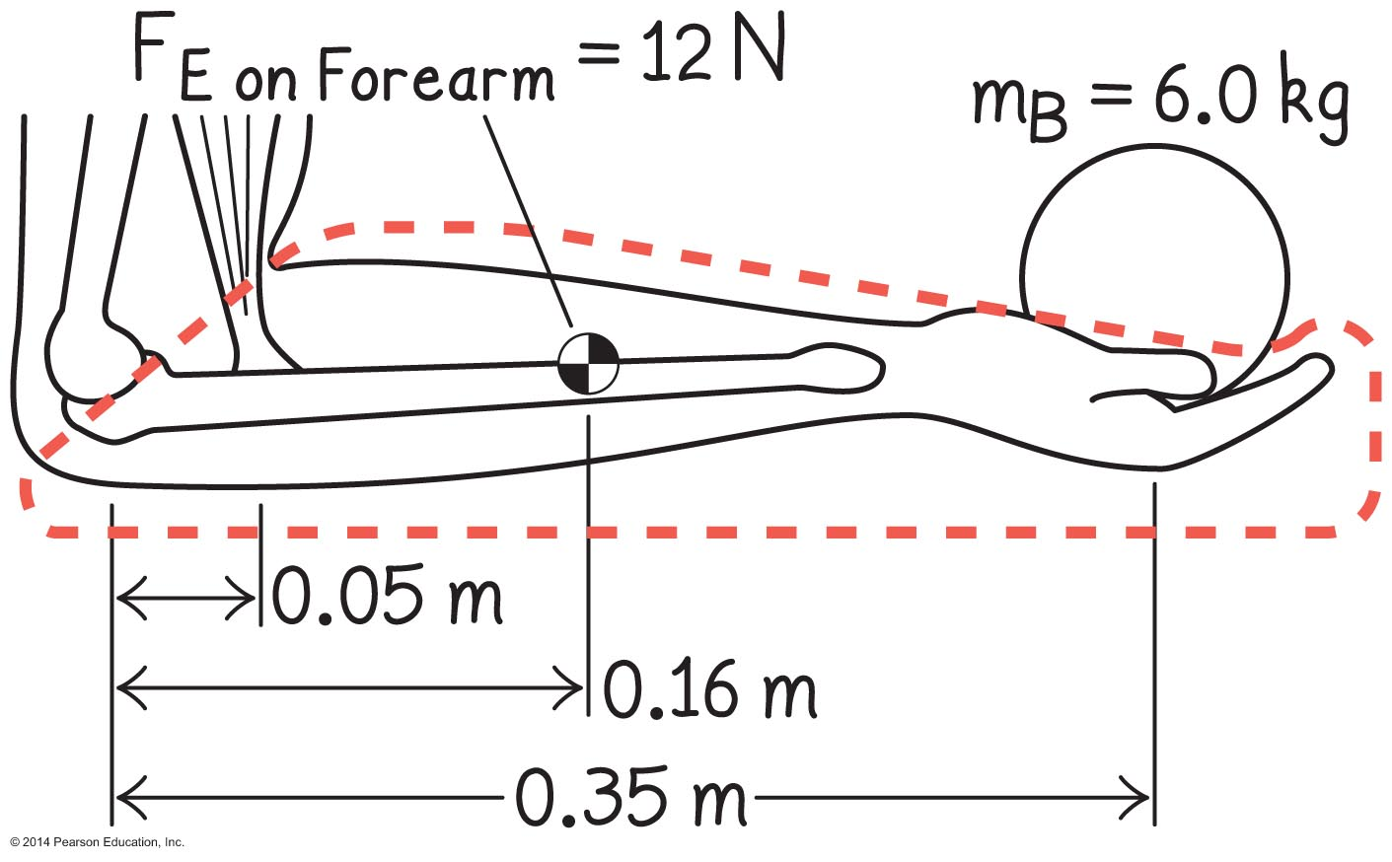
Problem-solving strategy: Applying static equilibrium conditions
Sketch and translate
Construct a labeled sketch of the situation. Include coordinate axes and choose an axis of rotation.
Choose a system for analysis.

Slide 34
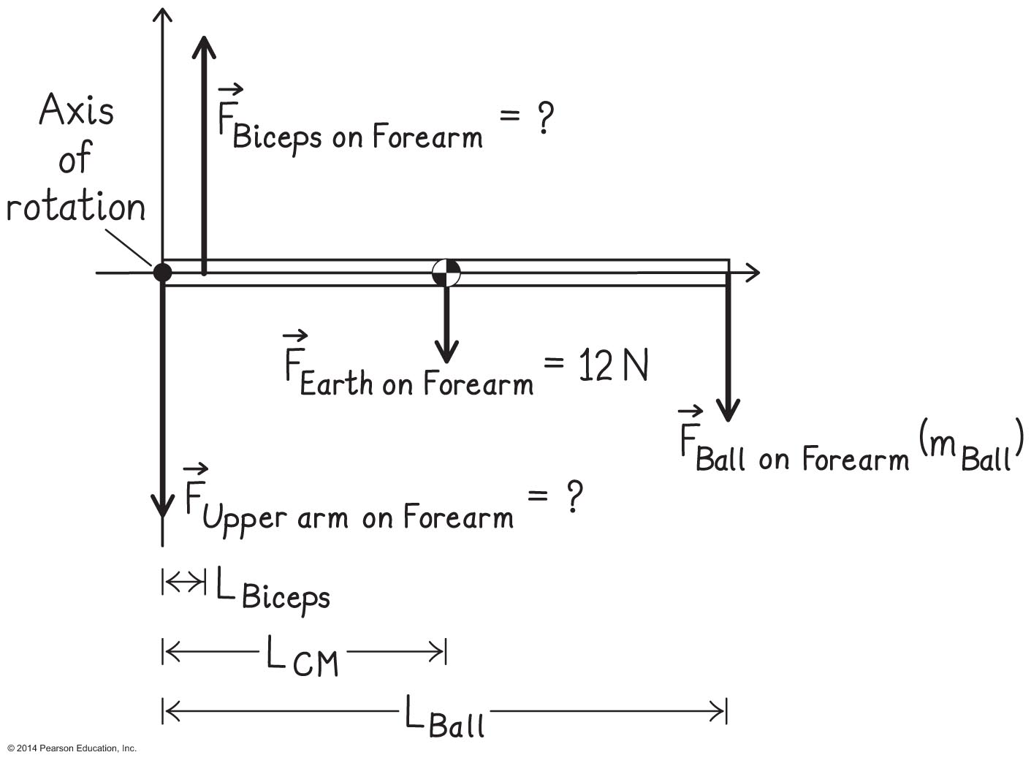
Problem-solving strategy: Applying static equilibrium conditions
Simplify and diagram
Decide whether you will model the system as a rigid body or as a point-like object.
Construct a force diagram for the system. Include the chosen coordinate system and the axis of rotation (the origin of the coordinate system).

Slide 35
Problem-solving strategy: Applying static equilibrium conditions
Represent mathematically
Use the force diagram to apply the conditions of equilibrium.
Solve and evaluate
Solve the equations for the quantities of interest.
Evaluate the results. Check whether their magnitudes are reasonable and whether they have the correct signs and units. Also see if they have the expected values in limiting cases.

Slide 36
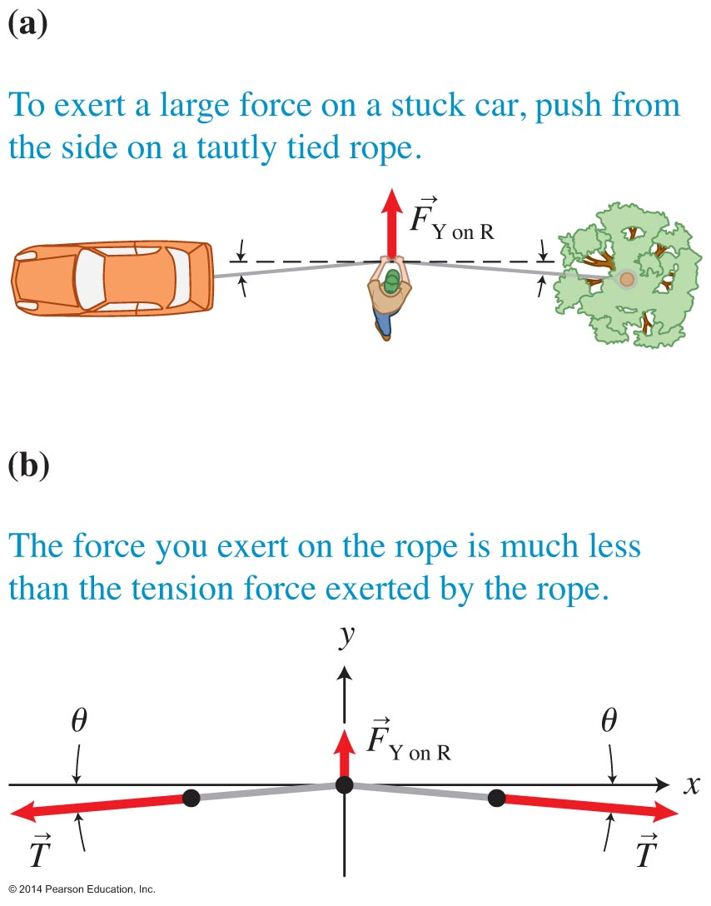
"Magnifying" a force
The force that the rope exerts on the car is much greater than the force that you exert on the rope.

Slide 37
Equilibrium and tipping objects
You have probably observed that it is easier to balance and avoid falling while standing in a moving bus or subway train if you spread your feet apart in the direction of motion.
By assuming this stance, you increase the area of support—the area of contact between an object and the surface it is supported by.

Slide 38
Observational experiment

Slide 39
Observational experiment

Slide 40
Tentative rule about tipping
For an object in static equilibrium, if a vertical line passing through the object's center of mass is within the object's area of support, the object does not tip.
If the line is not within the area of support, the object tips.

Slide 41
Testing experiment

Slide 42
Testing experiment

Slide 43
Testing experiment

Slide 44
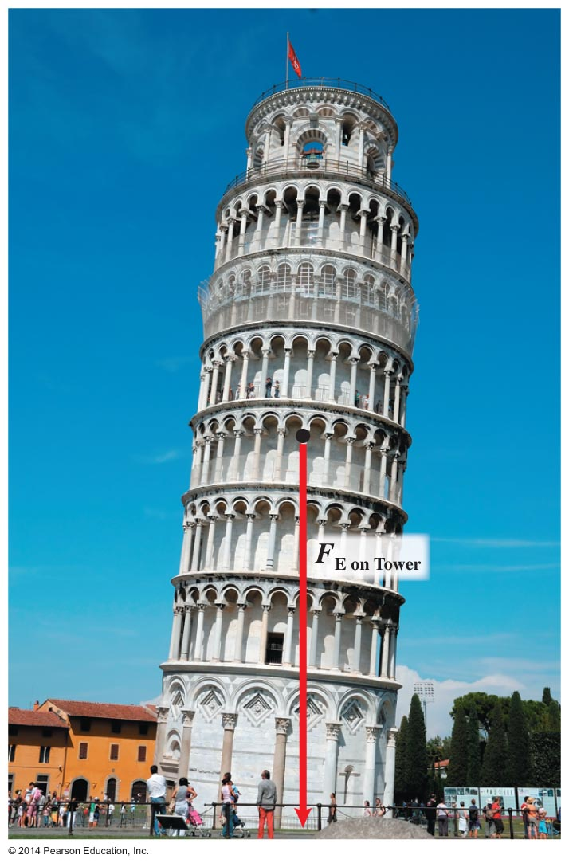
Equilibrium and tipping objects
The equilibrium of a system is stable against tipping if the vertical line through its center of mass passes through the system's area of support.
If the area of support is large or if the center of mass is closer to the ground, more tipping is possible without the object falling over—it is more stable.

Slide 45
Equilibrium and rotating objects

Slide 46
Equilibrium and rotating objects
If an object can rotate so that its center of mass becomes lower, it will tend to do so.
The equilibrium of a system is stable against rotation if the center of mass of the rotating object is below the axis of rotation.

Slide 47
Tip
Always try to understand new situations in terms of ideas we have already discussed.
The trick of balancing the pencil can be understood with the rules we expressed earlier:
The equilibrium is most stable:
When the center of mass of the system is in the lowest possible position or
When the gravitational potential energy of the system has the smallest value

Slide 48
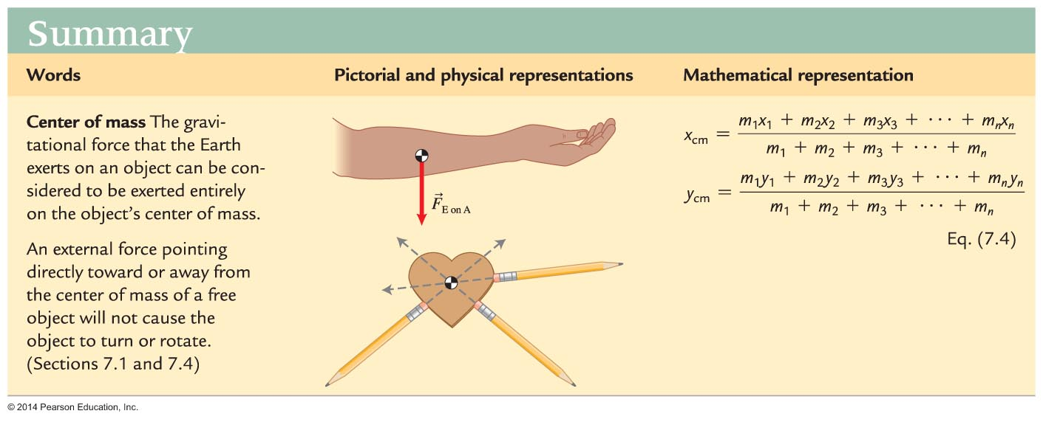
Summary

Slide 49
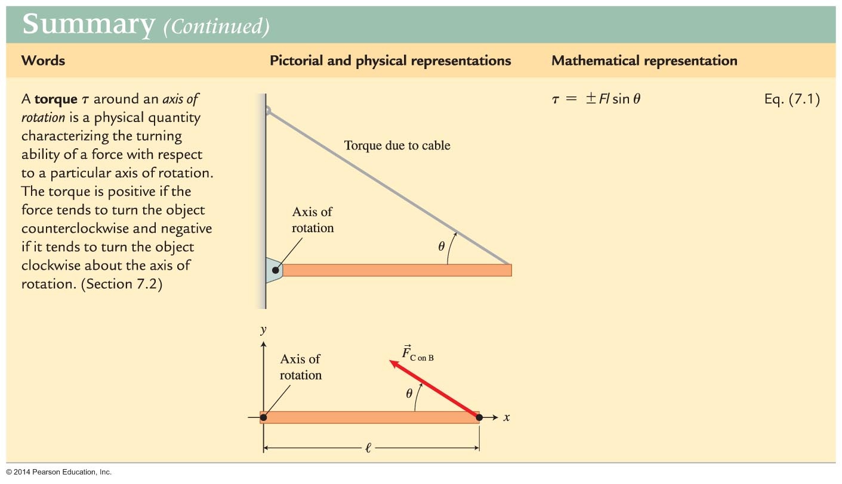
Summary

Slide 50
Summary

Slide 51
Summary

