Slide 1
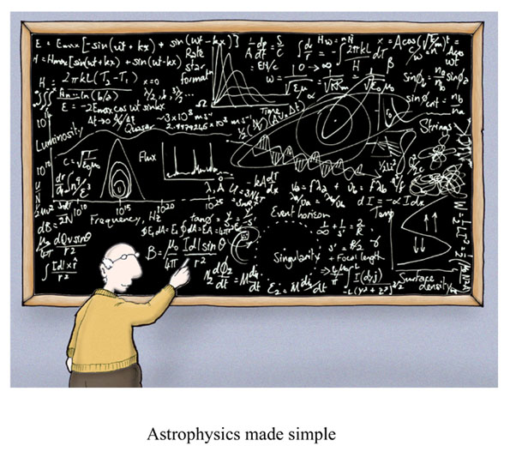
Uncertainty and Significant Figures
Cartoon courtesy of Lab-initio.com

Slide 2
Steps in the Scientific Method
1. Identify a problem
Gather information about the problem
- what info do you know
3. Formulating hypotheses
- possible explanation for the observation
- make a plan
Performing experiments
- gathering new information to decide
whether the hypothesis is valid
5. Form a conclusion

Slide 3
Nature of Measurement
A measurement is a quantitative observation consisting of 2 parts:
Part 1 - number
Part 2 - scale (unit)
Examples:
20 grams
6.63 x 10⁻³⁴ Joule·seconds

Slide 4
Who’s Ruling Who
Compare the measurements made using Ruler A with those made with Ruler B. Which measurement do your think is more accurate? Why?
Compare the measurements made using Ruler A with those made with Ruler C. Which measurement do your think is more accurate? Why?

Slide 5
Who’s Ruling Who
What conclusions can you make concerning the number of decimal places a measurement needs?
What conclusions can you draw about the accuracy of measurements of length based on the number of increments on a ruler?

Slide 6
The Fundamental SI Units (le Système International, SI)

Slide 7
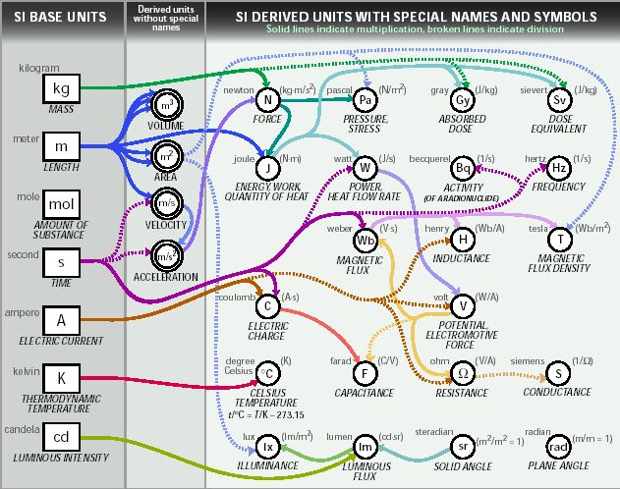
SI Units

Slide 8
Uncertainty in Measurement
A digit that must be estimated is called uncertain. A measurement always has some degree of uncertainty.

Slide 9
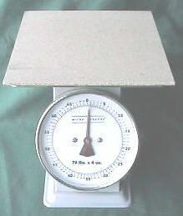
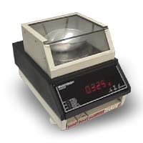
Why Is there Uncertainty?
Measurements are performed with instruments
No instrument can read to an infinite number of decimal places
Which of these balances has the greatest uncertainty in measurement?

Slide 10
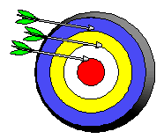
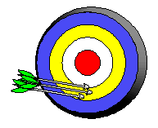
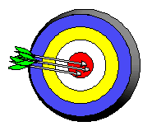
Precision and Accuracy
Accuracy refers to the agreement of a particular value with the true value.
Precision refers to the degree of agreement among several measurements made in the same manner.
Neither accurate nor precise
Precise but not accurate
Precise AND accurate

Slide 11
Types of Error
Random Error (Indeterminate Error) - measurement has an equal probability of being high or low.
Systematic Error (Determinate Error) - Occurs in the same direction each time (high or low), often resulting from poor technique or incorrect calibration.

Slide 12
Rules for Counting Significant Figures - Details
Nonzero integers always count as significant figures.
3456 has
4 significant figures

Slide 13
Rules for Counting Significant Figures - Details
Zeros
- Leading zeros do not count as
significant figures.
0.0486 has
3 significant figures

Slide 14
Rules for Counting Significant Figures - Details
Zeros
- Captive zeros always count as
significant figures.
16.07 has
4 significant figures

Slide 15
Rules for Counting Significant Figures - Details
Zeros
Trailing zeros are significant only if the number contains a decimal point.
9.300 has
4 significant figures

Slide 16
Rules for Counting Significant Figures - Details
Exact numbers have an infinite number of significant figures.
1 inch = 2.54 cm, exactly

Slide 17
Sig Fig Practice #1
How many significant figures in each of the following?
1.0070 m →
5 sig figs
17.10 kg →
4 sig figs
100,890 L →
5 sig figs
3.29 x 10³ s →
3 sig figs
0.0054 cm →
2 sig figs
3,200,000 →
2 sig figs

Slide 18
Rules for Significant Figures in Mathematical Operations
Multiplication and Division: # sig figs in the result equals the number in the least precise measurement used in the calculation.
6.38 x 2.0 =
12.76 → 13 (2 sig figs)

Slide 19
Sig Fig Practice #2
Calculation
Calculator says:
Answer
3.24 m x 7.0 m
22.68 m²
23 m²
100.0 g ÷ 23.7 cm³
4.219409283 g/cm³
4.22 g/cm³
0.02 cm x 2.371 cm
0.04742 cm²
0.05 cm²
710 m ÷ 3.0 s
236.6666667 m/s
240 m/s
1818.2 lb x 3.23 ft
5872.786 lb·ft
5870 lb·ft
1.030 g ÷ 2.87 mL
2.9561 g/mL
2.96 g/mL

Slide 20
Rules for Significant Figures in Mathematical Operations
Addition and Subtraction: The number of decimal places in the result equals the number of decimal places in the least precise measurement.
6.8 + 11.934 =
18.734 → 18.7 (3 sig figs)

Slide 21
Sig Fig Practice #3
Calculation
Calculator says:
Answer
3.24 m + 7.0 m
10.24 m
10.2 m
100.0 g - 23.73 g
76.27 g
76.3 g
0.02 cm + 2.371 cm
2.391 cm
2.39 cm
713.1 L - 3.872 L
709.228 L
709.2 L
1818.2 lb + 3.37 lb
1821.57 lb
1821.6 lb
2.030 mL - 1.870 mL
0.16 mL
0.160 mL

Slide 22
Density
Density - the volume which is occupied by a specific mass of a material, usually given in units of grams per cubic centimeters or grams per milliliter.
D = m/v

Slide 23
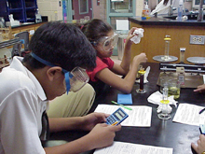
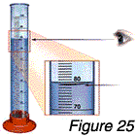
Density of Liquid
The density of a liquid can be determined by massing the liquid and then measuring the exact volume.

Slide 24
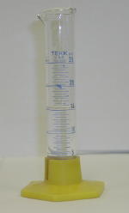
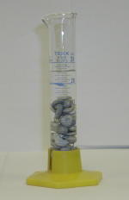
Displacement/Solid Density
The volume of a solid can be difficult to measure, so its density is determined using a different method. The volume is found by measuring the volume of a liquid that the solid displaces. In the example below, the volume of the compound is 17.2 mL
Volume of water= 15.0 ml Volume of water + compound = 32.2 ml

Slide 25
Math problems
To solve all math problems in this class you will use the “u,k,p,s” method.
u: unknown
k: known
p: plan
s: solve
Notes:
Scientific method

Slide 26
Density practice problem 1
An aluminum bar with a volume of 35 cm³ has a mass of 94.5 g. What is the density of aluminum based on this information?
u: density Al
k: m= 94.5 g; v=35cm³
p: d= m
v
s: d = 94.5g =
35cm³
2.7 g/cm³

Slide 27
Density practice problem 2
A glass tube that holds exactly 75.0000 mL is filled with liquid mercury metal whose mass is shown to be 1020.0011g. From these data, what is the density of mercury metal?
u: density Hg
k: m= 1020.0011 g; v=75.0000mL
p: d= m
v
s: d = 1020g =
75mL
13.6000 g/mL

Slide 28
Density practice problem 3
The mass of 155 mL of ethyl alcohol is found to be exactly 122.5 g. What is the density of ethyl alcohol?
u: density of ethyl alcohol
k: m= 122.5g; v=155mL
p: d= m
v
s: d = 122.5g =
155mL
0.790 g/mL

Slide 29
Density practice problem 4
A block of ice with a mass of 519.0g is found to occupy a volume of 565.8 cm³. What is the density of the ice?
u: density H₂O(s)
k: m= 519.0 g; v=565.8cm³
p: d= m
v
s: d = 519.0g =
565.8 cm³
0.9173 g/cm³

Slide 30
Density practice problem 5
Find the density of a sample of silicon which has a volume of 235.7cm³ and a mass of 570.44 g.
u: density Si
k: m= 570.44g; v=235.7cm³
p: d= m
v
s: d = 570.44g =
235.7 cm³
2.42 g/cm³

Slide 31
Density practice problem 6
A solid cube of impure zinc metal, 3.50 cm on a side, has a density of 6.95g/cm³. What is the mass of the cube?
u: mass of Zn
k: d= 6.95g/mL; l(per side)=3.50cm
p: d= m volume=l*w*h
v
s: volume =3.50cm*3.50cm*3.50cm = 42.88cm³
6.95g = m =
cm³ 42.88cm³
(6.95g)(42.88cm³) = m (cm³)
cm³ cm³
m =298g

Slide 32
Density practice problem 7
An irregularly shaped piece of gold (density = 19.3g/cm³) has a mass of 428.4g. What is the volume of this piece of gold?
u: volume of Au
k: d= 19.3g/mL; m=428.4g
p: d= m
v
s: 19.3g = 428.4g =
mL v
(19.3g)(v) = mL (428.4g)
19.3g 19.3g
22.2cm³ Au = v

Slide 33
SigFig & Density Quiz tomorrow

