Slide 1
Chapter 6
The Periodic Table

Slide 2
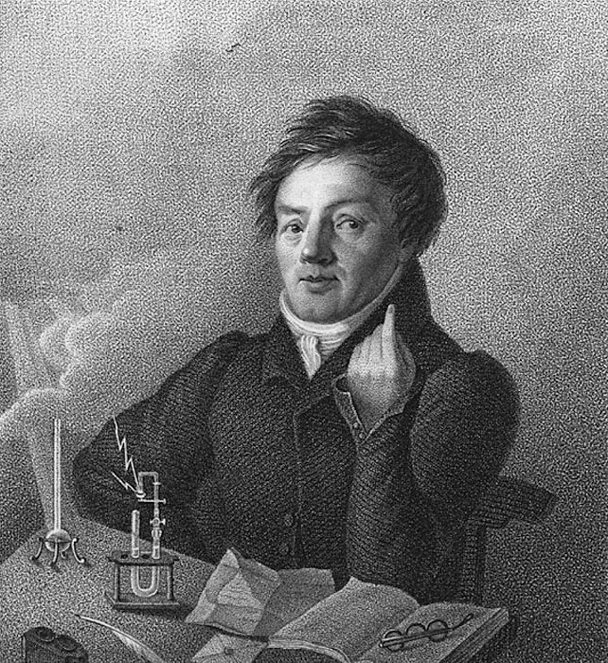
Johann Dobereiner (1829)
attempted to classify elements based on triads
Triad—group of 3 elements with similar properties
EX: Cl, Br, I

Slide 3
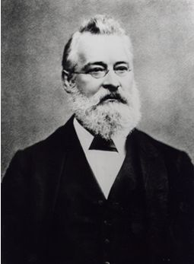
John Newlands (1863)
arranged the elements in terms of increasing atomic masses
He noted that the properties repeated every 8th element (only 49 elements discovered then)
Law of Octaves—similar properties occur every 8th element when elements are listed in the order of increasing atomic mass

Slide 4
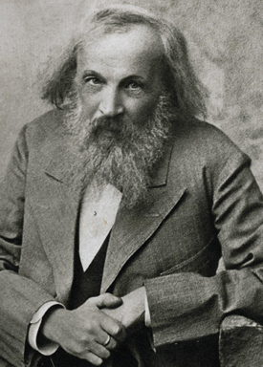
Dimitri Mendeleev (1869)
Father of the periodic chart
columns had elements with similar properties over each other
horizontal rows arranged by increasing atomic mass
blank spaces actually PREDICTED undiscovered elements and their properties

Slide 5
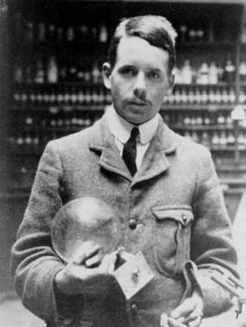
Henry Moseley (1913)
found a way to determine the atomic number (p+) of an atom and suggested that elements be arranged based on increasing atomic number

Slide 6
Periodic
Periodic—means repeating pattern
Periodic Law
elements in a column (group) have similar properties
elements across a row have regularly changing properties

Slide 7
Modern Periodic Table
arranged by increasing atomic #
columns have similar properties (e- configurations)

Slide 8
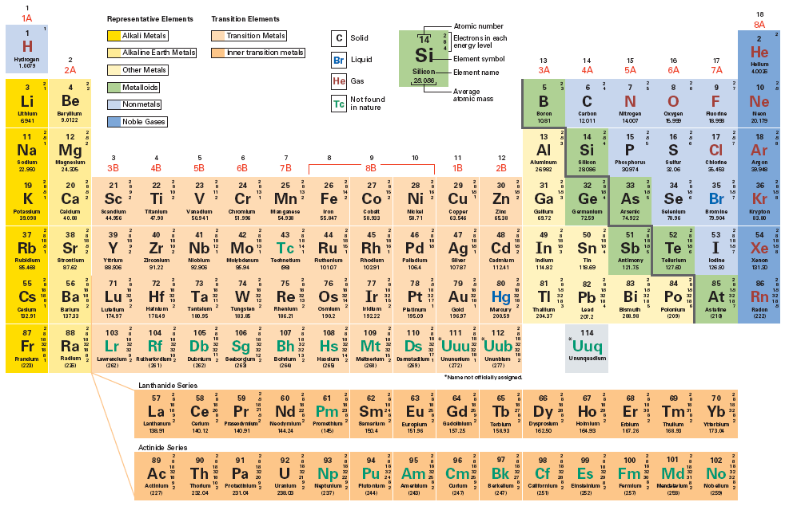
Modern Periodic Table

Slide 9
The “Real” Periodic Table

Slide 10
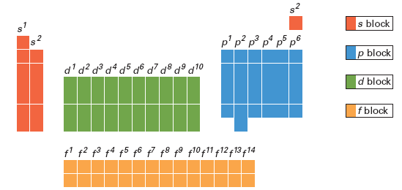
Modern Periodic Table

Slide 11
Groups

Slide 12
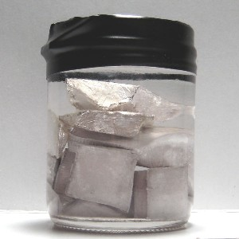
Unstable!!!
Alkali Metals (Group 1)
most reactive metals
never found alone in nature
lose 1 e- to achieve stability
Brainiac Video

Slide 13
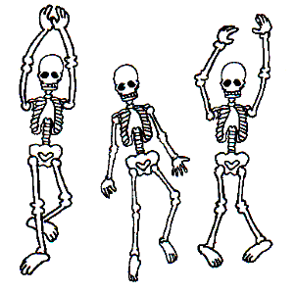
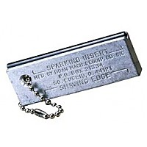
Alkaline Earth Metals (Group 2)
harder, denser, stronger, higher melting points than Group 1
less reactive than Group 1
will lose 2 e- to achieve stability

Slide 14
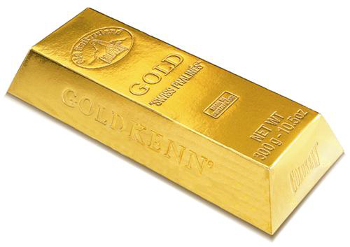
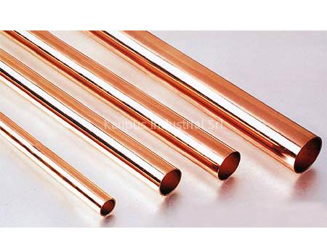
Transition Metals (Groups 3-12)
metals with 1 or 2 e- in their outer energy level
less reactive than Group 1 & 2
some exist in nature as free elements (Au, Pd, Pt, Ag)
lose e- to achieve stability

Slide 15
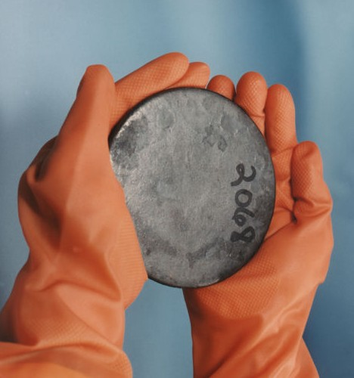
Inner Transition Metals
Lanthanides—elements 57-70
all very similar to each other
this is why they are not placed in a group
all are metals, some are very strong magnets
Actinides—elements 89-102
all are radioactive
most are synthetic
all are metals

Slide 16
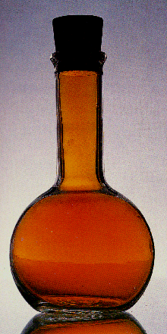
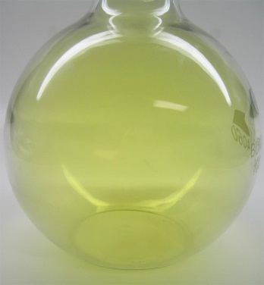
Unstable!!!
Halogens (Group 17)
most reactive nonmetals
never found alone in nature
gain or share e- to achieve stability
Chlorine
Iodine
Bromine

Slide 17
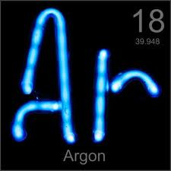
Noble Gases (Group 18)
Discovered between 1858 and 1900
inert
Newest Group

Slide 18
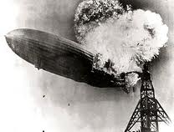
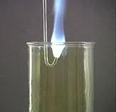
HYDROGEN (H)
doesn’t belong to any group
unique properties
nonmetal
placed where it is based on e- config.
can lose, gain, or share its 1 e-

Slide 19
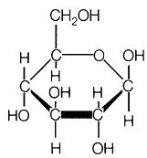
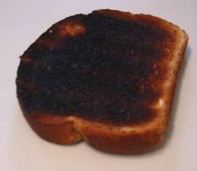
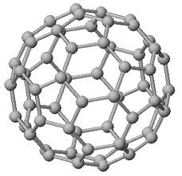
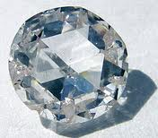
CARBON
can lose, gain, or share 4 e-
Prefers to share. Why?
Element of life

Slide 20
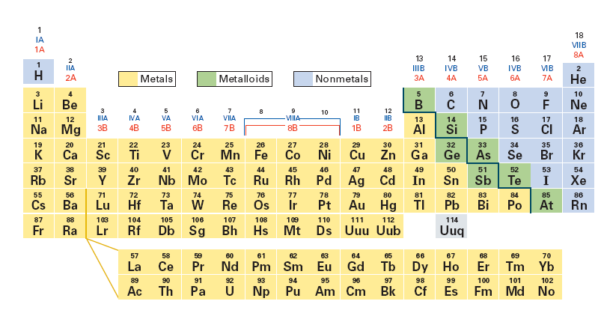
Metals, Nonmetals, & Metalloids

Slide 21
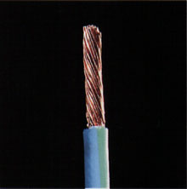
Metals
hard, shiny, good conductor, loses e- to form compounds, usually 2 or less e- in the outer energy level
malleable – hammered into sheets
ductile – drawn into wires

Slide 22
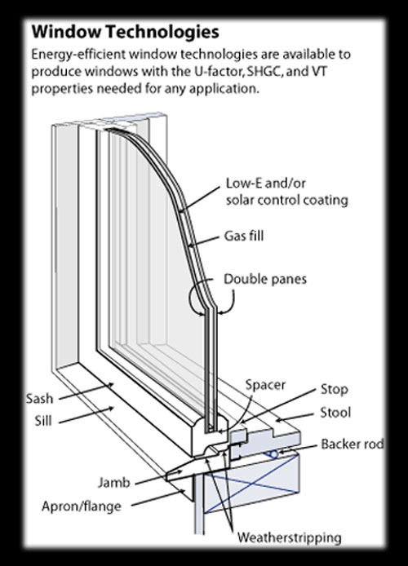
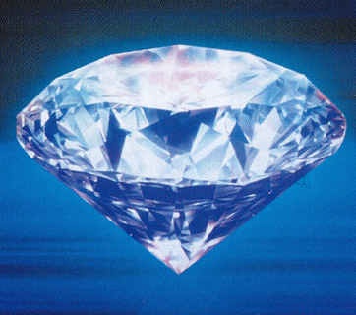
Nonmetals
gases or brittle solids
insulators, gain or share e- to form compounds
usually have 5 or more e- in outer energy level

Slide 23
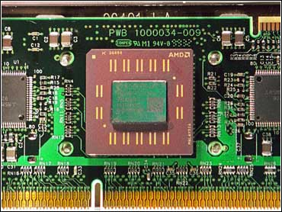
Metalloids
semiconductors
properties of both metals and nonmetals

Slide 24
Electron Configurations
An element’s chemical properties are determined by its e- config.
Differences in properties of elements are due to different e- configurations, not just placement on the chart.

Slide 25
Chemical Reactions
Why do elements form compounds?
When elements react, they try to produce a system in which all of the atoms have full outer energy levels.

Slide 26
Outer Electrons
Main group elements – “s” and “p” block elements (1A, 2A, 3A, 4A, 5A, 6A, 7A, 8A)
Valence Electrons—e- available to be gained, lost, or shared (“s” and “p”)
Recall Lewis Dot diagrams

Slide 27
Ions
Ion – an atom or group of atoms having a charge
can be (+) or (-)
charged due to gain or loss of electrons
Cation – positive ion, forms when metals LOSE e-
Anion – negative ion, forms when nonmetals GAIN e-

Slide 28
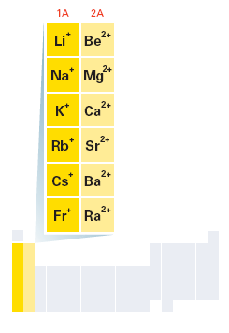
Ions

Slide 29
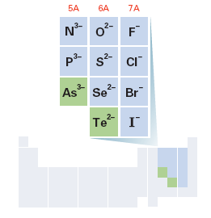
Ions

Slide 30
Oxidation Number (charge)
The Oxidation Number (charge) tells the number of electrons an atom will lose or gain to achieve stability
Group 1 = +1 | Aluminum = +3
Group 2 = +2 | Zinc = +2
Group 18 = 0 | Cadmium = +2
Group 17 = -1 | Silver = +1
Group 16 = -2 | Carbon = -4 or +4
Group 15 = -3 (nonmetals) | Hydrogen = +1 or -1
Transition metals can lose e- from “s” or “d” sublevel or both, multiple oxidation #s (usually +1 or +2).

Slide 31
Periodic Trends

Slide 32
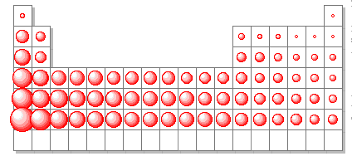
Atomic Radius
Atomic Radius – how big an atom is (p. 171)
decreases across a period b/c Z_{eff} increases
increases down a group b/c more electrons are added

Slide 33
Z_{eff}
Z_{eff} = effective nuclear charge
This is how much charge the negative valence electrons “feel” from the positive
Z_{eff} can be approximated by subtracting the number of inner (non-valence) electrons from the atomic number.

Slide 34
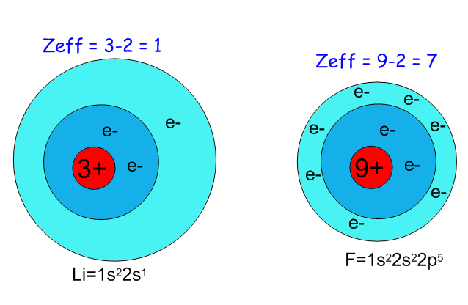
*Fluorine's outer electrons experience a stronger attraction to the nucleus and are pulled in closer.

Slide 35
Periodic Trends
Ionic Radius – how big an ion is (charged particle); p. 177
Metal ions – have lost electrons, charge is (+), cation
Ionic radius is smaller than atomic radius
isoelectronic with preceding noble gas
size of metal cations
decreases across a period
increases down a group
Nonmetal ions – have gained electrons, charge is (-), anion
Ionic radius is larger than atomic radius
isoelectronic with following noble gas
size of nonmetal anions
decreases across a period
increases down a group

Slide 36
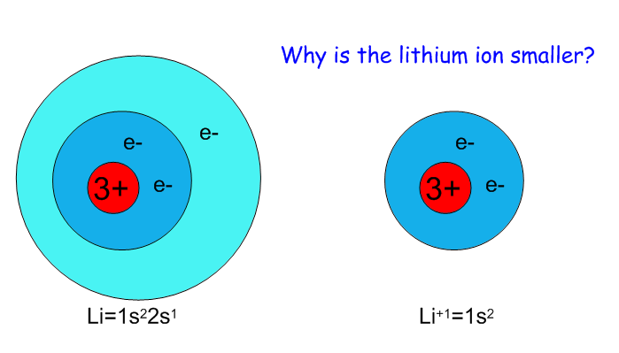
Ionic Radius

Slide 38
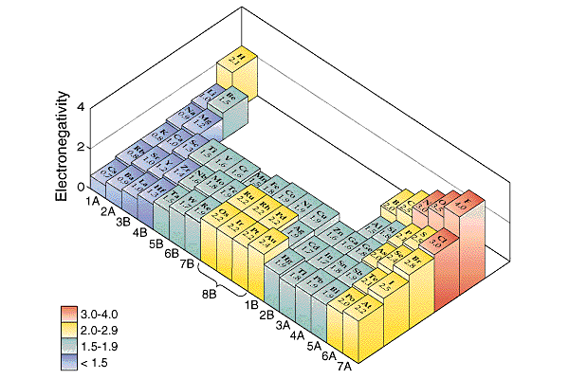
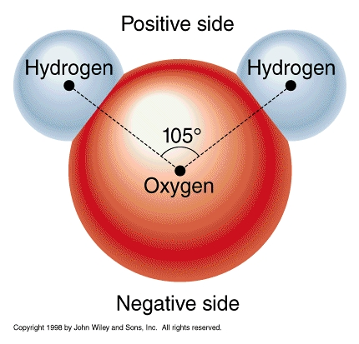
Electronegativity (EN)
Electronegativity – the ability of an atom to attract e- when in a compound
Increases across a period. Why?
Increased Z_{eff} attracts electrons closer to nucleus.
decreases down a group
Inner electrons “shield” the outer electrons from the nucleus.

Slide 39
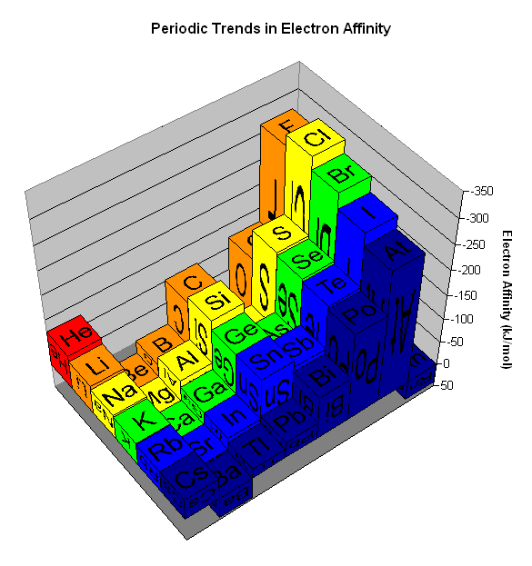
Electron Affinity
Attraction for outer electrons of a neutral non-bonded atom.
Trend is identical to EN

Slide 40
Ionization Energy (IE)
Ionization Energy – energy required to remove an e- from an atom
(units = kJ/mol) {p. 173-174}
First Ionization Energy (FIE) – energy required to remove most loosely held e-
increases across a period
decreases down a group
Metals have low ionization energies. Why?
They easily lose electrons in order to become stable.
Nonmetals have high ionization energies. Why?
Losing electrons makes them more unstable.

Slide 41
Shielding
Shielding – inner e- block Z_{eff} attraction of (+) nucleus for outer e-
constant across a period
increases down a group
Outer e- feel less charge
How does this affect ionization energy?
It causes IE to decrease down a group

Slide 42
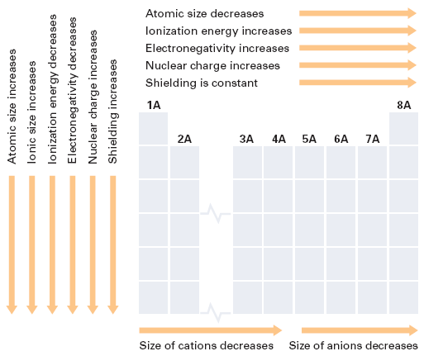
Summary of Periodic Trends

