Slide 1
Our Solar System
Section 1: Formation of the Solar System
Section 2: The Inner Planets
Section 3: The Outer Planets
Section 4: Other Solar System Objects

Slide 3

Section 1: Formation of the Solar System
The solar system formed from the collapse of an interstellar cloud.
K What I Know | W What I Want to Find Out | L What I Learned

Slide 4
Essential Questions
How did the solar system form?
How are early concepts of the structure of the solar system described?
How has our current knowledge of the solar system developed?
What is the relationship between gravity and the motions of the objects in the solar system?
Copyright © McGraw-Hill Education
Formation of the Solar System

Slide 5
Vocabulary
Review
focus
New
planetesimal
retrograde motion
ellipse
astronomical unit
eccentricity
Copyright © McGraw-Hill Education
Formation of the Solar System

Slide 6
Formation Theory
Scientific theories on the origin of the solar system must explain observed facts, such as the shape of the solar system, differences among the planets, and the nature of the oldest planetary surfaces—asteroids, meteorites, and comets.
Formation of the Solar System
Copyright © McGraw-Hill Education

Slide 7
A Collapsing Interstellar Cloud
Stars and planets form from interstellar clouds, which exist in space between the stars. These clouds consist mostly of hydrogen and helium gas with small amounts of other elements and dust.
At first, the density of interstellar gas is low. However, gravity slowly draws matter together until it is concentrated enough to form a star and possibly planets. Astronomers think that the solar system began this way.
Formation of the Solar System
Copyright © McGraw-Hill Education

Slide 8
A Collapsing Interstellar Cloud
Collapse accelerates
At first, the collapse of an interstellar cloud is slow, but it gradually accelerates and the cloud becomes much denser at its center.
If rotating, the cloud spins faster as it contracts, due to centripetal force.
Formation of the Solar System
Copyright © McGraw-Hill Education

Slide 9
A Collapsing Interstellar Cloud
Collapse accelerates
As a collapsing interstellar cloud spins, the rotation slows the collapse in the equatorial plane, and the cloud becomes flattened.
Eventually, the cloud becomes a rotating disk with a dense concentration of matter at the center.
Formation of the Solar System
Copyright © McGraw-Hill Education

Slide 10
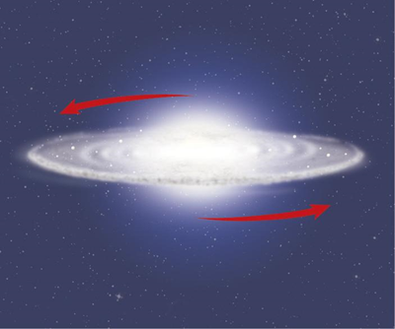
A Collapsing Interstellar Cloud
Collapse accelerates
The interstellar cloud that formed our solar system collapsed into a rotating disk of dust and gas. When concentrated matter in the center acquired enough mass, the Sun formed in the center and the remaining
matter gradually condensed, forming the planets.
Formation of the Solar System
Copyright © McGraw-Hill Education

Slide 11
A Collapsing Interstellar Cloud
Matter condenses
Within the rotating disk surrounding the young Sun, the temperature varied greatly with location. This resulted in different elements and compounds condensing, depending on their distance from the Sun, and affected the distribution of elements in the forming planets.
Formation of the Solar System
Copyright © McGraw-Hill Education

Slide 12
Planetesimals
Colliding particles in the early solar system merged to form planetesimals—space objects built of solid particles that can form planets through collisions and mergers.
Formation of the Solar System
Copyright © McGraw-Hill Education

Slide 13
Physical Data of the Planets
Concepts In Motion
FPO Add link to Interactive Table from p. 798 here https://connected.mcgraw-hill.com/media/repository/protected_content/COMPOUND/50000025/5/64/index.html?mghCourseID=KOSMFW99ZJ2NCX8MZLX1S3Y51O
Copyright © McGraw-Hill Education
Formation of the Solar System

Slide 14
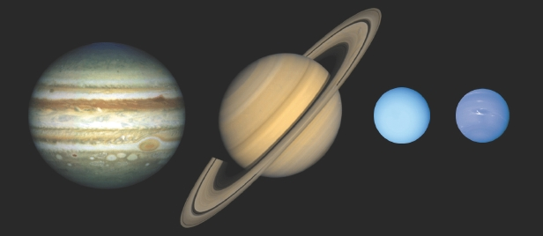
Planetesimals
Gas giants form
The first large planet to develop was Jupiter. Jupiter increased in size through the merging of icy planetesimals that contained mostly lighter elements.
Saturn and the other gas giants formed similarly to Jupiter, but they could not become as large because Jupiter had collected so much of the available material.
https://www.spaceanswers.com/wp-content/uploads/2013/04/gas_sizes-CREDIT-Lunar-and-Planetary-Institute.jpg
Formation of the Solar System
Copyright © McGraw-Hill Education

Slide 15
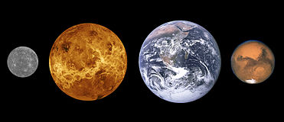
Planetesimals
Terrestrial planets form
Planets that formed in the inner part of the main disk, near the young Sun, were composed primarily of elements that resist vaporization, so the inner planets are rocky and dense.
https://upload.wikimedia.org/wikipedia/commons/thumb/2/25/Terrestrial_planet_sizes.jpg/371px-Terrestrial_planet_sizes.jpg
Formation of the Solar System
Copyright © McGraw-Hill Education

Slide 16
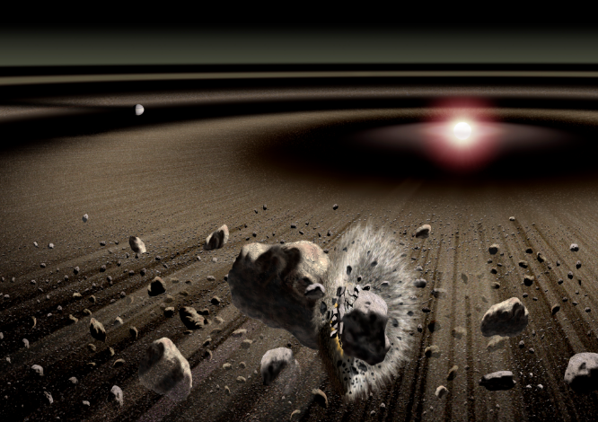
Planetesimals
Debris
Material that remained after the formation of the planets and satellites is called debris. Some debris that was not ejected from the solar system became icy objects known as comets. Other debris formed rocky bodies known as asteroids.
http://sci.esa.int/science-e-media/img/aa/beta-pic_pr_2004.jpg
Formation of the Solar System
Copyright © McGraw-Hill Education

Slide 17
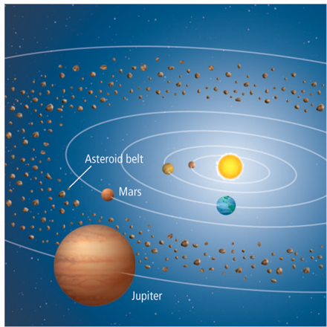
Planetesimals
Debris
Hundreds of thousands of asteroids have been detected in the asteroid belt, which lies between Mars and Jupiter.
Formation of the Solar System
Copyright © McGraw-Hill Education

Slide 18
Modeling the Solar System
Ancient astronomers assumed that the Sun, planets, and stars orbited a stationary Earth in an Earth-centered model of the solar system.
This geocentric, or Earth-centered, model could not readily explain some aspects of planetary motion, such as retrograde motion.
Formation of the Solar System
Copyright © McGraw-Hill Education

Slide 19
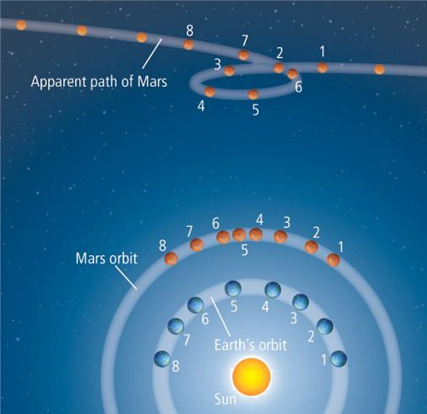
Modeling the Solar System
The apparent backward movement of a planet is called retrograde motion. The changing angles of view from Earth create the apparent retrograde motion of Mars.
Formation of the Solar System
Copyright © McGraw-Hill Education

Slide 20
Modeling the Solar System
Heliocentric model
In 1543, Polish scientist Nicolaus Copernicus suggested that the Sun was the center of the solar system. In this Sun-centered or heliocentric model, Earth and all the other planets orbit the Sun.
Formation of the Solar System
Copyright © McGraw-Hill Education

Slide 21
Modeling the Solar System
Kepler’s first law
Within a century, the ideas of Copernicus were confirmed by other astronomers.
From 1576–1601, before the telescope was used in astronomy, Tycho Brahe, a Danish astronomer, made accurate observations to within a half arc minute of the planets’ positions.
Formation of the Solar System
Copyright © McGraw-Hill Education

Slide 22
Modeling the Solar System
Kepler’s first law
Using Brahe’s data, German astronomer Johannes Kepler demonstrated that each planet orbits the Sun in a shape called an ellipse, rather than a circle. This is known as Kepler’s first law of planetary motion. An ellipse is an oval shape that is centered on two points.
The two points in an ellipse are called the foci. The major axis is the line that runs through both foci at the maximum diameter of the ellipse.
Formation of the Solar System
Copyright © McGraw-Hill Education

Slide 23
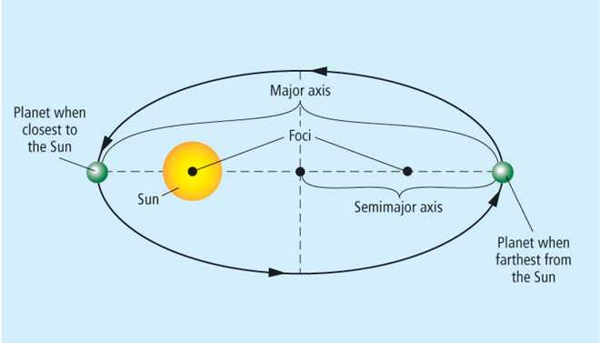
Modeling the Solar System
Kepler’s first law
Each planet has its own elliptical orbit, but the Sun is always at one focus. For each planet, the average distance between the Sun and the planet is its semimajor axis.
Draw:
Formation of the Solar System
Copyright © McGraw-Hill Education

Slide 24
Modeling the Solar System
Kepler’s first law
Earth’s semimajor axis is of special importance because it is a unit used to measure distances within the solar system.
Earth’s average distance from the Sun is 1.496 × 10⁸ km, or 1 astronomical unit (AU).
Formation of the Solar System
Copyright © McGraw-Hill Education

Slide 25
Modeling the Solar System
Kepler’s first law
The shape of a planet’s elliptical orbit is defined by eccentricity, which is the ratio of the distance between the foci to the length of the major axis.
Formation of the Solar System
Copyright © McGraw-Hill Education

Slide 26
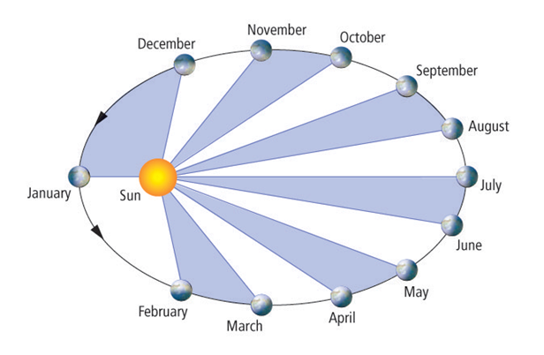
Modeling the Solar System
Kepler’s second law
Kepler’s second law states that planets move faster when close to the Sun and slower when farther away. This means that a planet sweeps out equal areas in equal amounts of time.
Formation of the Solar System
Copyright © McGraw-Hill Education

Slide 27
Modeling the Solar System
Kepler’s third law
The length of time it takes for a planet or other body to travel a complete orbit around the Sun is called its orbital period.
Formation of the Solar System
Copyright © McGraw-Hill Education

Slide 28
Modeling the Solar System
Kepler’s third law
In Kepler’s third law, he determined the mathematical relationship between the size of a planet’s ellipse and its orbital period. This relationship is written as follows:
P² = a³
P is time measured in Earth years, and a is length of the semimajor axis measured in astronomical units.
The farther a planet orbits from the sun, the longer it takes for one orbit.
Formation of the Solar System
Copyright © McGraw-Hill Education

Slide 29
Modeling the Solar System
Kepler’s third law
Italian scientist Galileo Galilei was the first person to use a telescope to observe the sky. He discovered that four moons orbit the planet Jupiter, proving that not all celestial bodies orbit Earth and demonstrating that Earth was not necessarily the center of the solar system.
Formation of the Solar System
Copyright © McGraw-Hill Education

Slide 30
Gravity
The English scientist Isaac Newton described falling as a downward acceleration produced by gravity, an attractive force between two objects that have mass. He determined that both the masses of and the distance between two bodies determined the force between them.
Larger masses have larger gravitational fields.
The gravitational field weakens as the distance from an object increases.
Formation of the Solar System
Copyright © McGraw-Hill Education

Slide 31

Gravity
Newton’s law of universal gravitation is stated mathematically as follows:
F is the force measured in newtons, G is the universal gravitational constant (6.67 × 10^{–11} m3/ kg•s²), m₁ and m₂ are the masses of the bodies in kilograms, and r is the distance between the two bodies in meters.
Formation of the Solar System
Copyright © McGraw-Hill Education

Slide 32
Gravitational Attraction
Concepts In Motion
FPO Add link to Animation from p. 802 here.
Copyright © McGraw-Hill Education
Formation of the Solar System

Slide 33
Gravity
Gravity and orbits
Newton observed the Moon’s motion and realized that its direction changes because of the gravitational attraction of Earth. In a sense, the Moon is constantly falling toward Earth.
If it were not for gravity, the Moon would continue to move in a straight line and would not orbit Earth. The same is true of the planets and their moons, stars, and all orbiting bodies throughout the universe.
Formation of the Solar System
Copyright © McGraw-Hill Education

Slide 34
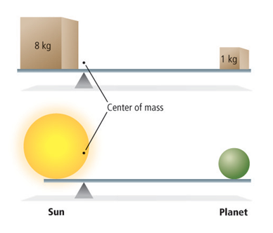
Gravity
Center of mass
Newton determined that each planet orbits a point between it and the Sun called the center of mass (or Barycenter). Just as the balance point on a seesaw is closer to the heavier box, the center of mass between two orbiting bodies is closer to the more massive body.
Formation of the Solar System
Copyright © McGraw-Hill Education

Slide 35
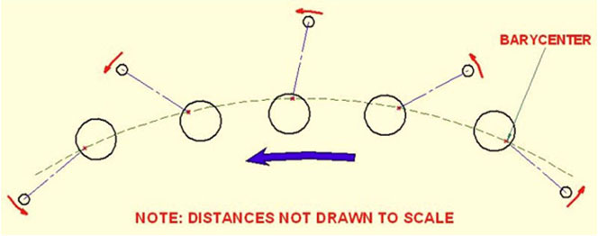
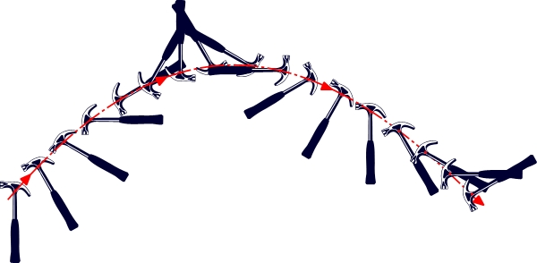
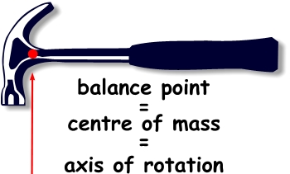
https://www.youtube.com/watch?v=uGBANgbRkws
http://colomboherald.com/wordpress/wp-content/uploads/2010/10/moon_7.jpg
http://resources.yesican-science.ca/

Slide 36
Present-Day Viewpoints
Recent discoveries have led many astronomers to rethink traditional views of the solar system. Some already define it in terms of three zones: the inner terrestrial planets, the outer gas giant planets, and the dwarf planets and comets.
Formation of the Solar System
Copyright © McGraw-Hill Education

Slide 37
Review
Essential Questions
How did the solar system form?
How are early concepts of the structure of the solar system described?
How has our current knowledge of the solar system developed?
What is the relationship between gravity and the motions of the objects in the solar system?
Vocabulary
planetesimal
retrograde motion
ellipse
astronomical unit
eccentricity
Copyright © McGraw-Hill Education
Formation of the Solar System

Slide 39
Section 2: The Inner Planets
Mercury, Venus, Earth, and Mars have high densities and rocky surfaces.
K What I Know | W What I Want to Find Out | L What I Learned

Slide 40
Essential Questions
How are the characteristics of the inner planets similar?
What are some of the space probes used to explore the solar system?
How are the terrestrial planets different from each other?
Copyright © McGraw-Hill Education
The Inner Planets

Slide 41
Vocabulary
Review
albedo
New
terrestrial planet
scarp
Copyright © McGraw-Hill Education
The Inner Planets

Slide 42
Terrestrial Planets
The four inner planets are called terrestrial planets because they are similar in density to Earth and have solid, rocky surfaces.
The Inner Planets
Copyright © McGraw-Hill Education

Slide 43
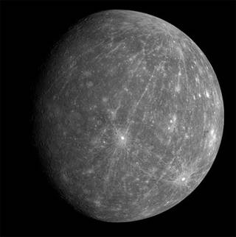
Mercury
Mercury is the planet closest to the Sun. It is about one-third the size of Earth and has a smaller mass. Mercury has no moons, and it has a slow spin of 1407.6 hours.
nasa.gov
The Inner Planets
Copyright © McGraw-Hill Education

Slide 44
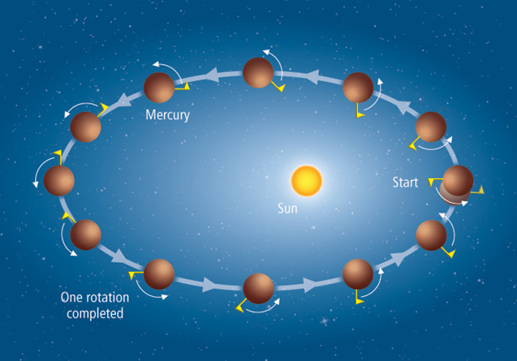
Mercury
In one orbit around the Sun, Mercury rotates one and one-half times. As Mercury spins, the side facing the Sun at the beginning of the orbit faces away from the Sun at the end of the orbit.
The Inner Planets
Copyright © McGraw-Hill Education

Slide 45
Mercury
Atmosphere
What little atmosphere does exist on Mercury is composed primarily of oxygen, sodium, and hydrogen deposited by the Sun.
The daytime surface temperature is 700 K (427°C), while temperatures at night fall to 100 K (-173°C). This is the largest day-night temperature difference among the planets.
The Inner Planets
Copyright © McGraw-Hill Education

Slide 46
Mercury
Surface
Images from the U.S. space probe Mariner 10, which passed close to Mercury three times in 1974 and 1975, show that Mercury’s surface is covered with craters and plains.
The MESSENGER space probe is the first spacecraft to orbit Mercury.
The Inner Planets
Copyright © McGraw-Hill Education

Slide 47
Mercury
Surface
Mercury has a planetwide system of cliffs called scarps. Though similar to those on Earth, Mercury’s scarps are much higher.
Discovery, the largest scarp on Mercury, is 550 km long and 1.5 km high.
The Inner Planets
Copyright © McGraw-Hill Education

Slide 48
Mercury
Interior
Mercury’s high density suggests that it has a large nickel-iron core. Mercury’s small magnetic field indicates that some of its core is molten.
The Inner Planets
Copyright © McGraw-Hill Education

Slide 49
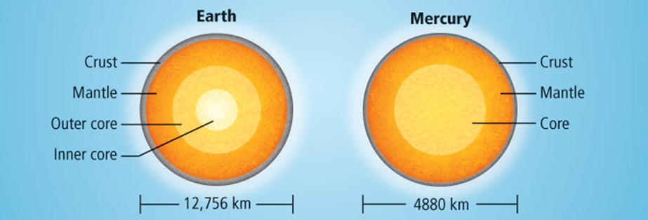
Mercury
Early Mercury
The structure of Mercury’s interior, which contains a proportionally larger core than Earth, suggests that Mercury was once much larger.
The Inner Planets
Copyright © McGraw-Hill Education

Slide 50
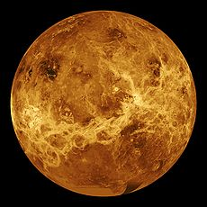
Venus
Venus has no moons. It is the brightest planet in the sky because it is close to Earth and because its albedo is 0.90—the highest of any planet.
Astronomers have learned much about Venus from spacecraft launched by the United States and the Soviet Union.
The 1978 Pioneer-Venus and 1989 Magellan missions of the United States used radar to map 98 percent of the surface of Venus.
The Inner Planets
Copyright © McGraw-Hill Education
nasa.gov

Slide 51
Venus
Retrograde rotation
Venus rotates clockwise, unlike most planets that spin counterclockwise.
This backward spin, called retrograde rotation, means that an observer on Venus would see the Sun rise in the west and set in the east.
The Inner Planets
Copyright © McGraw-Hill Education

Slide 52
Venus
Atmosphere
The atmospheric pressure on Venus is 92 atmospheres (atm), compared to 1 atm at sea level on Earth.
The atmosphere of Venus is composed primarily of carbon dioxide and small amounts of nitrogen and water vapor. It also has clouds that consist of sulfuric acid.
The Inner Planets
Copyright © McGraw-Hill Education

Slide 53
Venus
Greenhouse effect
Venus experiences a greenhouse effect similar to Earth’s, but Venus’s is more efficient. The concentration of carbon dioxide is so high in Venus’s atmosphere that it keeps the surface extremely hot. Venus is the hottest planet, with an average surface temperature of about 737 K (464°C).
The Inner Planets
Copyright © McGraw-Hill Education

Slide 54
Venus
Surface
When the Magellan orbiter mapped the surface of Venus, it revealed that Venus has a surface smoothed by volcanic lava flows and with few impact craters.
Observations from Venus Express indicate that Venus might still be volcanically active.
The Inner Planets
Copyright © McGraw-Hill Education

Slide 55
Venus
Interior
Astronomers theorize that Venus has a liquid metal core that extends halfway to the surface. Despite this core, Venus has no measurable magnetic field, probably because of its slow rotation.
The Inner Planets
Copyright © McGraw-Hill Education

Slide 56
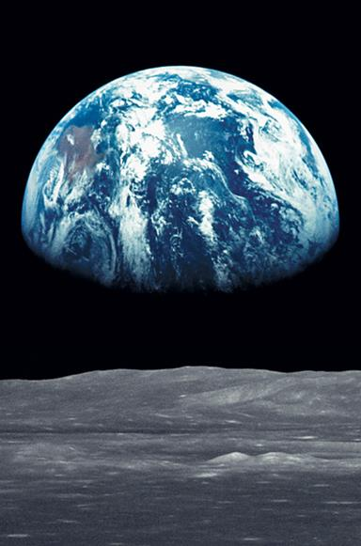
Earth
Earth’s distance from the Sun and its nearly circular orbit allow water to exist on its surface in all three states—solid, liquid, and gas. Liquid water is required for life.
In addition, Earth’s mild greenhouse effect and moderately dense atmosphere of nitrogen and oxygen provide conditions suitable for life.
Earth is the most dense and the most tectonically active of the terrestrial planets. It is the only known planet where plate tectonics occurs.
The Inner Planets
Copyright © McGraw-Hill Education

Slide 57

Earth’s axis is tilted and has a wobble.
Precession is the wobble in Earth’s rotational axis.
The precession has another wobble called nutation.
It takes Earth’s rotational axis about 26 000 years to go through one cycle of precession.
The sideways pull that causes precession comes from the Moon’s gravitational force on Earth, as well as to a lesser extent, the Sun’s gravitational force.

Slide 58
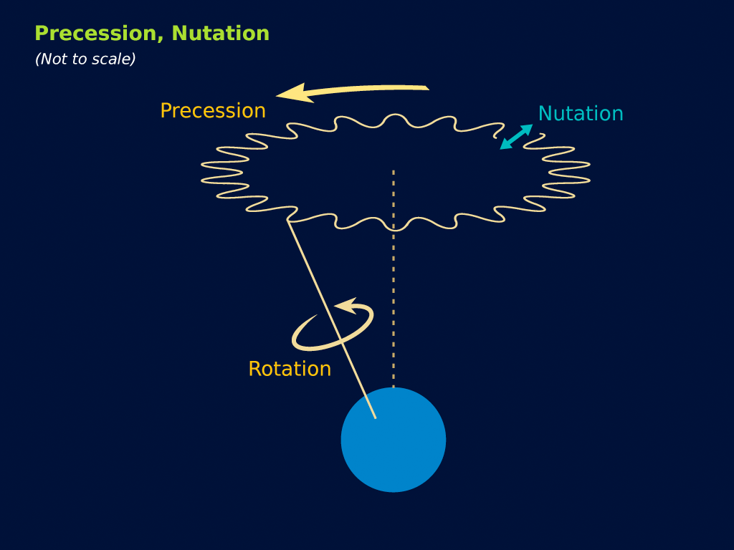
Draw:

Slide 59
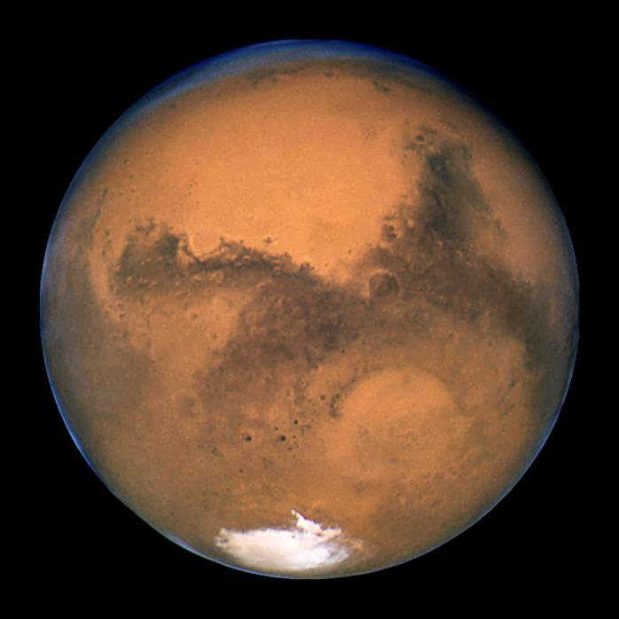
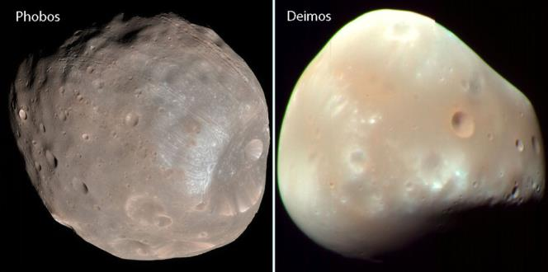
Mars
Mars is often referred to as the red planet because of its reddish surface color. It is smaller and less dense than Earth and has two irregularly shaped moons—Phobos and Deimos.
universetoday.com
The Inner Planets
Copyright © McGraw-Hill Education
nasa.gov

Slide 60
Mars
Atmosphere
Mars and Venus have atmospheres of similar composition. The density and pressure of the atmosphere on Mars are much lower; therefore, Mars does not have a strong greenhouse effect like Venus does.
The Inner Planets
Copyright © McGraw-Hill Education

Slide 61
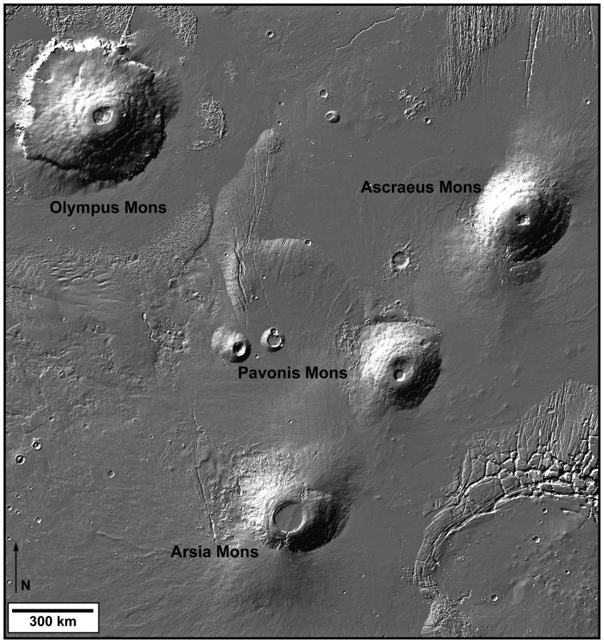
Mars
Surface
The southern hemisphere of Mars is a heavily cratered, highland region resembling the highlands of the Moon. The northern hemisphere has sparsely cratered plains. Four gigantic shield volcanoes are located near the equator, near a region called the Tharsis Plateau.
nasa.gov
The Inner Planets
Copyright © McGraw-Hill Education

Slide 62
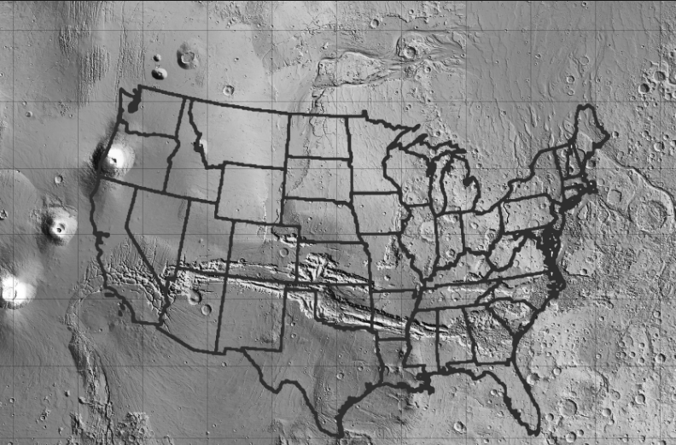
Mars
Surface
An enormous, 4000-km-long canyon, Valles Marineris, lies on the Martian equator, splitting the Tharsis Plateau. It probably formed as a fracture during a period of tectonic activity 3 bya, when the Tharsis Plateau was uplifted.
www.lpi.usra.edu
The Inner Planets
Copyright © McGraw-Hill Education

Slide 63
Mars
Surface
Other Martian surface features include dried river and lake beds, gullies, outflow channels, and runoff channels. These erosional features suggest that liquid water once existed on the surface of Mars.
The Mars Reconnaissance Orbiter found water ice below the surface at mid-latitudes, and near the poles and elsewhere on Mars.
The Inner Planets
Copyright © McGraw-Hill Education

Slide 64
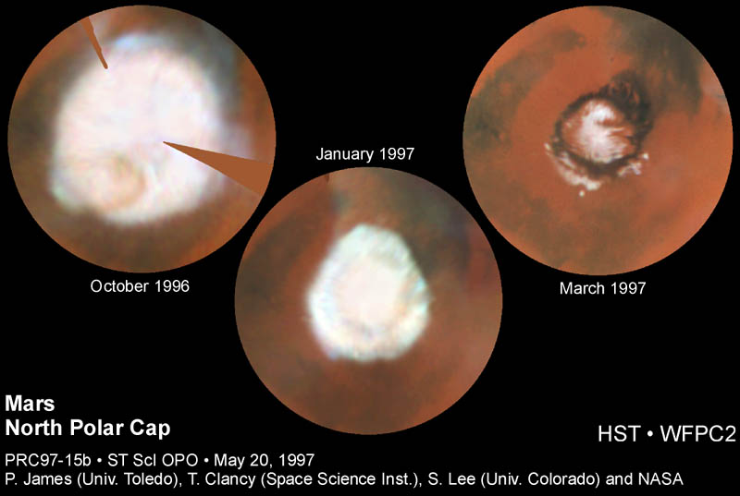
Mars
Surface
The ice caps that cover both poles on Mars grow and shrink with the seasons. The caps are made of carbon dioxide ice, sometimes called dry ice. Water ice lies beneath the carbon dioxide ice in both caps.
The Inner Planets
Copyright © McGraw-Hill Education

Slide 65
Mars
Interior
Astronomers hypothesize that Mars has a core of iron, nickel, and possibly sulfur that extends somewhere between 1200 km and 2400 km from the center of the planet. Because Mars has no magnetic field, astronomers think that the core is probably solid.
The Inner Planets
Copyright © McGraw-Hill Education

Slide 66
Review
Essential Questions
How are the characteristics of the inner planets similar?
What are some of the space probes used to explore the solar system?
How are the terrestrial planets different from each other?
Vocabulary
terrestrial planet
scarp
Copyright © McGraw-Hill Education
The Inner Planets

Slide 68
Section 3: The Outer Planets
Jupiter, Saturn, Uranus, and Neptune have large masses, low densities, and many moons and rings.
K What I Know | W What I Want to Find Out | L What I Learned

Slide 69
Essential Questions
What are the similarities among and differences between the gas giant planets?
What are the major moons?
How do moons and rings form?
How does the composition of the gas giant planets and the composition of the Sun compare?
Copyright © McGraw-Hill Education
The Outer Planets

Slide 70
Vocabulary
Review
asteroid
New
gas giant planet
liquid metallic hydrogen
belt
zone
Copyright © McGraw-Hill Education
The Outer Planets

Slide 71
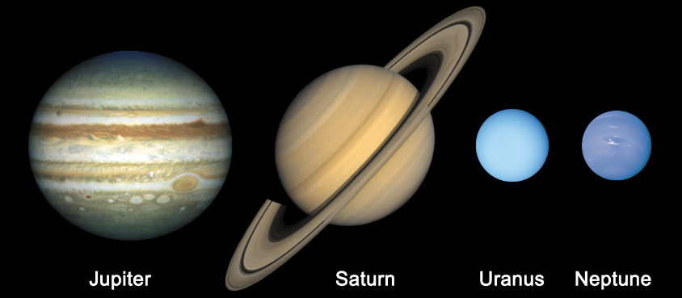
The Gas Giant Planets
Jupiter, Saturn, Uranus, and Neptune are gas giant planets. These large, gaseous planets are very cold at their surfaces, have ring systems and many satellites, and are made primarily of lightweight elements.
teachastronomy.com
The Outer Planets
Copyright © McGraw-Hill Education

Slide 72
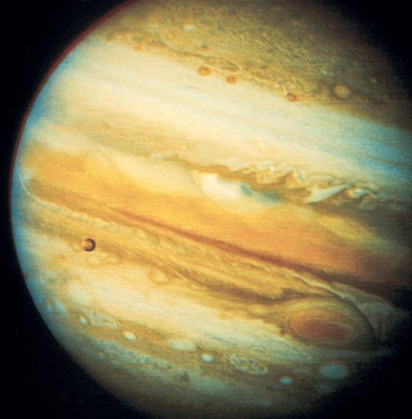
Jupiter
Jupiter is the largest planet, with a diameter one-tenth that of the Sun and 11 times larger than Earth’s. Jupiter’s mass makes up 70 percent of all planetary matter in the solar system.
Jupiter has a banded appearance as a result of flow patterns in its atmosphere. Nestled among Jupiter’s cloud bands is the Great Red Spot, an atmospheric storm that has raged for more than 300 years.
The Outer Planets
Copyright © McGraw-Hill Education

Slide 73
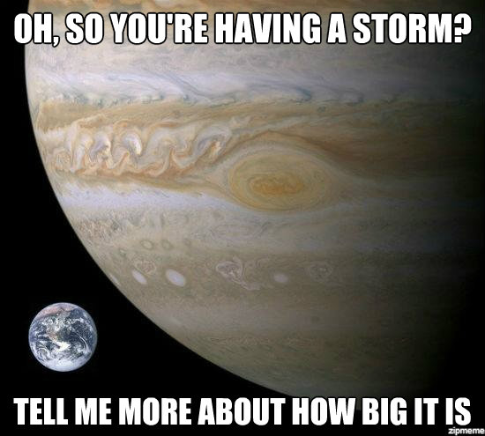
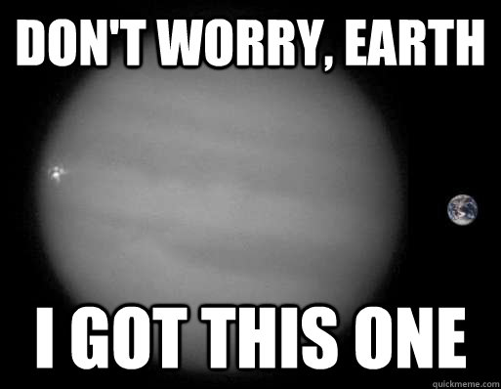

Slide 74
Jupiter
Rings
The Galileo spacecraft’s observation of Jupiter revealed two faint rings around the planet, in addition to a 6400-km-wide ring around Jupiter that had been discovered by Voyager I.
The Outer Planets
Copyright © McGraw-Hill Education

Slide 75
Jupiter
Atmosphere and interior
Jupiter is composed mostly of hydrogen and helium in gaseous or liquid form. Below the liquid hydrogen is a layer of liquid metallic hydrogen, a form of hydrogen that has properties of both a liquid and a metal, which can exist only under conditions of very high pressure.
Electric currents exist within the layer of liquid metallic hydrogen and generate Jupiter’s magnetic field.
The Outer Planets
Copyright © McGraw-Hill Education

Slide 76
Jupiter
Rotation
Jupiter spins once on its axis in a little less than 10 hours, giving it the shortest among the planets. This rapid rotation distorts the shape of the planet so that the diameter through its equatorial plane is 7 percent larger than the diameter through its poles.
The Outer Planets
Copyright © McGraw-Hill Education

Slide 77
Jupiter
Rotation
Jupiter’s rapid rotation causes its clouds to flow rapidly, in bands of alternating colors called belts and zones.
Belts are low, warm, dark-colored clouds that sink.
Zones are high, cool, light-colored clouds that rise.
The Outer Planets
Copyright © McGraw-Hill Education

Slide 78
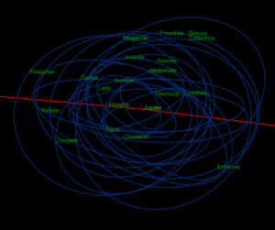
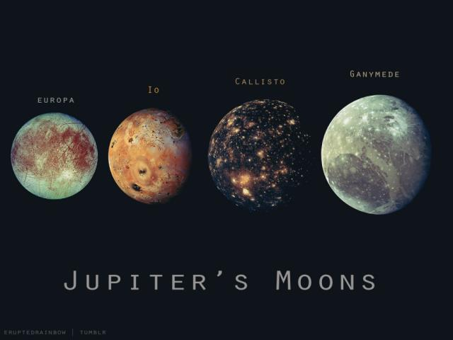
Jupiter
Moons
Jupiter has more than 60 moons. Jupiter’s four largest moons, Ganymede, Callisto, Io, and Europa, are called Galilean satellites after their discoverer. Three of them are bigger than Earth’s Moon, and all four are composed of ice and rock.
The Outer Planets
Copyright © McGraw-Hill Education

Slide 79
Jupiter
Moons
Jupiter’s smaller moons were discovered by a series of space probes beginning with Pioneer 10 and Pioneer 11 in the 1970s, followed by Voyager 1 and Voyager 2 that also detected Jupiter’s rings. Jupiter’s four small, inner moons are thought to be the source of Jupiter’s rings.
The Outer Planets
Copyright © McGraw-Hill Education

Slide 80
Jupiter
Gravity assist
It is common for satellites to use a planet’s gravity to help propel them deeper into space. Jupiter is the most massive planet, and so any satellite passing deeper into space than Jupiter can use Jupiter’s gravity to give it an assist.
The Outer Planets
Copyright © McGraw-Hill Education

Slide 81
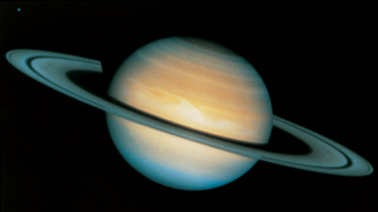
Saturn
Saturn is the second-largest planet in the solar system. Five space probes have visited Saturn, including Pioneer 10, Pioneer 11, and Voyagers 1 and 2.
In 2004, the United States’ Cassini spacecraft arrived at Saturn and began to orbit the planet.
The Outer Planets
Copyright © McGraw-Hill Education

Slide 82
Saturn
Atmosphere and interior
Saturn’s average density is lower than that of water. It rotates rapidly for its size and has a layered cloud system.
Saturn’s atmosphere is mostly hydrogen and helium with ammonia ice near the cloud tops.
The Outer Planets
Copyright © McGraw-Hill Education

Slide 83
Saturn
Atmosphere and interior
Saturn’s internal structure is probably fluid throughout, except for a small, solid core. Saturn’s magnetic field is 1000 times stronger than Earth’s and is aligned with its rotational axis. This is highly unusual among the planets.
The Outer Planets
Copyright © McGraw-Hill Education

Slide 84
Saturn
Rings
Saturn’s rings are composed of pieces of ice that range from microscopic particles to house-sized chunks. There are seven major rings, and each ring is made up of narrower rings, called ringlets. The rings contain many open gaps.
The Outer Planets
Copyright © McGraw-Hill Education

Slide 85
Saturn
Rings
Many astronomers now think the particles in Saturn’s rings are debris left over from collisions of asteroids and other objects, or from moons broken apart by Saturn’s gravity.
The Outer Planets
Copyright © McGraw-Hill Education

Slide 86
Saturn
Moons
Saturn has more than 60 satellites, including the giant Titan, which is larger than the planet Mercury. Titan is unique among planetary satellites because it has a dense atmosphere made of nitrogen and methane.
The Outer Planets
Copyright © McGraw-Hill Education

Slide 87
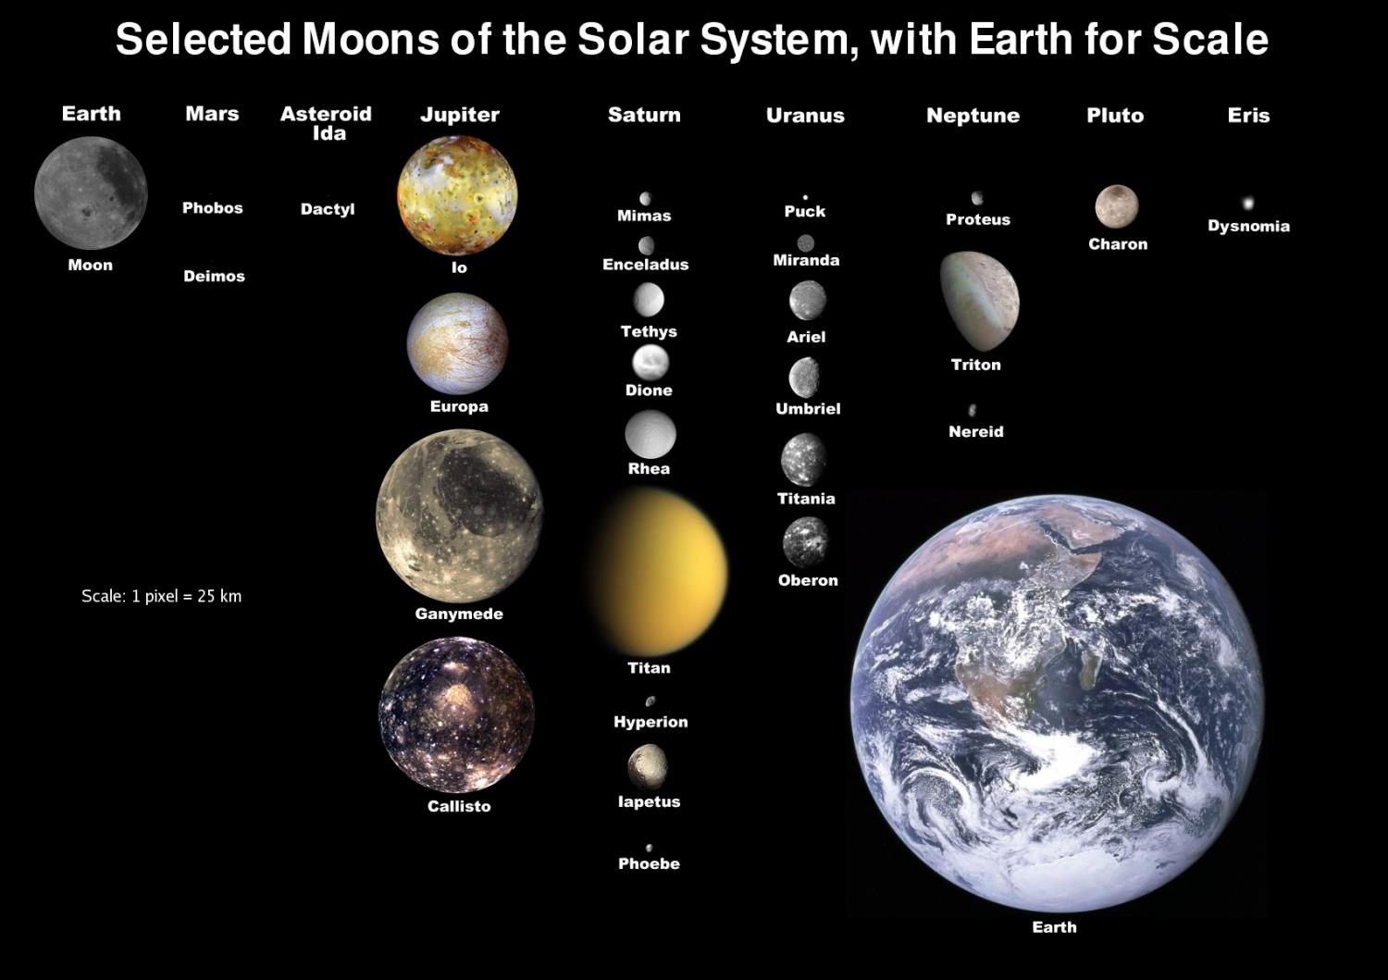

Slide 88
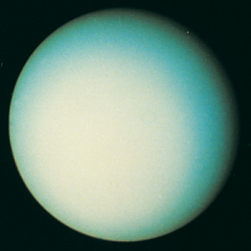
Uranus
Uranus was discovered accidentally in 1781. In 1986, Voyager 2 flew by Uranus and provided detailed information about the planet, including the existence of new moons and rings.
Uranus’s average temperature is 58 K (-215°C).
The Outer Planets
Copyright © McGraw-Hill Education

Slide 89
Uranus
Atmosphere
Uranus has a blue, velvety appearance, which is caused by methane gas in its atmosphere reflecting blue light. Most of the atmosphere is composed of helium and hydrogen, which are colorless.
The internal structure of Uranus is completely fluid except for a small, solid core. It also has a strong magnetic field.
The Outer Planets
Copyright © McGraw-Hill Education

Slide 90
Uranus
Moons and rings
Uranus has at least 27 moons and a faint ring system. Many of Uranus’s rings are dark—almost black and almost invisible.
The Outer Planets
Copyright © McGraw-Hill Education

Slide 91
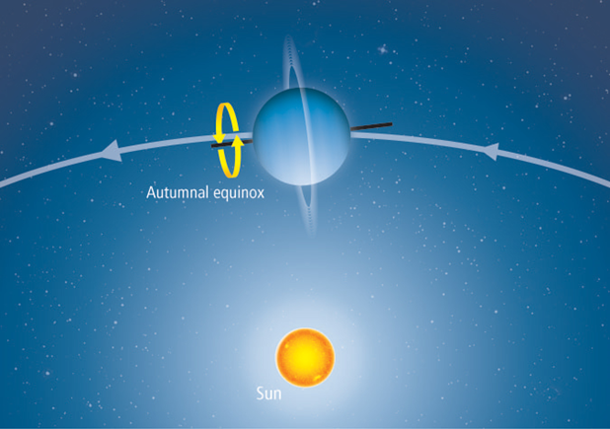
Uranus
Rotation
The rotational axis of Uranus is tipped so far that its north pole almost lies in its orbital plane. This view shows its position at an equinox.
The Outer Planets
Copyright © McGraw-Hill Education

Slide 92
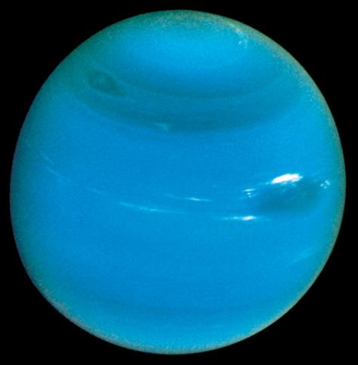
Neptune
The existence of Neptune was predicted before it was discovered, based on small deviations in the motion of Uranus and the application of Newton’s law of universal gravitation. In 1846, Neptune was discovered where astronomers had predicted it to be.
The Outer Planets
Copyright © McGraw-Hill Education

Slide 93
Neptune
Atmosphere
Neptune is slightly smaller and denser than Uranus. Similarities between Neptune and Uranus include a bluish color caused by methane in the atmosphere, their atmospheric compositions, temperatures, magnetic fields, interiors, and particle belts or rings.
Neptune has distinctive clouds and atmospheric belts and zones similar to those of Jupiter and Saturn.
The Outer Planets
Copyright © McGraw-Hill Education

Slide 94
Neptune
Moons and rings
The largest of Neptune’s 13 moons is Triton, which has a retrograde orbit. Triton has a thin atmosphere and nitrogen geysers.
Neptune’s six rings are composed of microscopic dust particles, which do not reflect light well.
The Outer Planets
Copyright © McGraw-Hill Education

Slide 95
Review
Essential Questions
What are the similarities among and differences between the gas giant planets?
What are the major moons?
How do moons and rings form?
How does the composition of the gas giant planets and the composition of the Sun compare?
Vocabulary
gas giant planet
liquid metallic hydrogen
belt
zone
Copyright © McGraw-Hill Education
The Outer Planets

Slide 97
Section 4: Other Solar System Objects
Besides the Sun and planets, there are many other objects in the solar system that are composed primarily of rocks, dust, and ice.
K What I Know | W What I Want to Find Out | L What I Learned

Slide 98
Essential Questions
What are the differences between planets and dwarf planets?
What are the oldest members of the solar system?
How are meteoroids, meteors, and meteorites described?
What are the structure and behavior of comets?
Copyright © McGraw-Hill Education
Other Solar System Objects

Slide 99
Vocabulary
Review
smog
New
dwarf planet
meteoroid
meteor
meteorite
Kuiper belt
comet
meteor shower
Copyright © McGraw-Hill Education
Other Solar System Objects

Slide 100
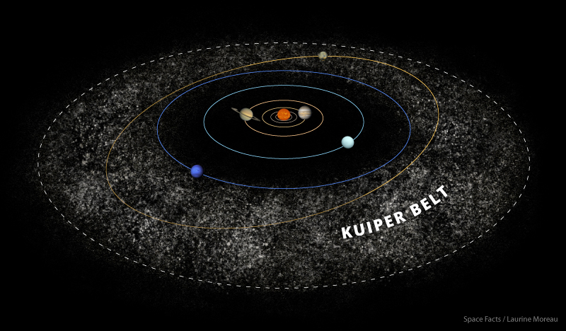
Dwarf Planets
In the early 2000s, astronomers began to detect large objects in the region of the then-planet Pluto, about 40 AU from the Sun, called the Kuiper belt.
Other Solar System Objects
Copyright © McGraw-Hill Education

Slide 101
Dwarf Planets
In 2003 an object, now known as Eris, was discovered that was larger than Pluto.
At that time, the scientific community began to take a closer look at the planetary status of Pluto and other solar system objects.
Other Solar System Objects
Copyright © McGraw-Hill Education

Slide 102
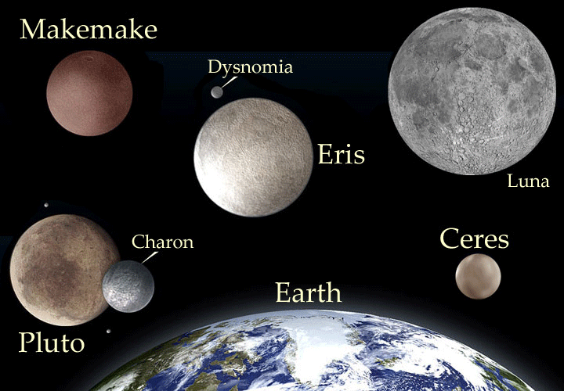
Dwarf Planets
Ceres
In 1801, Giuseppe Piazzi discovered a large object, which was given the name Ceres, in orbit between Mars and Jupiter. Scientists had predicted that there was a planet somewhere in that region, and it seemed that this discovery was it. However, Ceres was extremely small for a planet.
nasa.gov
Other Solar System Objects
Copyright © McGraw-Hill Education

Slide 103
Dwarf Planets
Ceres
In the century following the discovery of Ceres, hundreds of thousands of other objects were discovered in the area between Mars and Jupiter. Therefore, Ceres was no longer thought of as a planet, but as the largest of the asteroids in what would be called the asteroid belt.
Other Solar System Objects
Copyright © McGraw-Hill Education

Slide 104
Dwarf Planets
Pluto
At first, the collapse of an interstellar cloud is slow, but it gradually accelerates and the cloud becomes much denser at its center.
If rotating, the cloud spins faster as it contracts, due to centripetal force.
Other Solar System Objects
Copyright © McGraw-Hill Education

Slide 105
Dwarf Planets
Pluto
Pluto has a long, elliptical orbit that overlaps the orbit of Neptune. It has three moons which orbit at a widely odd angle from the plane of the ecliptic. It is also smaller than Earth’s Moon.
Other Solar System Objects
Copyright © McGraw-Hill Education

Slide 106
Dwarf Planets
How many others?
With the discovery of objects close to and larger than Pluto’s size, the International Astronomical Union (IAU) chose to create a new classification of objects in space called dwarf planets.
Other Solar System Objects
Copyright © McGraw-Hill Education

Slide 107
Dwarf Planets
How many others?
The IAU has defined a dwarf planet as an object that, due to its own gravity, is spherical in shape, orbits the Sun, is not a satellite, and has not cleared the area of its orbit of smaller debris.
Other Solar System Objects
Copyright © McGraw-Hill Education

Slide 108
Dwarf Planets
How many others?
The IAU has limited the dwarf planet classification to Pluto, Eris, Ceres, Makemade, and Haumea. There are at least 10 other objects whose classifications are undecided.
Other Solar System Objects
Copyright © McGraw-Hill Education

Slide 109
Visualizing Other Solar System Objects
Recent findings of objects beyond Pluto have forced scientists to rethink what features define a planet.
Other Solar System Objects
Copyright © McGraw-Hill Education

Slide 110
Visualizing Other Solar System Objects
Concepts In Motion
FPO Add link to Animation from p. 817 here.
Copyright © McGraw-Hill Education
Other Solar System Objects

Slide 111
Small Solar System Bodies
Once the IAU defined planets and dwarf planets, they had to identify what was left.
In the early 1800s, a name was given to the rocky planetesimals between Mars and Jupiter—the asteroid belt.
Other Solar System Objects
Copyright © McGraw-Hill Education

Slide 112
Small Solar System Bodies
Objects beyond the orbit of Neptune have been called trans-Neptunian objects, Kuiper belt objects, comets, and members of the Oort cloud. The IAU calls all these objects, collectively, small solar system bodies.
Other Solar System Objects
Copyright © McGraw-Hill Education

Slide 113
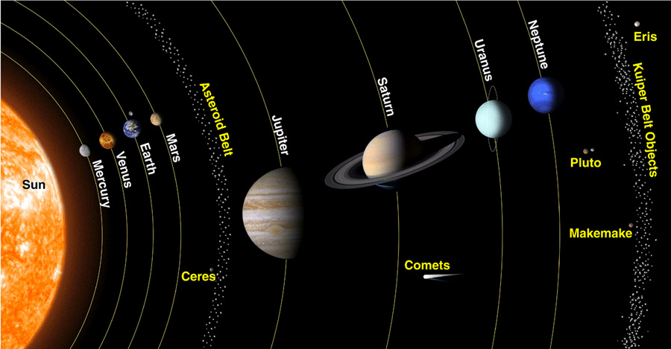
Small Solar System Bodies
Asteroids
There are hundreds of thousands of asteroids orbiting the Sun between Mars and Jupiter. As asteroids orbit, they occasionally collide and break into fragments. An asteroid fragment, or any other interplanetary material is called a meteoroid.
Other Solar System Objects
Copyright © McGraw-Hill Education
crystallinks.com

Slide 114
Small Solar System Bodies
Asteroids
When a meteoroid passes through the atmosphere, the air around it is heated by friction and compression, producing a streak of light called a meteor.
If the meteoroid does not burn up completely and part of it strikes the ground, the part that hits the ground is called a meteorite.
Other Solar System Objects
Copyright © McGraw-Hill Education

Slide 115
Small Solar System Bodies
Kuiper belt
The Kuiper belt is a group of small solar system bodies that are mostly rock and ice. Most of these bodies probably formed in this region—30 to 50 AU from the Sun—from the material left over from the formation of the Sun and planets.
Other Solar System Objects
Copyright © McGraw-Hill Education

Slide 116
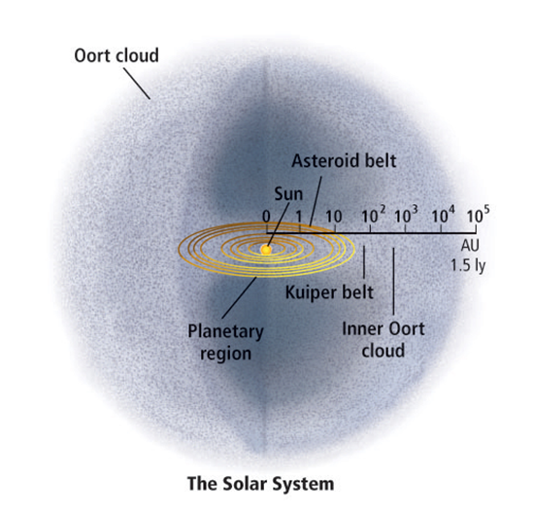
Small Solar System Bodies
Kuiper belt
The Kuiper belt appears as the outermost limit of the planetary disk. The Oort cloud surrounds the Sun, echoing its solar sphere.
Other Solar System Objects
Copyright © McGraw-Hill Education

Slide 117
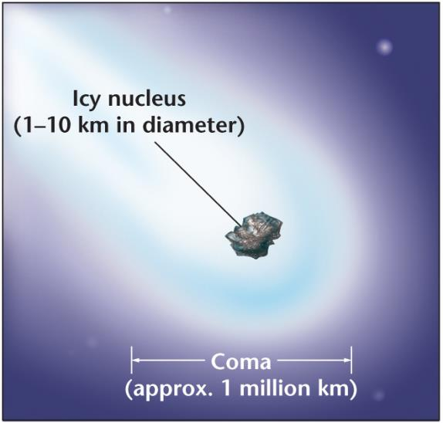
Comets
Comets are small, icy bodies that have highly eccentric orbits around the Sun.
Ranging from 1 to 10 km in diameter, most comets orbit in a continuous distribution that extends from the Kuiper belt to 100,000 AU from the Sun. The outermost region is known as the Oort cloud.
Other Solar System Objects
Copyright © McGraw-Hill Education

Slide 118
Comets
Comet structure
When a comet comes within 3 AU of the Sun, it begins to evaporate and forms a head and one or more tails. The head is surrounded by an envelope of glowing gas, and it has a small solid core.
Other Solar System Objects
Copyright © McGraw-Hill Education

Slide 119
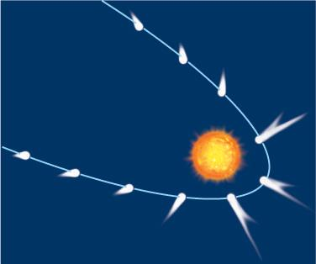
Comets
Comet structure
A comet’s tail always points away from the Sun and is driven by a stream of particles and radiation.
Other Solar System Objects
Copyright © McGraw-Hill Education

Slide 120
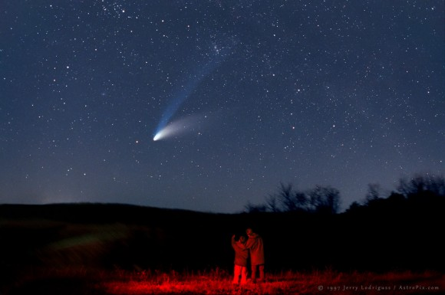
Comets
Periodic comets
Comets that repeatedly return to the inner solar system are known as periodic comets. Each time a periodic comet comes near the Sun, it loses some of its matter, leaving behind a trail of particles.
1995 Hale Bopp Comet
Other Solar System Objects
Copyright © McGraw-Hill Education

Slide 121
Comets
Periodic comets
When Earth crosses the trail of a comet, particles left in the trail burn up in Earth’s upper atmosphere, producing bright streaks of light called a meteor shower.
Most meteors are caused by dust particles from comets.
Other Solar System Objects
Copyright © McGraw-Hill Education

Slide 122
Review
Essential Questions
What are the differences between planets and dwarf planets?
What are the oldest members of the solar system?
How are meteoroids, meteors, and meteorites described?
What are the structure and behavior of comets?
Vocabulary
dwarf planet
meteoroid
meteor
meteorite
Kuiper belt
comet
meteor shower
Copyright © McGraw-Hill Education
Other Solar System Objects

