Slide 1
Work and Energy
Prepared by
Dedra Demaree, Georgetown University

Slide 2
Patterns from observational experiments
Which patterns did you observe in the previous series of experiments?
With your neighbor, write down at least three patterns you observed.

Slide 3
Quantitative Exercise 6.1: Pushing a bicycle uphill
Two friends are cycling up a hill inclined at 8°, which is steep for bicycle riding. The stronger cyclist helps his friend up the hill by exerting a 50-N pushing force on his friend's bicycle parallel to the hill, while the friend moves a distance of 100 m up the hill. The force exerted on the weaker cyclist and the displacement are in the same direction.
Sketch and translate.
Represent mathematically.

Slide 4
Review Question 6.1
Describe two processes in which an external force is exerted on a system object and no work is done on the system.
Explain why no work is done using both a diagram and an equation.

Slide 5
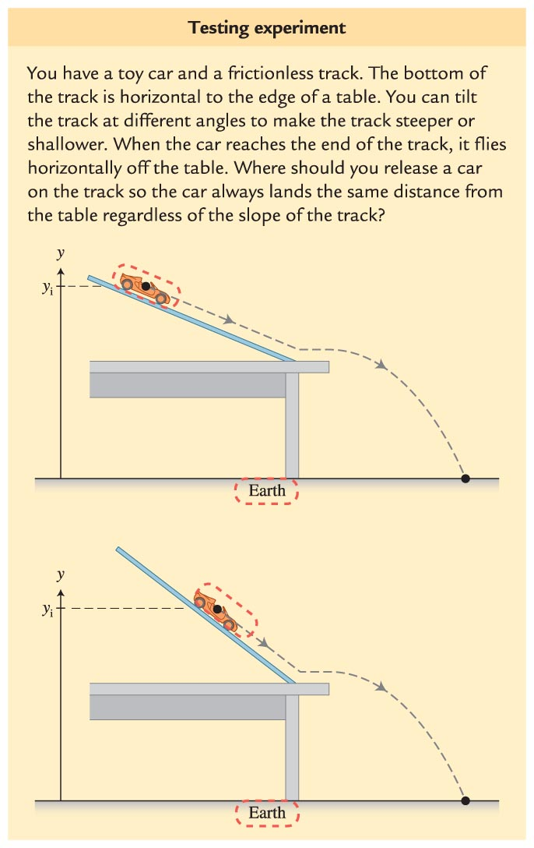
Testing Experiment: Is the energy of an isolated system constant?
What does our hypothesis predict will be the outcome of this experiment?

Slide 6
Practice with work-energy bar charts
Draw a work-energy bar chart for a stunt man who falls from a height of 50 m and sinks 2 m into a cushion before coming to rest (you can model the cushion as a spring).
Is the spring inside your system? Does it matter? Why or why not?

Slide 7
Conceptual Exercise 6.2: Pole vaulter
A pole vaulter crosses a bar high above a cushion below.
Construct a sketch and a work-energy bar chart where the initial state starts at the highest point in the jump and the final state is just before the vaulter reaches the cushion below.

Slide 8
Conceptual Exercise 6.2: Pole vaulter
A pole vaulter crosses a bar high above a cushion below.
Construct a sketch and a work-energy bar chart where the initial state starts at the highest point in the jump and the final state is at the instant the jumper sinks into the cushion.
Notes:
This is left for the instructor to solve

Slide 9
Review Question 6.2
A system can possess energy but it cannot possess work. Why?

Slide 10
Review Question 6.3
When we use the work-energy equation, how do we incorporate the force that Earth exerts on an object?

Slide 11
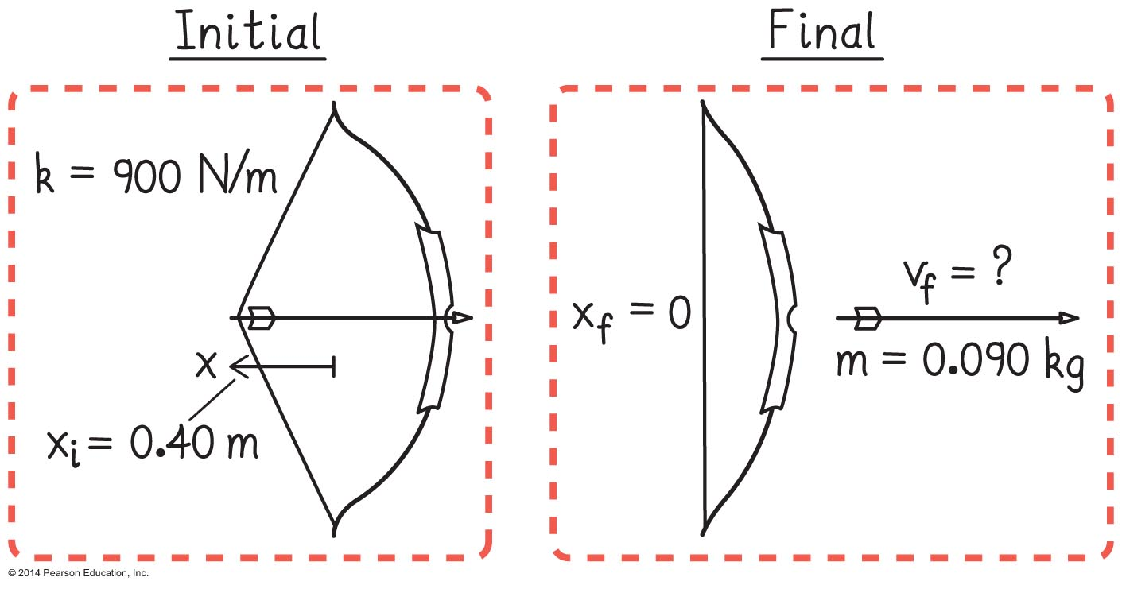
Example 6.4: Shooting an arrow
You load an arrow (mass = 0.090 kg) into a bow and pull the bowstring back 0.50 m. The bow has a spring constant k = 900 N/m.
Sketch and translate.
Simplify and diagram.
Represent mathematically.

Slide 12
Review Question 6.4
If the magnitude of the force exerted by a spring on an object is kx, why is it that the work done to stretch the spring a distance x is not equal to kx • x = kx²?

Slide 13
Example 6.5: Skidding to a stop
To avoid a collision, you apply the brakes, leaving skid marks on the road. A police officer observes the near collision and gives you a speeding ticket, claiming that you were exceeding the 35-mph speed limit.
Draw an energy bar chart for the car as the system.
Draw an energy bar chart for the car and road as the system.
Are the two charts consistent with each other? Why or why not?

Slide 14
Review Question 6.5
Why, when friction cannot be neglected, is it useful to include both surfaces in the system when analyzing processes using the energy approach?

Slide 15
A 1000-kg elevator is moving downward. While moving down at 4.0 m/s, its speed decreases steadily until it stops in 6.0 m.
Sketch and translate.
Simplify and diagram.
Represent mathematically.

Slide 16
Example 6.7: The human cannonball again
To launch a 60-kg human so that he leaves a cannon moving at a speed of 15 m/s, you need a spring with an appropriate spring constant. This spring will be compressed 3.0 m from its natural length to launch the person. The cannon is oriented at an angle of 37° above the horizontal.
Sketch and translate.
Simplify and diagram.
Represent mathematically.

Slide 17
Conceptual Exercise 6.8: Stretching the aorta
When your heart beats, the left ventricle pumps about 80 cm³ of blood into the aorta, the largest artery. This pumping occurs during a short time interval, about 0.13 s. The elastic aorta walls stretch to accommodate the extra blood. During the next 0.4 s or so, the walls of the aorta contract, applying pressure on the blood and thereby moving it out of the aorta and into the rest of the circulatory system.
Represent this process with a qualitative work-energy bar chart.

Slide 18
Example 6.9: Bungee jumping
We estimate the Oxford team used a 40-m-long bungee cord that stretched another 35 m when the jumper was at the very lowest point in the jump. We estimate the jumper's mass is 70 kg. Imagine your job is to buy a bungee cord that would provide a safe jump given these specifications.
Sketch and translate.
Simplify and diagram.
Represent mathematically.

Slide 19
Review Question 6.6
What would change in the solution to the problem in the bungee jumping example if we did not include Earth in the system? How would the answer be different?

Slide 20
Patterns in observational experiments
With your neighbor, list at least three patterns you observed in the set of observational experiments for collisions.

Slide 21
Review Question 6.7
Imagine that a collision occurs. You measure the masses of the two objects before the collision and measure the velocities of the objects both before and after the collision. Describe how you could use these data to determine which type of collision occurred.

Slide 22
Example 6.11: Lifting weights
Xueli is doing a dead lift. She lifts a 13.6-kg (30-lb) barbell from the floor to just below her waist (a vertical distance of 0.70 m) in 0.80 s.
Sketch and translate.
Simplify and diagram.
Represent mathematically.

Slide 23
Example 6.13: Escape speed
What vertical speed must a jumper have to leave the surface of a planet and never come back down?
Sketch and translate.
Simplify and diagram.
Represent mathematically.

Slide 24
Review Question 6.9
In this section you read that the gravitational potential energy of two large bodies (for example, the Sun and Earth) is negative. Why is this true?

