Slide 1
Work and Energy
Prepared by
Dedra Demaree,
Georgetown University

Slide 2
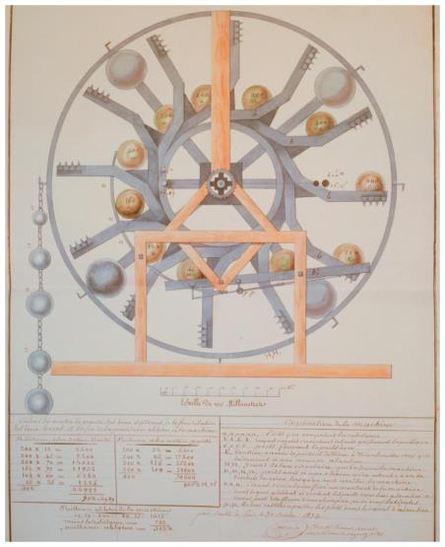
Work and energy
Why it is impossible to build a perpetual motion machine?
Why does blood pressure increase when the aorta walls thicken?
If Earth were to become a black hole, how big would it be?

Slide 3
Be sure you know how to:
Choose a system and the initial and final states of a physical process (Sections 5.2–5.4).
Use Newton's second law of motion to analyze a physical process (Section 3.3).
Use kinematics to describe motion (Section 1.7).

Slide 4
Where we are headed:
We have had success analyzing a variety of phenomena using vector quantities (acceleration, force, impulse, and momentum).
When working with vector quantities, we need to apply the component forms of principles.
Can we analyze interesting everyday phenomena using a different type of thinking that depends less on vector quantities?

Slide 5
Experiments to investigate work and energy
We begin by conducting experiments and looking for a pattern.
We choose a system of interest, its initial state, its final state, and an external force that causes the system to change.
This change involves displacement of one of the system objects.
We draw vectors indicating the external force causing the displacement and the resulting displacement of the system object.

Slide 6
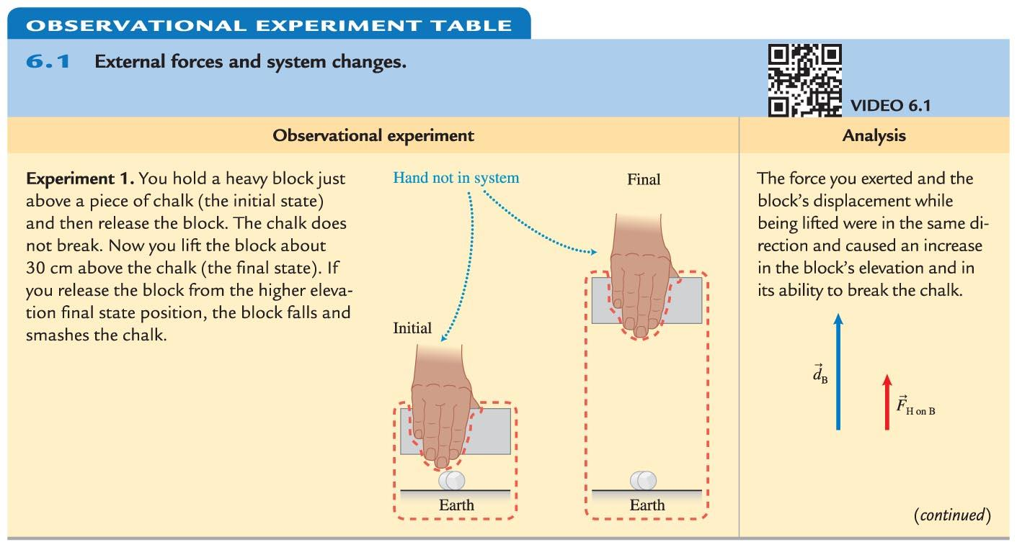
Observational Experiment: External forces and system changes

Slide 7
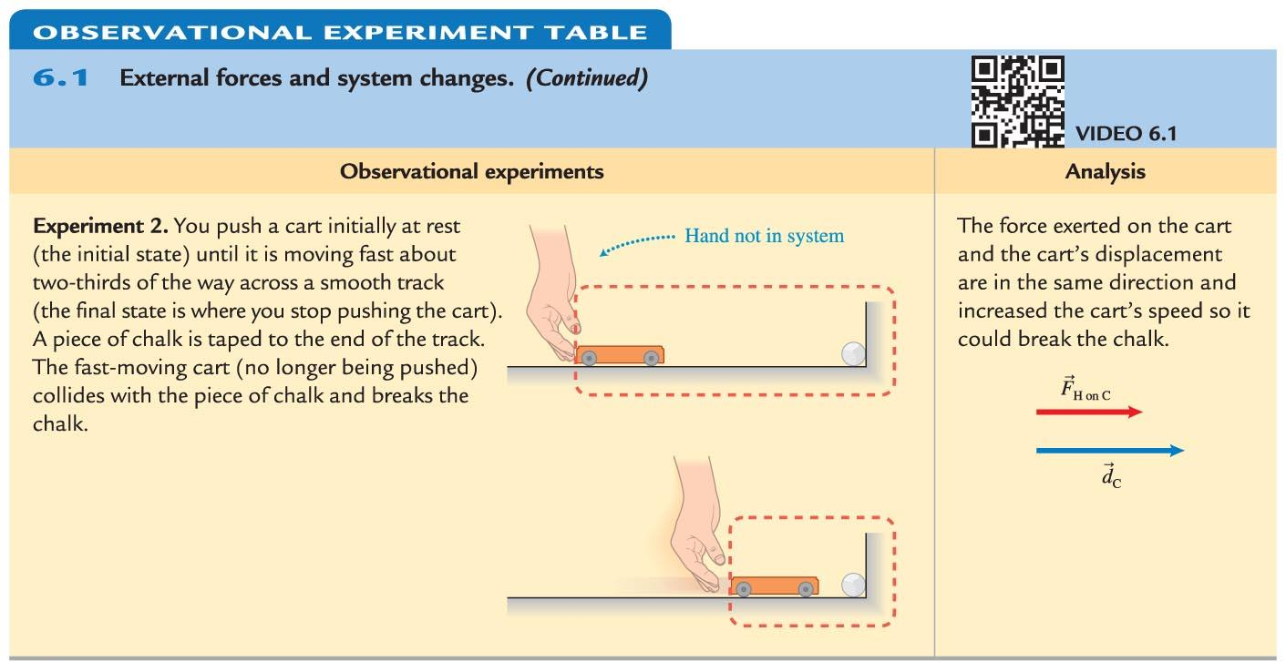
Observational Experiment: External forces and system changes

Slide 8
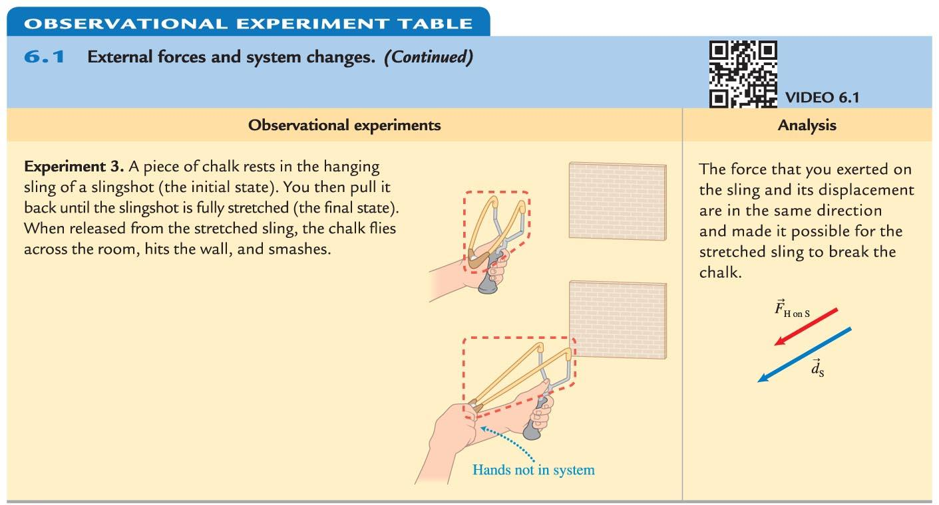
Observational Experiment: External forces and system changes

Slide 9
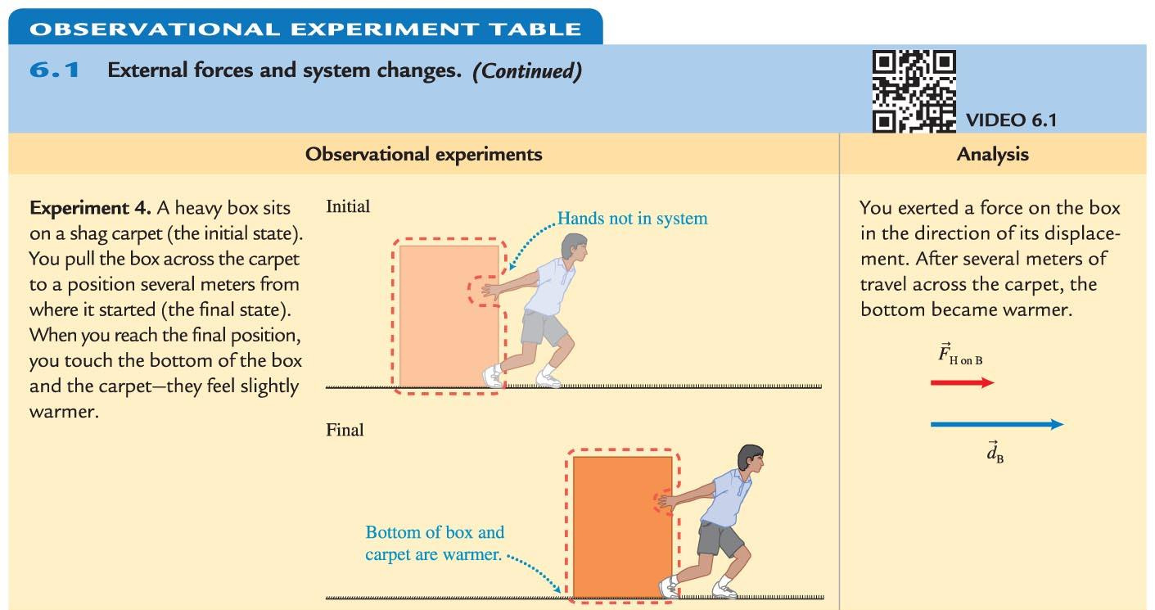
Observational Experiment: External forces and system changes

Slide 10
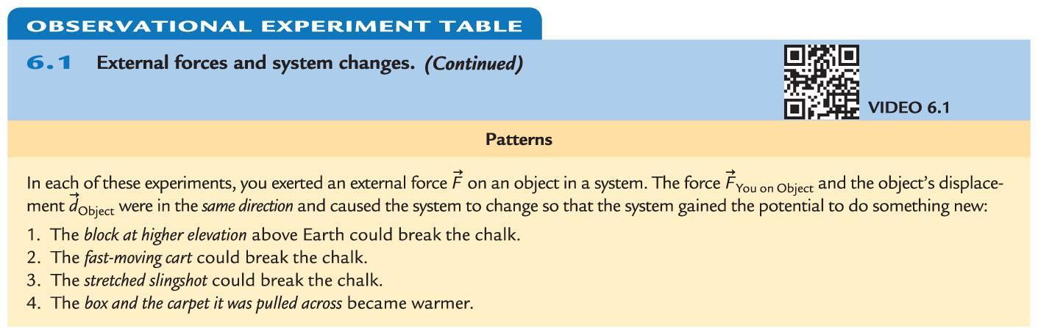
Observational Experiment: External forces and system changes

Slide 11
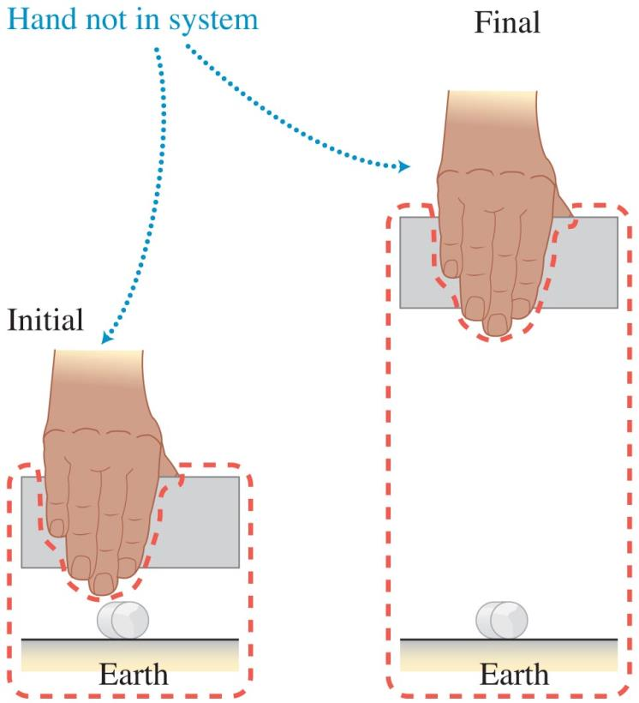
Gravitational potential energy
The energy of an object-Earth system associated with the elevation of the object above Earth is called gravitational potential energy (symbol U_{g}).
The higher above Earth the object is, the greater the gravitational potential energy.

Slide 12
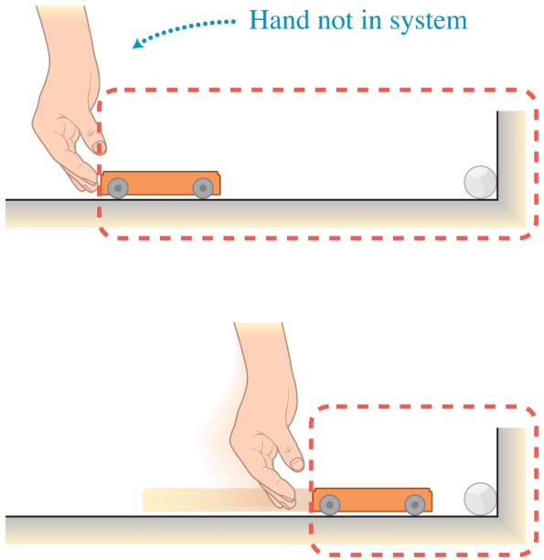
Kinetic energy
The energy due to an object's motion is called kinetic energy (symbol K).
The faster the object is moving, the greater its kinetic energy.

Slide 13
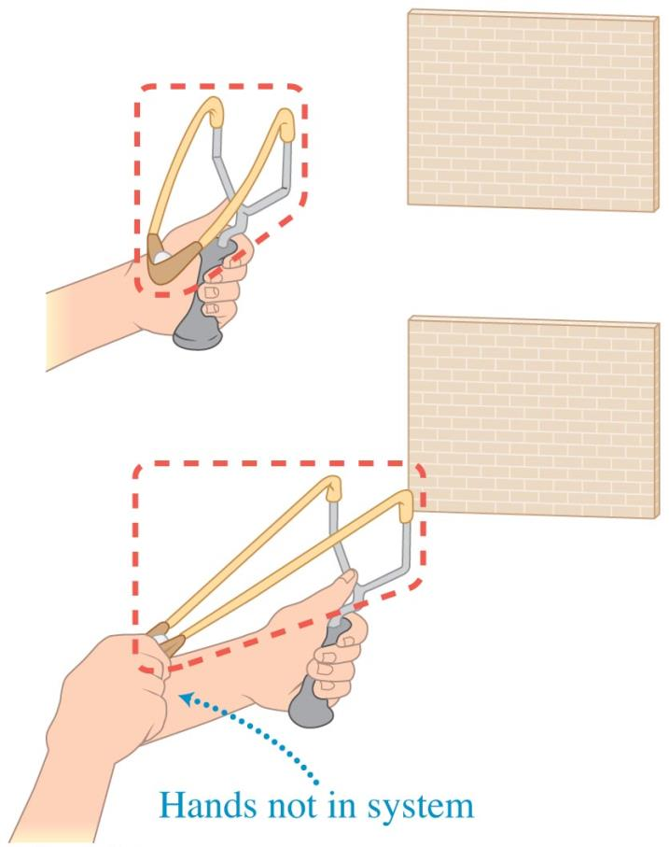
Elastic potential energy
The energy associated with an elastic object's degree of stretch is called elastic potential energy (symbol U_{s}).
The greater the stretch (or compression), the greater the object's elastic potential energy.

Slide 14
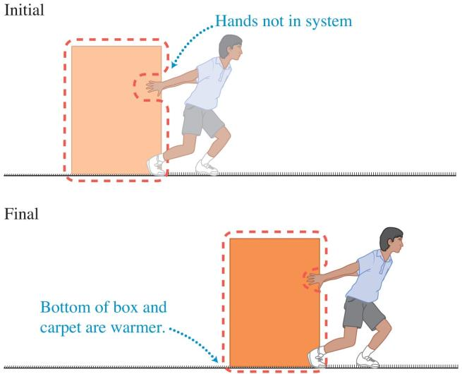
Internal energy
If a object slides on a surface, the surfaces in contact can become warmer.
Structural changes in an object can occur when an external force is applied.
The energy associated with both temperature and structure is called internal energy (symbol U_{int}).

Slide 15
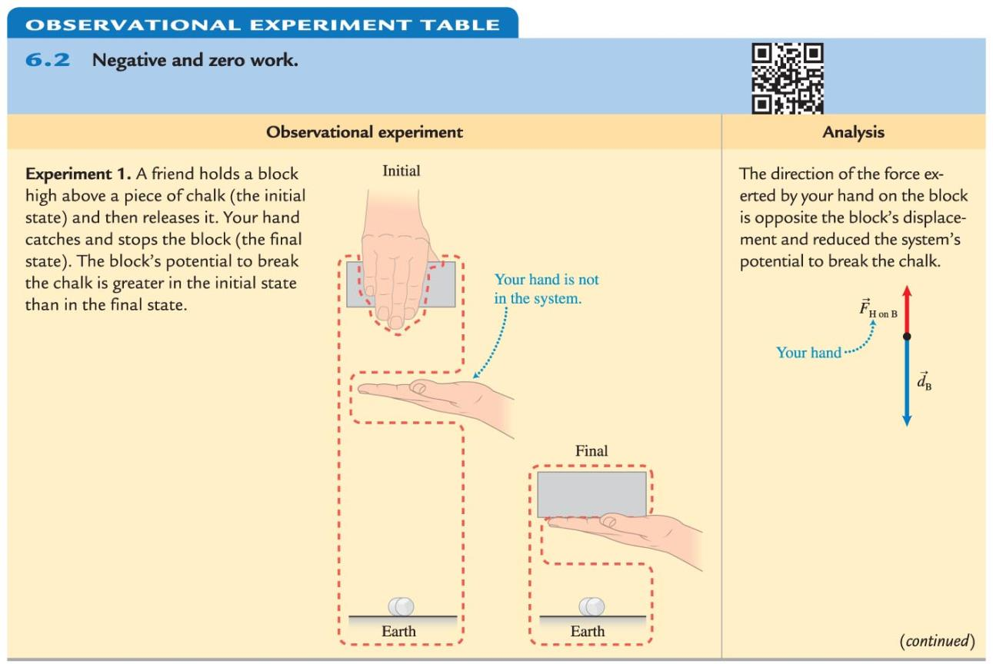
Observational Experiment Table: Negative and zero work

Slide 16
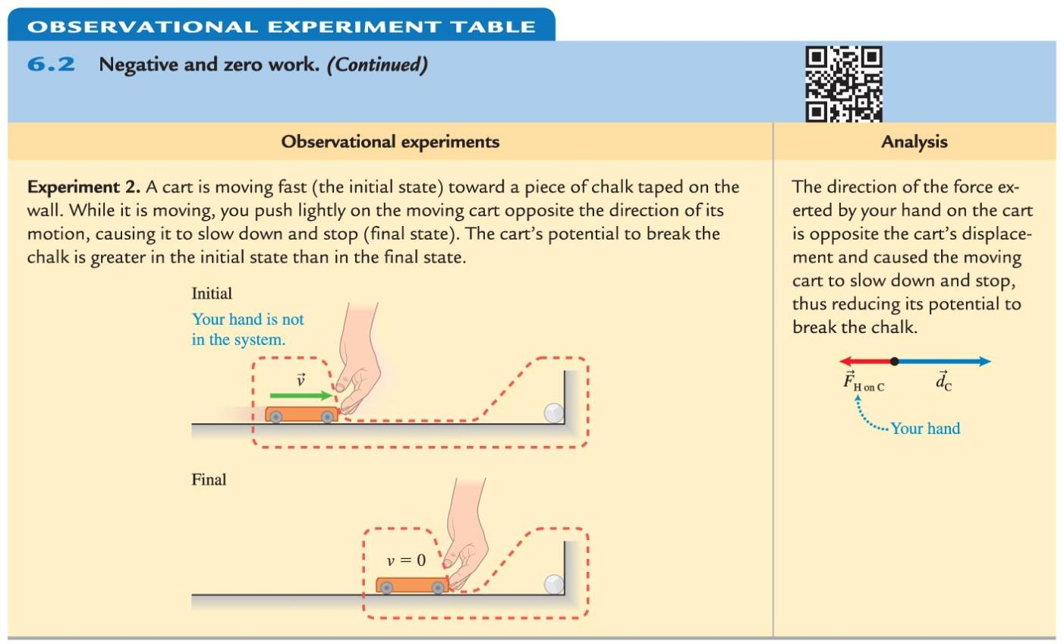
Observational Experiment Table: Negative and zero work

Slide 17
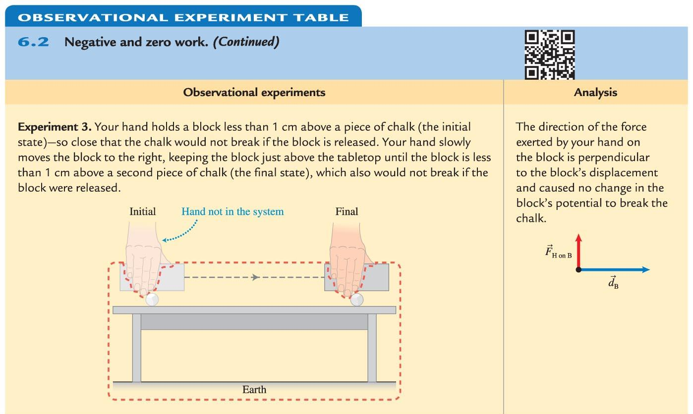
Observational Experiment Table: Negative and zero work

Slide 18
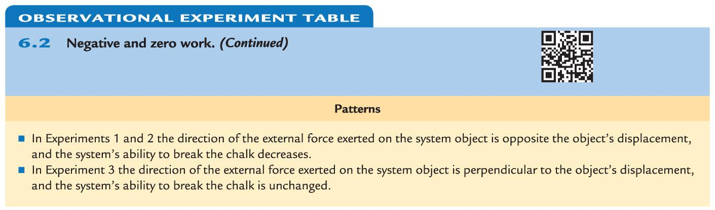
Observational Experiment Table: Negative and zero work

Slide 19
Patterns found from observational experiments: Relating work and energy
When the external force is in the direction of the object's displacement, it does positive work, causing the system to gain energy.
If the external force points in the direction opposite to a system object's displacement, it does negative work, causing the system energy to decrease.
If the external force points in a direction perpendicular to a system object's displacement, it does zero work on the system, causing no change to its energy.

Slide 20
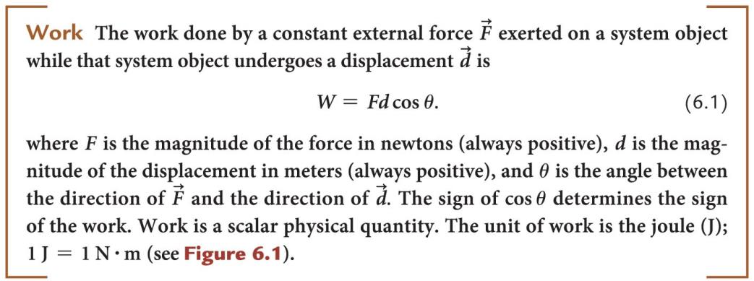
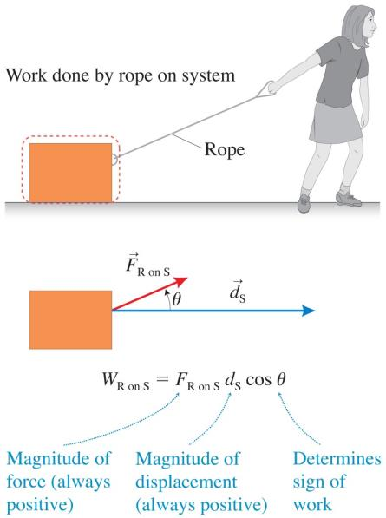
Defining work as a physical quantity

Slide 21
Patterns revisited from observational experiments about work and energy
In some experiments, force and displacement were in the same direction: θ = 0° and
cos 0° = +1.0. Positive work was done.
In other experiments, force and displacement were in opposite directions: θ = 180° and
cos 180° = –1.0. Negative work was done.
In one experiment, force and displacement were perpendicular to each other: θ = 90° and
cos 90° = 0. Zero work was done.

Slide 22
Tip
It is tempting to equate the work done on a system with the force that is exerted on it.
In physics, there must be a displacement of a system object for an external force to do work.
Force and work are not the same thing.

Slide 23
Quantitative Exercise 6.1: Pushing a bicycle uphill
Two friends are cycling up a hill inclined at
8°—steep for bicycle riding. The stronger cyclist helps his friend up the hill by exerting a 50-N pushing force on his friend's bicycle and parallel to the hill, while the friend moves a distance of 100 m up the hill. The force exerted on the weaker cyclist and the displacement are in the same direction.
Determine the work done by the stronger cyclist on the weaker cyclist.
Notes:
This is left for the instructor to solve

Slide 24
Tip
The angle that appears in the definition of work is the angle between the external force and the displacement of the system object.
When calculating work, it is useful to draw
tail-to-tail arrows representing the external force doing the work and the system object displacement. Then note the angle between the arrows.

Slide 25
Energy is a conserved quantity
Work done on a system object by an external force results in a change of one or more types of energy in the system: kinetic energy, gravitational potential energy, elastic potential energy, or internal energy.
The energy of a system can also be converted from one form to another.
  Can this happen when the work done is zero?

Slide 26
Total energy
The total energy U of a system is the sum of all these energies in the system:
Hypothesis: if no work is done on the system, the energy of the system should not change; it should be constant.

Slide 27
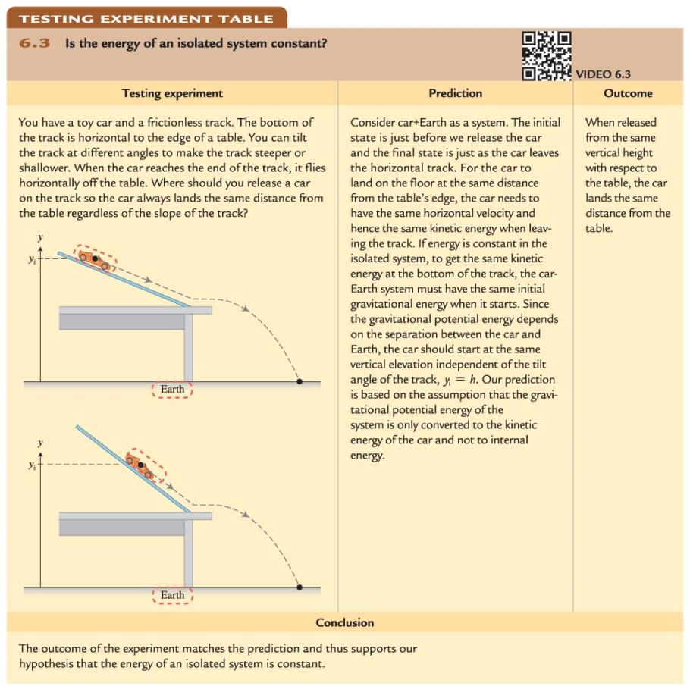
Testing experiment: Is the energy of an isolated system constant?

Slide 28
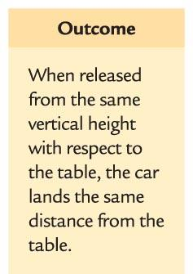
Testing experiment: Is the energy of an isolated system constant?
What can we conclude based on the prediction and the observed outcome of the testing experiment?

Slide 29
Reasoning from our experiments
We have support for a hypothesis that the energy of an isolated system is constant and the different processes inside the system convert energy from one form to another.
We reason that work is a mechanism through which the energy of a nonisolated system changes.
  Based on this reasoning, we can hypothesize that energy is a conserved quantity—that it is constant in an isolated system and changes as a result of work done on a nonisolated system.

Slide 30
Work-energy bar charts
A work-energy bar chart indicates the relative amounts of a system's different types of energy in the initial state of a process, the work done on the system by external forces during the process, and the relative amounts of different types of energy in the system at the end of the process.
The work bar is shaded to emphasize that work does not reside in the system.

Slide 31
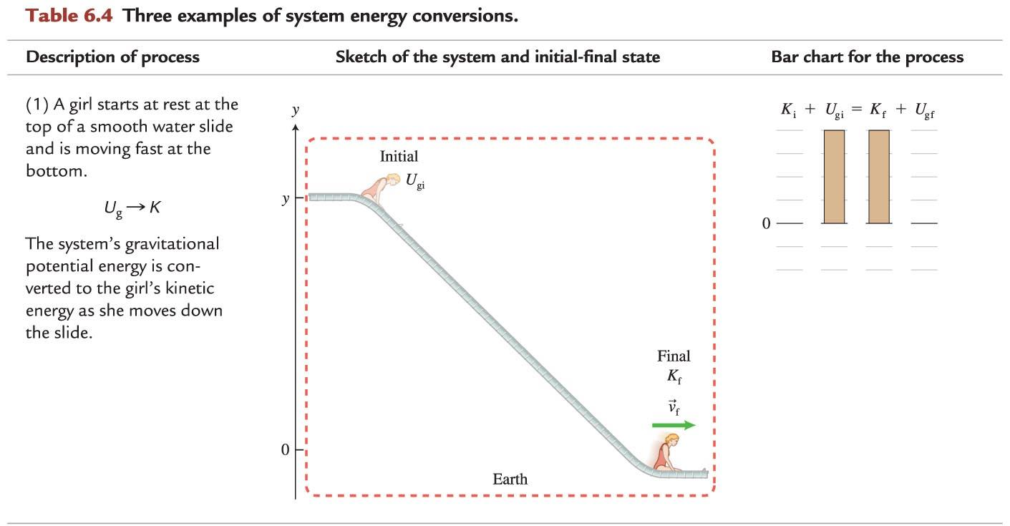
Example 1: Work-energy bar chart

Slide 32
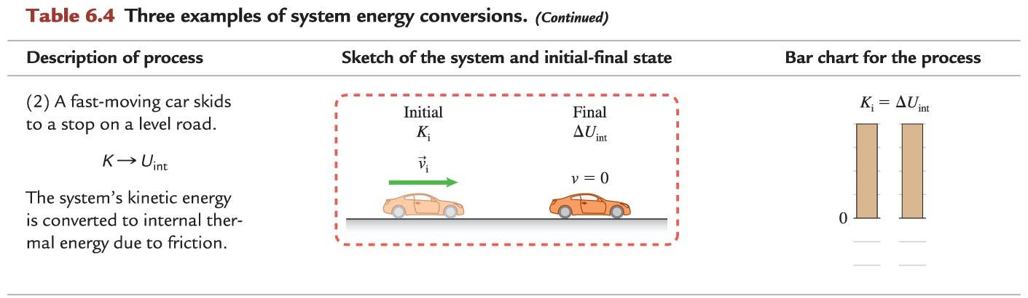
Example 2: Work-energy bar chart

Slide 33
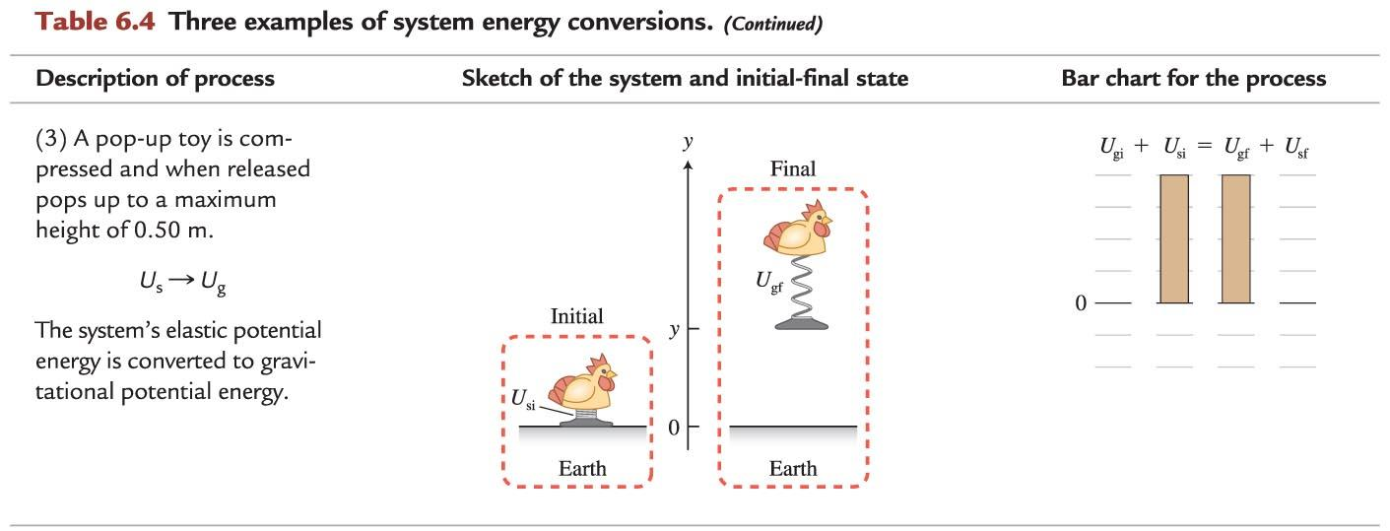
Example 3: Work-energy bar chart

Slide 34
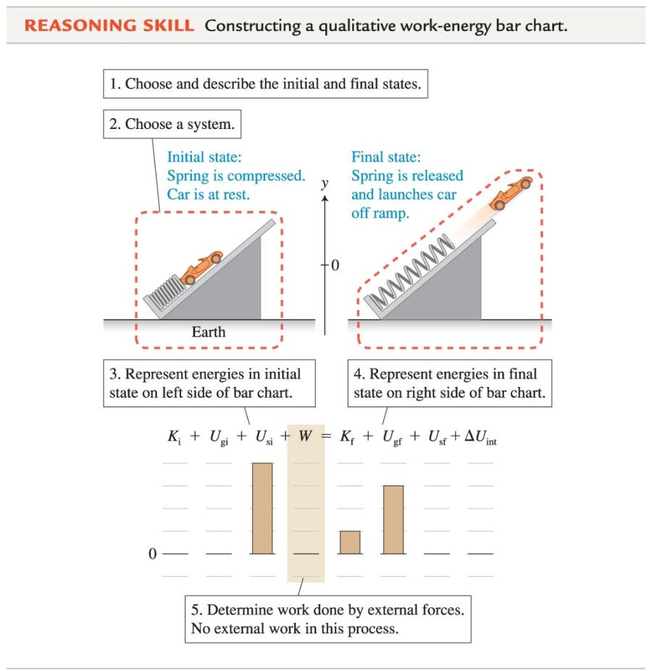
Reasoning Skill: Constructing a qualitative work-energy bar chart

Slide 35
Tip
In the Skills box for work-energy bar charts, the system is isolated.
  No work is done on it.
If we do not include Earth in the system, then Earth will do negative work on the cart.
  Such a system will not have gravitational potential energy.

Slide 36
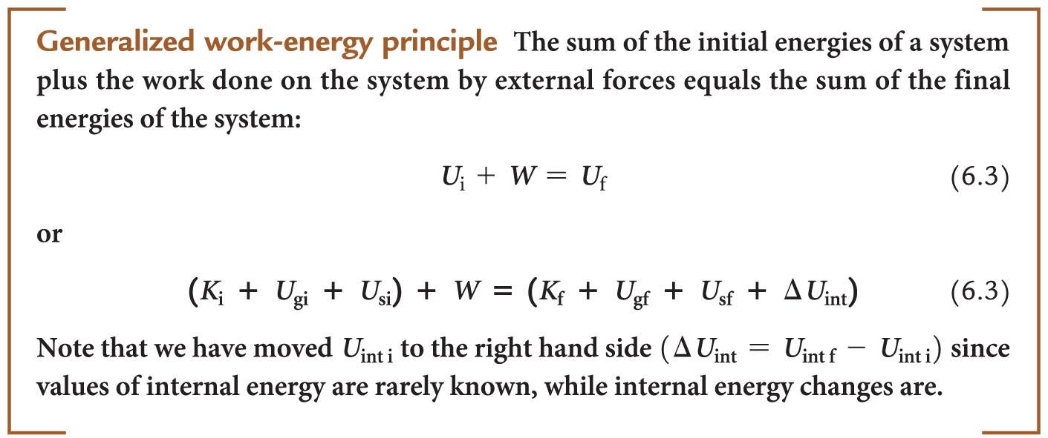
The generalized work-energy principle

Slide 37
The generalized work-energy principle and perpetual motion
A perpetual motion machine is a mechanical device that continuously and indefinitely does useful things by transferring energy to the environment.
The work-energy equation gives insight as to why this is impossible: the energy transfer by negative work causes the system's energy to decrease.
The machine cannot continue in motion forever.

Slide 38
Conceptual Exercise 6.2: Pole vaulter
A pole vaulter crosses a bar high above a cushion below.
Construct a sketch and a work-energy bar chart for two processes:
  The initial state starts at the highest point in the jump, and the final state is just before the vaulter reaches the cushion below.
  The initial state starts at the highest point in the jump, and the final state is at the instant the jumper comes to rest on the cushion.
Notes:
This is left for the instructor to solve

Slide 39
Tip
The amount of gravitational potential energy in a system depends on where the origin is placed on the vertical y-axis.
This placement is arbitrary.
The important thing is the change in position and the corresponding change in gravitational potential energy.

Slide 40
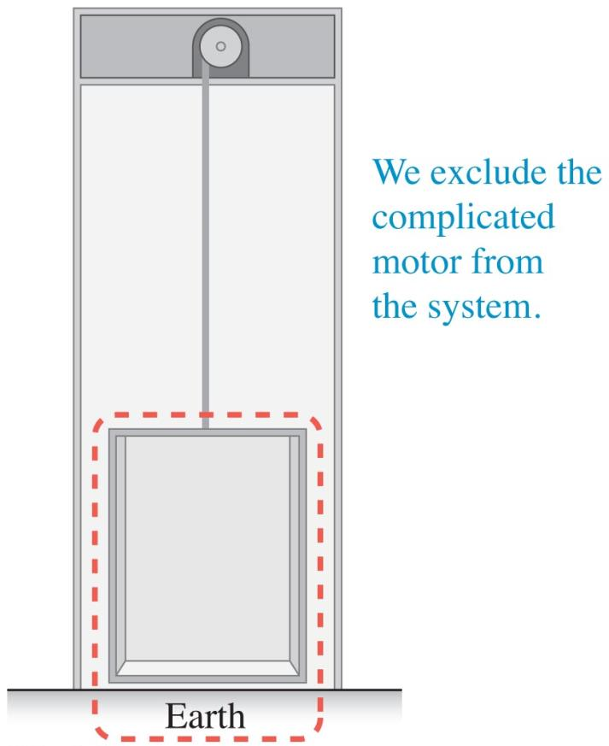
Choosing what to include in a system
It is preferable to have a larger system so that the changes occurring can be included as energy changes within the system rather than as the work done by external forces.
Even so, often it is best to exclude something like a motor from a system because its energy changes are complex.

Slide 41

Gravitational potential energy
A rope lifts a heavy box upward at a constant negligible velocity. The box is the system.
  The box moves at constant velocity; the upward tension force of the rope on the box is equal in magnitude to the downward gravitational force Earth exerts on the box: m_{box}g.
  The rope does work on the box, changing its vertical position from y_{i} to y_{f}:

Slide 42
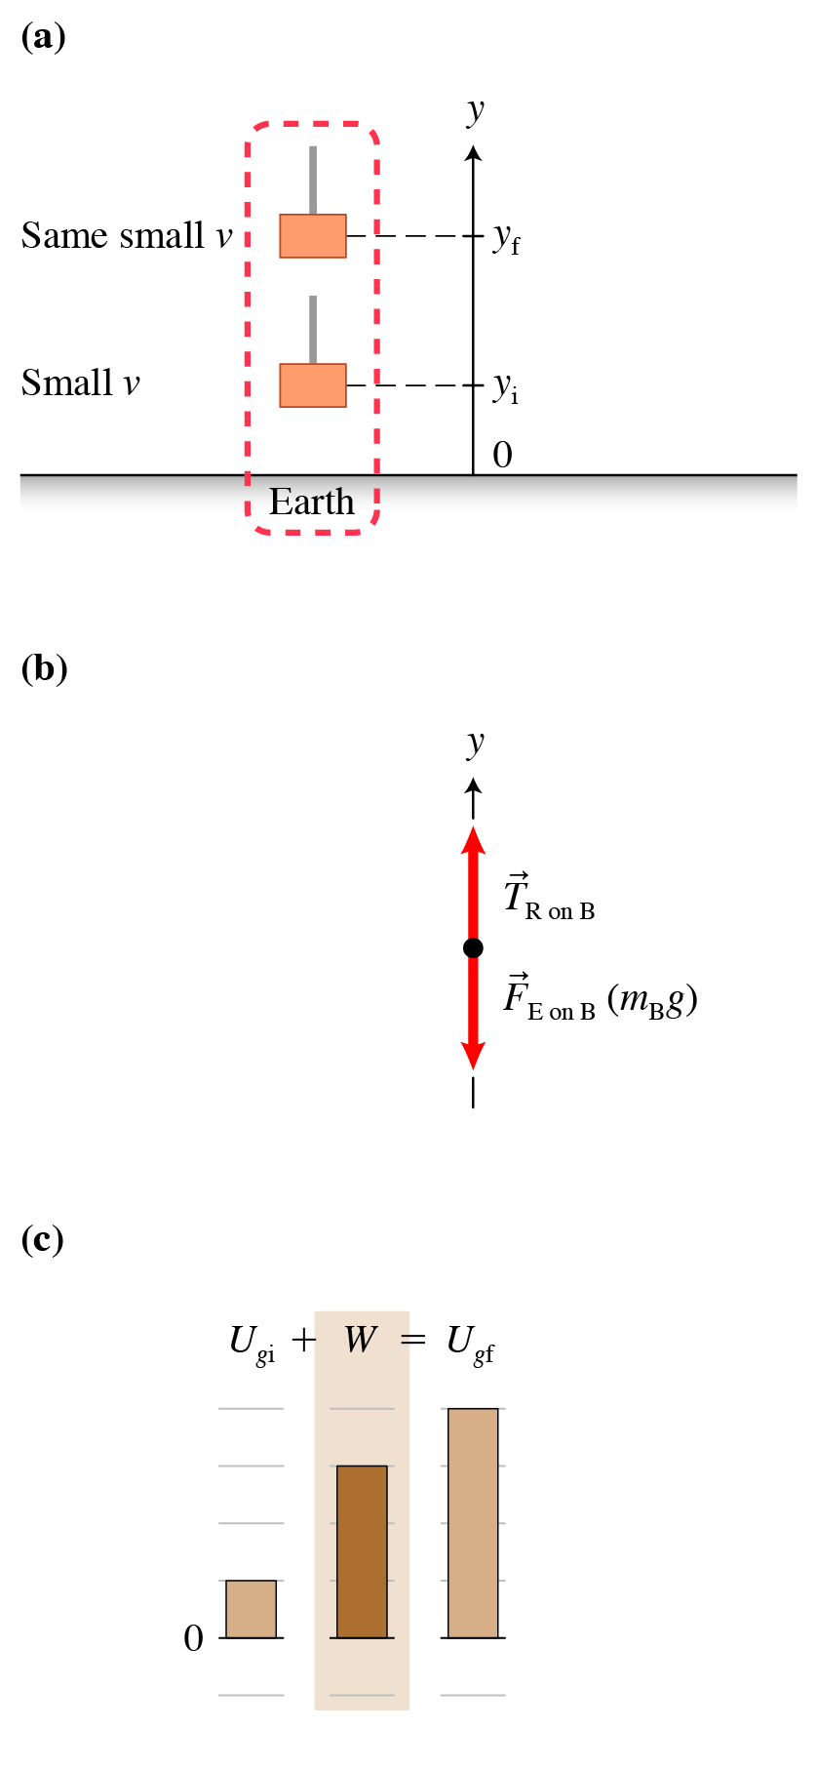
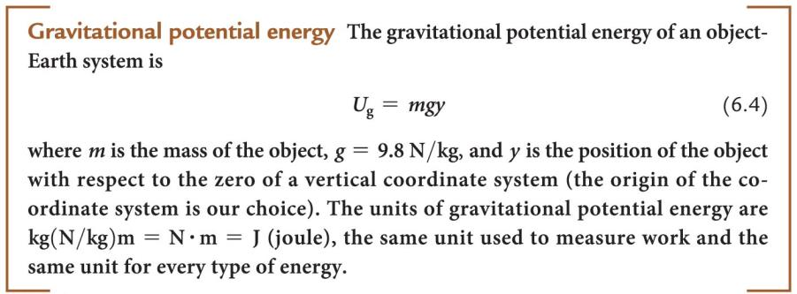
Gravitational potential energy

Slide 43
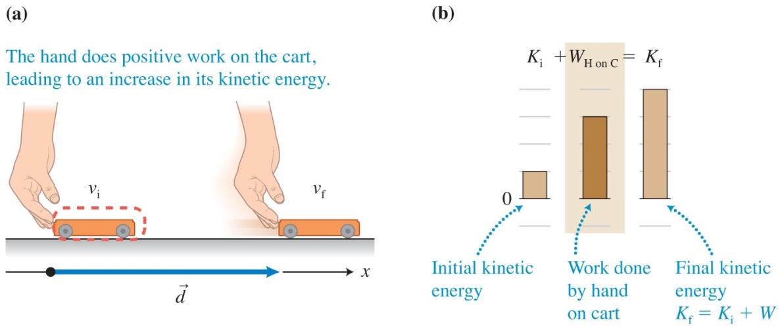


Kinetic energy
The cart is the system. Your hand exerts a force on the cart while pushing it to the right on a horizontal frictionless surface.

Slide 44

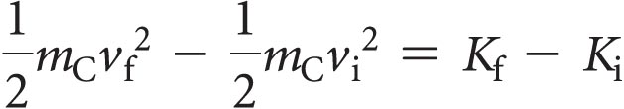
Kinetic energy
The equation we found can be put in terms of properties of the cart using dynamics and kinematics:
We find:

Slide 45
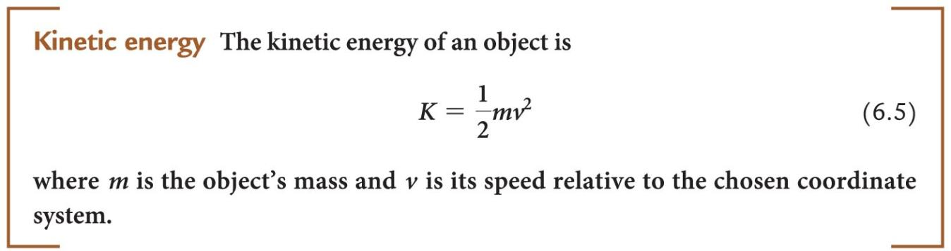
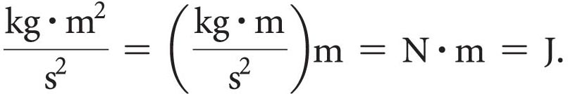
Kinetic energy
To check whether the unit of kinetic energy is the joule (J), we use Eq. (6.5) with the units

Slide 46
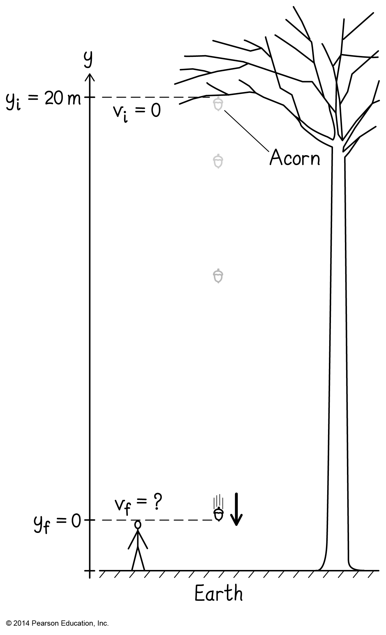
Example 6.3: An acorn falls
You sit on the deck behind your house. Several 5-g acorns fall from the trees high above, just missing your chair and head.
Use the work-energy equation to estimate how fast one of these acorns is moving just before it reaches the level of your head.
Notes:
This is left for the instructor to solve

Slide 47
Quantifying elastic potential energy
When you stretch or compress an elastic
spring-like object, you have to pull or push harder as the object is stretched or compressed more.
  The force is not constant.
This factor makes it more difficult to find a mathematical expression for the elastic potential energy stored by an elastic object when it has been stretched or compressed.

Slide 48
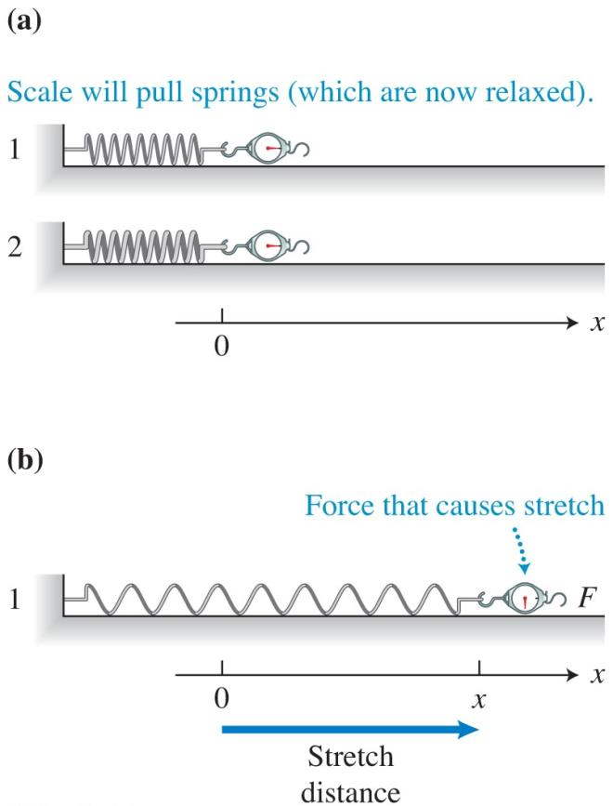
Hooke's law
Two springs of the same length—one less stiff and the other more stiff—are pulled, and the magnitude of the force and the distance that each spring stretches from its unstretched position are measured.

Slide 49
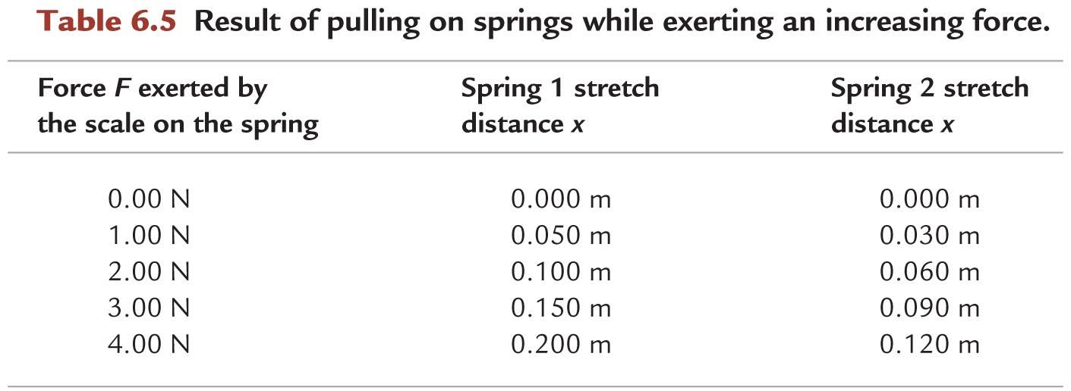
Hooke's law

Slide 50
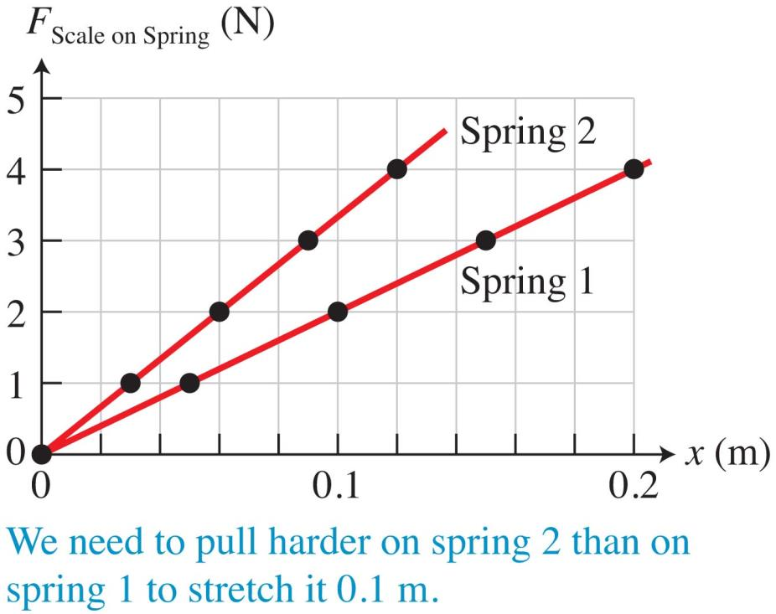
Hooke's law
We can plot our data to find a relationship:

Slide 51


Hooke's law
The magnitude of the force exerted by the scale on each spring is proportional to the distance that each spring stretches:
From Newton's third law:

Slide 52
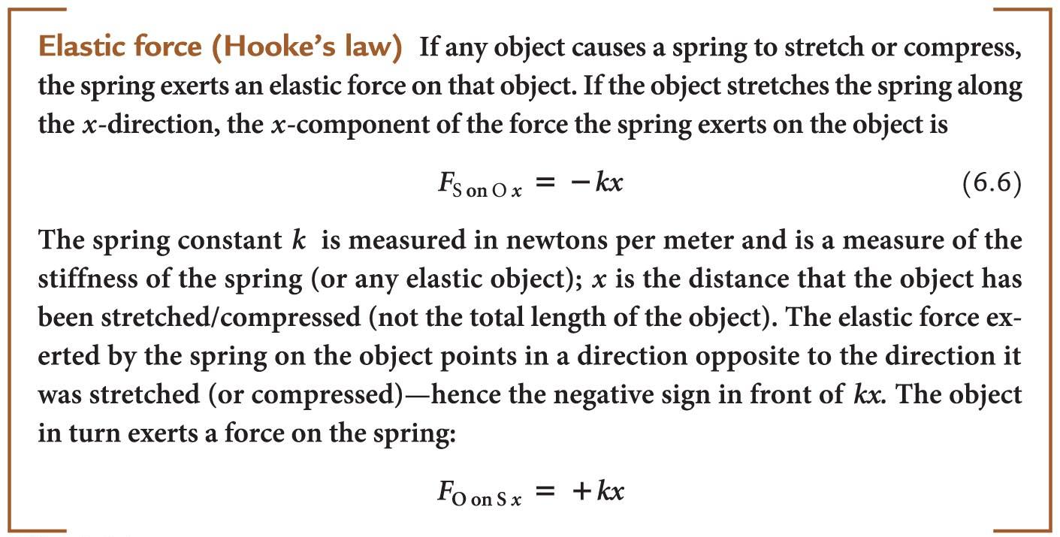
Elastic force (Hooke's law)

Slide 53
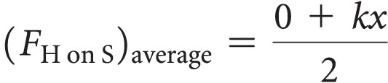
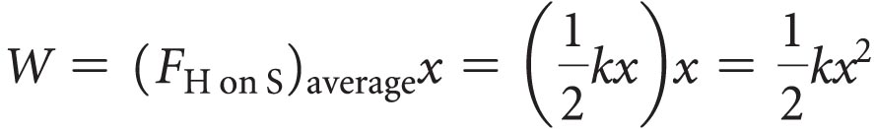
Elastic potential energy
To calculate the work done on the spring by such a variable force, we can replace this variable force with the average force:
Thus the work done by this force on the spring to stretch it a distance x is:

Slide 54
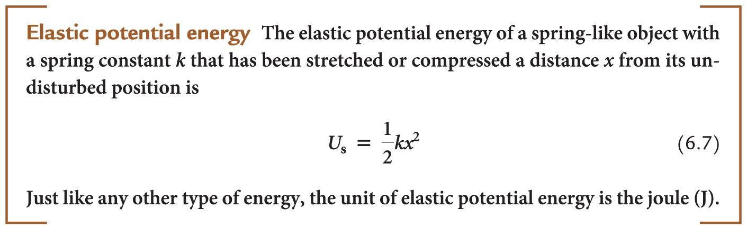
Elastic potential energy
This assumes that the elastic potential energy of the unstretched spring is zero.

Slide 55
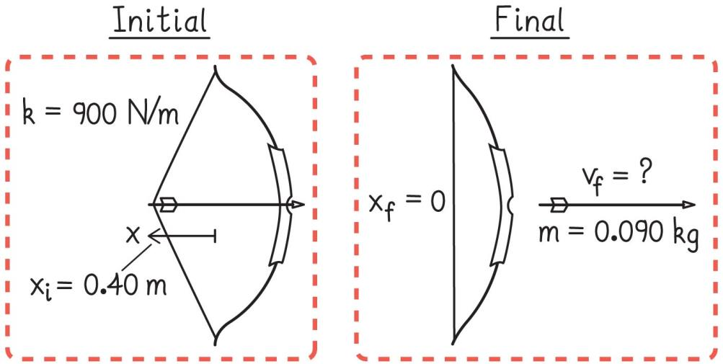
Example 6.4: Shooting an arrow
You load an arrow (mass = 0.090 kg) into a bow and pull the bowstring back 0.50 m. The bow has a spring constant k = 900 N/m.
Determine the arrow's speed as it leaves the bow.
Notes:
This is left for the instructor to solve

Slide 56
Friction and energy conversion
In nearly every mechanical process, objects exert friction forces on each other.
Sometimes the effect of friction is negligible, but most often friction is important.
Our next goal is to investigate how we can incorporate friction into work and energy concepts.

Slide 57
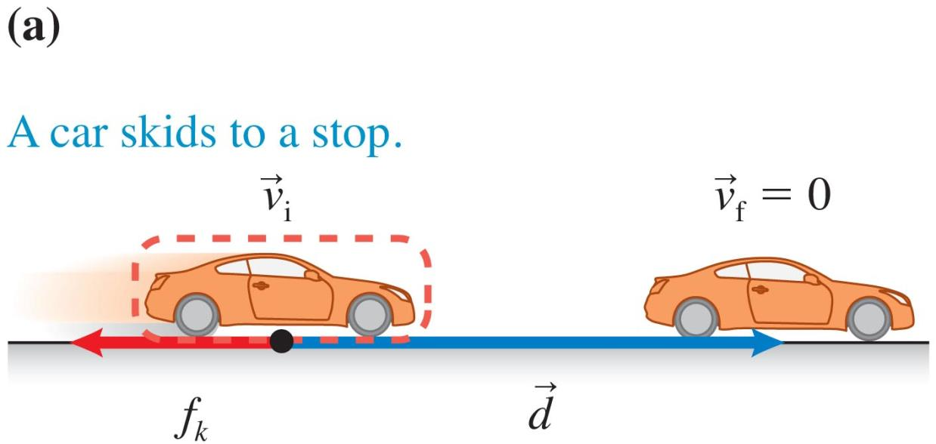
Can friction force do work?
Consider a car skidding on a road.

Slide 58
Can friction force do work?
The kinetic friction force exerted by the road surface on the car does work on the car and slows it to a stop.
The negative work done indicates that the car's energy is decreasing.

Slide 59
Can friction force do work?
When a car skids, touching the tires would reveal that they are warm to the touch. There would also be black skid marks on the
road—some of the rubber is scraped off the tires.

Slide 60
Can friction force do work?
  The internal energy of the system increases.
The change in the kinetic energy of the car equals the work done by friction.
  We have "extra" energy! There is a problem with our model.

Slide 61
Can friction force do work?
Consider a box pulled by a rope across a horizontal carpet at constant velocity.
The force of kinetic friction from the carpet on the box is against the direction of motion, so the work done is negative; this is balanced by the positive work done by the rope pulling on the box.
  The net change in energy should be zero, yet the surfaces warm up!

Slide 62
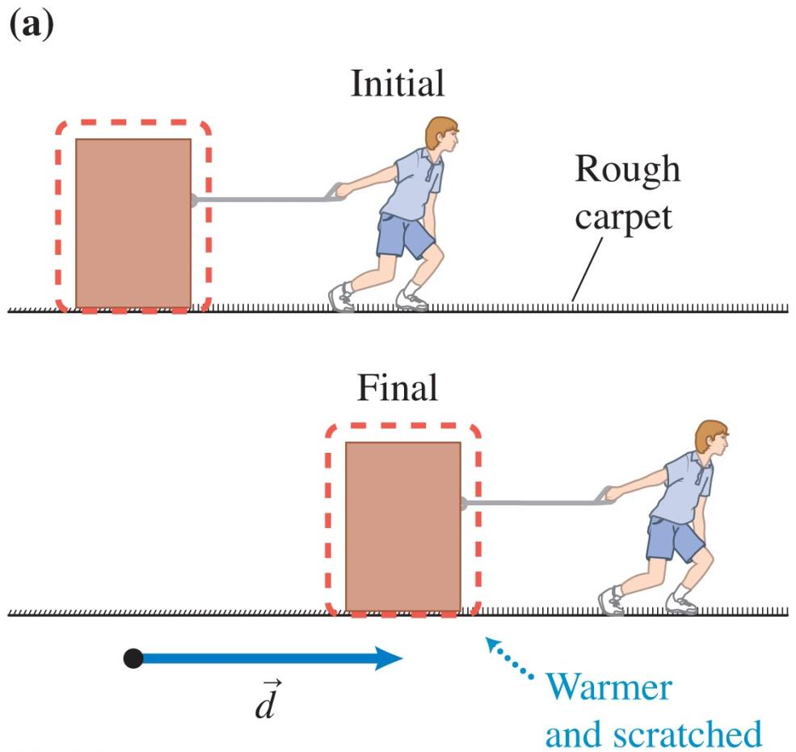
Can friction force do work?

Slide 63
The effect of friction as a change in internal energy
If we choose the box or car as our system object, our model does not account for the change in internal energy.
If we pick the surface and the box or car as our system, then the friction force between the surface and the box or car is internal and does no work.
This choice of systems allows us to construct an expression for the change in internal energy of a system.

Slide 64
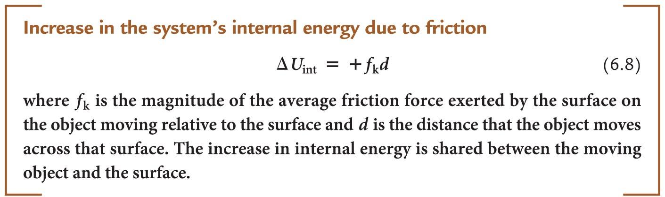
Increase in the system's internal energy due to friction
Including friction in the work-energy equation as an increase in the system's internal energy produces the same result as calculating the work done by the friction force.

Slide 65
Example 6.5: Skidding to a stop
To avoid a collision while driving, you apply the brakes in your car, leaving 24-m skid marks on the road while stopping. A police officer observes the near collision and gives you a speeding ticket, claiming that you were exceeding the 35-mph speed limit. She estimates your car's mass as 1390 kg and the coefficient of kinetic friction μ_{k} between your tires and this particular road as about 0.70.
Do you deserve the speeding ticket?
Notes:
This is left for the instructor to solve as an example problem

Slide 66
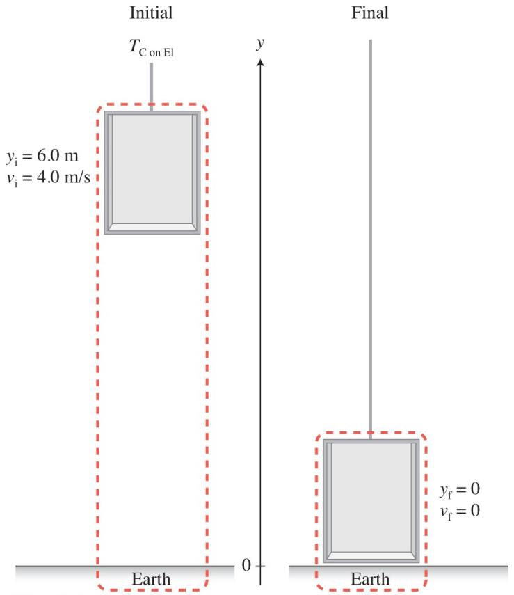
Skills for analyzing processes using the work-energy principle
Sketch and translate
  Sketch the initial and final states of the process, labeling the known and unknown information.
  Choose the system of interest.
  Include the object of reference and the coordinate system.

Slide 67
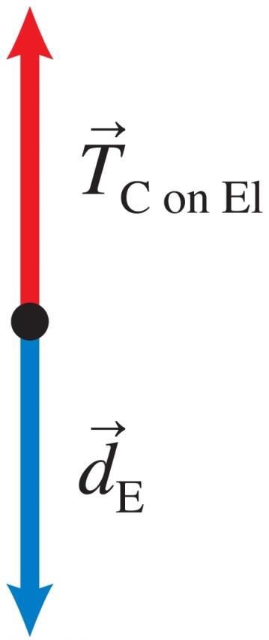
Skills for analyzing processes using the work-energy principle
Simplify and diagram
  Which simplifications can you make to the objects, interactions, and processes?
  Decide which energy types are changing.
  Are external objects doing work?
  Use the initial and final sketches to help draw a work-energy bar chart.

Slide 68

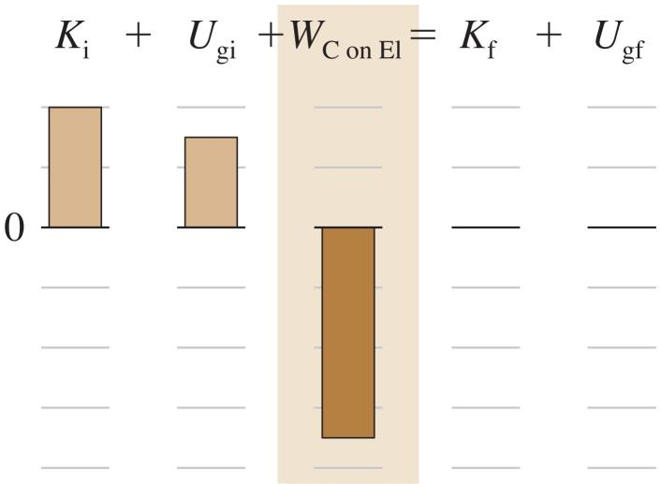
Skills for analyzing processes using the work-energy principle
Represent mathematically
  Convert the bar chart into a mathematical description of the process.
  Each bar in the chart will appear as a single term in the equation.

Slide 69
Skills for analyzing processes using the work-energy principle
Solve and evaluate
  Solve for the unknown and evaluate the result.
  Does it have the correct units? Is its magnitude reasonable? Do the limiting cases make sense?

Slide 70
Example 6.7: The human cannonball again
To launch a 60-kg human so that he leaves a cannon moving at a speed of 15 m/s, you need a spring with an appropriate spring constant. This spring will be compressed 3.0 m from its natural length when it is ready to launch the person. The cannon is oriented at an angle of 37° above the horizontal.
Which spring constant should the spring have so that the cannon functions as desired?
Notes:
This is left for the instructor to solve as an example

Slide 71
Conceptual Exercise 6.8: Stretching the aorta
When your heart beats, the left ventricle pumps about 80 cm³ of blood into the aorta, the largest artery. This pumping occurs during a short time interval, about 0.13 s. The elastic aorta walls stretch to accommodate the extra blood. During the next 0.4 s or so, the walls of the aorta contract, applying pressure on the blood, moving it out of the aorta into the rest of the circulatory system.
Represent this process with a qualitative work-energy bar chart.
Notes:
This is left for the instructor to solve as an example

Slide 72
Example 6.9: Bungee jumping
The Oxford team used a 40-m-long bungee cord that stretched another 35 m when the jumper was at the very lowest point in the jump. The jumper's mass is 70 kg. Imagine your job is to buy a bungee cord that would provide a safe jump with these specifications.
Specifically, you need to determine the spring constant k of the cord to buy.
Notes:
This is left for the instructor to solve as an example

Slide 73
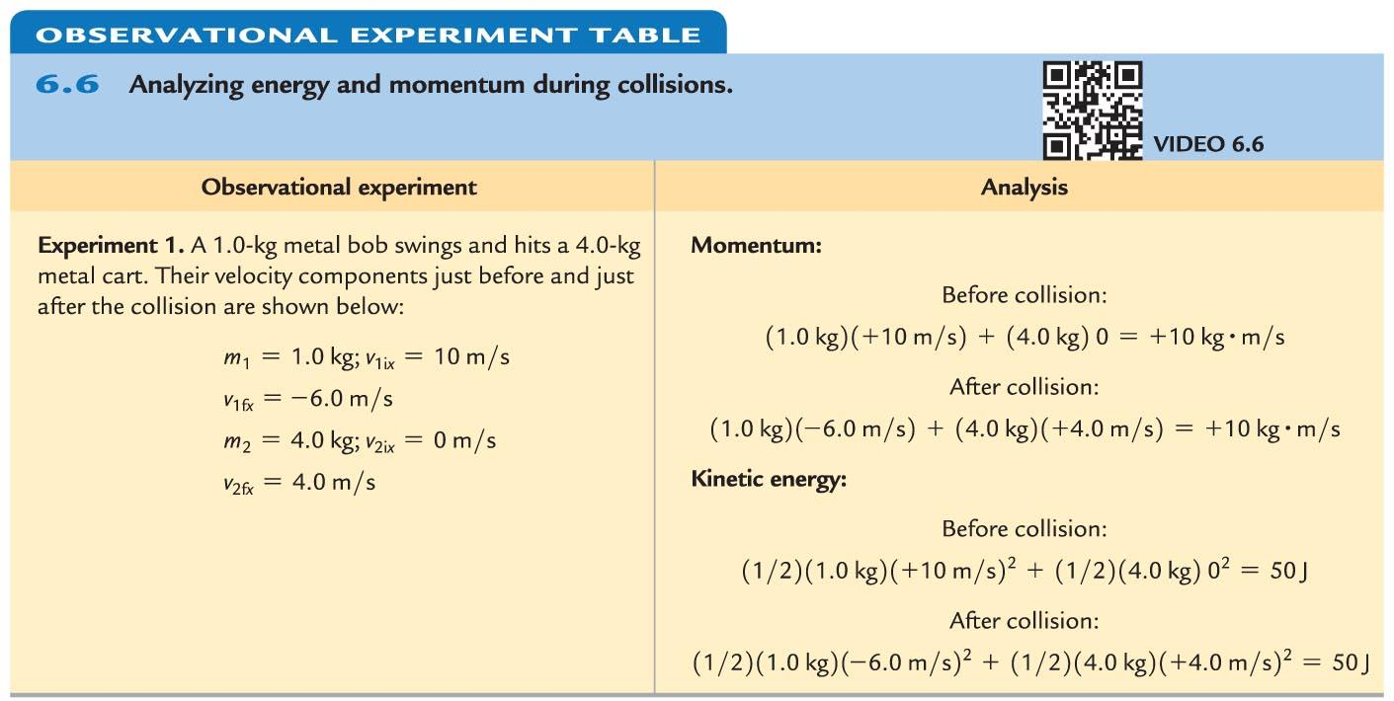
Analyzing collisions using momentum and energy principles: Observational experiment

Slide 74
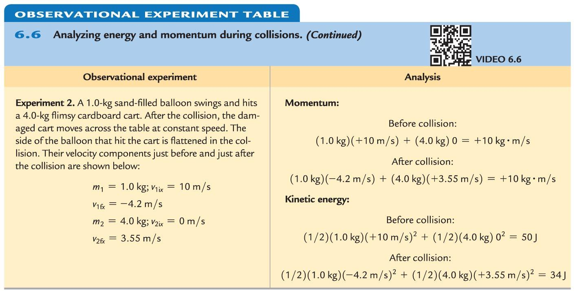
Analyzing collisions using momentum and energy principles: Observational experiment

Slide 75
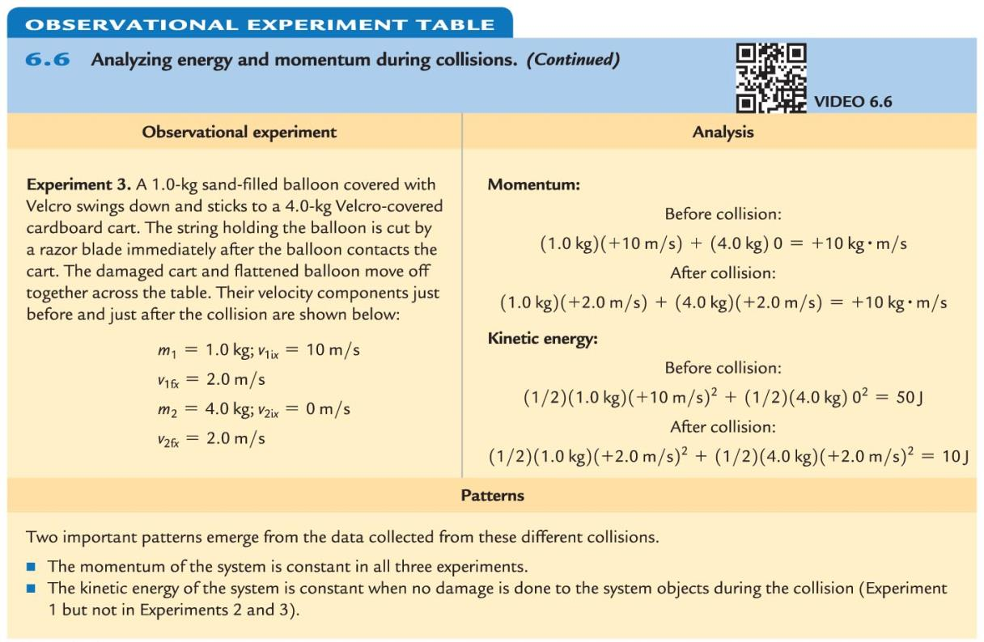
Analyzing collisions using momentum and energy principles: Observational experiment

Slide 76
Analyzing collisions using momentum and energy principles
Two important patterns emerge from the data collected from these different collisions.
  The momentum of the system is constant in all three experiments.
  The kinetic energy of the system is constant when no damage is done to the system objects during the collision (this condition holds for experiment 1 but not for experiments 2 and 3).

Slide 77
Analyzing collisions using momentum and energy principles
With data, we can determine the amount of kinetic energy converted to internal energy for collisions that result in deformation.
  It is impossible to predict this value ahead of time!
In collisions where any deformation of the system objects occurs, we cannot make predictions about the amount of kinetic energy converted to internal energy.
  Even in collisions where the system objects become damaged, the momentum of the system remains constant.

Slide 78
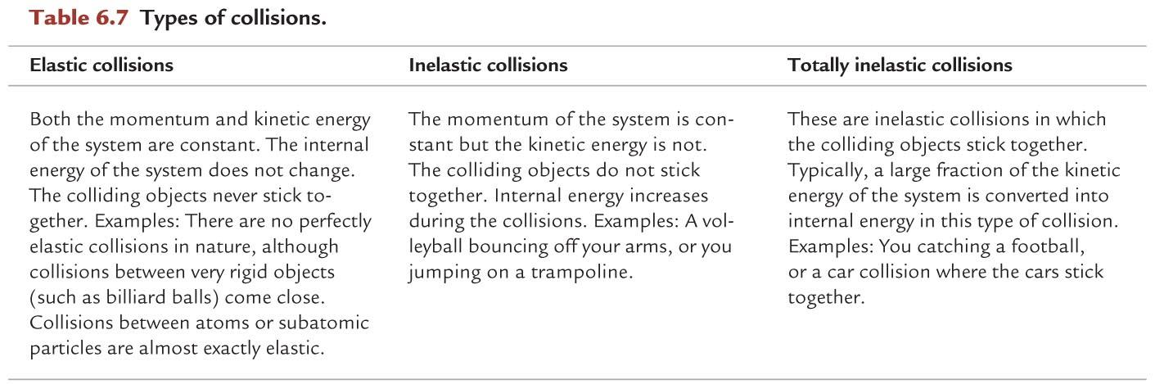
Types of collisions

Slide 79
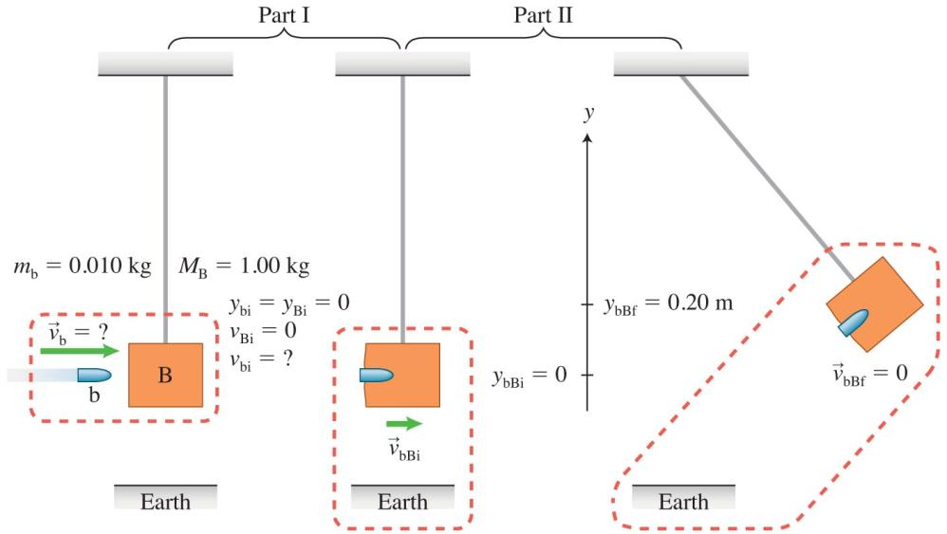
Example 6.10: A ballistic pendulum
A gun is several centimeters from a 1.0-kg wooden block hanging at the end of strings. The gun fires a 10-g bullet that becomes embedded in the block, which swings upward a height of 0.20 m.
Determine the speed of the bullet when it leaves the gun.
Notes:
This is left for the instructor to solve as an example

Slide 80
Power
Why is it more difficult for the same person to run up a flight of stairs than to walk if the change in gravitational potential energy of the person-Earth system is the same in both scenarios?
  The amount of internal energy converted into gravitational energy is the same in both cases, but the rate of that conversion is not.
  When you run upstairs, you convert the energy at a faster rate.
  The rate at which the conversion occurs is called the power.

Slide 81

Power

Slide 82
Power
Power is sometimes expressed in horsepower (hp): 1 hp = 746 W.
Horsepower is most often used to describe the power rating of engines or other machines.
  A 50-hp gasoline engine (typical in cars) converts the internal energy of the fuel into other forms of energy at a rate of 50 x 746 W = 37,300 W, or 37.30 kJ/s.

Slide 83
Example 6.11: Lifting weights
Xueli is doing a dead lift. She lifts a 13.6-kg
(30-lb) barbell from the floor to just below her waist (a vertical distance of 0.70 m) in 0.80 s.
Determine the power during the lift.
Notes:
This is left for the instructor to do as an example

Slide 84

Improving our model of gravitational potential energy
We have an expression for the gravitational potential energy of an object-Earth system:
U_{g} = mgy.
  This expression is valid only when an object is close to Earth's surface.
The gravitational force exerted by planetary objects on moons and satellites and by the Sun on planets has the form:
  Can we find a more general expression for gravitational potential energy change?

Slide 85

Gravitational potential energy for large mass separations
Imagine a "space elevator" that transports supplies from the surface of Earth to the International Space Station.
  The elevator moves at constant velocity, except for a very brief acceleration and deceleration at the beginning and end of the trip.
Knowing the expression for the gravitational force and calculus allows us to write:

Slide 86

Gravitational potential energy for large mass separations (Cont'd)

Slide 87

Gravitational potential energy of a system consisting of Earth and any object
We can use Eq. (6.11) to find the gravitational potential energy for any two spherical or point-like objects.

Slide 88

Gravitational potential energy and negative energy
The gravitational potential energy is zero when the objects are an infinite distance apart.
  The only way to add positive energy to a system and have it become zero is if it starts with negative energy.
  The gravitational potential energy is therefore negative when the objects are closer together.

Slide 89
Escape speed
Escape speed is the minimum speed an object needs to jump up and never come back down.
  For example, if we want to launch a spacecraft to explore far planets in the solar system, we do not want the spacecraft to fall back to Earth or start orbiting Earth.
The minimum speed means the object will just barely manage to "escape"; this indicates that the object has no energy in the final state.
  If energy was not zero in the final state, the object could have escaped at a slower speed.

Slide 90
Tip
The escape speed does not depend on the mass of the escaping object: a tiny speck of dust and a huge boulder would need the same initial speed to leave Earth.
Why is that?

Slide 91
Black holes
The equation found in the previous example for escape speed suggests something amazing:
  If the mass of the star or planet were large enough or its radius small enough, the escape speed could be very large.
  If the star's escape speed were faster than the speed of light, light leaving the star's surface would not be moving fast enough to escape; the star would be completely dark.

Slide 92
Quantitative Exercise 6.14: The Sun as a black hole
How small would our Sun need to be for it to become a black hole?
Notes:
This is left for the instructor to solve as an example

Slide 93


Summary

Slide 94
Summary

Slide 95
Summary

Slide 96


Summary

Slide 97

Summary

Slide 98

Summary

