Slide 1
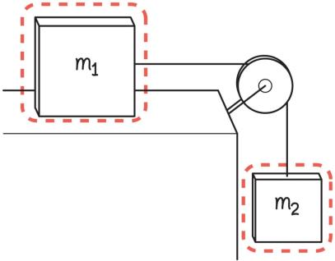
Example 3.5: Slowing the fall
In a modified Atwood machine, one block rests on a horizontal surface and the other block hangs off the edge of the surface. A string attached to each block passes over a light, smooth pulley.
Determine the force that the string exerts on the hanging block of mass m₂ and the magnitude of the acceleration of each block.
Notes:
I'm leaving this one for the instructor to solve in class

Slide 2
Static friction

Slide 3
Static friction

Slide 4
Static friction
Static friction force is parallel to the surfaces of two objects that are not moving in relation to each other and opposes the tendency of one object to move across the other.
Static friction force changes magnitude to prevent motion, up to a maximum value called the maximum static friction force.
When the external force exceeds this static friction force, the object starts moving.

Slide 5
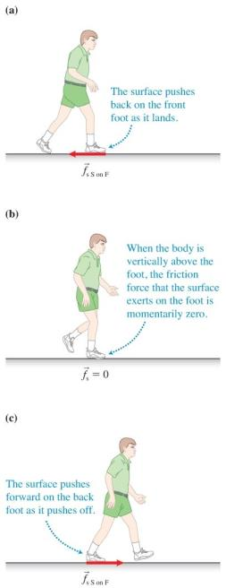
Static friction can help us move
Sometimes friction is a necessary phenomenon for movement—for example, when walking on a flat horizontal sidewalk.
Static friction prevents your shoe from sliding at the start and end of a step.

Slide 6
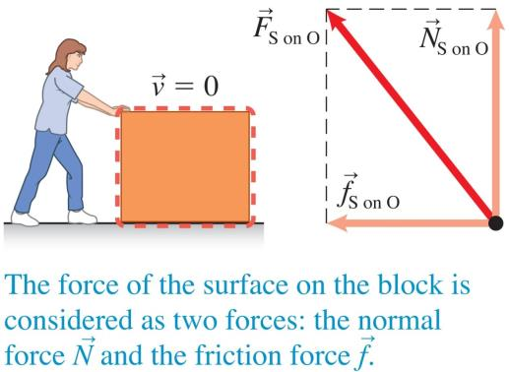
Tip about static friction and the normal force

Slide 7
Magnitude of the maximum static friction force

Slide 8
Testing a hypothesis
Design an experiment in which we can vary a property and make a prediction of the outcome based on the hypothesis.
We have a hypothesis about the maximum static friction force based on observational experiments:
The maximum static friction force that a surface can exert on a block depends on the roughness of the contacting surfaces and the mass of the block, but does not depend on the area of contact between the surfaces.

Slide 9
Magnitude of the maximum static friction force: Testing experiment

Slide 10
Does the maximum static friction force depend on mass?
Which conclusion can you draw about the hypothesis based on agreement or disagreement between the prediction and the outcome of the testing experiment?

Slide 11
Further testing experiments for the maximal static friction force
The hypothesis that the maximal static friction force depends on mass did not turn out to be correct.
We must test the other proposed relationships.
The data in the table indicate there is a constant ratio between the maximum static friction force and the normal force.

Slide 12
Relationship between normal force and friction force
It makes sense that the static friction force should be proportional to the normal force.
The normal force and friction force are two perpendicular components of the same force—the force a surface exerts on an object!
If the force exerted by the surface on an object increases, the normal and friction forces increase proportionally.

Slide 13
Making sense of a relationship
The relationship between friction and the normal force makes sense:
Consider pulling a sled over snow.
Pulling is easier than pushing because when you pull, you lift the sled a little off the surface, reducing the force that it exerts on the snow and in turn reducing the normal force the snow exerts on the sled.

Slide 14
Relationship between normal force and friction force
The ratio of the maximum friction force to the normal force is constant in all trials.
The proportionality constant is different for different surfaces; the proportionality depends on the types of contacting surfaces.
The proportionality constant is greater for two rough surfaces contacting each other and smaller for smoother surfaces.
This ratio is the coefficient of static friction.

Slide 15
Coefficient of static friction
The coefficient of static friction is a measure of the relative difficulty of sliding two surfaces across each other.
The easier it is to slide one surface on the other, the smaller the coefficient is.
This coefficient is unit-less and typically has a value between 0 and 1.

Slide 16
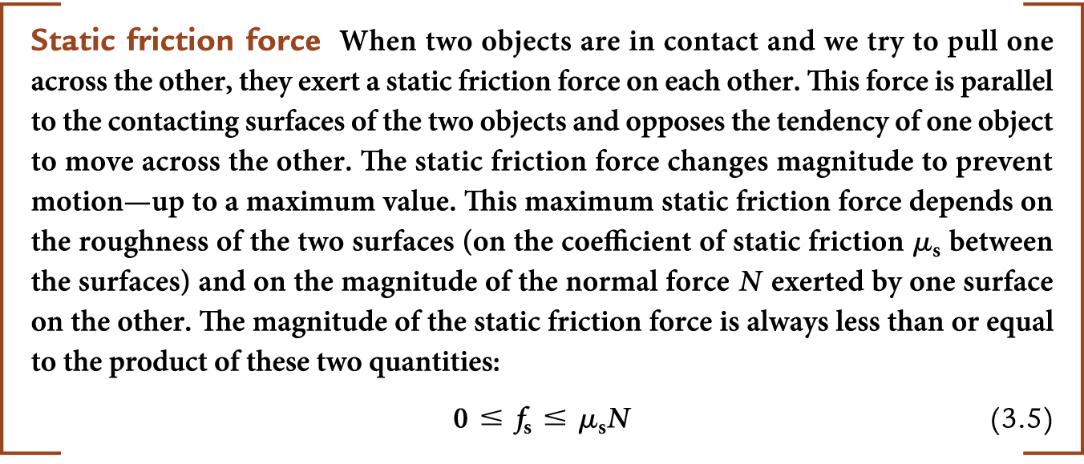
Static friction force

Slide 17
Assumptions for our static friction model
Our equation is reasonable only in situations in which the following conditions hold:
Relatively light objects are resting on relatively firm surfaces.
The objects never cause the surfaces to deform significantly (for example, they do not involve a car tire sinking into mud).

Slide 18
Kinetic friction
Kinetic indicates that the surfaces in contact are moving relative to each other.
A similar relationship exists as between the friction force and the normal force, but with two important differences:
Under the same conditions, the magnitude of the kinetic friction force is always lower than the maximum static friction force.
The resistive force exerted by the surface on the moving object has a constant value.

Slide 19
Kinetic friction

Slide 20
Assumptions for our kinetic friction model
Our equation is reasonable only in situations in which the following conditions hold:
It cannot be used for rolling objects.
It makes the same assumption about the rigidity of the surfaces as the model for static friction.
The objects cannot be moving at high speed.
This equation does not have general applicability, but it is useful for rigid surfaces and objects moving at everyday speeds.

Slide 21
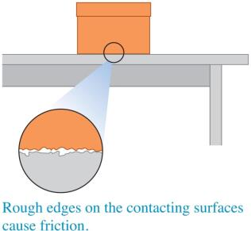
What causes friction?
Even the slickest surfaces have bumps that can hook onto the bumps on another surface.
Smoother surfaces should have reduced friction, consistent with our previous findings.
If two surfaces are too smooth, friction increases again (for example, two pieces of plastic wrap).
This is due to attraction between particles at the surface that are too close together without typical surface bumpiness.

Slide 22
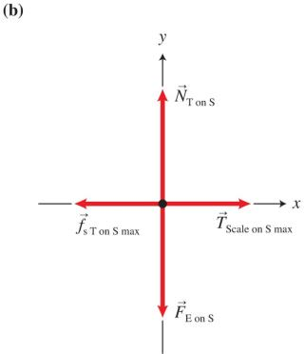
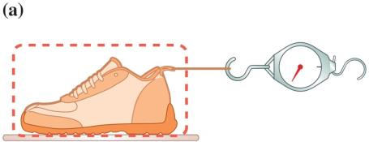
Determining friction experimentally: Experiment 1
The shoe is pulled horizontally with a spring scale until the shoe begins to slide.

Slide 23
Determining friction experimentally: Experiment 1 (Cont'd)
Just before the shoe starts to slide, its acceleration is zero, and the scale indicates the maximum force of static friction that the tile exerts on the shoe.

Slide 24
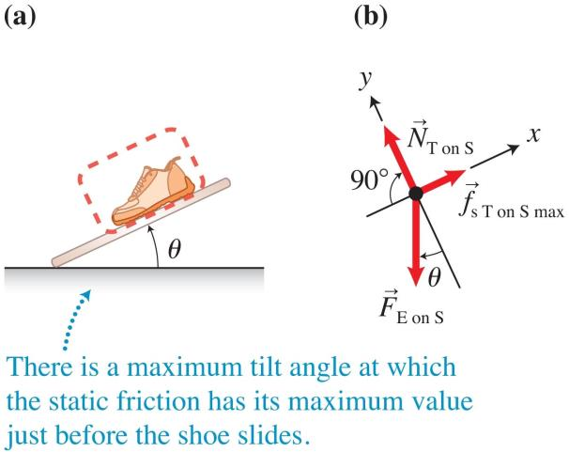
Determining friction experimentally: Experiment 2
Place the shoe on the tile and tilt the tile until the shoe starts to slide.

Slide 25
Determining friction experimentally: Experiment 2 (Cont'd)
Just before the shoe starts to slide, its acceleration is zero, and the static friction force is at its maximum.

Slide 26
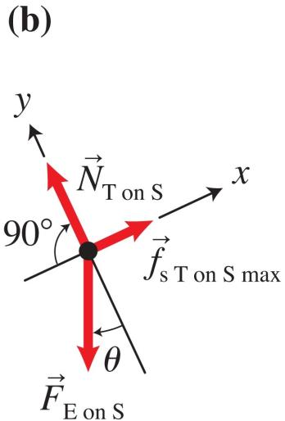
Tip
The magnitude of the normal force that a surface exerts on an object does not necessarily equal the magnitude of the gravitational force that Earth exerts on the object, especially when the object is on an inclined surface!

Slide 27
Example 3.6: Using skid marks for evidence
If a driver slams on the brakes, the tires can lock, causing the car to skid.
Police officers use the length of skid marks to estimate the initial speed of the vehicle.
A car involved in a minor accident left 18.0-m skid marks on a horizontal road. After inspecting the car and road surface, the police officer decided the coefficient of kinetic friction was 0.80. The speed limit was 15.6 m/s on that street. Was the car speeding?
Notes:
This is left as an example for the instructor to solve

Slide 28
Other types of friction
Rolling friction is caused by the surfaces of rolling objects indenting slightly as they turn.
This friction is decreased in tires that have been inflated to a higher pressure.
In Chapter 11, we will learn about another type of friction: the friction that air or water exerts on a solid object moving through the air or water.
This is called a drag force.

