Slide 1
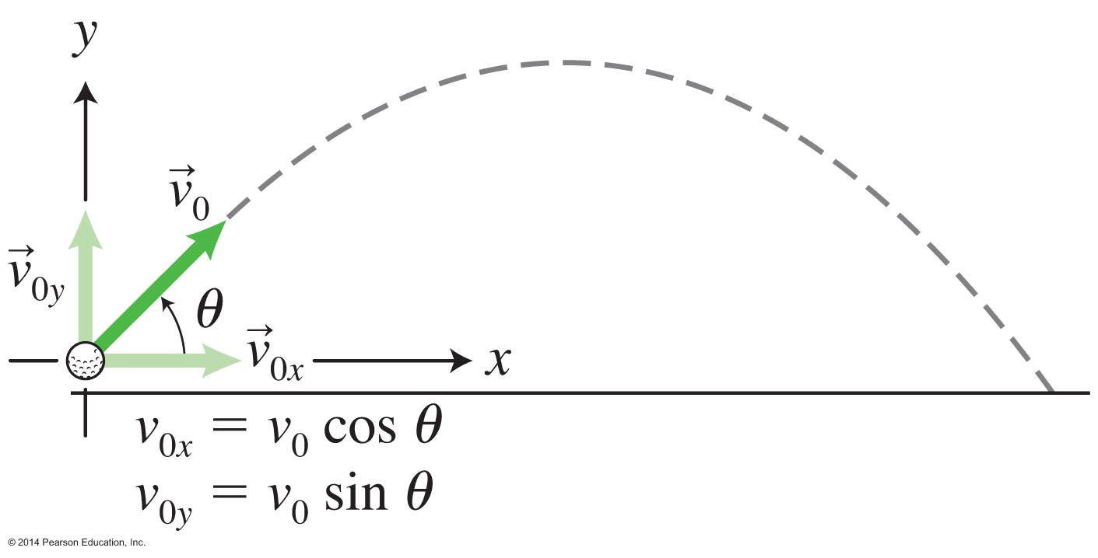
Projectile motion
Projectiles are objects launched at an angle relative to a horizontal surface.

Slide 2
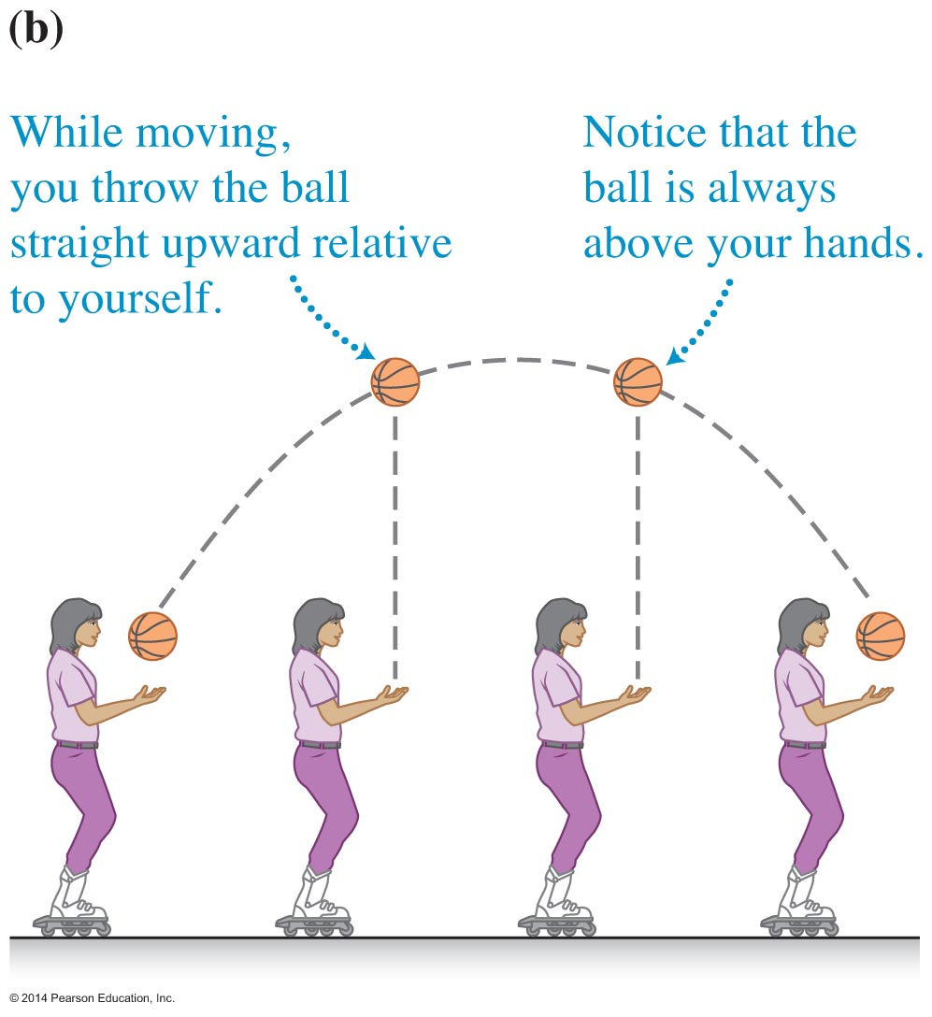
Creating projectile motion
Throw the ball straight up while moving on rollerblades. As long as you do not change your speed or direction while the ball is in flight, it will land back in your hands.

Slide 3
Qualitative analysis of projectile motion in the y-axis
A ball thrown straight up in the air by a person moving horizontally on rollerblades will land back in the person's hand.
Earth exerts a gravitational force on the ball, so its upward speed decreases until it stops at the highest point, and then its downward speed increases until it returns to your hands.
With respect to you on the rollerblades, the ball simply moves up and down.

Slide 4
Qualitative analysis of projectile motion in the x-axis
A ball thrown straight up in the air by a person moving horizontally on rollerblades will land back in the person's hand.
The ball also moves horizontally.
No object exerts a horizontal force on the ball. Thus, according to Newton's first law, the ball's horizontal velocity does not change once it is released and is the same as the person's horizontal component of velocity.

Slide 5
Qualitative analysis of projectile motion in the x- and y-axes
A ball thrown straight up in the air by a person moving horizontally on rollerblades will land back in the person's hand.
The ball continues moving horizontally as if it were not thrown upward.
The ball moves up and down as if it does not move horizontally.
It seems that the horizontal and vertical motions of the ball are independent of each other. We need to test this pattern!

Slide 6
Testing experiment

Slide 7
Testing experiment
Given our prediction based on the previously observed pattern, and the outcome of the testing experiment, what can we conclude?

Slide 8
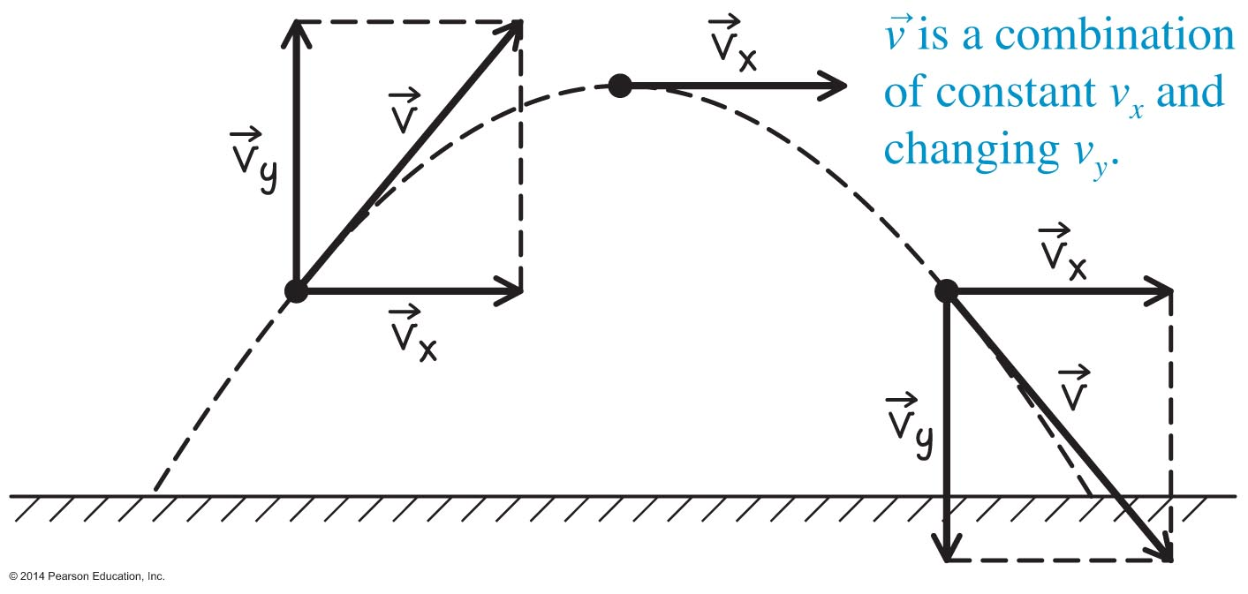
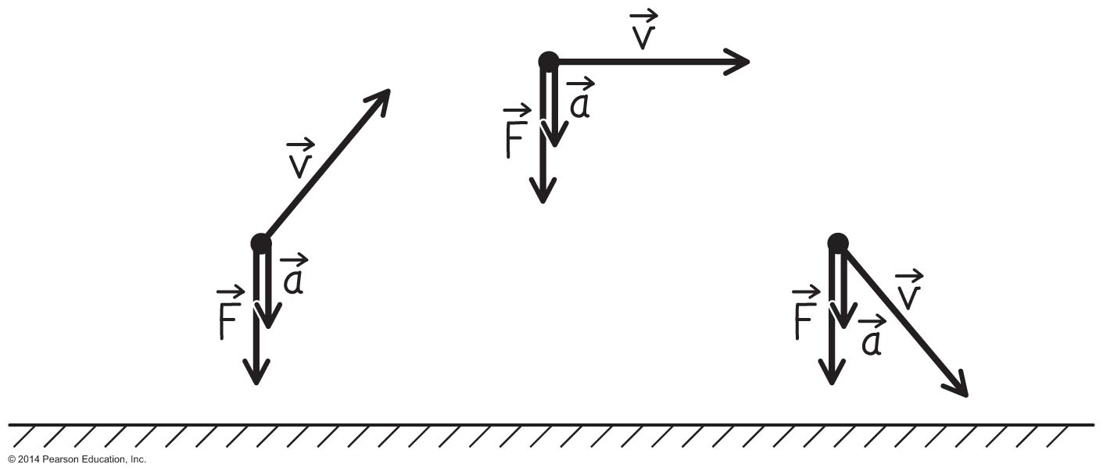
Conceptual Exercise 3.7: Throwing a ball
You throw a tennis ball as a projectile. Arrows represent the ball's instantaneous velocity and acceleration and the force or forces exerted on the ball by other objects when at the three positions shown in the diagram.

Slide 9
Quantitative analysis of projectile motion: Acceleration
The equations of motion for velocity and constant acceleration are used to analyze projectile motion quantitatively.
The x-component (in the horizontal direction) of a projectile's acceleration is zero.
The y-component (in the vertical direction) of a projectile's acceleration is –g.
The force is mg—the force of gravity that Earth exerts on the projectile.

Slide 10
Quantitative analysis of projectile motion: Velocity
For a projectile launched at speed v₀ at an angle θ relative to the horizontal:
Its initial x- and y-velocity components are:
[insert the equations in the middle of the paragraph, on the 9th text line, on page 106 for v_{0x} and v_{0y}]
The x-component of velocity remains constant during the flight because the acceleration along the x-axis is zero.

Slide 11
Quantitative analysis of projectile motion: Using our kinematics equations
Equation (3.8y) can be used to determine the time interval for the projectile's flight.
Equation (3.8x) can be used to determine how far the projectile travels in the horizontal direction during that time interval.

Slide 12
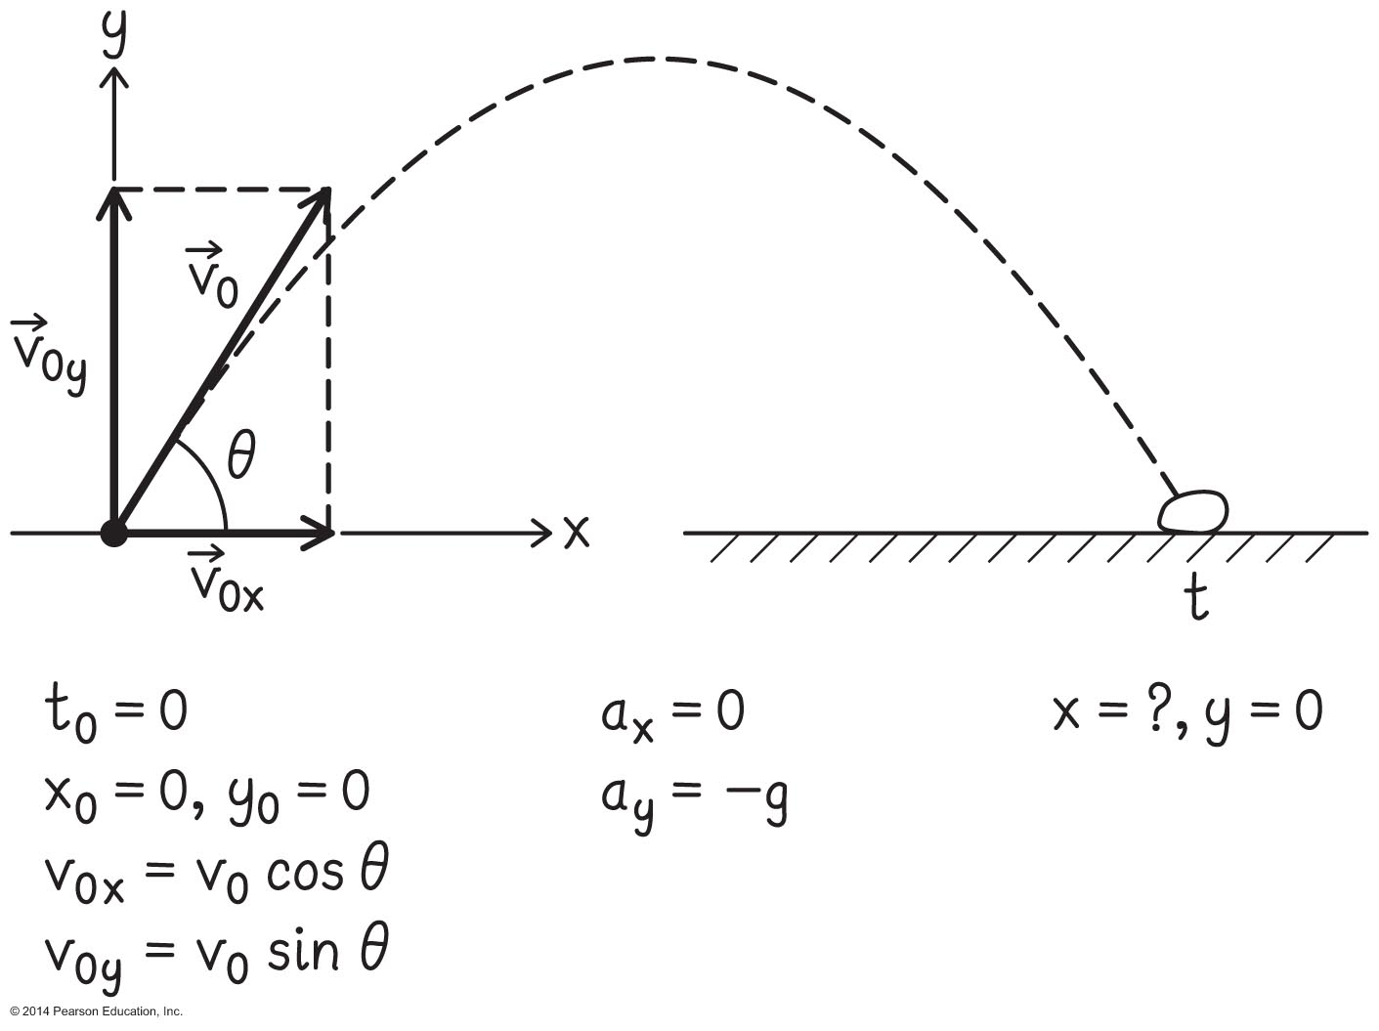
Example 3.8: Best angle for farthest flight
You want to throw a rock the farthest possible horizontal distance. You keep the initial speed of the rock constant and find that the horizontal distance it travels depends on the angle at which it leaves your hand.
What is the angle at which you should throw the rock so that it travels the longest horizontal distance, assuming you throw it with the same initial speed?
Notes:
I'm leaving this for the instructor to solve in class

Slide 13
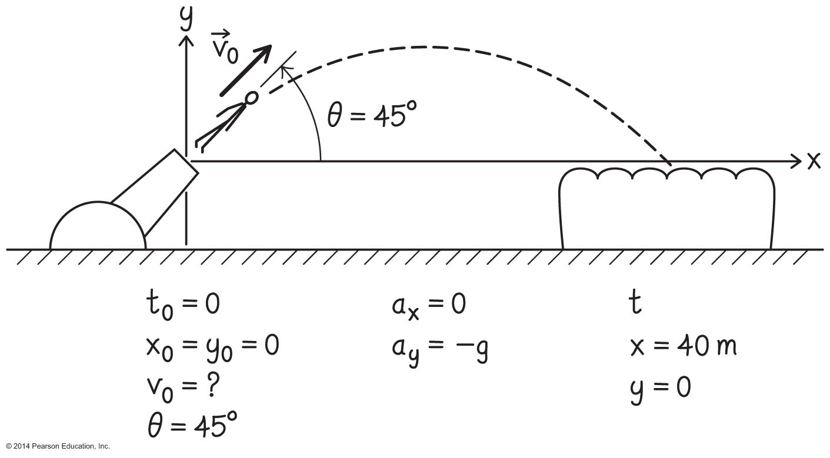
Example 3.9: Shot from a cannon
Stephanie Smith Havens is to be shot from an 8-m-long cannon at 100 km/h. The barrel of the cannon is oriented 45° above the horizontal. She hopes to be launched so that she lands on a net that is 40 m from the end of the cannon barrel and at the same elevation (our assumption).
Estimate the speed with which she needs to leave the cannon to make it to the net.
Notes:
This is left for the instructor to solve as an example

Slide 14
Using Newton's laws to explain how static friction helps a car start and stop
Increasing or decreasing a car's speed involves static friction between the tire's region of contact and the pavement.
To move faster, turn the tire faster. The tire then pushes back harder on the pavement, and the pavement pulls forward more on the tire (Newton's third law).

Slide 15
Using Newton's laws to explain how static friction helps a car start and stop (Cont'd)
To slow down, turn the tire more slowly. The tire pulls forward on the pavement, which in turn pushes back on the tire to accelerate the car backward.

Slide 16
Tip
Some people think a car's engine exerts a force on the car that starts the car's motion and helps it maintain a constant speed despite air resistance. In fact, the forces the engine exerts on other parts of the car are internal forces. Only external forces exerted by objects in the environment can affect the car's acceleration. The engine rotates the wheels, and the wheels push forward or backward on the ground. It is the ground (an external object) that pushes backward or forward on the wheels, causing the car to slow down or speed up. The force responsible for this backward or forward push is the static friction force that the road exerts on the tires.

Slide 17
Summary

Slide 18
Summary

Slide 19
Summary

