Slide 1
Chapter 14: Climate

Slide 2

Section 1: Defining Climate
Climate is affected by several factors including latitude and elevation.
K What I Know | W What I Want to Find Out | L What I Learned

Slide 3
Essential Questions
What are limits associated with the use of normals?
Why do climates vary?
How do temperatures in different regions on Earth differ?
Copyright © McGraw-Hill Education
Defining Climate

Slide 4
Vocabulary
Review
jet stream
New
climatology
normal
tropics
temperate zones
polar zones
Copyright © McGraw-Hill Education
Defining Climate

Slide 5
Annual Averages and Variations
Climatology is the study of Earth’s climate and the factors that affect past, present, and future climatic changes.
Climate describes the long-term weather patterns of an area.
Defining Climate
Copyright © McGraw-Hill Education

Slide 6
Annual Averages and Variations
Normals
The data used to describe an area’s climate include daily high and low temperatures, amounts of rainfall, wind speed and direction, humidity, and air pressure.
The data are averaged on a monthly or annual basis for a period of at least 30 years to determine the normals, which are the standard values for a location.
Copyright © McGraw-Hill Education
Defining Climate

Slide 7
Annual Averages and Variations
Normals
Normals apply only to the specific place where the meteorological data were collected.
Changes in elevation and other factors, such as proximity to large bodies of water, can cause climates to vary.
Copyright © McGraw-Hill Education
Defining Climate

Slide 8
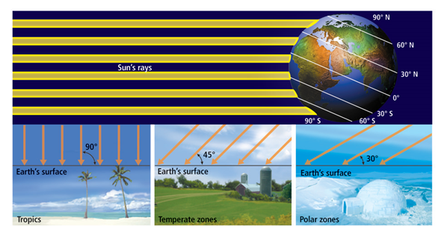
Causes of Climate
Latitude
Latitude has a great effect on climate. The amount of solar radiation received on Earth decreases from the equator to the poles.
Copyright © McGraw-Hill Education
Defining Climate

Slide 9
Causes of Climate
Latitude
The tropics are between 23.5° S and 23.5° N of the equator.
Tropical areas receive the most solar radiation and are generally warm year-round.
Copyright © McGraw-Hill Education
Defining Climate

Slide 10
Causes of Climate
Latitude
The temperate zones lie between 23.5° and 66.5° north and south of the equator.
As their name implies, temperatures in these regions are moderate.
Copyright © McGraw-Hill Education
Defining Climate

Slide 11
Causes of Climate
Latitude
The polar zones are located from 66.5° north and south of the equator to the poles.
Polar temperatures tend to be cold.
Copyright © McGraw-Hill Education
Defining Climate

Slide 12
Causes of Climate
Topographic effects
Water heats up and cools down more slowly than land. Thus, large bodies of water affect the climates of coastal areas.
Temperatures in the lower atmosphere generally decrease with altitude. Thus, mountain climates are usually cooler than those at sea level.
Copyright © McGraw-Hill Education
Defining Climate

Slide 13
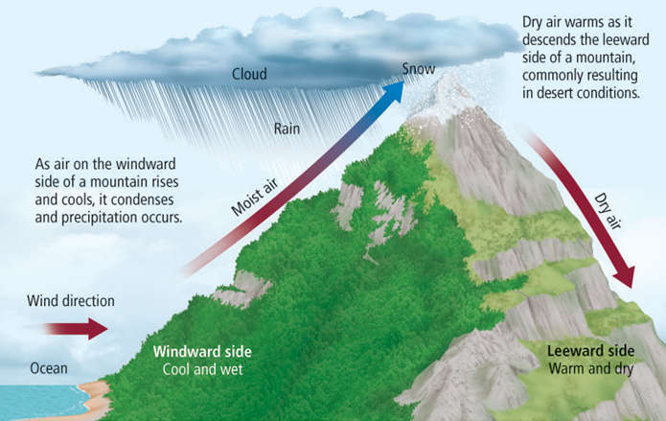
Causes of Climate
Topographic effects
Orographic lifting leads to rain on the windward side of a mountain. The leeward side is usually dry and warm.
Copyright © McGraw-Hill Education
Defining Climate

Slide 14
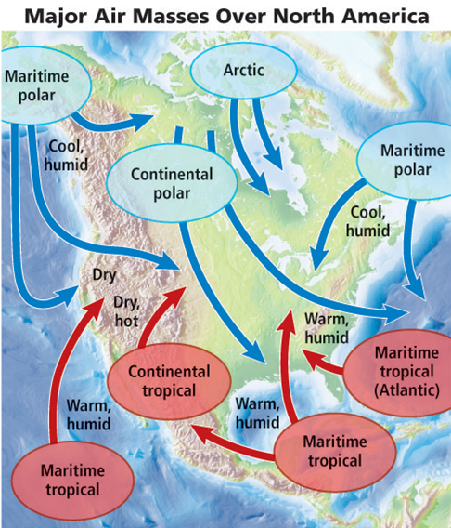
Causes of Climate
Air masses
Air masses affect regional climates by transporting the temperature and humidity of their source regions.
Copyright © McGraw-Hill Education
Defining Climate

Slide 15
Review
Essential Questions
What are limits associated with the use of normals?
Why do climates vary?
How do temperatures in different regions on Earth differ?
Vocabulary
climatology
normal
tropics
temperate zones
polar zones
Copyright © McGraw-Hill Education
Defining Climate

Slide 16
Section 2: Climate Classification
Climates are categorized according to the average temperatures and precipitation amounts.
K What I Know | W What I Want to Find Out | L What I Learned

Slide 17
Essential Questions
What are the criteria used to classify climates?
How are different climates described?
What are microclimates?
Copyright © McGraw-Hill Education
Climate Classification

Slide 18
Vocabulary
Review
precipitation
New
Köppen classification system
microclimate
heat island
Copyright © McGraw-Hill Education
Climate Classification

Slide 19
Köppen Classification System
The Köppen classification system is a classification system for climates that is based on the average monthly values of temperature and precipitation.
Developed by German climatologist Wladimir Köppen, the system also takes into account the distinct vegetation found in different climates.
Climate Classification
Copyright © McGraw-Hill Education

Slide 20
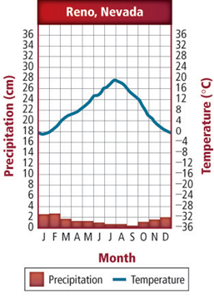
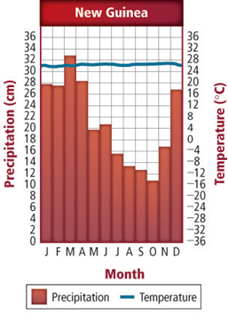
Köppen Classification System
These graphs show temperature and precipitation for two different climates—a desert in Reno, Nevada, and a tropical rain forest in New Guinea.
Copyright © McGraw-Hill Education
Climate Classification

Slide 21
Visualizing Worldwide Climates
Köppen’s classification system is made up of five main divisions based on temperature and precipitation.
Copyright © McGraw-Hill Education
Climate Classification

Slide 22
Visualizing Worldwide Climates
Concepts In Motion
FPO Add link to Animation from p. 383 here.
Copyright © McGraw-Hill Education
Climate Classification

Slide 23
Köppen Classification System
Tropical climates
Year-round high temperatures characterize tropical climates. In tropical wet climates, high temperatures are accompanied by up to 600 cm of rain each year.
Tropical regions are almost continually under the influence of maritime tropical air.
Copyright © McGraw-Hill Education
Climate Classification

Slide 24
Köppen Classification System
Tropical climates
The areas that border the rainy tropics to the north and south of the equator are transition zones, known as the tropical wet and dry zones.
These areas have distinct dry winter seasons as a result of the occasional influx of dry continental air masses.
Copyright © McGraw-Hill Education
Climate Classification

Slide 25
Köppen Classification System
Dry climates
Dry climates, which cover about 30 percent of Earth’s land area, make up the largest climatic zone.
In these climates, continental tropical air dominates, precipitation is low, and vegetation is scarce.
Copyright © McGraw-Hill Education
Climate Classification

Slide 26
Köppen Classification System
Dry climates
There are two subtypes of dry climates: arid regions, called deserts, and semiarid regions, called semideserts.
Semideserts are usually more humid than deserts. They generally separate arid regions from bordering wet climates.
Copyright © McGraw-Hill Education
Climate Classification

Slide 27
Köppen Classification System
Mild climates
Mild climates can be classified into three subtypes: humid subtropical climates, marine west-coast climates, and Mediterranean climates.
Copyright © McGraw-Hill Education
Climate Classification

Slide 28
Köppen Classification System
Mild climates
Humid subtropical climates are influenced by the subtropical high-pressure systems that are normally found over oceans in the summer.
The marine west-coast climates are dominated by the constant inland flow of air off the ocean.
Copyright © McGraw-Hill Education
Climate Classification

Slide 29
Köppen Classification System
Mild climates
Summers in Mediterranean climates are generally warm and dry because of their nearness to the dry midlatitude climates from the south. Winters are cool and rainy as a result of the midlatitude weather systems that bring storm systems from the north.
Copyright © McGraw-Hill Education
Climate Classification

Slide 30
Köppen Classification System
Continental climates
Continental climates are classified into three subtypes: warm summer climates, cool summer climates, and subarctic climates.
Copyright © McGraw-Hill Education
Climate Classification

Slide 31
Köppen Classification System
Continental climates
Tropical and polar air masses often form fronts where they meet in continental climates.
Thus, these zones experience rapid and sometimes violent changes in weather, including severe thunderstorms or tornadoes.
Copyright © McGraw-Hill Education
Climate Classification

Slide 32
Köppen Classification System
Polar climates
To the north of the subarctic climate lies one of the polar climates—the tundra.
The tundra is known for its low temperatures. There are no trees in the tundra and precipitation is generally low.
Copyright © McGraw-Hill Education
Climate Classification

Slide 33
Köppen Classification System
Polar climates
The ice-cap polar climate, found at the highest latitudes in both hemispheres, does not have a single month in which average temperatures rise above 0°C.
A variation of the polar climate, called a highland climate, is found at high elevations.
Copyright © McGraw-Hill Education
Climate Classification

Slide 34
Microclimates
A localized climate that differs from the main regional climate is called a microclimate.
Copyright © McGraw-Hill Education
Climate Classification

Slide 35
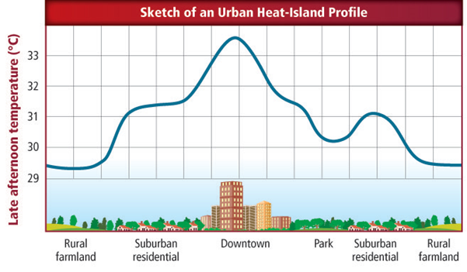
Microclimates
Heat islands
Many concrete buildings and large expanses of asphalt can create a heat island, where the climate is warmer than in surrounding rural areas.
Copyright © McGraw-Hill Education
Climate Classification

Slide 36
Review
Essential Questions
What are the criteria used to classify climates?
How are different climates described?
What are microclimates?
Vocabulary
Köppen classification system
microclimate
heat island
Copyright © McGraw-Hill Education
Climate Classification

Slide 37
Section 3: Climatic Changes
Earth’s climate is constantly changing on many different timescales.
K What I Know | W What I Want to Find Out | L What I Learned

Slide 38
Essential Questions
What is the difference between long-term and short-term climatic changes?
What are natural causes of climate change?
Why do climatic changes occur?
Copyright © McGraw-Hill Education
Climatic Changes

Slide 39
Vocabulary
Review
glacier
New
ice age
season
El Niño
Maunder minimum
Copyright © McGraw-Hill Education
Climatic Changes

Slide 40
Long-Term Climatic Changes
Ice ages
During the periods of extensive glacial coverage called ice ages, average global temperatures decreased by an estimated 5°C.
Climatic Changes
Copyright © McGraw-Hill Education

Slide 41
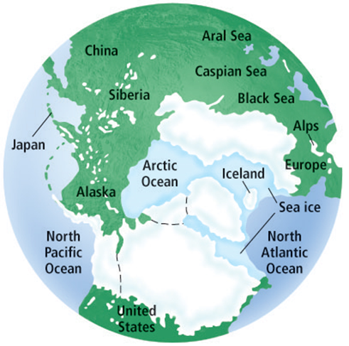
Long-Term Climatic Changes
Ice ages
The most recent ice age, as shown here by the extent of its glaciers, ended only about 10,000 years ago.
Climatic Changes
Copyright © McGraw-Hill Education

Slide 42
Climate History
Video
FPO Add link to Video from p. 387 here.
Copyright © McGraw-Hill Education
Climatic Changes

Slide 43
Short-Term Climatic Changes
While an ice age may last for several million years, other climatic changes occur over much shorter time periods.
Seasons are short-term periods of climatic change caused by regular variations in daylight, temperature, and weather patterns.
Copyright © McGraw-Hill Education
Climatic Changes

Slide 44
Short-Term Climatic Changes
Seasons
The variations that occur with seasons are the result of changes in the amount of solar radiation an area receives.
When the North Pole is pointed away from the Sun, the northern hemisphere experiences winter and the southern hemisphere experiences summer. During spring and fall, neither pole points toward the Sun.
Copyright © McGraw-Hill Education
Climatic Changes

Slide 45
Seasons
Concepts In Motion
FPO Add link to Animation from p. 388 here.
Copyright © McGraw-Hill Education
Climatic Changes

Slide 46
Short-Term Climatic Changes
El Niño
Other short-term climatic changes include those caused by El Niño, a warm ocean current that occasionally develops off the western coast of South America.
Copyright © McGraw-Hill Education
Climatic Changes

Slide 47
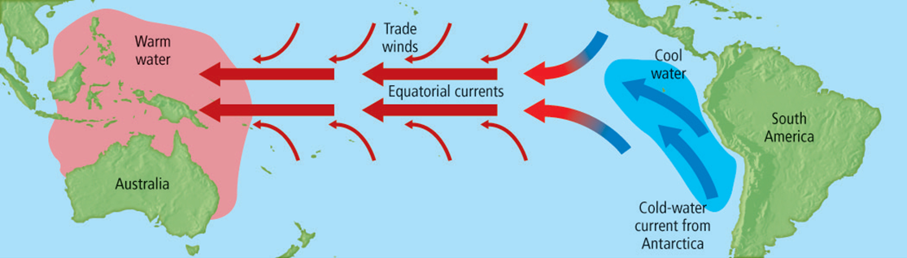
Short-Term Climatic Changes
El Niño
Under normal conditions, trade winds and ocean currents move warm water west across the Pacific Ocean.
Copyright © McGraw-Hill Education
Climatic Changes

Slide 48
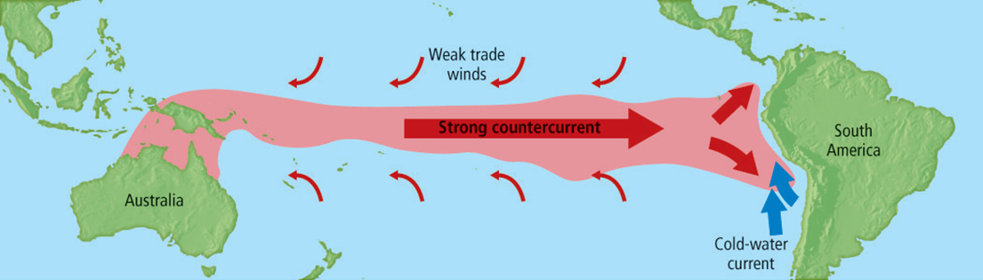
Short-Term Climatic Changes
El Niño
During El Niño, warm water surges back toward South America, changing weather patterns.
Copyright © McGraw-Hill Education
Climatic Changes

Slide 49
El Niño Southern Circulation
Copyright © McGraw-Hill Education
Climatic Changes

Slide 50
Natural Causes of Climatic Changes
Solar activity
The Maunder minimum is the term used to describe the period of low numbers of sunspots, from 1645 to 1716.
This period closely corresponds to an unusually cold climatic episode called the Little Ice Age.
Copyright © McGraw-Hill Education
Climatic Changes

Slide 51
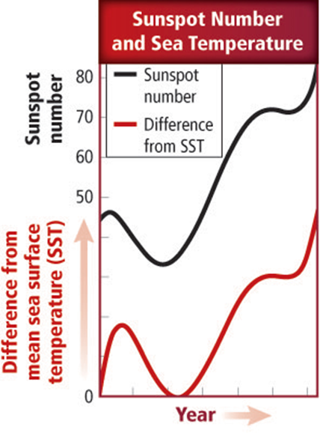
Natural Causes of Climatic Changes
Solar activity
Studies indicate that increased solar activity coincides with warmer-than-normal sea surface temperatures, while periods of low solar activity, such as the Maunder minimum, coincide with colder sea surface temperatures.
Copyright © McGraw-Hill Education
Climatic Changes

Slide 52
Natural Causes of Climatic Changes
Earth’s orbit
Climatic changes might also be triggered by changes in Earth’s axis and orbit.
The shape of Earth’s elliptical orbit appears to change, becoming more elliptical, then more circular, over the course of a 100,000-year cycle.
Copyright © McGraw-Hill Education
Climatic Changes

Slide 53
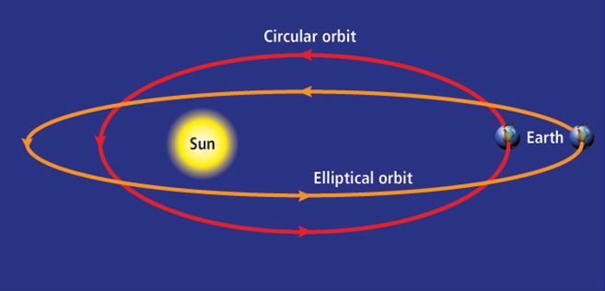
Natural Causes of Climatic Changes
Earth’s orbit
Scientists hypothesize that a more elliptical orbit around the Sun could produce significant changes in Earth’s climate.
Copyright © McGraw-Hill Education
Climatic Changes

Slide 54
Natural Causes of Climatic Changes
Earth’s tilt
At present, the angle of the tilt of Earth’s axis is 23.5°. However, the angle of tilt varies from a minimum of 22.1° to a maximum of 24.5° every 41,000 years.
Scientists theorize that these changes in angle affect the differences in seasons.
Copyright © McGraw-Hill Education
Climatic Changes

Slide 55
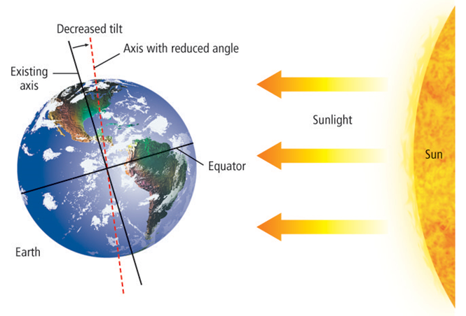
Natural Causes of Climatic Changes
Earth’s tilt
If the angle of the tilt of Earth’s axis decreased, there would be less temperature contrast between summer and winter.
Copyright © McGraw-Hill Education
Climatic Changes

Slide 56
Natural Causes of Climatic Changes
Earth’s wobble
Over a period of about 26,000 years, Earth wobbles as it spins around on its axis.
Currently, the axis points toward the North Star, Polaris.
Copyright © McGraw-Hill Education
Climatic Changes

Slide 57
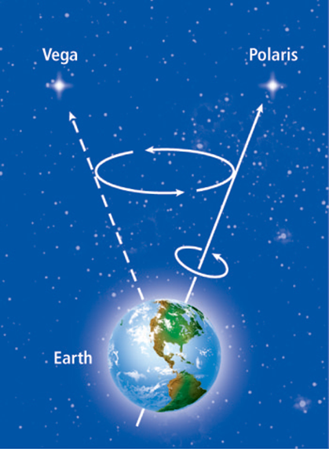
Natural Causes of Climatic Changes
Earth’s wobble
Earth’s wobble determines the timing of the seasons. When the axis points toward the star Vega in 13,000 years, the northern hemisphere will experience summer during the time now associated with winter.
Copyright © McGraw-Hill Education
Climatic Changes

Slide 58
Natural Causes of Climatic Changes
Volcanic activity
Climatic changes can also be triggered by the immense quantities of dust-sized particles, called aerosols, that are released into the atmosphere during major volcanic eruptions.
Copyright © McGraw-Hill Education
Climatic Changes

Slide 59
Natural Causes of Climatic Changes
Volcanic activity
Climatic changes can also be large amounts of dust-sized particles that are released into the atmosphere during volcanic eruptions.
Volcanic dust can remain suspended in the atmosphere for several years, blocking incoming solar radiation and thus lowering global temperatures.
Copyright © McGraw-Hill Education
Climatic Changes

Slide 60
Review
Essential Questions
What is the difference between long-term and short-term climatic changes?
What are natural causes of climate change?
Why do climatic changes occur?
Vocabulary
ice age
season
El Niño
Maunder minimum
Copyright © McGraw-Hill Education
Climatic Changes

Slide 61
Section 4: Impact of Human Activities
Over time, human activities can alter atmospheric conditions enough to influence changes in weather and climate.
K What I Know | W What I Want to Find Out | L What I Learned

Slide 62
Essential Questions
What is the greenhouse effect?
What is global warming?
How do humans impact climate?
Copyright © McGraw-Hill Education
Impact of Human Activities

Slide 63
Vocabulary
Review
radiation
New
greenhouse effect
global warming
Copyright © McGraw-Hill Education
Impact of Human Activities

Slide 64
Influence on the Atmosphere
The greenhouse effect
The process of absorption and radiation of energy in the atmosphere results in the greenhouse effect—the natural heating of Earth’s surface caused by certain atmospheric gases called greenhouse gases.
Impact of Human Activities
Copyright © McGraw-Hill Education

Slide 65
Influence on the Atmosphere
The greenhouse effect
An increase in the amount of atmospheric greenhouse gases, particularly carbon dioxide and methane, would theoretically result in increased absorption of energy in the atmosphere. This can lead to a rise in global temperatures, known as global warming.
Impact of Human Activities
Copyright © McGraw-Hill Education

Slide 66
The Greenhouse Effect
Concepts In Motion
FPO Add link to Video from p. 393 here.
Copyright © McGraw-Hill Education
Impact of Human Activities

Slide 67
Global Warming
Temperatures worldwide have shown an upward trend over the past 200 years, with several of the warmest years on record having occurred within the last two decades.
Impact of Human Activities
Copyright © McGraw-Hill Education

Slide 68
Global Warming
Burning fossil fuels
One of the main sources of atmospheric carbon dioxide from humans is from the burning of fossil fuels including coal, oil, and natural gas. Burning fossil fuels also releases other greenhouse gases, such as methane and nitrous oxide, into the atmosphere.
Copyright © McGraw-Hill Education
Impact of Human Activities

Slide 69
Global Warming
Deforestation
Deforestation—the mass removal of trees—also plays a role in increasing levels of atmospheric carbon dioxide.
When trees are cut down, photosynthesis is reduced, and more carbon dioxide remains in the atmosphere.
Copyright © McGraw-Hill Education
Impact of Human Activities

Slide 70
Global Warming
Environmental efforts
Individuals can reduce the amount of carbon dioxide emitted to the atmosphere by conserving energy, which reduces fossil fuel consumption.
Copyright © McGraw-Hill Education
Impact of Human Activities

Slide 71
Review
Essential Questions
What is the greenhouse effect?
What is global warming?
How do humans impact climate?
Vocabulary
greenhouse effect
global warming
Copyright © McGraw-Hill Education
Impact of Human Activities

