Slide 1
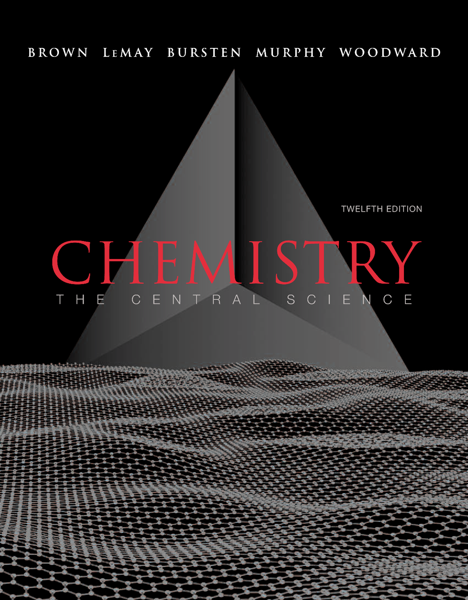
Lecture Presentation
Chapter 24 The Chemistry of Life: Organic and Biological Chemistry
John D. Bookstaver
St. Charles Community College
Cottleville, MO
© 2012 Pearson Education, Inc.

Slide 2
Organic Chemistry
Carbon!
Carbon can form long chains.
This makes large biomolecules (and life) possible.
Proteins
Lipids
Carbohydrates
Nucleic Acids
© 2012 Pearson Education, Inc.

Slide 3
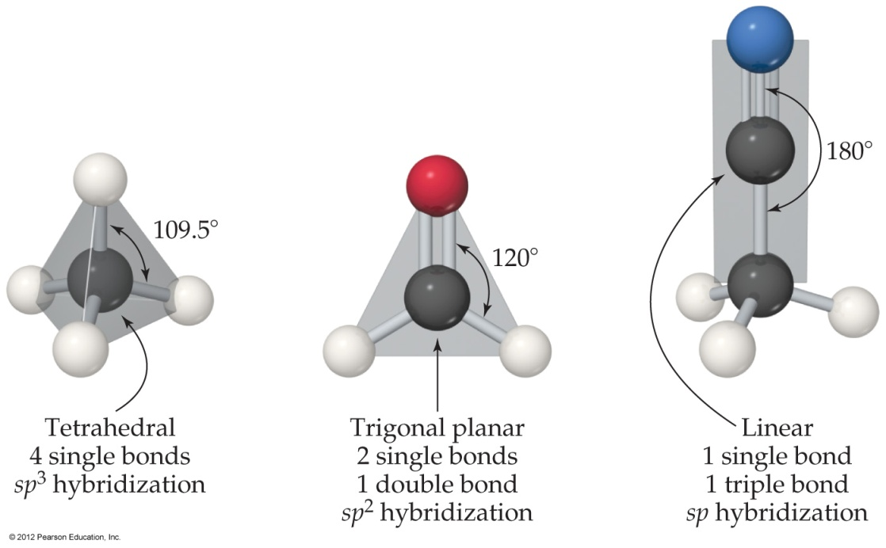
Structure of Carbon Compounds
Hybridization:
sp³ tetrahedral
sp² trigonal planar
sp linear
© 2012 Pearson Education, Inc.

Slide 4
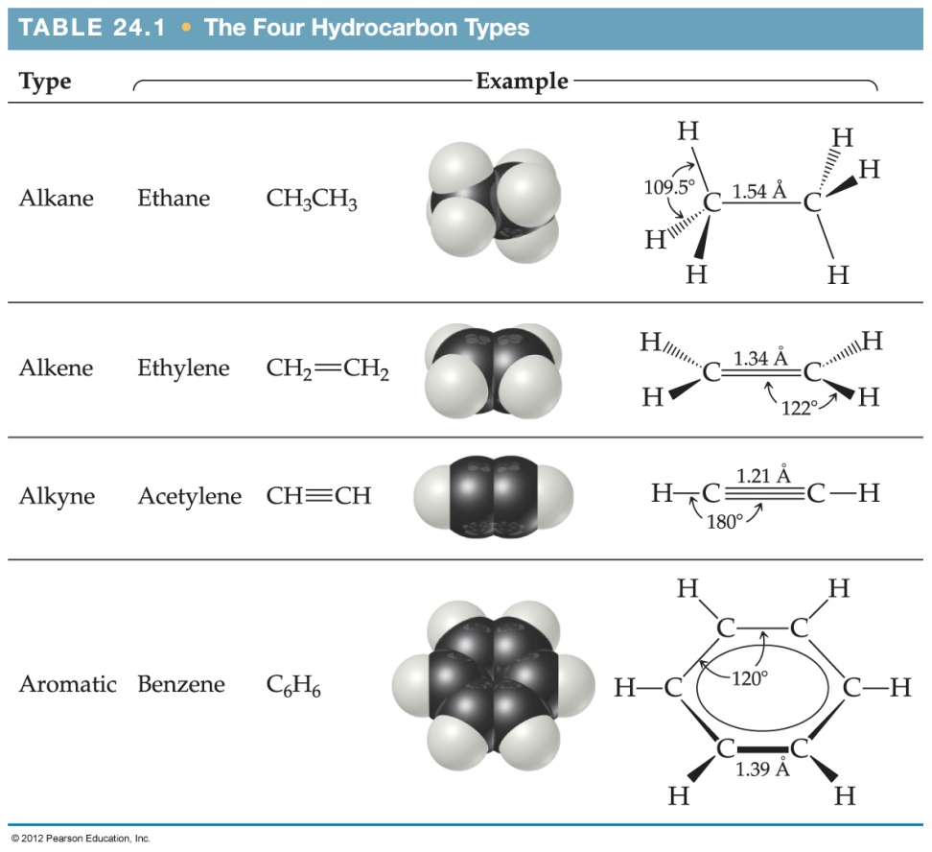
Hydrocarbons
Four types of hydrocarbons:
Alkanes
Alkenes
Alkynes
Aromatic hydrocarbons
© 2012 Pearson Education, Inc.

Slide 5
Alkanes
Alkanes
single bonds only (sp³)
saturated (Contain the max # of H atoms).
C_{n}H_{2n+2}
© 2012 Pearson Education, Inc.

Slide 6
Formulas
Structural formula
Condensed formulas
© 2012 Pearson Education, Inc.

Slide 7
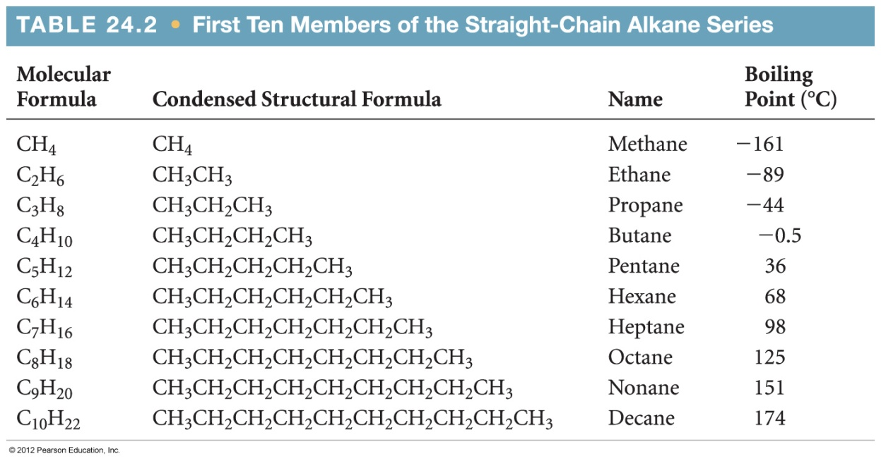
Properties of Alkanes
London dispersion forces are the only IMFs that affect alkanes.
BP increases with chain length.
© 2012 Pearson Education, Inc.

Slide 8
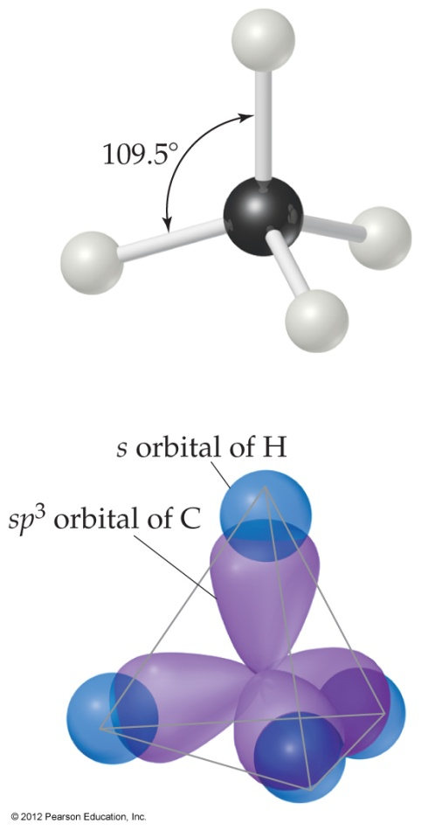
Structure of Alkanes
Carbons in alkanes are sp³ hybrids.
They have a tetrahedral geometry and 109.5° bond angles.
© 2012 Pearson Education, Inc.

Slide 9
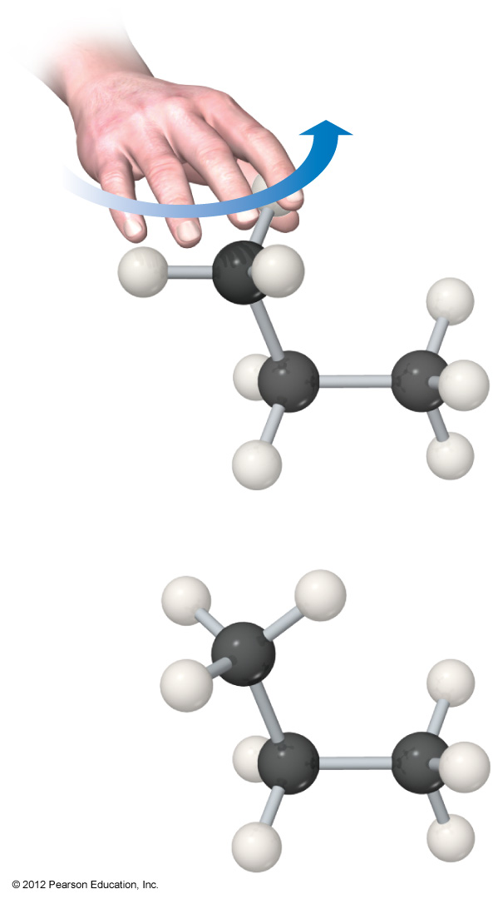
Structure of Alkanes
Alkane Structure
only σ-bonds
C—C bonds freely rotate
© 2012 Pearson Education, Inc.

Slide 10
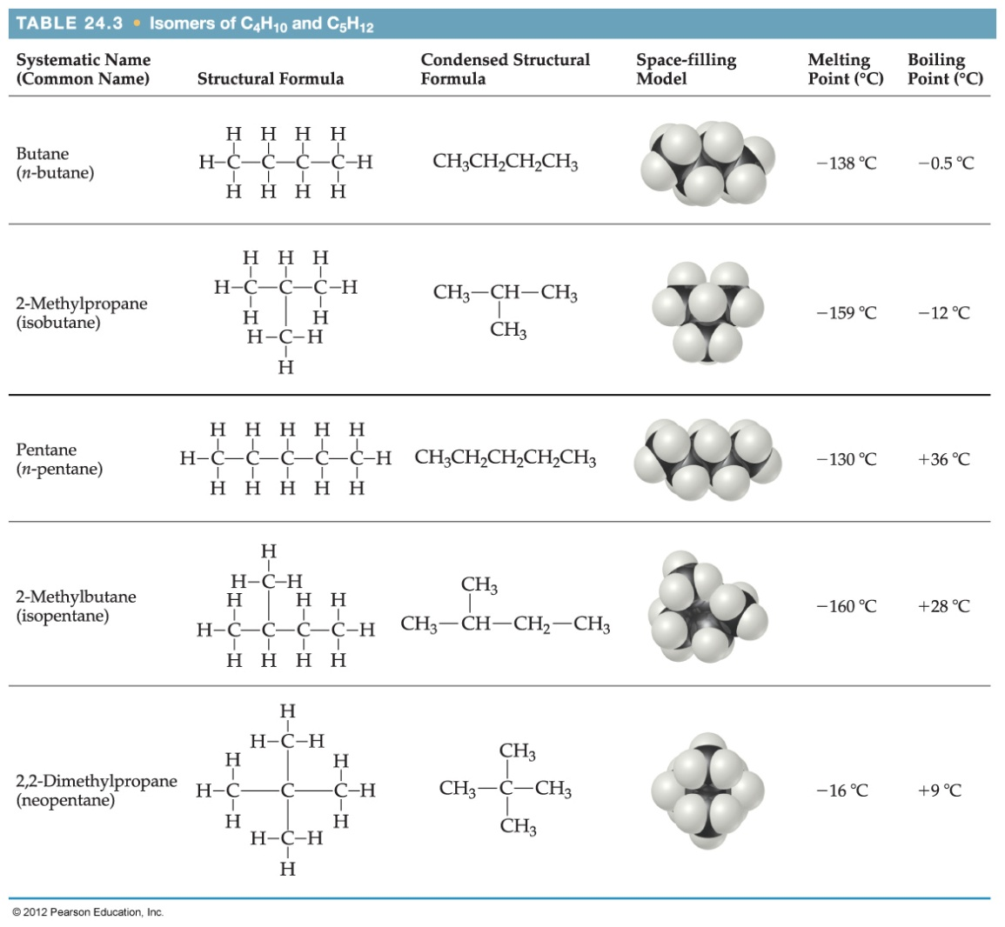
Isomers
Isomers have the same molecular formulas, but the atoms are bonded in a different order.
© 2012 Pearson Education, Inc.

Slide 11
Organic Nomenclature
There are three parts to a compound name:
Base: This tells how many carbons are in the longest continuous chain.
Suffix: This tells what type of compound it is.
Prefix: This tells what groups are attached to the chain.
© 2012 Pearson Education, Inc.

Slide 12
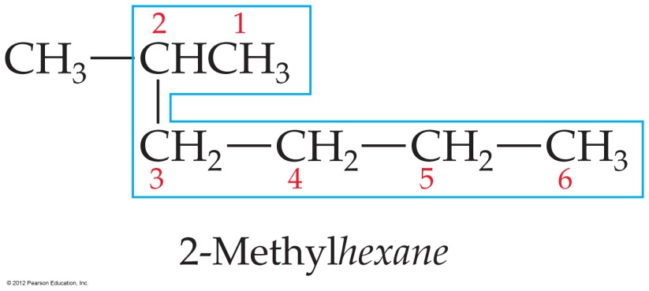
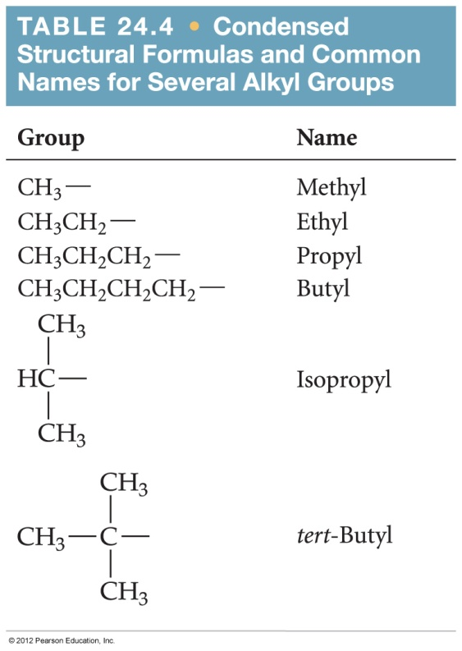
How to Name a Compound
Find the longest chain in the molecule.
Number the chain from the end nearest the first substituent encountered.
List the substituents as a prefix along with the number(s) of the carbon(s) to which they are attached.
© 2012 Pearson Education, Inc.

Slide 14
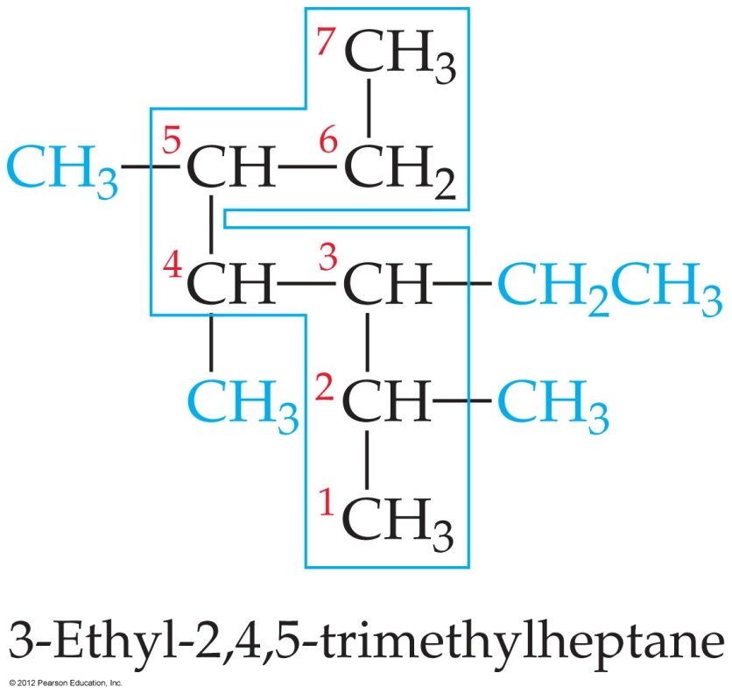
How to Name a Compound
If there is more than one type of substituent in the molecule, list them alphabetically.
© 2012 Pearson Education, Inc.

Slide 15
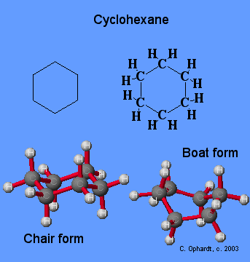
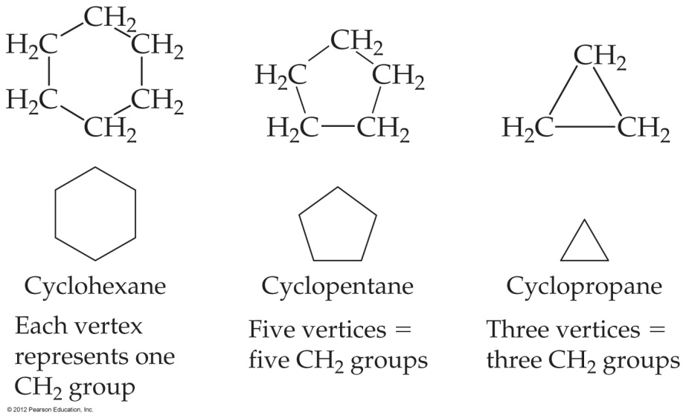
Cycloalkanes
Ringed structures.
Five- and six-membered rings are most stable.
Their bond angles are very close to the tetrahedral angle.
Smaller rings are strained.
© 2012 Pearson Education, Inc.

Slide 16
Reactions of Alkanes
C—C and C—H σ-bonds are very stable.
Therefore, alkanes make great nonpolar solvents.
© 2012 Pearson Education, Inc.

Slide 17
Alkenes
Alkenes contain at least one C–C double bond.
They are unsaturated (fewer than the maximum number of hydrogens)
© 2012 Pearson Education, Inc.

Slide 18
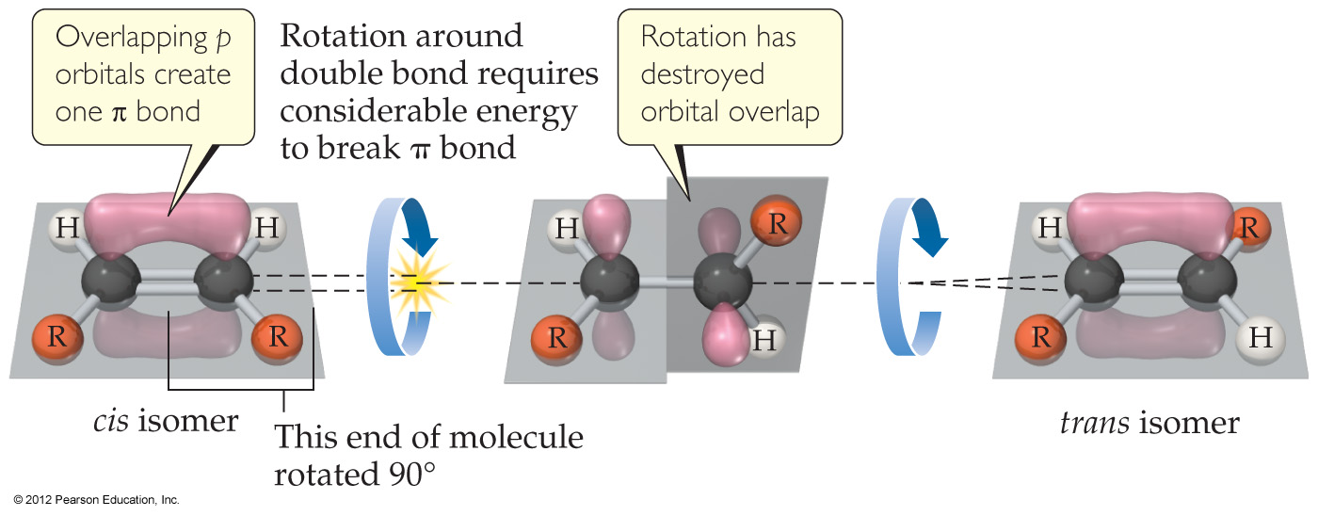
Structure of Alkenes
Alkenes cannot rotate freely about the double bond.
The side-to-side overlap in the π-bond makes this impossible without breaking the π-bond.
© 2012 Pearson Education, Inc.

Slide 19
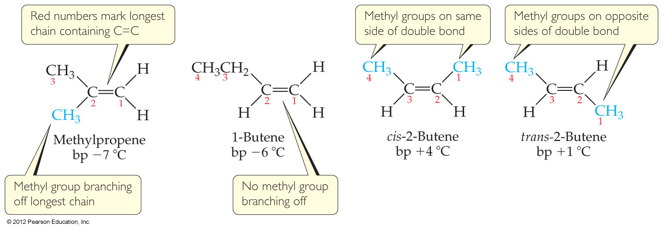
Structure of Alkenes
This creates geometric isomers
Structure affects the physical properties of alkenes.
© 2012 Pearson Education, Inc.

Slide 20
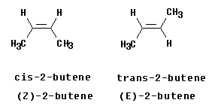
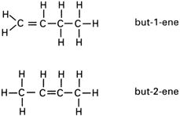
Nomenclature of Alkenes
The chain is numbered so the double bond gets the smallest possible number.
cis-Alkenes have the carbons in the chain on the same side of the molecule.
trans-Alkenes have the carbons in the chain on opposite sides of the molecule.
© 2012 Pearson Education, Inc.

Slide 21
Reactions of Alkenes
One reaction of alkenes is the addition reaction.
In it, two atoms (e.g., bromine) add across the double bond.
One π-bond and one σ-bond are replaced by two σ-bonds; therefore, ΔH is negative.
© 2012 Pearson Education, Inc.

Slide 22
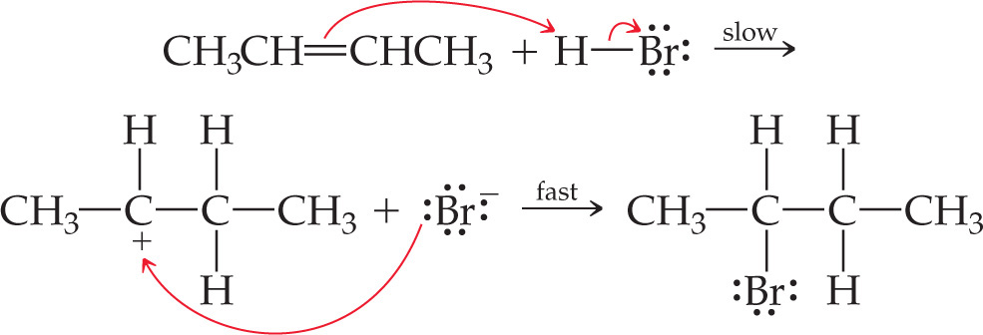
Mechanism of Addition Reactions
It is a two-step mechanism:
The first step is the slow, rate-determining step.
The second step is fast.
© 2012 Pearson Education, Inc.

Slide 23
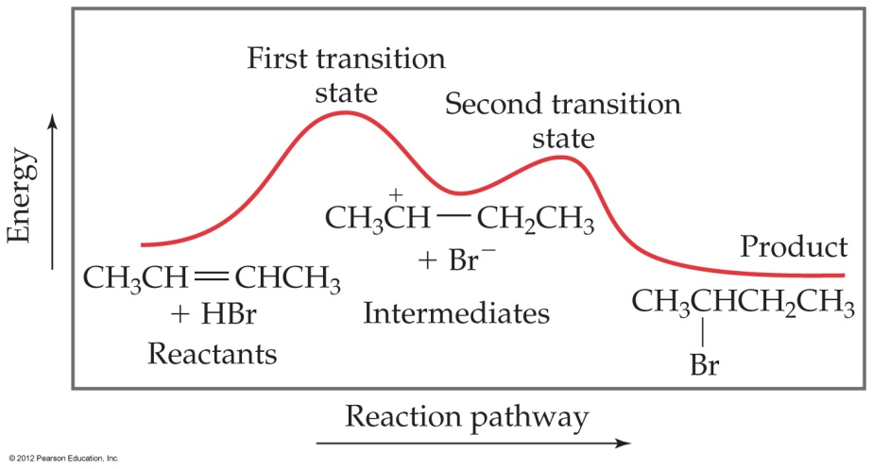
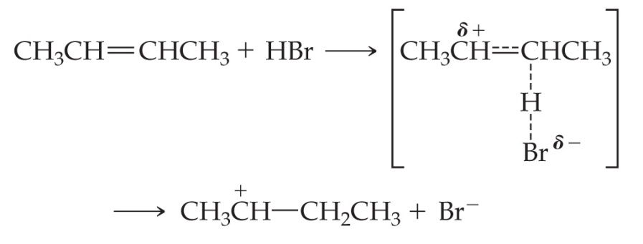
Mechanism of Addition Reactions
In the first step, the π-bond breaks and the new C—H bond and a cation form.
© 2012 Pearson Education, Inc.

Slide 24
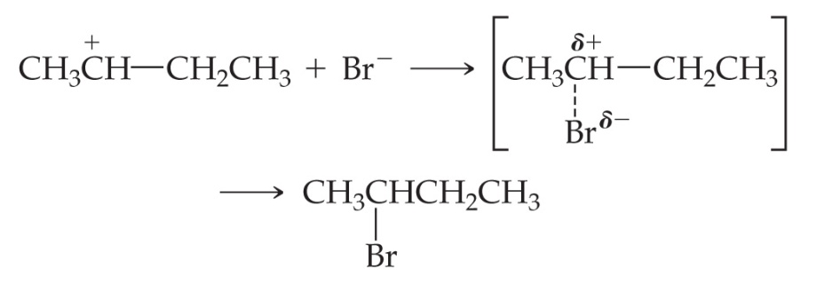
Mechanism of Addition Reactions
In the second step, a new bond forms between the negative bromide ion and the positive carbon.
© 2012 Pearson Education, Inc.

Slide 25
Alkynes
Alkynes contain at least one carbon–carbon triple bond.
sp-hybridized (linear).
Unsaturated.
© 2012 Pearson Education, Inc.

Slide 26
Nomenclature of Alkynes
4-methyl-2-pentyne
Identical to naming alkenes except the suffix is -yne rather than -ene.
© 2012 Pearson Education, Inc.

Slide 27
Reactions of Alkynes
Alkynes undergo many of the same reactions alkenes do.
As with alkenes, the impetus for reaction is the replacement of π-bonds with σ-bonds.
© 2012 Pearson Education, Inc.

Slide 28
Aromatic Hydrocarbons
Aromatic hydrocarbons are cyclic hydrocarbons with these features.
There is a p-orbital on each atom.
Makes the molecule planar.
There is an odd number of electron pairs in the π-system.
© 2012 Pearson Education, Inc.

Slide 29
Aromatic Nomenclature
Many aromatic hydrocarbons are known by their common names.
What do they all have in common?
© 2012 Pearson Education, Inc.

Slide 30
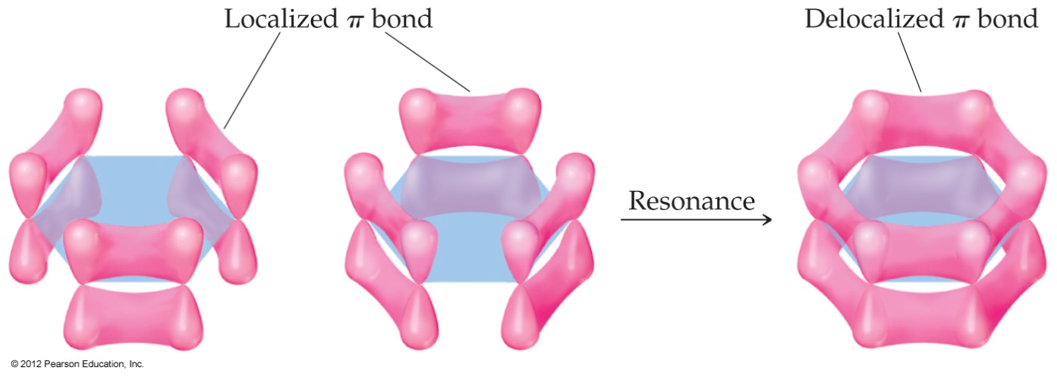
Reactions of Aromatic Compounds
In aromatic compounds, the electrons are delocalized, unlike in alkenes and alkynes.
This stabilizes aromatic compounds.
© 2012 Pearson Education, Inc.

Slide 31
Reactions of Aromatic Compounds
Due to this stabilization, aromatic compounds do not undergo addition reactions; they undergo substitution.
In substitution reactions, hydrogen is replaced by a substituent.
© 2012 Pearson Education, Inc.

Slide 32
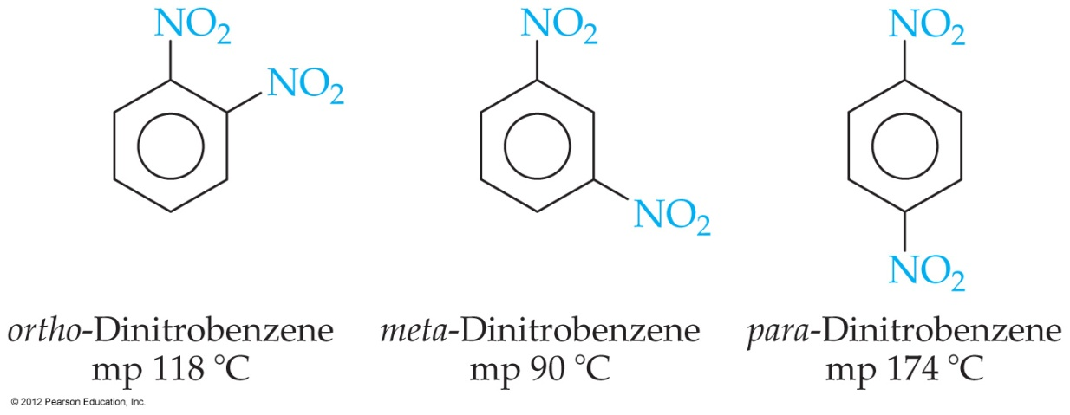
Structure of Aromatic Compounds
Two substituents on a benzene ring could have three possible relationships:
ortho-: On adjacent carbons.
meta-: With one carbon between them.
para-: On opposite sides of ring.
© 2012 Pearson Education, Inc.

Slide 33
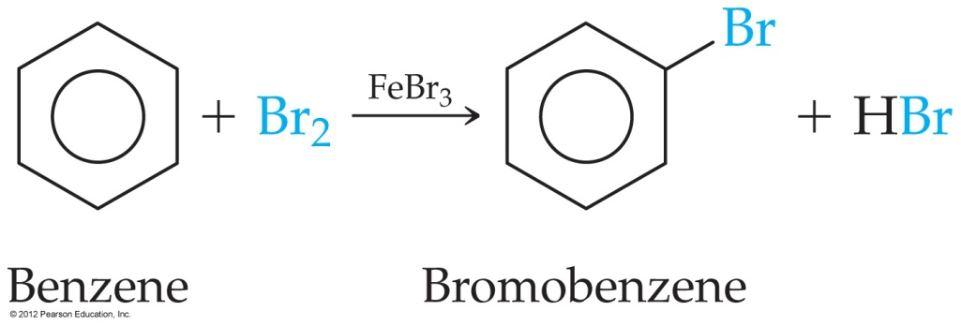
Reactions of Aromatic Compounds
Reactions of aromatic compounds often require a catalyst.
© 2012 Pearson Education, Inc.

Slide 34
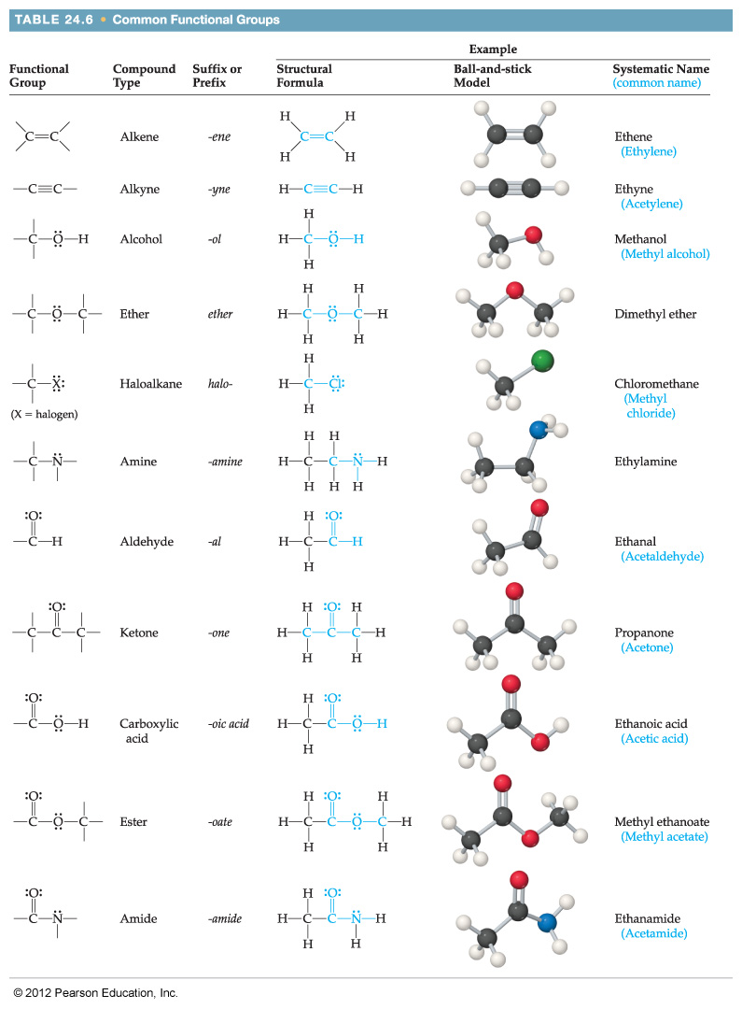
Functional Groups
The term functional group is used to refer to parts of organic molecules where reactions tend to occur.
© 2012 Pearson Education, Inc.

Slide 35
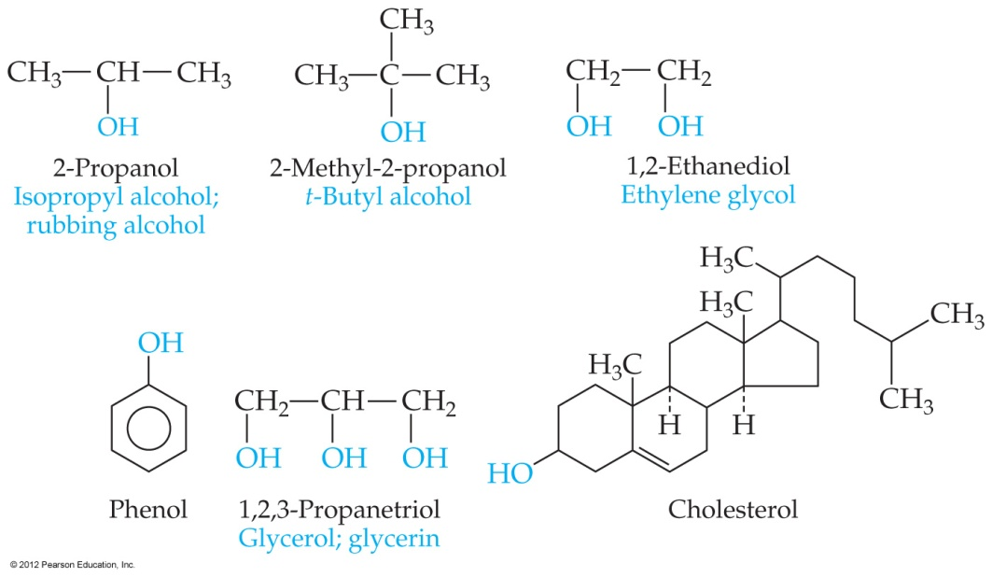
Alcohols
Alcohols contain one or more hydroxyl groups, —OH.
They are named from the parent hydrocarbon; the suffix is changed to -ol and a number designates the carbon to which the hydroxyl is attached.
© 2012 Pearson Education, Inc.

Slide 36
Alcohols
Alcohols are much more acidic than hydrocarbons.
pK_{a} ~15 for most alcohols.
Aromatic alcohols have pK_{a} ~10.
© 2012 Pearson Education, Inc.

Slide 37
Ethers
Ethers have an oxygen bonded to a carbon chain on either end.
© 2012 Pearson Education, Inc.

Slide 38
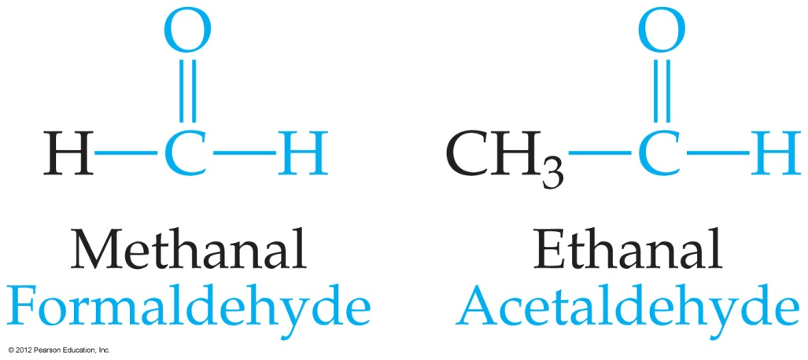
Aldehydes
In an aldehyde, at least one hydrogen is attached to the carbonyl carbon.
© 2012 Pearson Education, Inc.

Slide 39
Ketones
In ketones, there are two carbons bonded to the carbonyl carbon.
© 2012 Pearson Education, Inc.

Slide 40
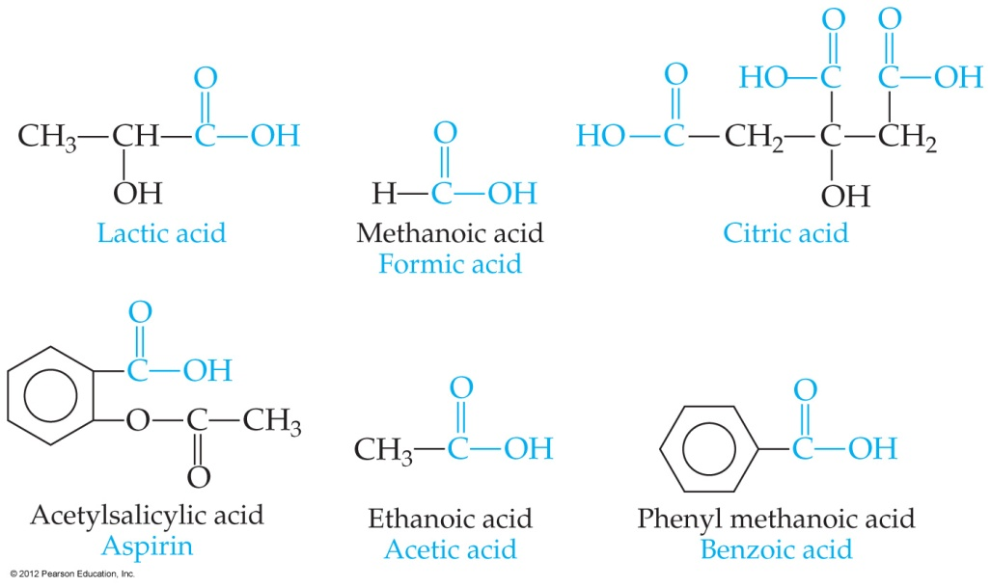
Carboxylic Acids
Acids have a hydroxyl group bonded to the carbonyl group.
They are tart tasting (Vinegar=acetic).
Carboxylic acids are weak acids.
© 2012 Pearson Education, Inc.

Slide 41
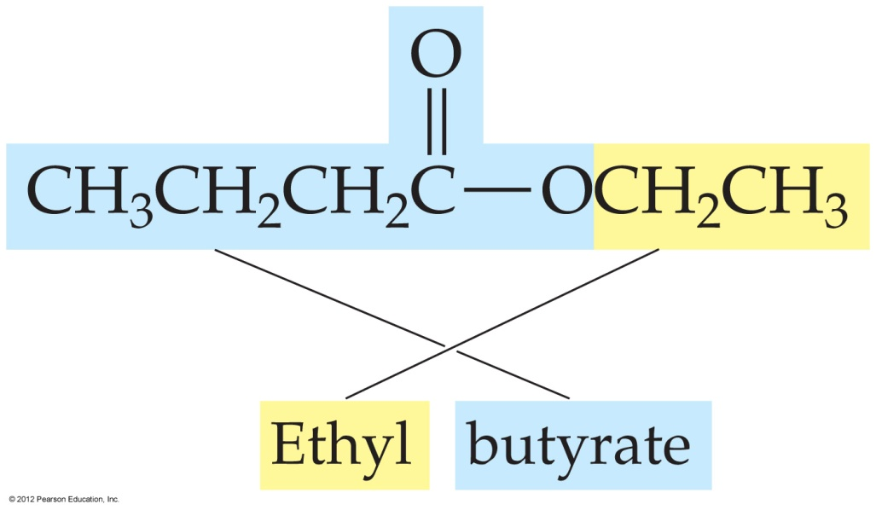
Esters
Esters are the products of reactions between carboxylic acids and alcohols.
They are found in many fruits and perfumes.
© 2012 Pearson Education, Inc.

Slide 42
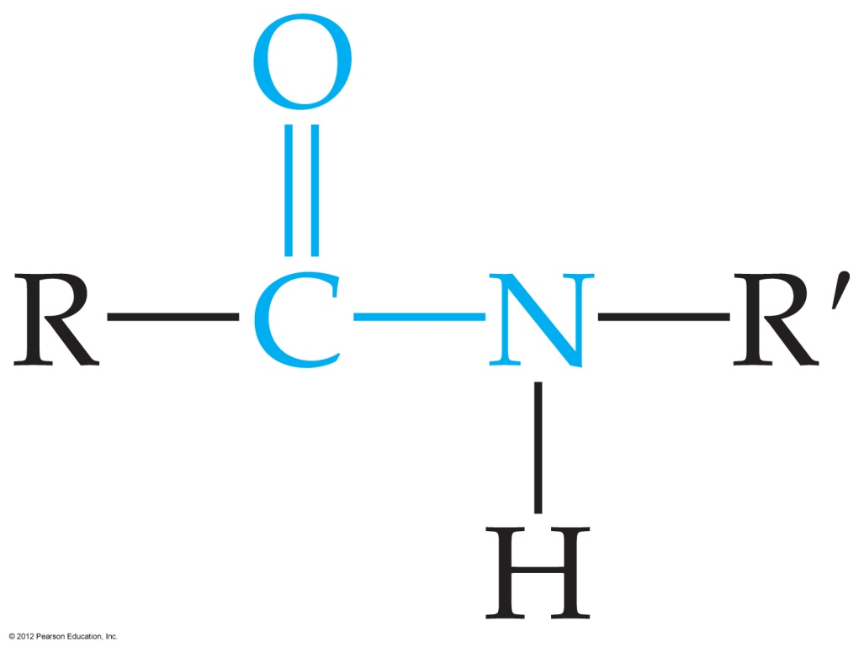
Amides
Amides are formed by the reaction of carboxylic acids with amines.
© 2012 Pearson Education, Inc.

Slide 43
Amines
Amines are organic bases.
They generally have strong, unpleasant odors.
© 2012 Pearson Education, Inc.

Slide 44
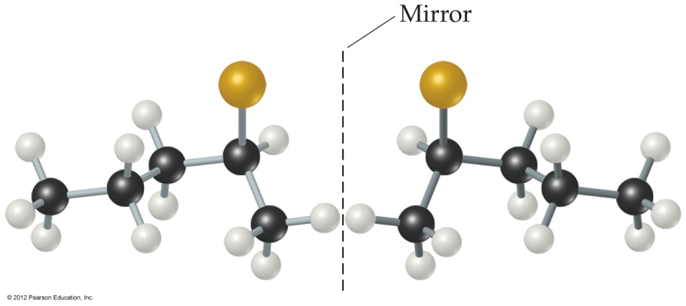
Chirality
Carbons with four different groups attached to them are handed, or chiral.
These are optical isomers, or stereoisomers.
If one stereoisomer is “right-handed,” its enantiomer is “left-handed.”
© 2012 Pearson Education, Inc.

Slide 45
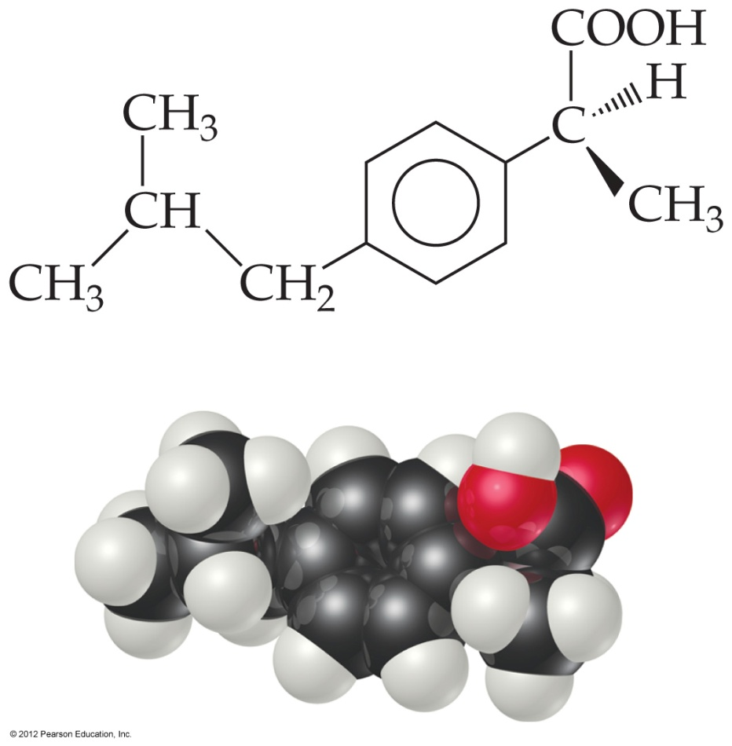
Chirality
Many pharmaceuticals are chiral.
Often only one enantiomer is clinically active.
© 2012 Pearson Education, Inc.

Slide 46
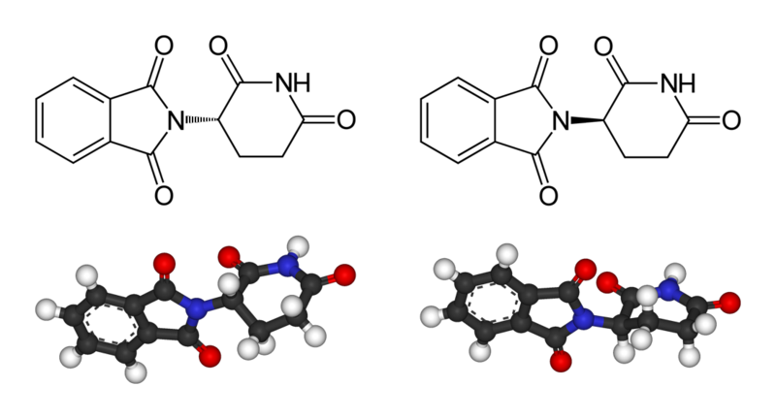
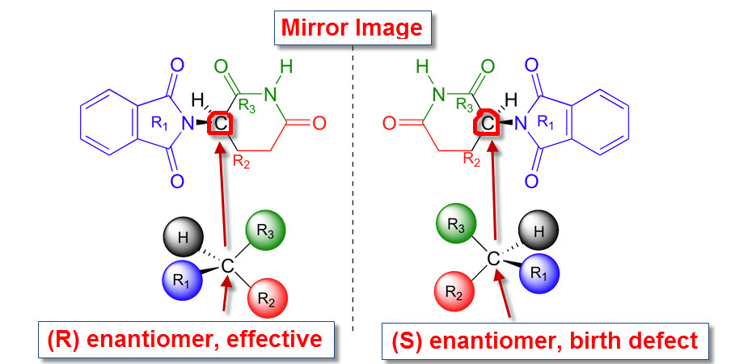
Who cares about isomers?
Thalidomide, a compound originally marketed as a sedative in Europe in 1956. Thalidomide contains a stereogenic carbon, and therefore the compound can exist in both R and S forms. Most synthesizing procedures generate equal mixtures of enantiomers (i.e., equal amounts of the R and S forms—a racemic mixture); special care must be taken to make a pure enantiomer, and the company involved in the original promotion of thalidomide saw no reason to bear the cost of this process. The result was the marketing of a racemic mixture of the R and S forms. (S)-Thalidomide turned out to be a powerful teratogen: it causes all manner of external and internal abnormalities in fetuses if it is given to pregnant women in the first trimester. The R enantiomer is far more benign—although even it is dangerous, as the R form racemizes under physiological conditions and thus produces some of the dangerous S enantiomer. http://www.britannica.com/EBchecked/topic/296365/isomerism/279767/Chirality-in-natural-and-synthetic-materials
© 2012 Pearson Education, Inc.

Slide 47
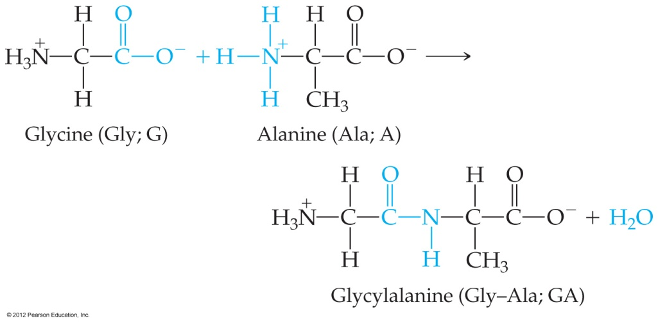
Amino Acids and Proteins
Proteins are polymers of α-amino acids.
A condensation reaction between the amine end of one amino acid and the acid end of another produces a peptide bond.
© 2012 Pearson Education, Inc.

Slide 48
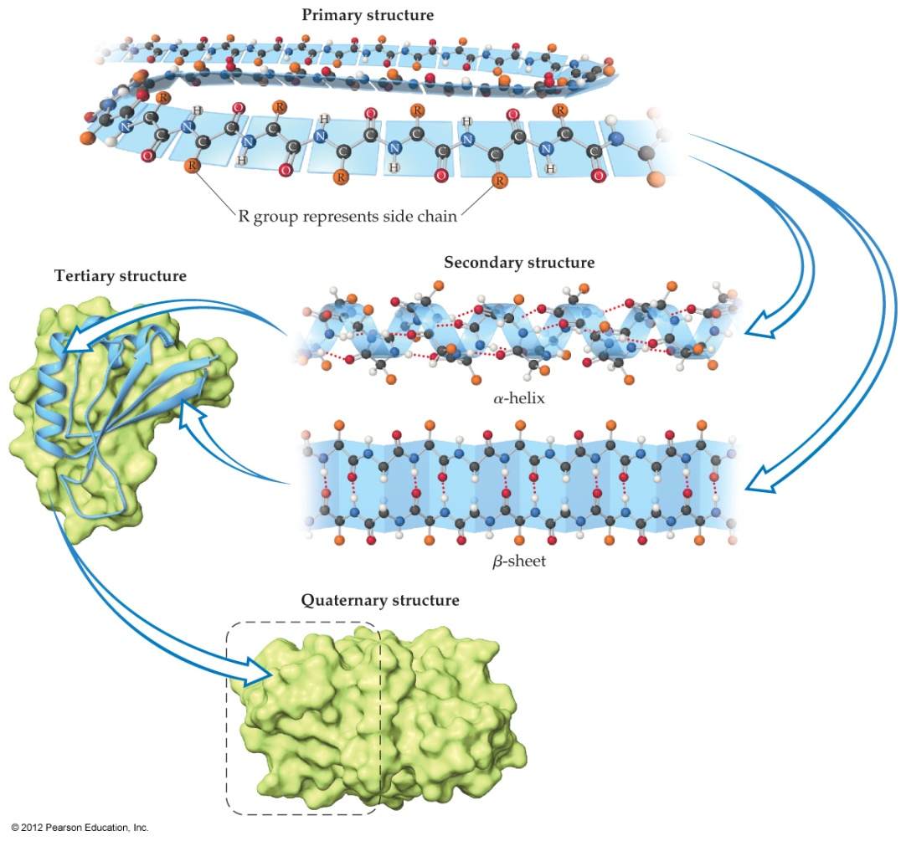
Amino Acids and Proteins
Hydrogen bonding in peptide chains causes coils and helices in the chain.
Kinking and folding of the coiled chain gives proteins a characteristic shape.
© 2012 Pearson Education, Inc.

Slide 49
Amino Acids and Proteins
Most enzymes are proteins.
The shape of the active site complements the shape of the substrate on which the enzyme acts; hence, the “lock- and-key” model.
© 2012 Pearson Education, Inc.

Slide 50
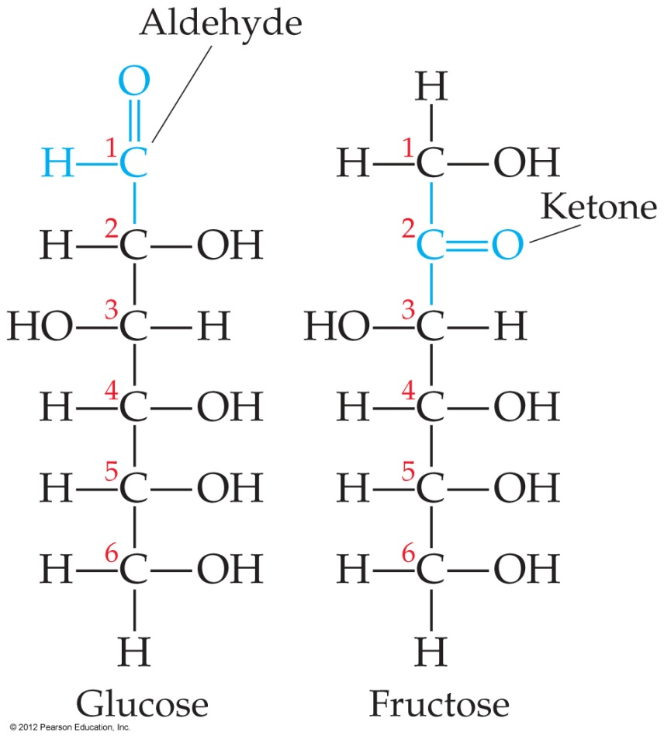
Carbohydrates
Simple sugars are polyhydroxy aldehydes or ketones.
© 2012 Pearson Education, Inc.

Slide 51
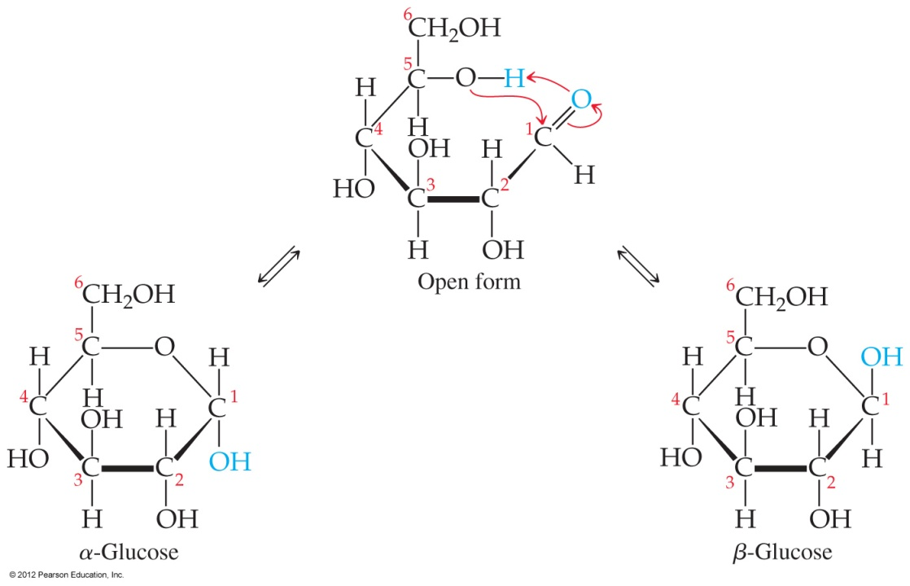
Carbohydrates
In solution, they form cyclic structures.
These structures can form chains of sugars that form structural molecules such as starch and cellulose.
© 2012 Pearson Education, Inc.

Slide 52
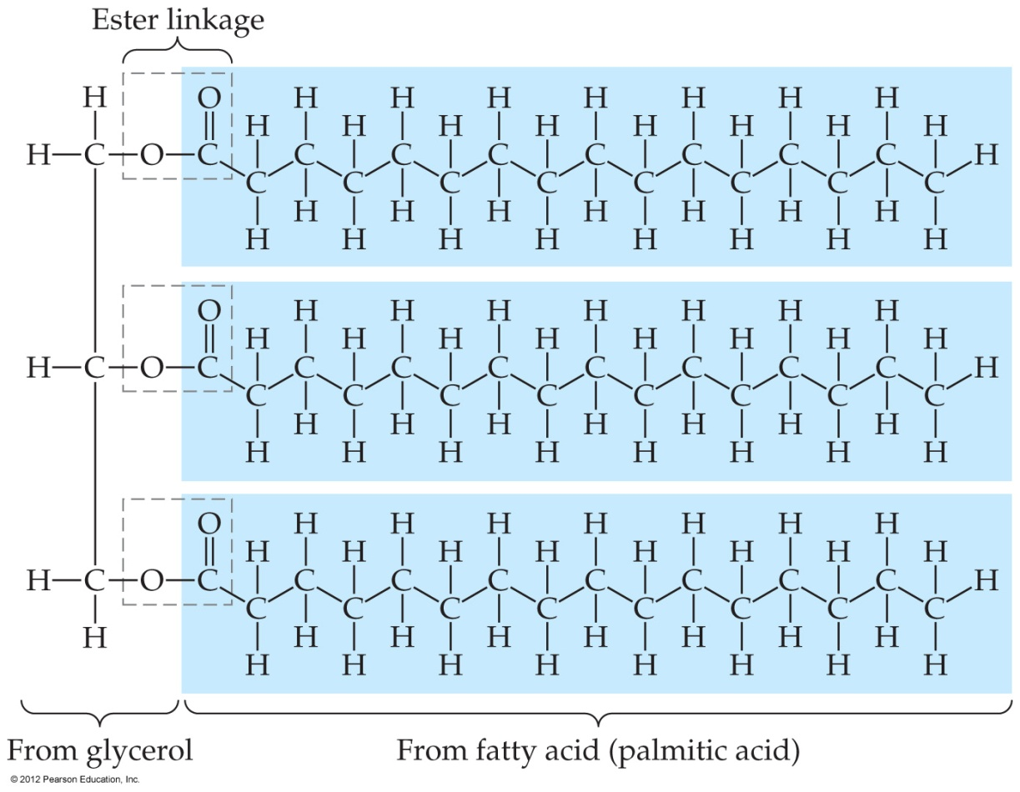
Lipids
Lipids are a broad class of nonpolar organic molecules.
The fats known as triglycerides are lipids made from carboxylic acids and glycerol.
© 2012 Pearson Education, Inc.

Slide 53
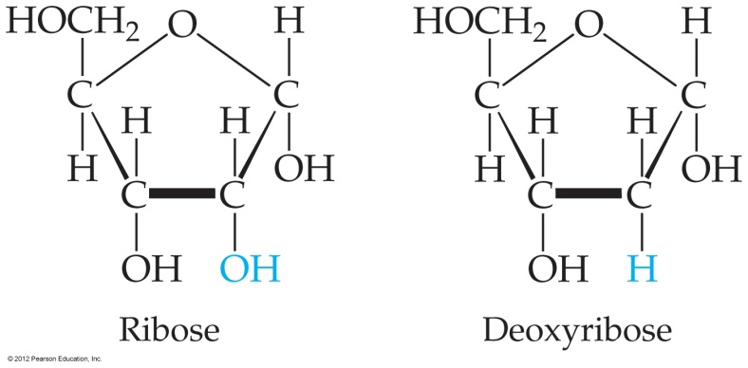
Nucleic Acids
Two of the building blocks of RNA and DNA are sugars (ribose or deoxyribose) and cyclic bases (adenine, guanine, cytosine, and thymine or uracil).
© 2012 Pearson Education, Inc.

Slide 54
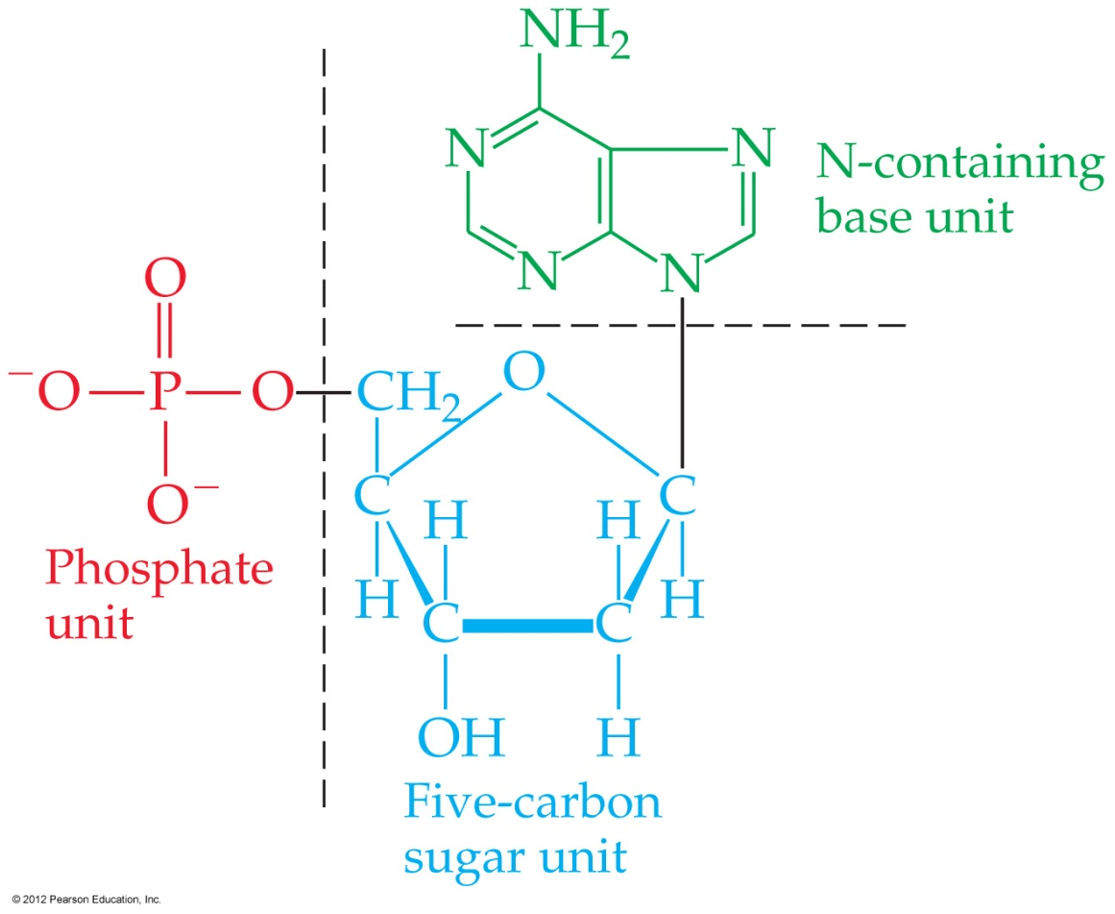
Nucleic Acids
These combine with a phosphate to form a nucleotide.
© 2012 Pearson Education, Inc.

Slide 55
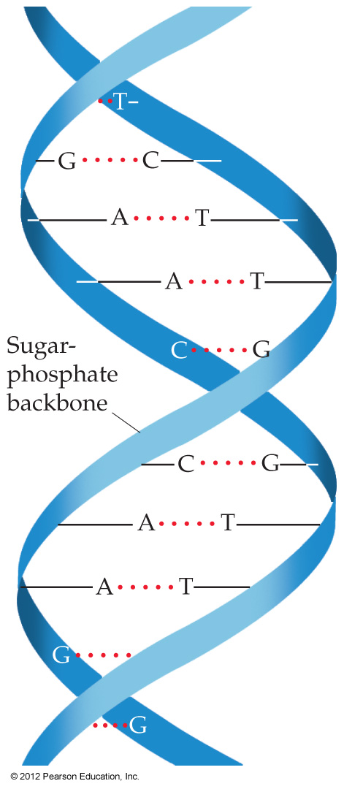
Nucleic Acids
Nucleotides combine to form the familiar double-helix form of the nucleic acids.
© 2012 Pearson Education, Inc.

Slide 56
12.8 & 12.9

Slide 57
Polymers
Polymers are molecules of high molecular mass made by bonding repeating units called monomers.

Slide 58
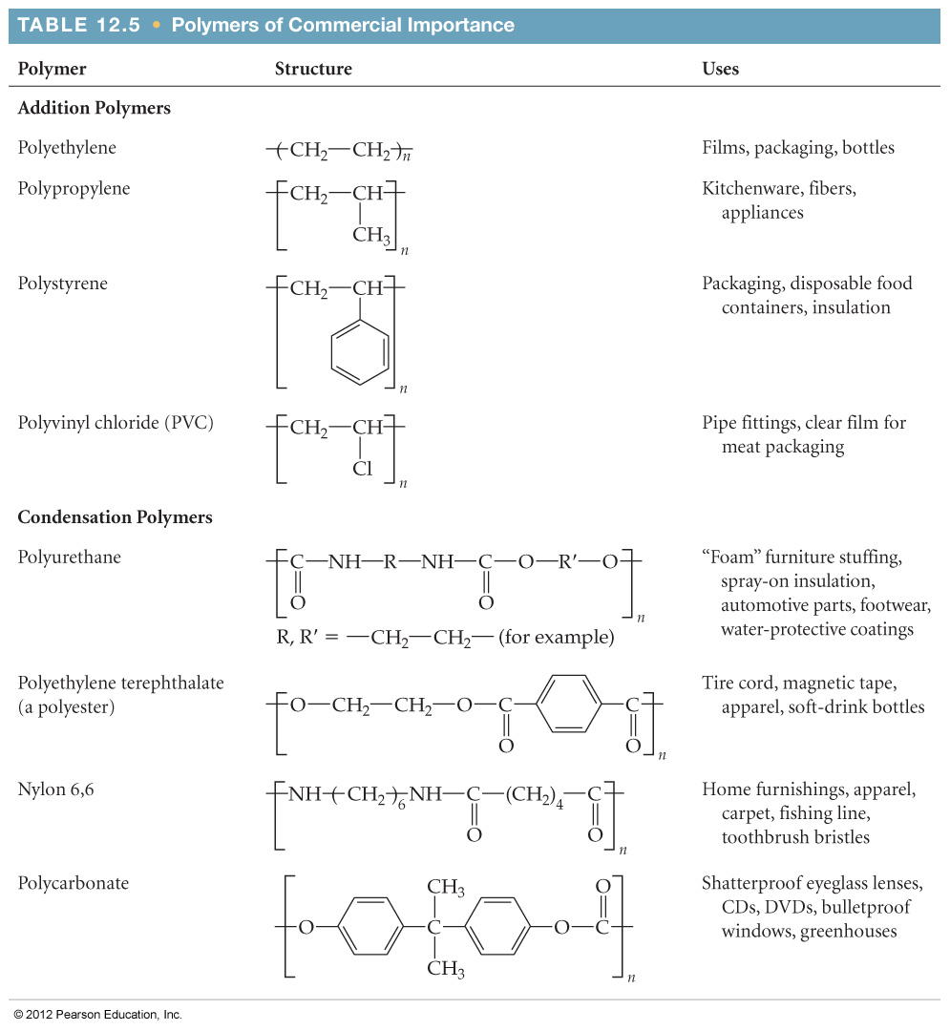
Some Common Polymers

Slide 59
Addition Polymers
Addition polymers are made by coupling the monomers by converting π bonds within each monomer to σ bonds between monomers.

Slide 60
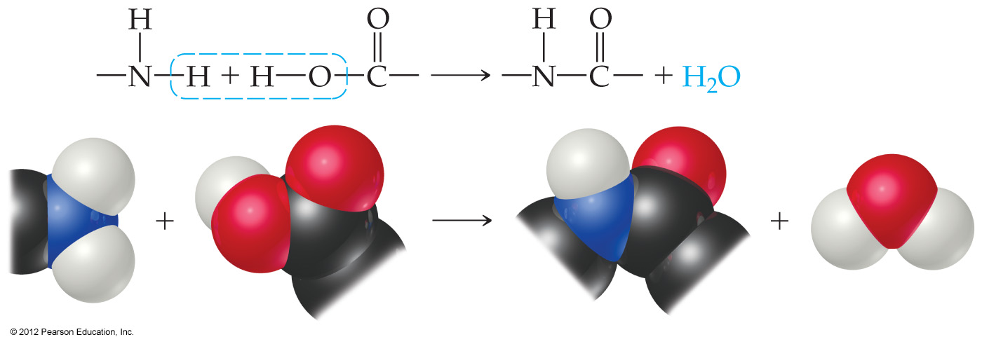
Condensation Polymers
Condensation polymers are made by joining two subunits through a reaction in which a smaller molecule (often water) is also formed as a by-product.
These are also called copolymers.

Slide 61
Synthesis of Nylon
Nylon is one example of a condensation polymer.

Slide 62
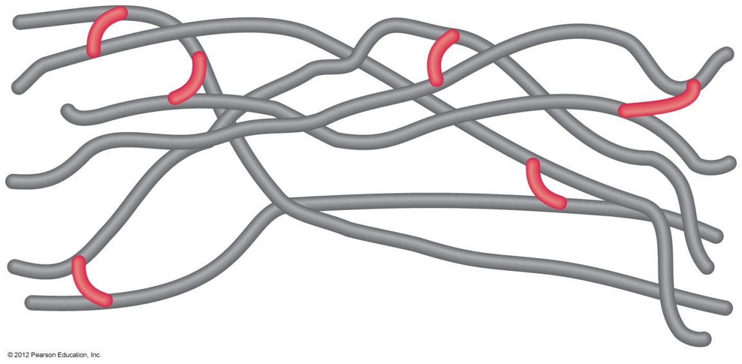
Cross-Linking
Chemically bonding chains of polymers to each other can stiffen and strengthen the substance.

Slide 63
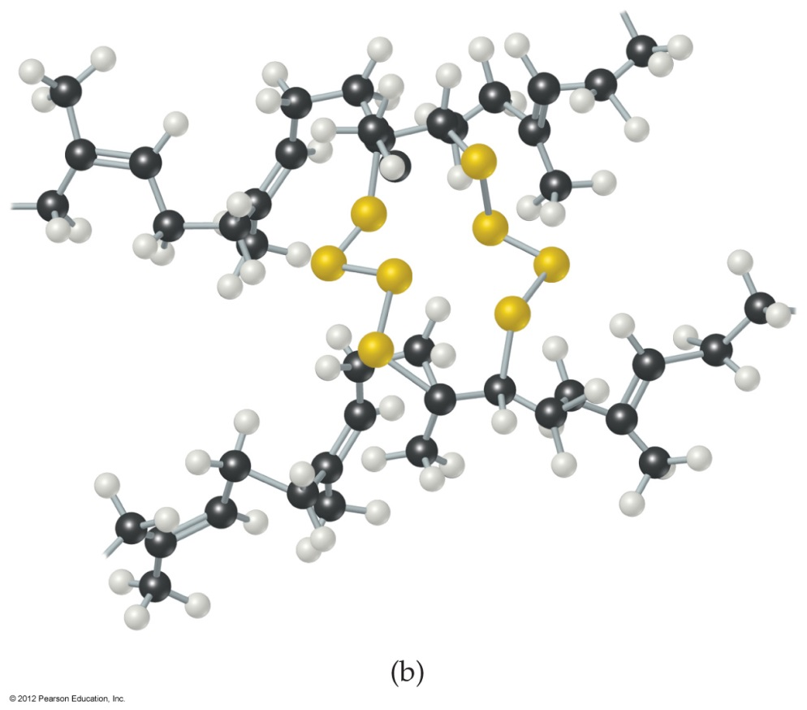
Cross-Linking
Naturally occurring rubber is too soft and pliable for many applications.

Slide 64
Cross-Linking
In vulcanization, carbon chains in rubber are cross-linked by short chains of sulfur atoms, making the rubber stronger and less susceptible to degradation.

Slide 65
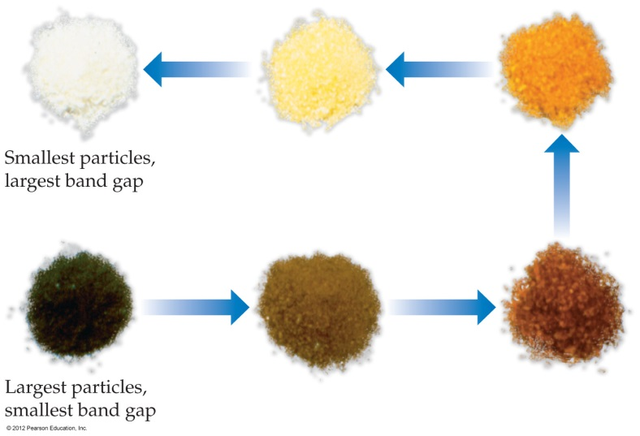
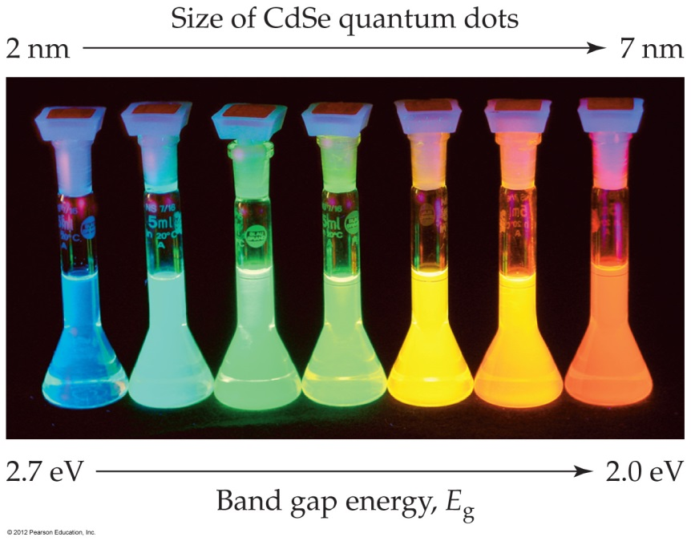
Nanoparticles
Different size particles of a semiconductor (like Cd₃P₂) can emit different wavelengths of light, depending on the size of the energy gap between bands.

Slide 66
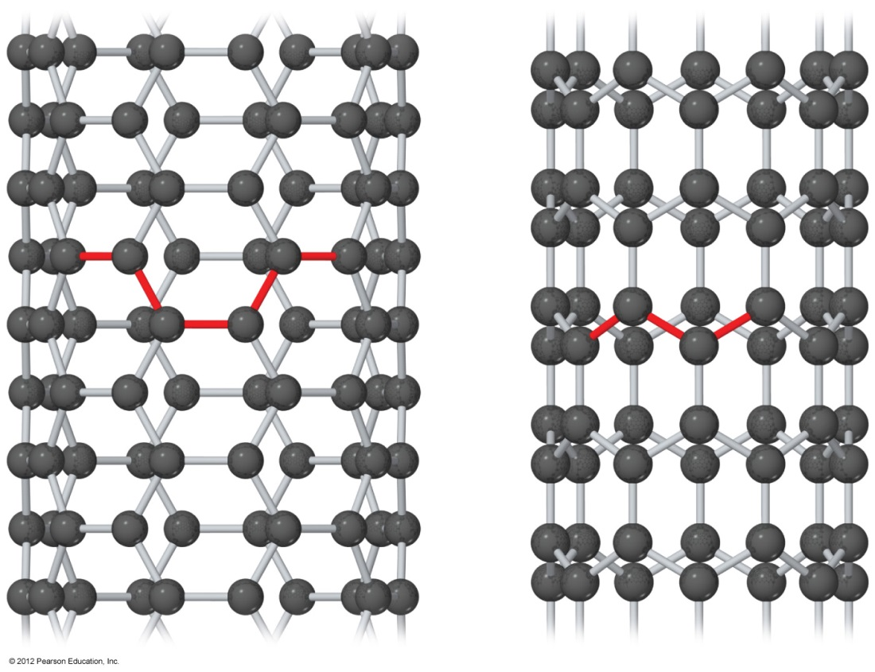
Carbon Nanotubes
Carbon nanotubes can be made with metallic or semiconducting properties without doping.

