Slide 1
Electric Charge, Force, and Energy
Prepared by
Dedra Demaree, Georgetown University

Slide 2
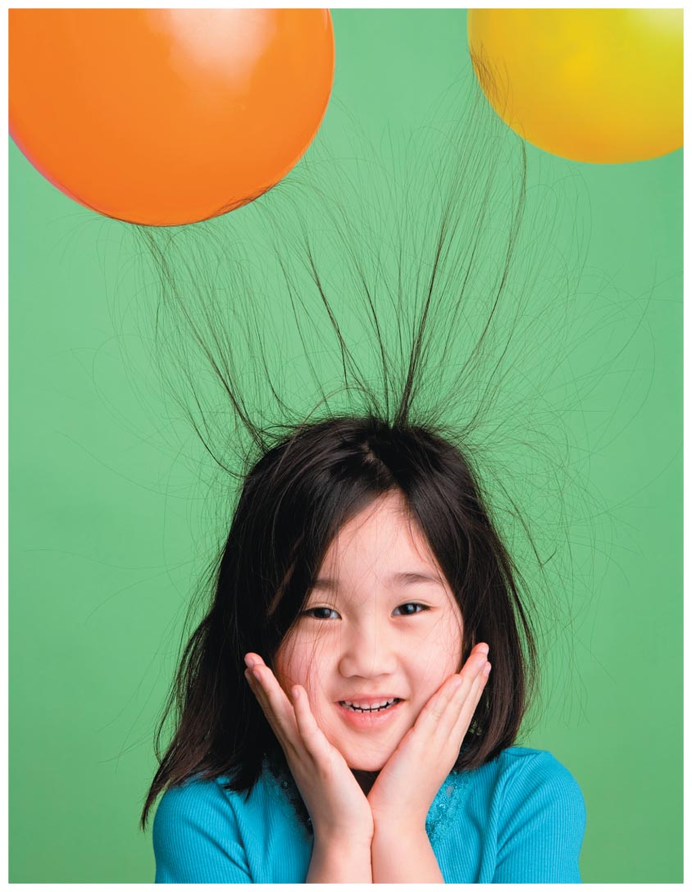
Electric Charge, Force, and Energy
How does a photocopier work?
Why is your hair attracted to a plastic comb after combing?
How is a metal soda can different from a plastic bottle on a microscopic level?

Slide 3
Be sure you know how to:
Identify a system and construct a force diagram for it (Section 2.1).
Identify a system and construct an energy bar chart for it (Section 6.2).
Convert a force diagram and an energy bar chart into a mathematical statement (Sections 2.3 and 6.6).

Slide 4
What's new in this chapter
In Chapters 9–13, we learned that all objects are made of tiny particles.
What holds these particles together?
The interaction responsible for holding the particles together is the same interaction that makes the toner stick to a copier drum and a balloon stick to your hair, as well as many other phenomena that we observe in our everyday world.

Slide 5
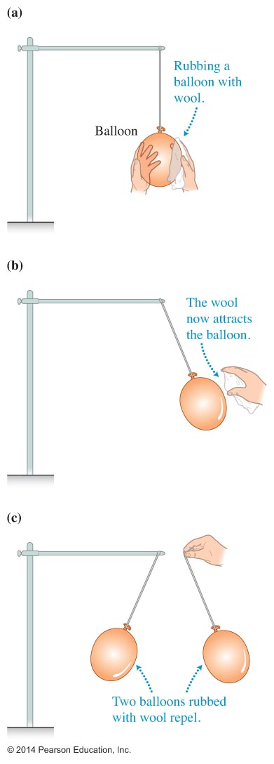
Electrostatic interactions
If you rub two balloons the same way with a wool cloth, they will attract the wool but repel each other.

Slide 6
Observational experiment

Slide 7
Observational experiment

Slide 8
Observational experiment

Slide 9
Observational experiment

Slide 10
Observational experiment

Slide 11
Electrostatic interactions
The property acquired by materials due to rubbing is called electric charge.
Objects acquire positive or negative electric charge.
Objects that interact with each other because they are charged exert electric forces on each other.
When charged objects are at rest, the force is an electrostatic force.

Slide 12
Electrostatic interactions
Materials rubbed against each other acquire electric charge.
Two objects with the same type of charge repel each other.
Two objects with opposite types of charge attract each other.
Two objects made of different materials rubbed against each other acquire opposite charges.

Slide 13
Electrostatic interactions
Sometimes more vigorous rubbing leads to a greater force exerted by the rubbed objects on each other.
The magnitude of the force that the charged objects exert on each other increases when the distance between the objects decreases.

Slide 14
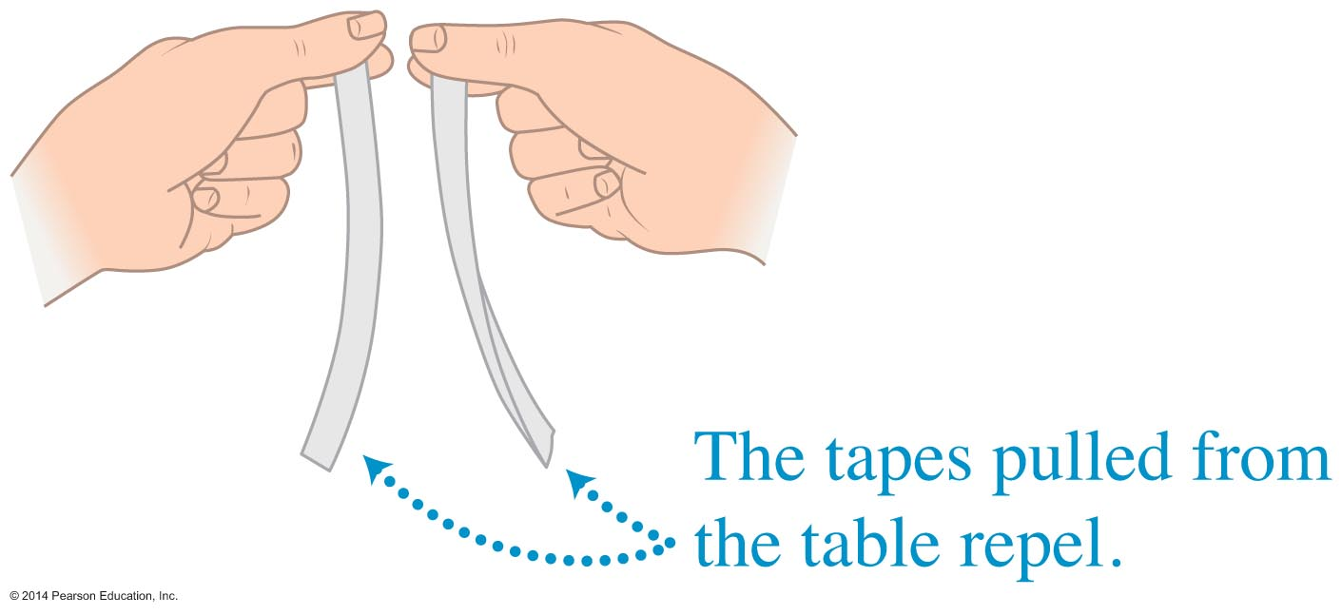
Conceptual Exercise 14.1
Take two 9-inch-long pieces of transparent tape and place them sticky side down on a plastic, glass, or wooden tabletop. Now pull on one end of each tape to remove them from the table. Bring the pieces of tape near each other. They repel each other, as shown in the figure. Can we explain the repulsion of the tapes as an electric interaction?

Slide 15
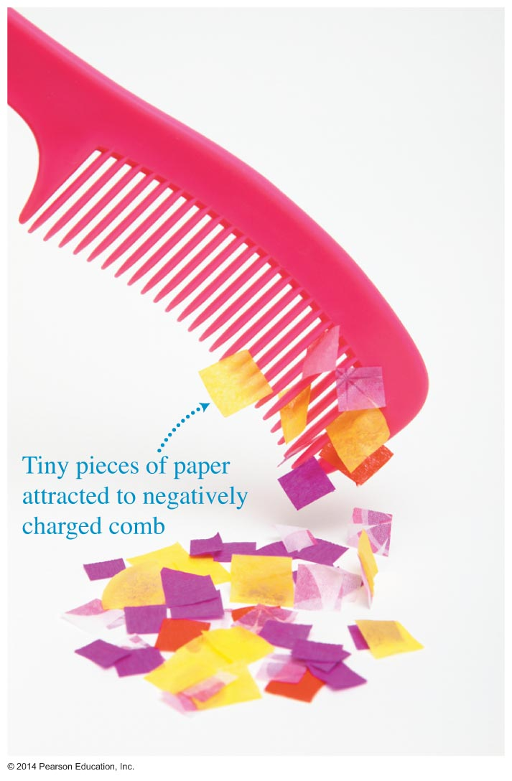
Charged objects attract uncharged objects
Everyday observations show that uncharged lightweight objects, such as small bits of paper that have not been rubbed against anything, are attracted to charged objects.

Slide 16
Observational experiment

Slide 17
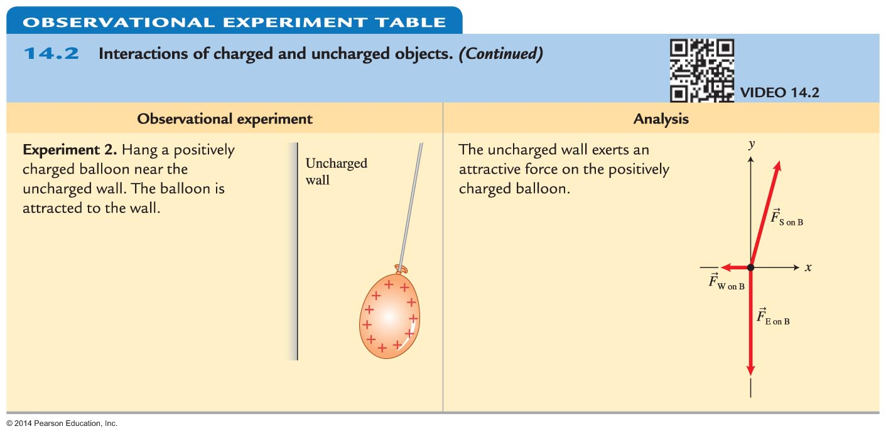
Observational experiment

Slide 18
Observational experiment

Slide 19
Observational experiment

Slide 20
Charged objects attract uncharged objects

Slide 21
Is the electrical interaction just a magnetic interaction?
Perhaps the electric interaction is actually the magnetic interaction, just described using different terminology. Let's test this hypothesis.

Slide 22
Testing experiment

Slide 23
Testing experiment

Slide 24
Historical models for electric charge
Fluid models of electric charge
Too much electric fluid in an object makes it positively charged and too little makes it negatively charged.
Particle model of electric charge
Electric charge is carried by microscopic particles. Removing or adding these particles to an object changes the charge of the object.
How could we test these models?

Slide 25
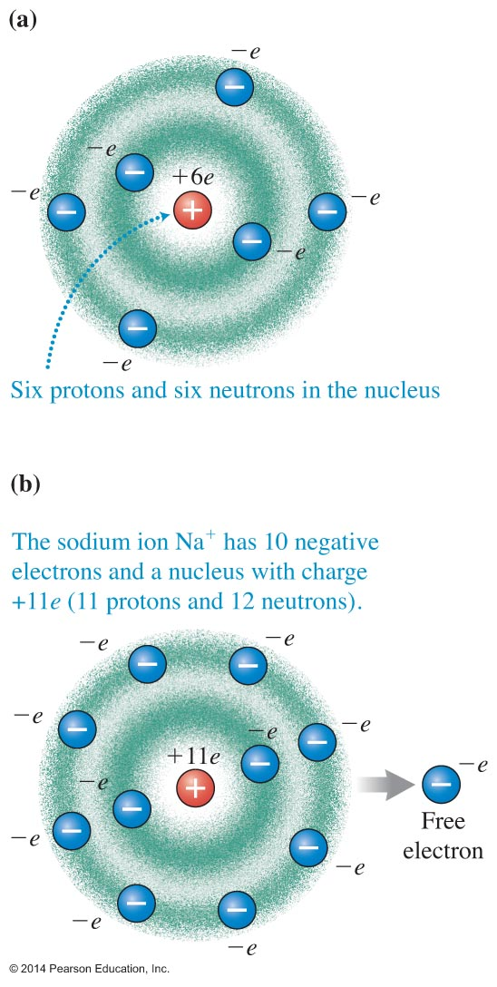
Contemporary model for electric charge
Two objects start as neutral—the total electric charge of each is zero.
During rubbing, one object gains electrons and becomes negatively charged.
The other object loses an equal number of electrons and with this deficiency of electrons becomes positively charged.

Slide 26
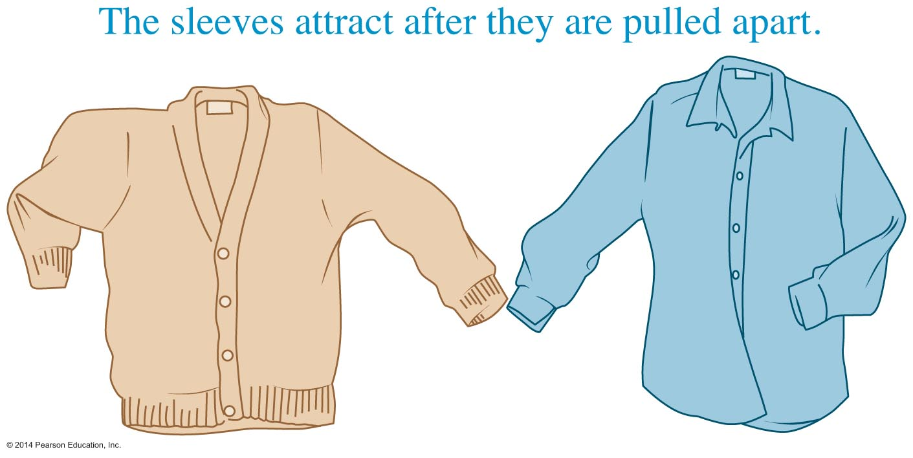
Conceptual Exercise 14.2
You pull your sweater and shirt off together, and then pull them apart. You notice that they attract each other—a phenomenon called "static" in everyday life. Explain the mechanism behind this attraction and suggest an experiment to test your explanation.

Slide 27
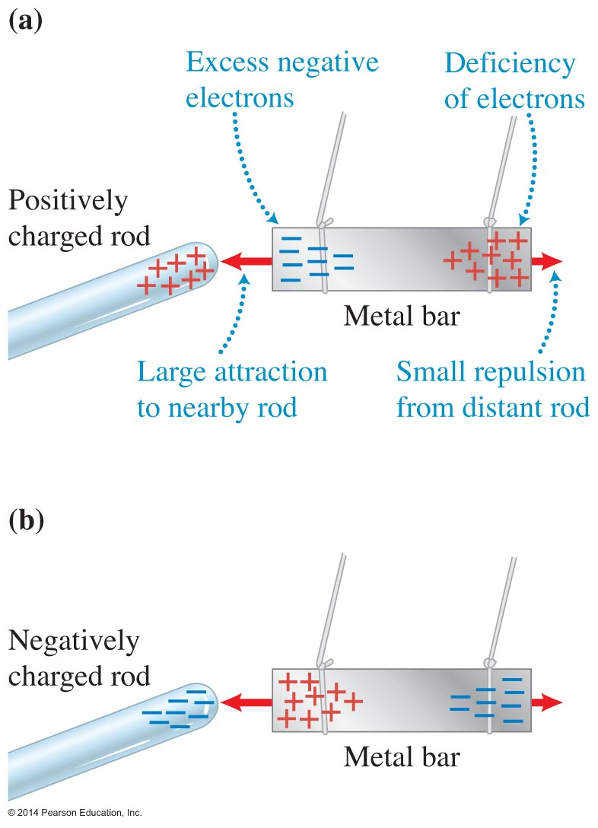
Conductors
In metals, some electrons can move freely throughout the metal.
When we bring a positively charged rod next to a metal bar, the free electrons move closer to the positively charged rod, leaving the other side with a deficiency of electrons.

Slide 28
Testing experiment

Slide 29
Testing experiment

Slide 30
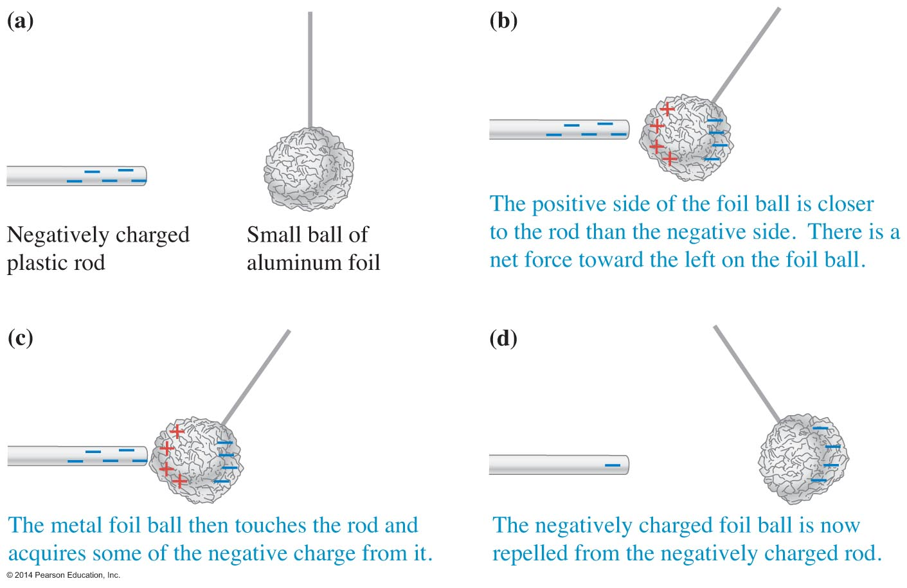
Conductors

Slide 31
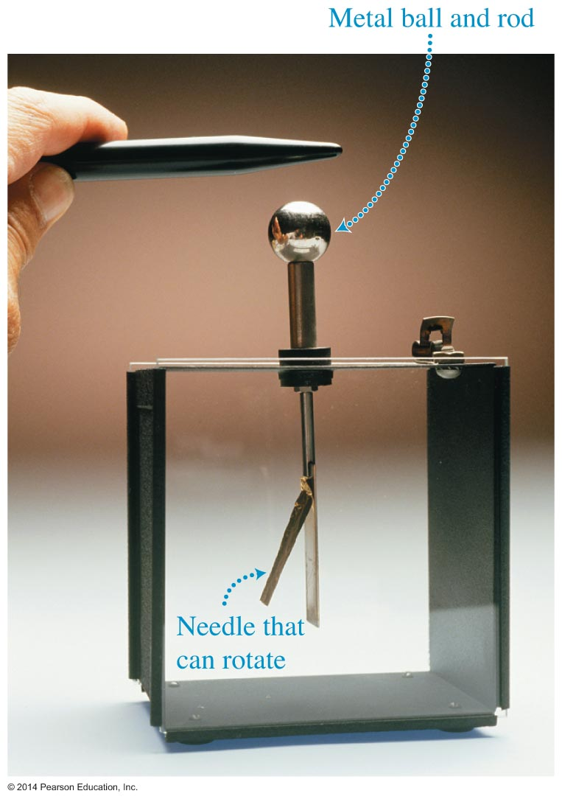
The electroscope
An electroscope consists of a metal ball attached to a metal rod. A very lightweight needle-like metal rod is connected on a pivot near the bottom of the larger rod.

Slide 32
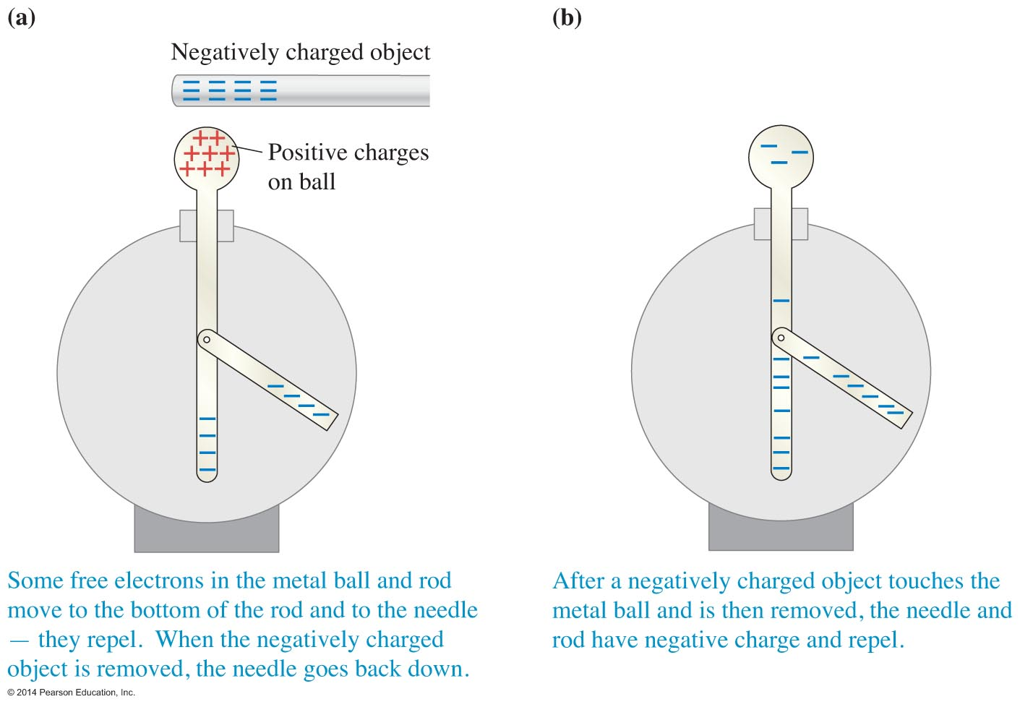
The electroscope
The angle of deflection is related to the magnitude of the electric charge of the electroscope.

Slide 33
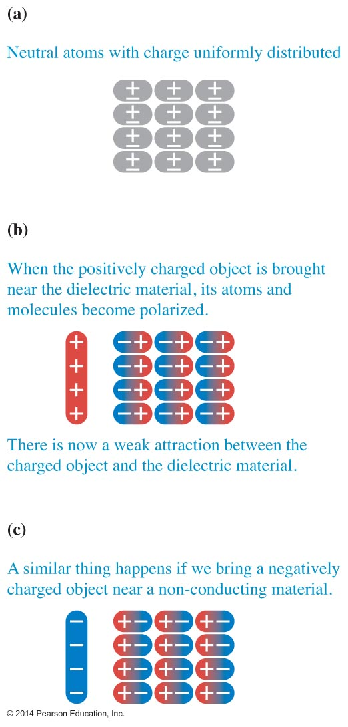
Dielectrics
Plastic, glass, and other nonmetal materials do not have free electrons or any other charged particles that are free to move inside.

Slide 34
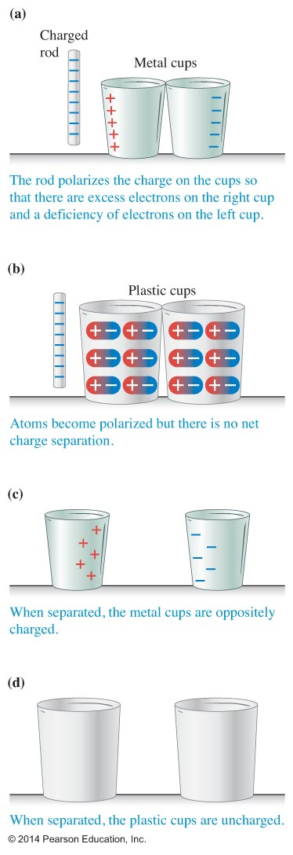
Polarization of conductors and dielectrics

Slide 35
Electric properties of materials

Slide 36
Tip

Slide 37
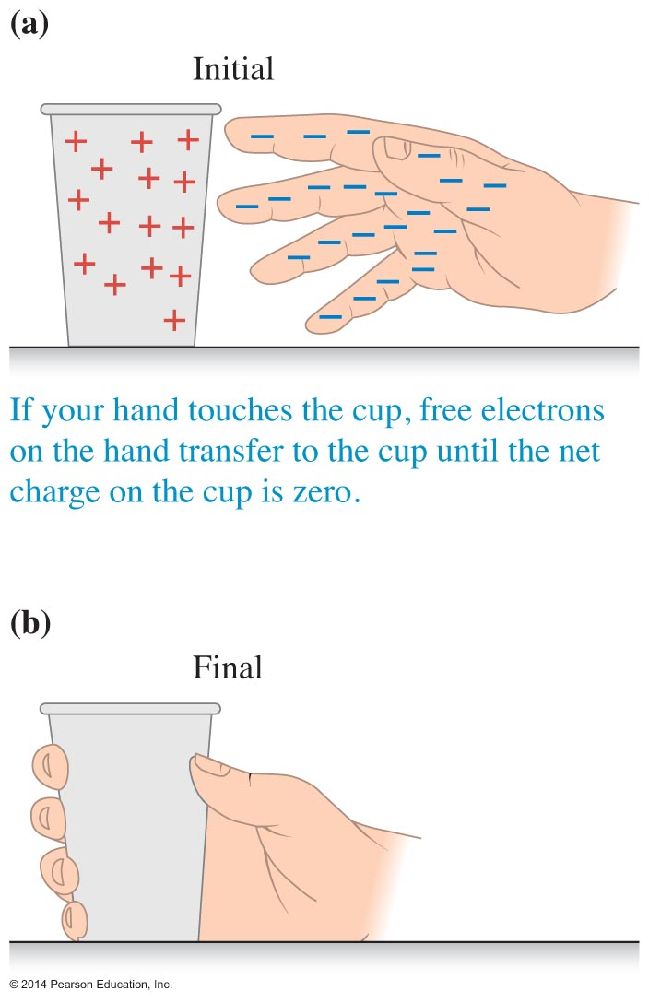
Is the human body a conductor or a dielectric?
As your hand approaches a positively charged cup, the free electrons on the surface of your hand and arm move toward it.

Slide 38
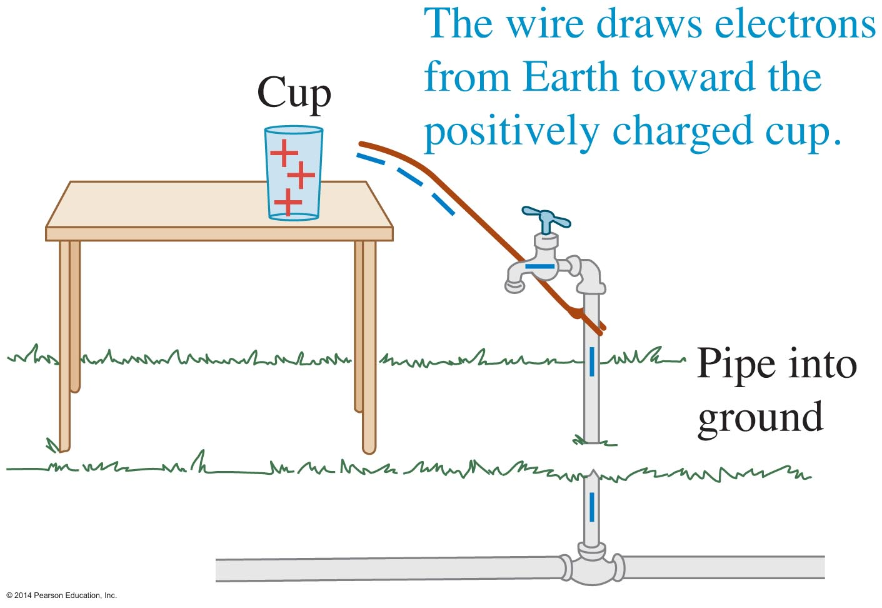
Grounding
If the cup has a positive charge, negative electrons in the ground are attracted toward the cup and travel from the ground to the cup, causing it to become neutral.

Slide 39
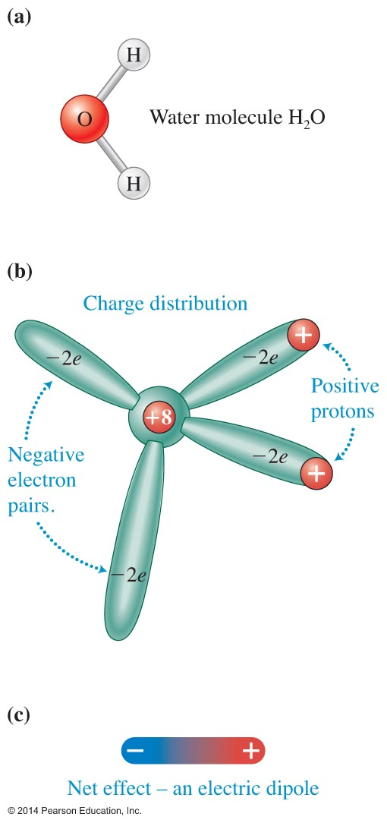
Discharging by moisture in the air
If you leave a negatively or positively charged object alone for a long time interval, the object can become neutral in part because of the presence of water vapor in the air.

Slide 40
Properties of electric charge
Similar to mass, momentum, and energy, electric charge is a conserved quantity; it changes in a predictable way in a nonisolated system and is constant in isolated systems.

Slide 41
Electric charge

Slide 42
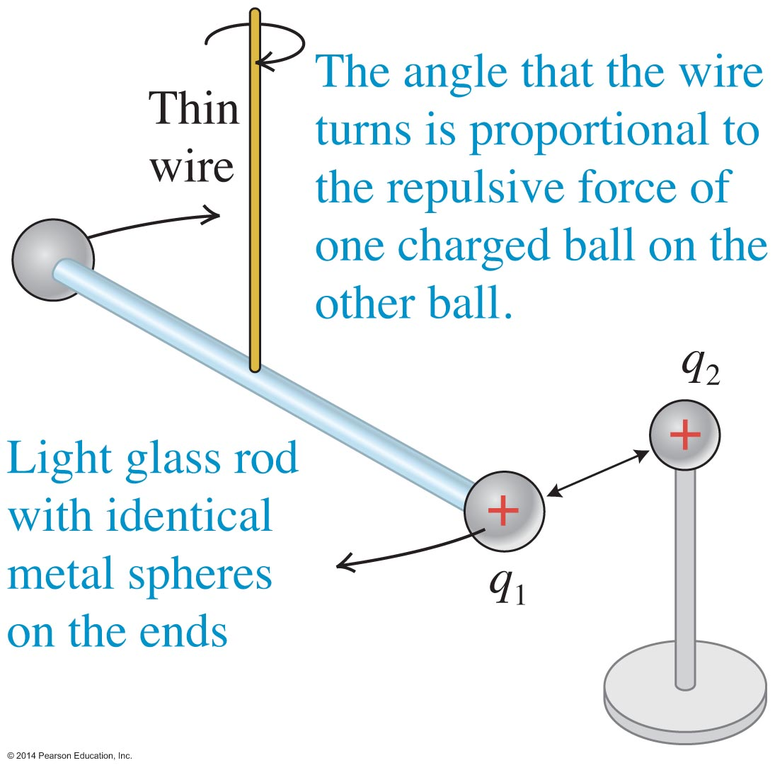
Coulomb's force law
In 1785, Charles Coulomb determined the relationship between distance and magnitude of charges, and the force between charges.
The experimental apparatus Coulomb used is called a torsion balance.

Slide 43
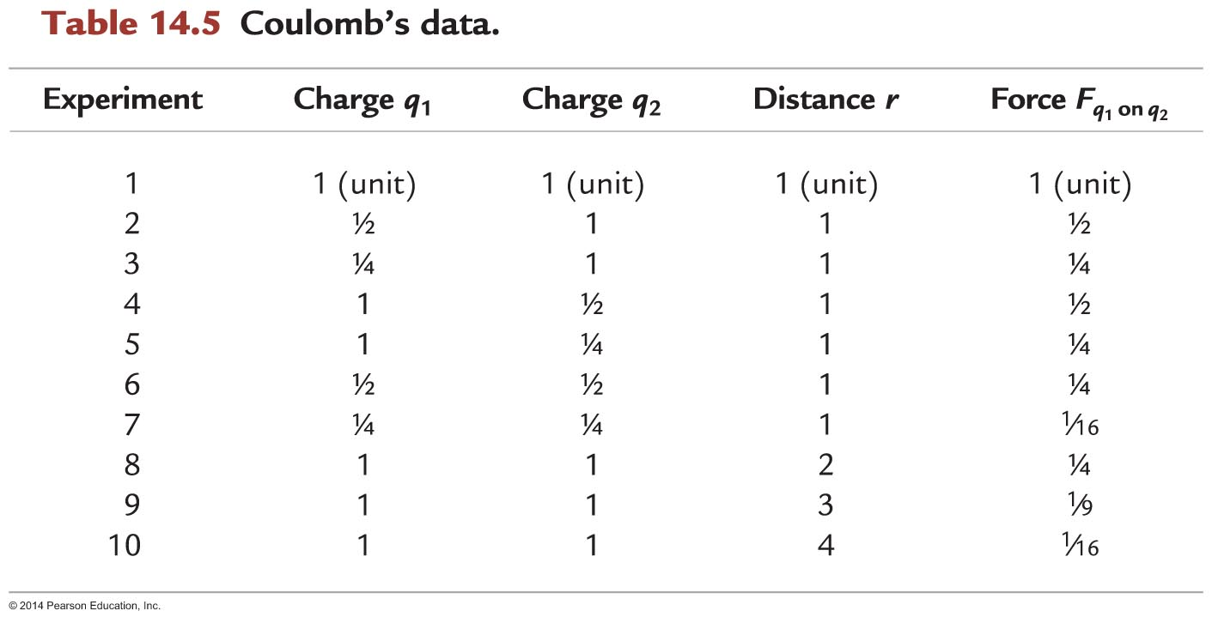
Coulomb's data

Slide 44
Coulomb's law

Slide 45
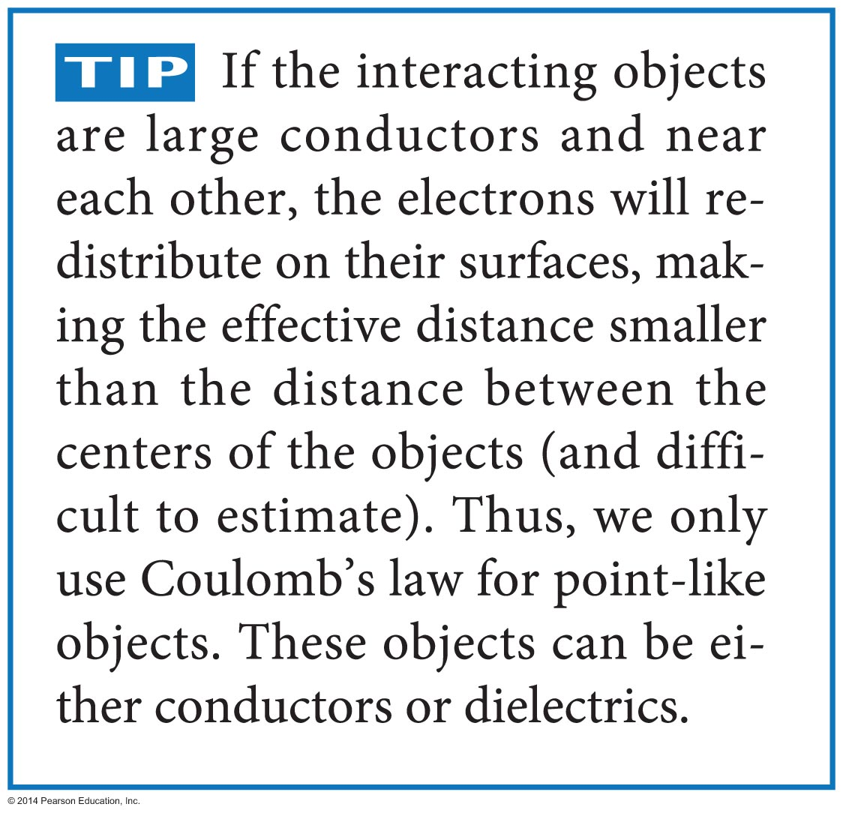
Tip

Slide 46
Comparing the magnitude of the electric force to the gravitational force
Consider a proton and an electron in a hydrogen atom. They are separated by about 10^{–10} m.
The electric force between the two objects is 2.3 x 10^{–8} N.
The gravitational force between the two objects is 1.0 x 10^{–47} N.
The electric force between these objects is about 2 x 10³⁹ times greater than the gravitational force!

Slide 47
Tip

Slide 48
Conceptual Exercise 14.3
Two small aluminum foil balls of equal mass, A and B, have electric charges +q and +3q, respectively. If the balls are suspended by equal-length strings from the same point, will one string hang at a greater angle from the vertical than the other? Justify your answer.

Slide 49
Quantitative Exercise 14.4
Three identical metal spheres A, B, and C are on separate insulating stands. You charge sphere A with charge +q. Then you touch sphere B to sphere A, and separate them by distance d.
Write an expression for the electric force that the spheres exert on each other.
You now take sphere C, touch it to sphere A, and then remove sphere C. You then separate spheres A and B by a distance d/2.
Write an expression for the magnitude of the force that spheres A and B exert on each other.

Slide 50
Example 14.5
Metal spheres on insulating stands have the following electric charges: q_{A} = +2.0 x 10^{–9} C, q_{B} = +2.0 x 10^{–9} C, and q_{C} = –4.0 x 10^{–9} C. The spheres are placed at the corners of an equilateral triangle whose sides have length d = 1.0 m, with q_{C} at the top of the triangle. What is the magnitude of the total (net) electric force that spheres A and B exert on sphere C?

Slide 51
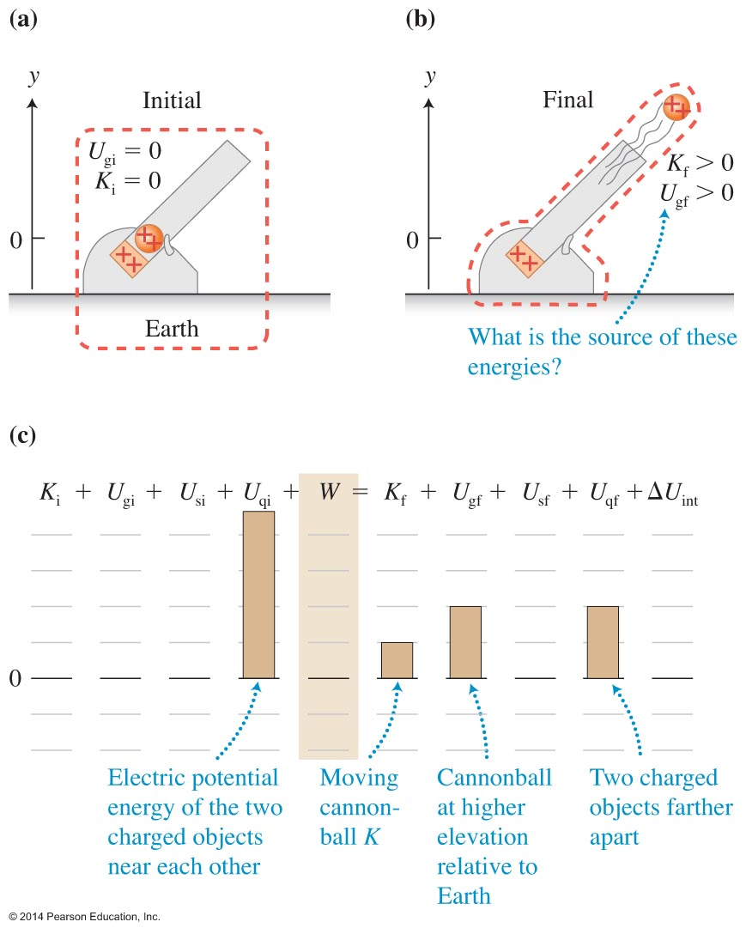
Electric potential energy: A qualitative analysis
A positively charged cannonball is held near another fixed positively charged object in the barrel of the cannon.
Some type of energy must decrease if gravitational and kinetic energies increase in this process.

Slide 52
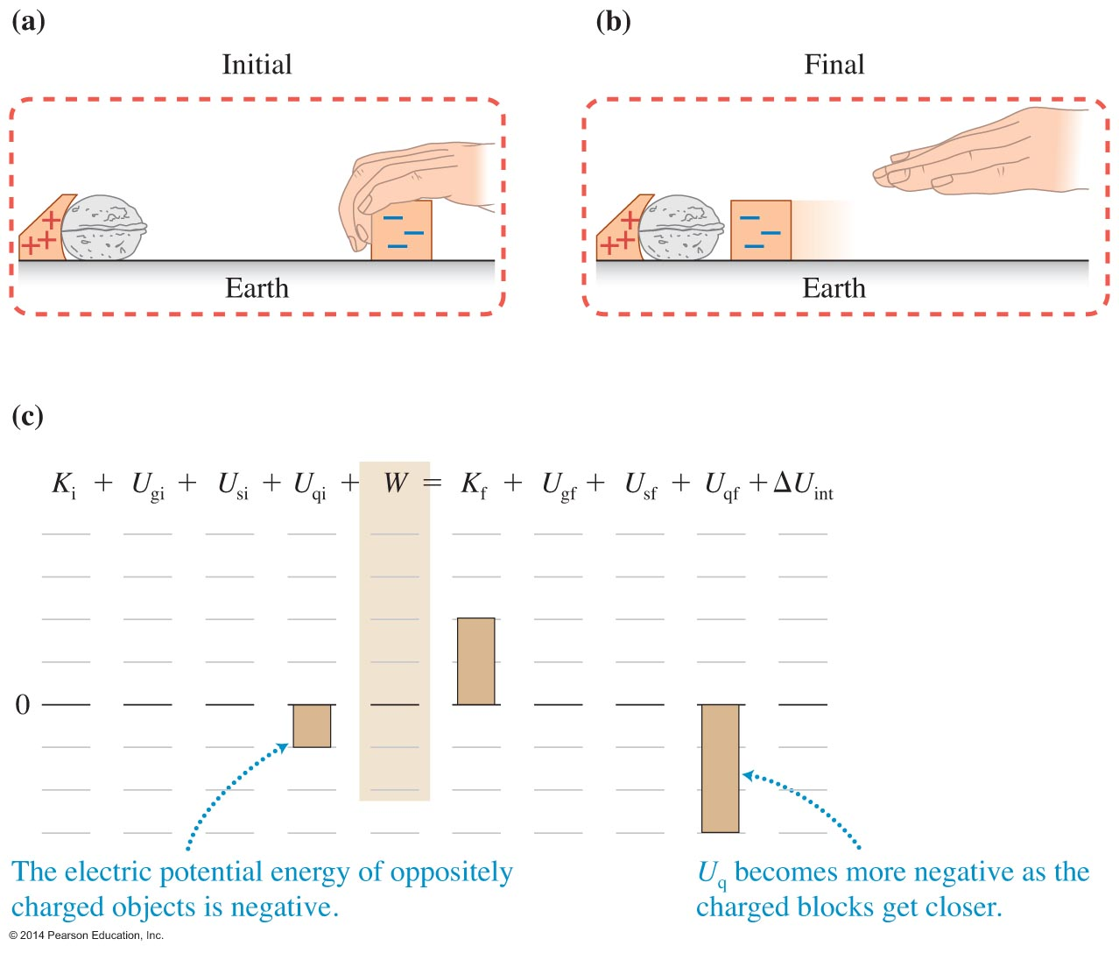
Electric potential energy: A qualitative analysis
Consider two oppositely charged blocks, one of which can slide without friction. When the negatively charged block is released and moves nearer the nut, the kinetic energy of the system increases.

Slide 53
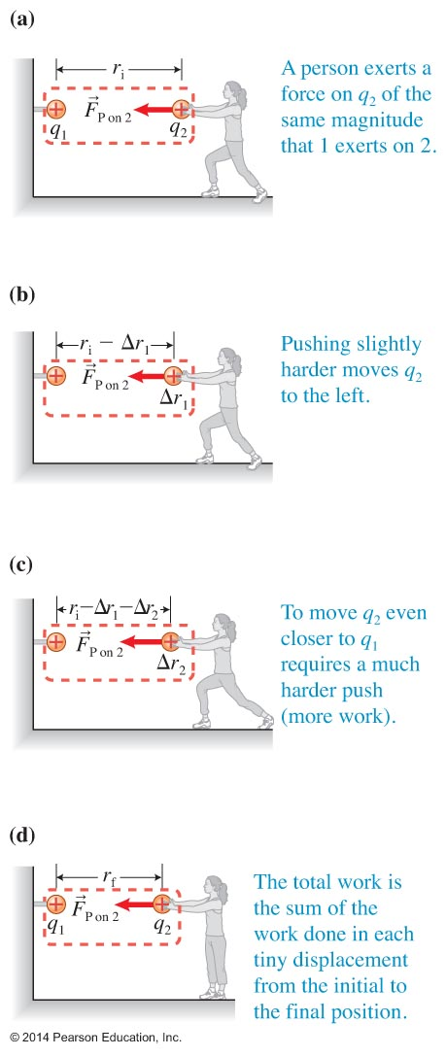
Electric potential energy: A quantitative analysis
Use the generalized work-energy principle to analyze a situation where only the electric potential energy changes when work is done.

Slide 54
Electric potential energy

Slide 55
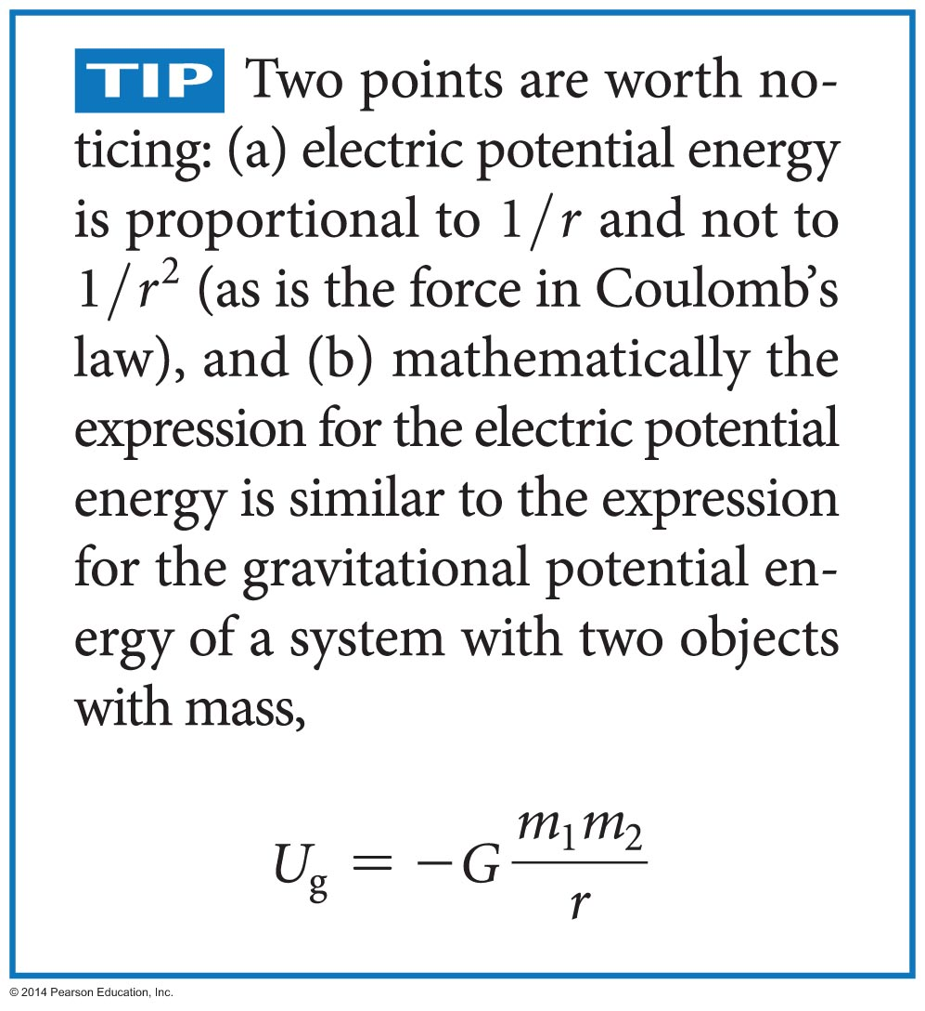
Tip

Slide 56
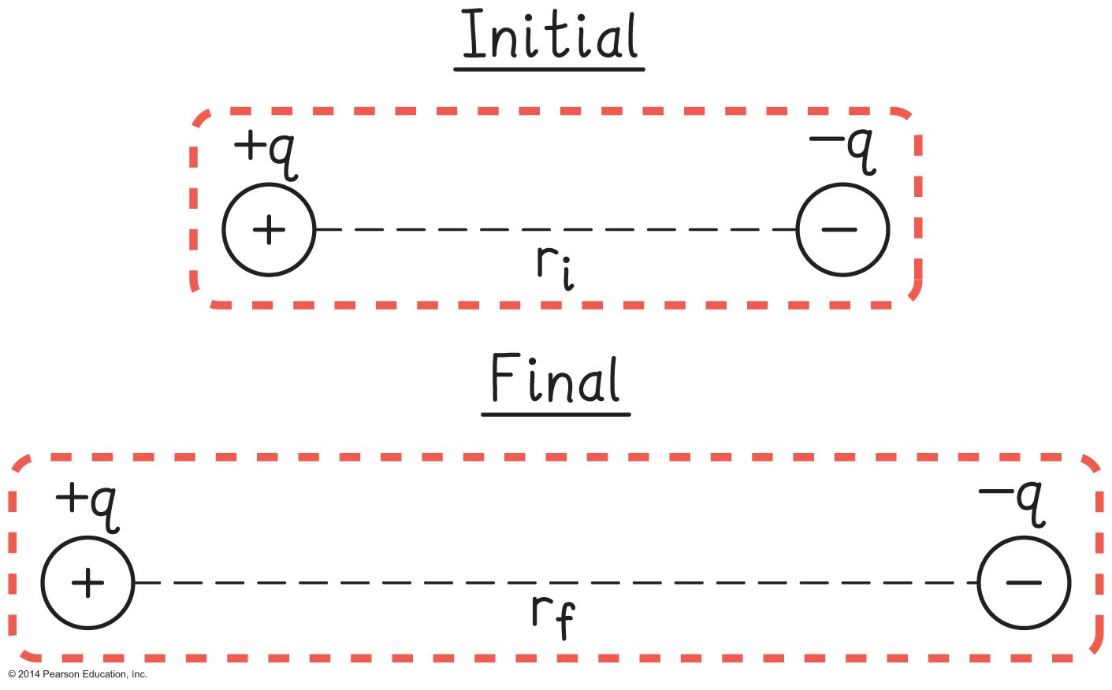
Example 14.6
Two oppositely charged objects (with positive charge +q and negative charge –q) are separated by distance r_{i}. Will the electric potential energy of the system decrease or increase if you pull the objects farther apart? Explain.

Slide 57
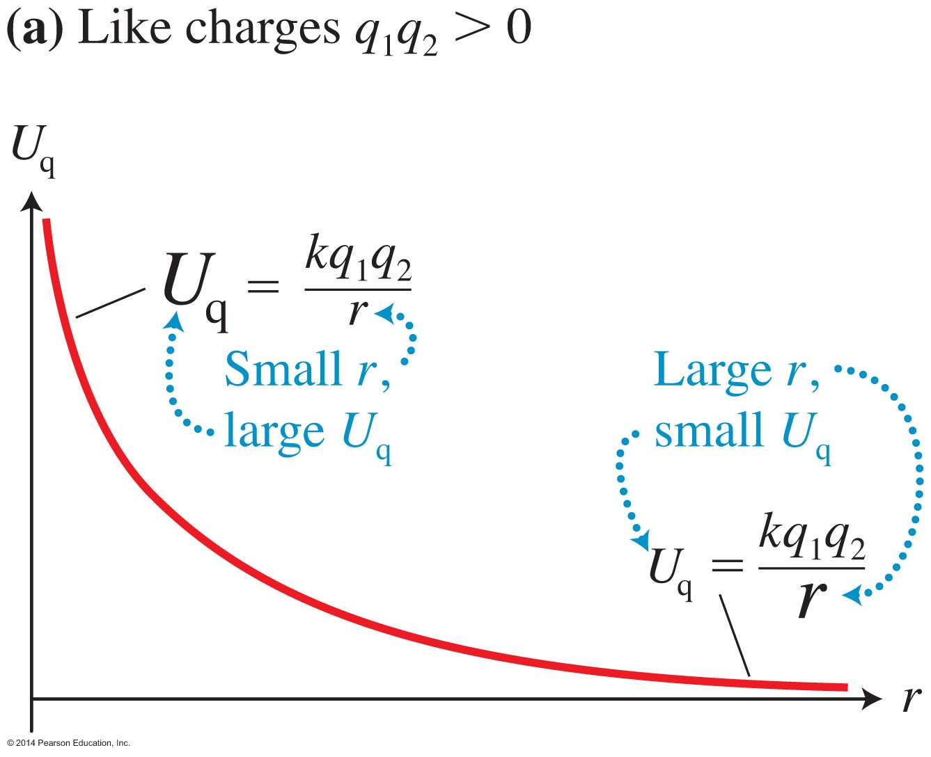
Graphing the electric potential energy versus distance
Because of the 1/r dependence, the electric potential energy approaches positive infinity when the separation approaches zero, and it becomes less positive and approaches zero as like charges are moved far apart.

Slide 58
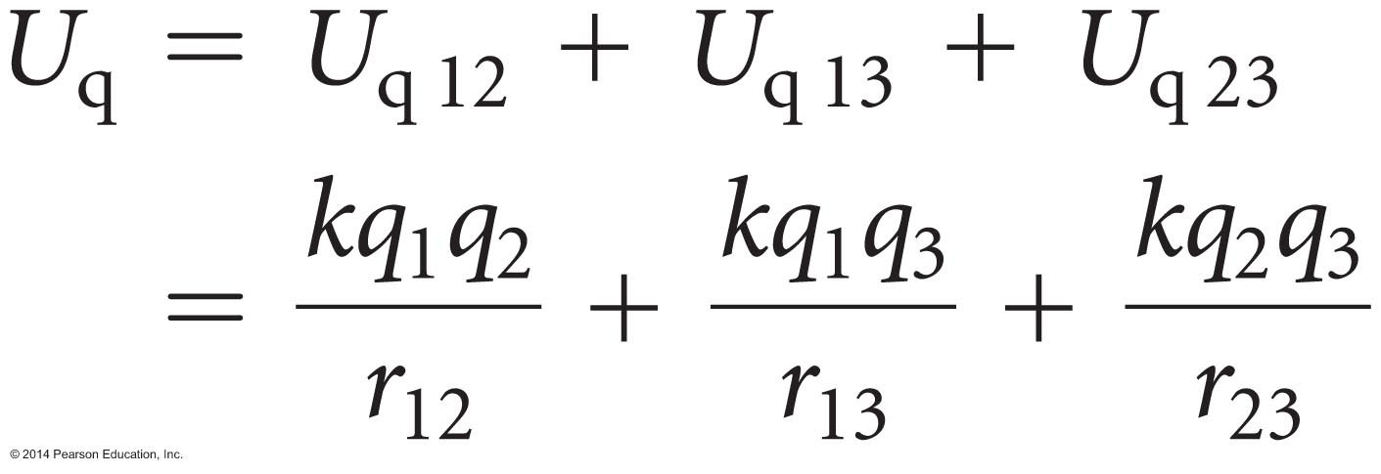
Electric potential energy of multiple charge systems
Each pair of charged objects has an associated electric potential energy, and the total electric potential energy of the system is the sum of the energies of all pairs.
For three charged objects, the total electric potential energy is:

Slide 59
Skills for analyzing processes involving electric force and electric potential energy
In conjunction with your problem-solving strategy:
Decide whether you can consider the charged objects to be point-like.
If you are using the work-energy principle, construct an energy bar chart. Decide where the zeros for potential energies are.

Slide 60
Example 14.8
Suppose that a radon atom in the air in a home is inhaled into the lungs. While in the lungs, the nucleus of the radon atom undergoes radioactive decay, emitting an α (alpha) particle, which is composed of two protons and two neutrons. During this process, the radon nucleus turns into a polonium nucleus with charge +84e and mass 3.6 x 10^{–25} kg. The α particle has charge +2e and mass 6.6 x 10^{–27} kg. Suppose the two particles are initially separated by 1.0 x 10^{–15} m and are at rest. How fast is the α particle moving when it is very far from the polonium nucleus?

Slide 61
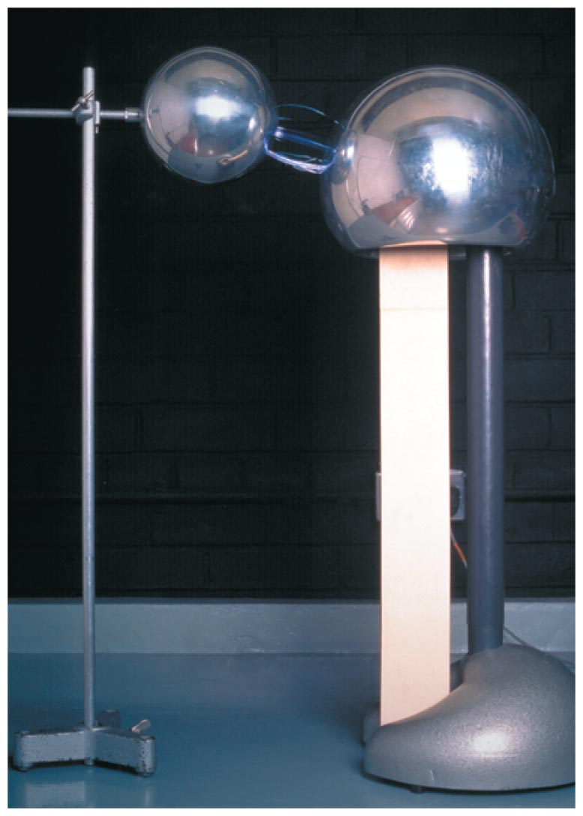
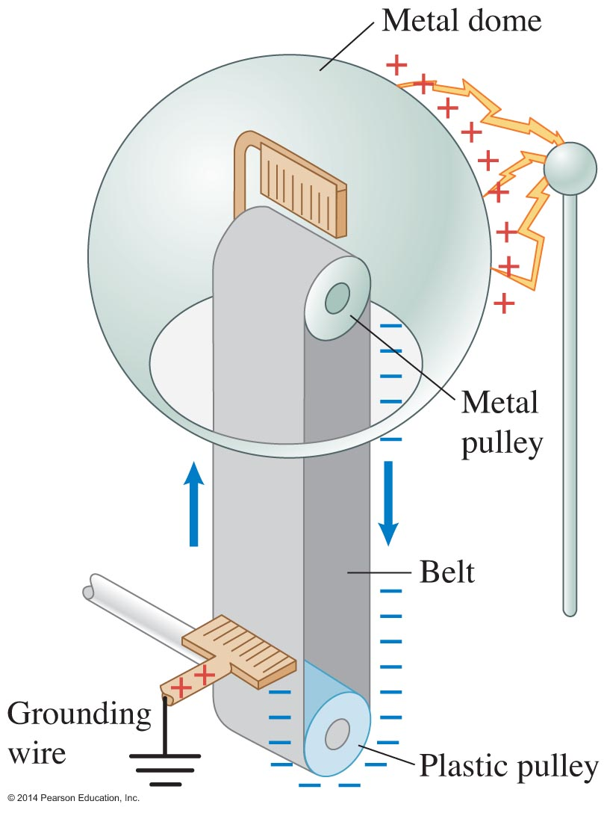
Van de Graaff generator

Slide 62
Example 14.10
The energy needed to remove an electron from a hydrogen atom is approximately 2 x 10^{–18} J (about the same for other atoms, too). The average distance a free electron in air will travel between collisions, called the mean free path, is about 10^{–6} m. The dome has a 0.15 m radius and a +10^{–5} C charge. Could a free electron in the air gain enough kinetic energy to ionize an atom and cause a spark as it travels that short distance toward the charged dome?

Slide 63
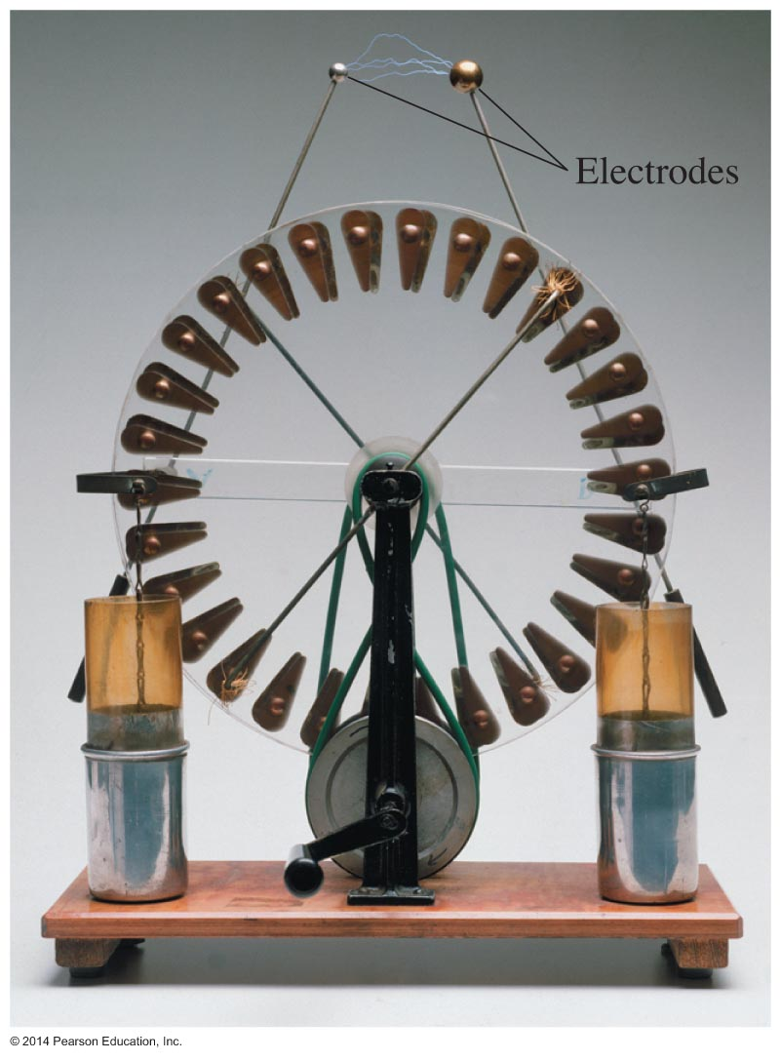
Wimshurst machine
The Wimshurst, invented in the 1880s, consists of two plastic disks that rotate in opposite directions. It can produce large charge separations.

Slide 64
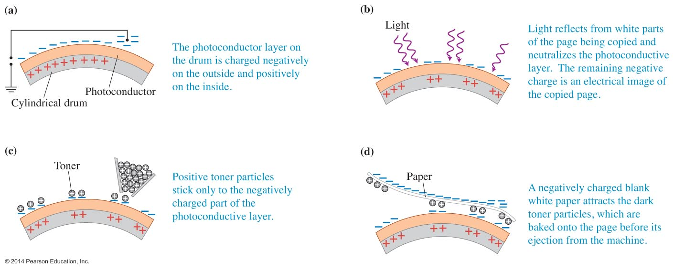
A photocopier
In a copy machine, a drum gets electrically charged with an image of the page being copied. Dark toner particles stick to the places where the drum is charged.

Slide 65
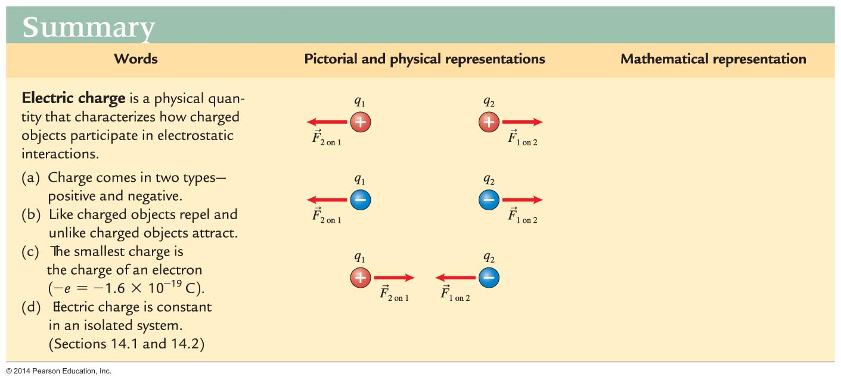
Summary

Slide 66
Summary

Slide 67
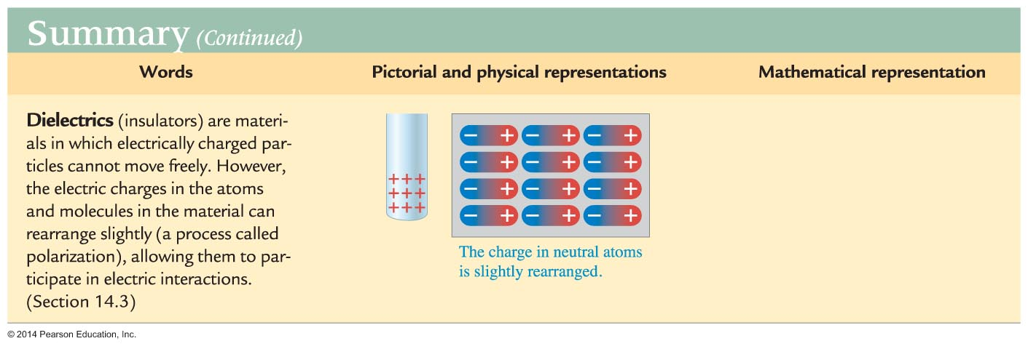
Summary

Slide 68
Summary

Slide 69
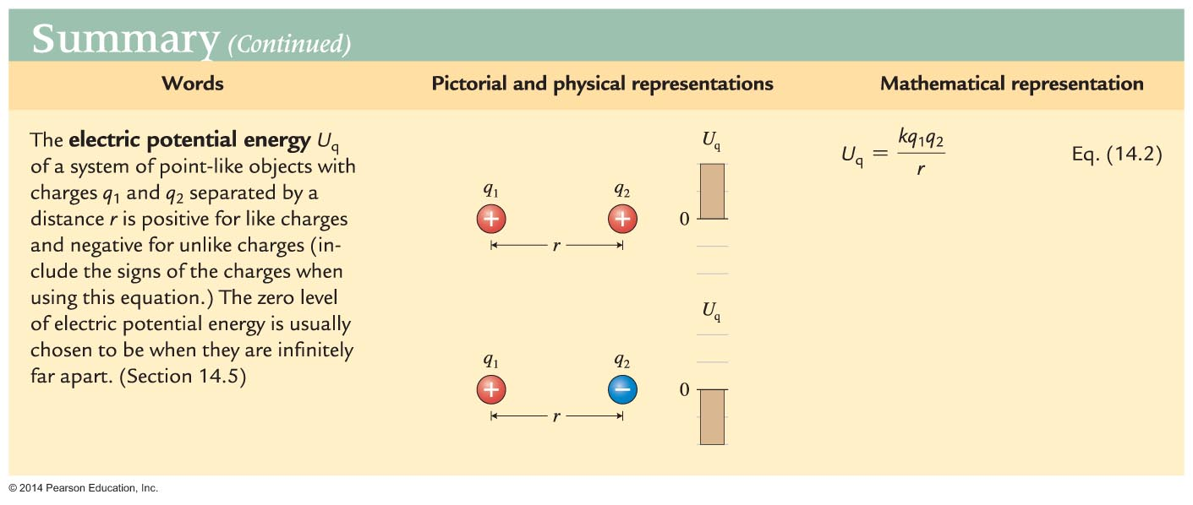
Summary

