Slide 1
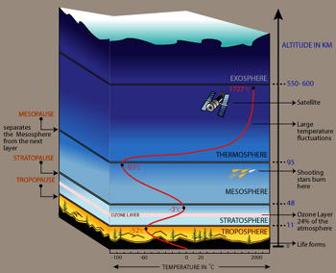
# 11 Atmosphere Notes
http://ds9.ssl.berkeley.edu/LWS_GEMS/3/images_3/layat350.jpg

Slide 2
Definition
Atmosphere is the mixture of gases that surrounds the Earth.
Composition:
Nitrogen 78%
Oxygen 21%
Other gases 1% (Argon, CO₂, and others)
Variable: H₂0 vapor

Slide 3
Atmospheric Pressure
As altitude increases, air pressure decreases.
Air pressure is a measure of the force that air molecules push on a surface.

Slide 4
TEMPERATURE
Air temperature changes as altitude increases.
Some parts of atmosphere warmer b/c contain high % of gases that absorb solar energy.

Slide 5
Layers of the Atmosphere
(From earth’s surface and up)
Troposphere-layer where gases turn and mix. It is where we live.
Stratosphere-gases are layered and don’t mix much.
Mesosphere-middle layer
Thermosphere-temps are the highest here
Exosphere-outer fringe of the atmosphere.

Slide 6
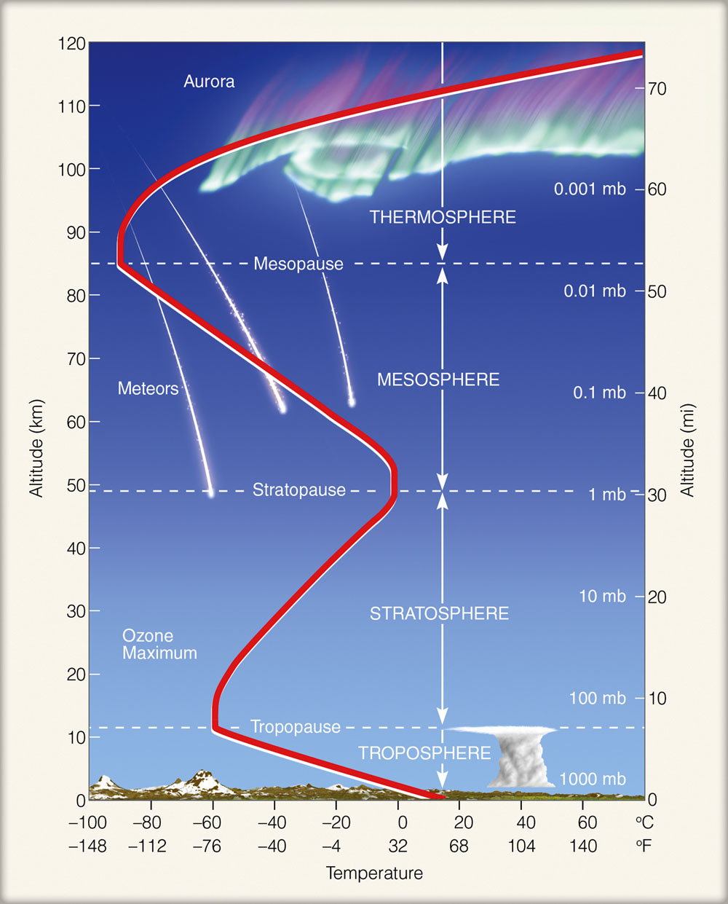
Draw:
http://geogrify.net/GEO1/Images/FOPG/0314.jpg

Slide 7
Troposphere
The densest layer.
Contains 90% of the atmosphere’s total mass.
All life forms live here
Differences in air temperature and density cause gases to mix continuously.
Temp decreases as altitude increases.

Slide 8
Stratosphere
Home of the ozone layer
Ozone layer protects life on Earth by absorbing harmful UV radiation.
Ozone hole located over the arctic due to CFC’s which are now banned.
Scientists predict that the hole will repair itself over time.
Gases are layered or “stratified”.
Temps increase as altitude increases

Slide 9
Mesosphere
Middle layer.
The coldest layer.
Temp decreases as altitude increases.

Slide 10
Thermosphere
The hottest layer (where astronauts re-enter the Earth’s atmosphere)
Temp increases with altitude.
Ionosphere, and aurora found here
High temps but doesn’t feel that hot due to large space between particles, thus particles not transferring thermal energy easily.

Slide 11
Ionosphere: Home of the Auroras
Part of the Thermosphere.
N and O absorb harmful solar radiation (gamma & x-ray) causing thermosphere’s temp to rise, and gas particles become electrically charged (ions carrying positive or negative charges).
These ions radiate light energy as shimmering, colorful lights.
http://www.youtube.com/watch?v=FcfWsj9OnsI

Slide 12
Greenhouse Effect
Greenhouse effect- gases in the atmosphere (H₂0 vapor and CO₂) absorb thermal energy and radiate some back toward Earth.
H₂O is most important, CO₂ is being increased by burning fossil fuels
Like a greenhouse because it allows solar energy to enter but prevents thermal energy from escaping.

Slide 13
Convection
It is the transfer of thermal energy by the circulation or movement of a liquid or a gas.
Ex. Pot of boiling water
As air is heated near the surface, it becomes less dense and rises, as it cools it becomes denser so sinks.
This cycle of warm air rising and cool air sinking causes convection currents.

Slide 14
Global Winds
Wind is the movement of air caused by differences in air pressure. (caused by convection)
The greater the pressure difference , the faster the wind moves.

Slide 15
Wind Belts
Both the Northern and Southern Hemispheres have 3 wind belts (located every 30 degrees latitude apart) as a result of pressure differences.

Slide 16
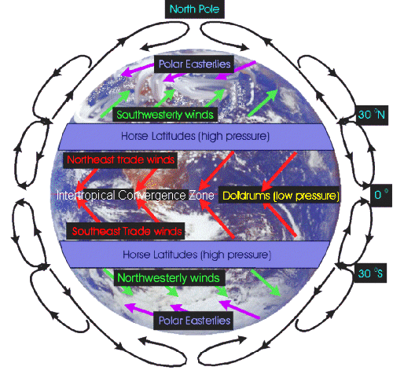
Draw:

Slide 17
Global Winds
Polar Easterlies: Wind belts from the poles to 60 degrees latitude to 90 degrees in both hemispheres.
In Northern H-carry cold arctic air over the US producing ice and snow
Westerlies: Wind belts b/t 30 to 60 lat. In both hemispheres which flow from W to E.

Slide 18
Global Winds Cont..
Trade Winds blow from 30 degrees latitude to almost the equator.
Coriolis effect cause these winds to curve to the west in N H and opposite in the S H.
These winds were effective at carrying trade ships from Europe to the Americas.

Slide 19
Winds cont…
Doldrums- very little wind around the equator warm rising air creates area of low pressure, “dull or sluggish” winds.
The Horse latitudes: at about 30 N and 30 S lat. Winds are calm, light due to sinking air creating area of high pressure.
(Horses used to be thrown overboard when ships stuck in windless area) to save H₂0 for sailors.

Slide 20
The Coriolis Effect
The apparent curving of the path of winds and ocean currents due to Earth’s rotation.
Because of this winds traveling from the North curve to the East in the N H, and those traveling from the South curve to the west. (Vise versa in S H)
https://youtu.be/WXuGYSM2D8k?t=6m58s
http://www.youtube.com/watch?v=_36MiCUS1ro

Slide 21
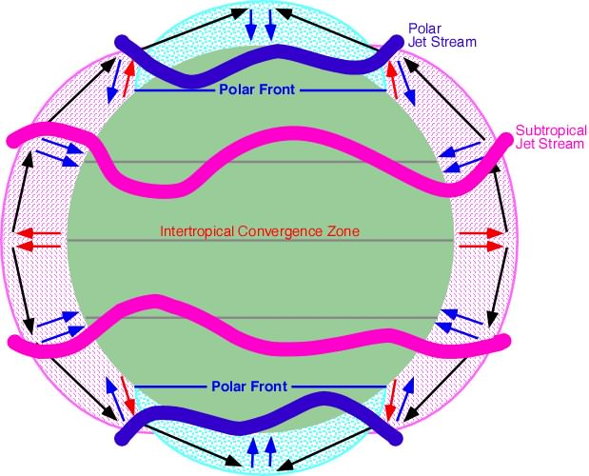
Jet Streams
http://www.srh.noaa.gov/jetstream/global/jet.htm
Like Atmospheric Conveyor Belts
Jet streams are narrow belts of high speed winds that blow in the upper troposphere and lower stratosphere.
Jet streams do not follow regular patterns around the Earth.
Important to predict its path for air travel, and storm movement.
Polar Jet Stream Visualization http://www.youtube.com/watch?v=yO3My5rYZXc
Jet Stream Explained (sort of) http://www.youtube.com/watch?v=CgMWwx7Cll4

Slide 22
Local Winds
Local winds move short distances and can blow from any direction.
Local geographical features (shoreline, mountains, valleys) can produce temp differences that cause local winds.

Slide 23
Sea and Land Breezes
During day, air over ocean is cooler (area of high pressure) and cool air flows to land producing a sea breeze.
At night air over ocean is warmer (area of low pressure), but air over land is cooler and cool air moves toward ocean, producing a land breeze.

Slide 24
Atmospheric Data
Humidity-% saturated with H₂O
Measured with hygrometer or psychrometer
0% = dry, 100% = fog
Pressure
Measured with a barometer
Sea level=14.7 psi, Everest Peak=4 psi

Slide 25
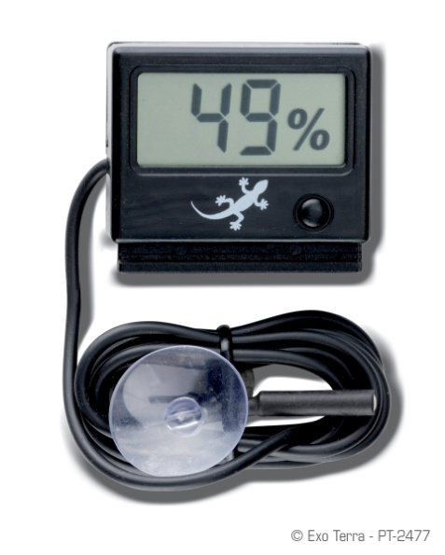
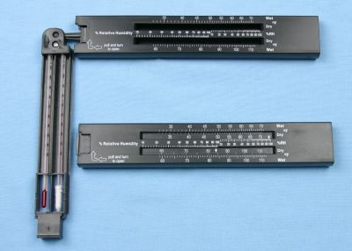
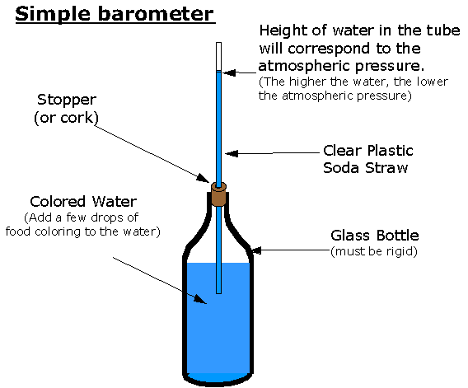
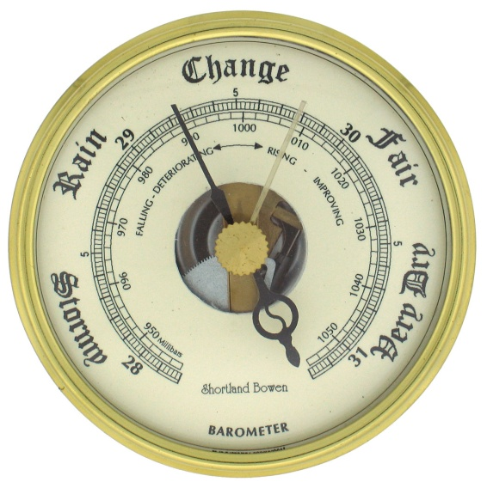
Hygrometer
Psychrometer
Barometer

Slide 26
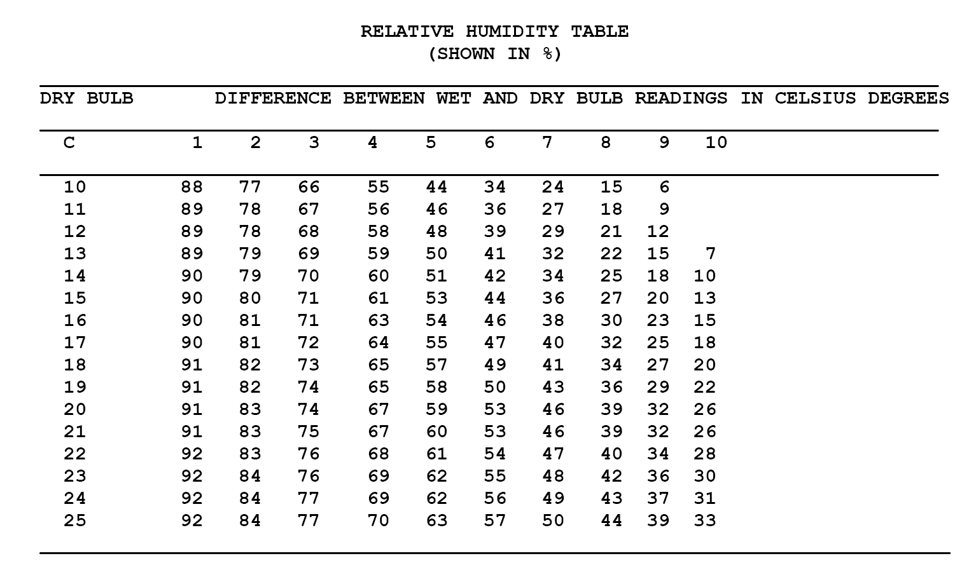
Psychrometer Table

Slide 27
Cloud Types
Based on information from “Athena”
http://inspire.ospi.wednet.edu:8001/curric/weather/pricloud/

Slide 28
Cirrus Clouds
Cirrus (meaning "curl") clouds are very high, wispy clouds made of ice. Even in the summer, cirrus clouds are made of ice because it is cold high above Earth. (May indicate bad weather coming)

Slide 29
Cumulus
Cumulus (meaning "heap") clouds look like huge puffs of cotton. (Fair weather clouds but may develop into thunderstorms.)

Slide 30
Cumulonimbus
Cumulonimbus clouds. These clouds often produce lightning and thunder. Nimbus always tells us that a cloud brings rain.

Slide 31
Stratus
Stratus (meaning “flat layers") clouds are made up of low layers of clouds that usually cover the whole sky and blot out the sun. When rain falls from them, they are called nimbostratus clouds. (Usually longer periods of gloomy/rainy weather)

Slide 32
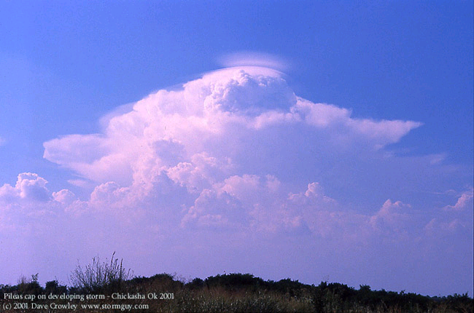
Slide images take by Dave “Stormguy” Crowley http://www.stormguy.com/

Slide 33
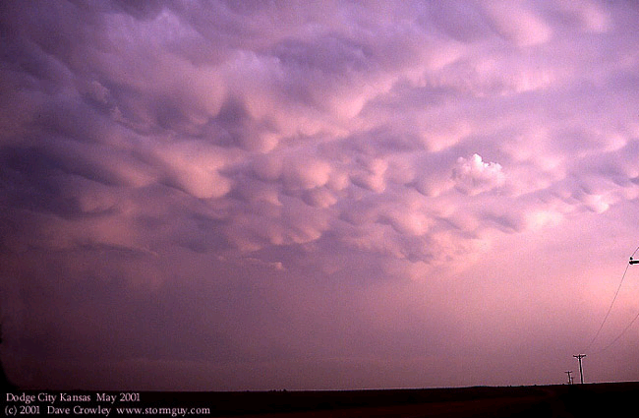
“Mammatus” --altocumulus

Slide 34
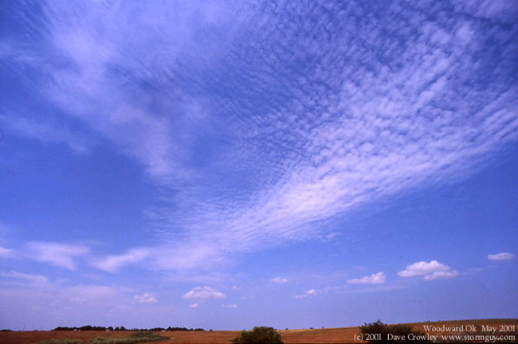

Slide 35
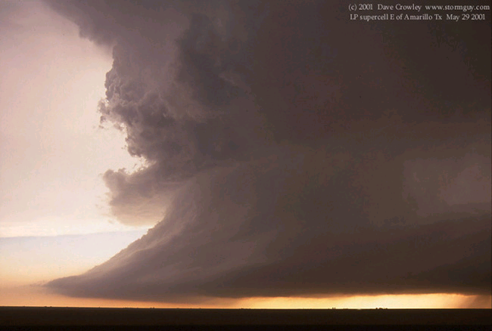
Supercell near Amarillo TX

Slide 36
